Slide 1
WP5 – WP4
Yan Grange, after discussions with Dave Morris, Nico Vermaas and John Swinbank

Slide 2
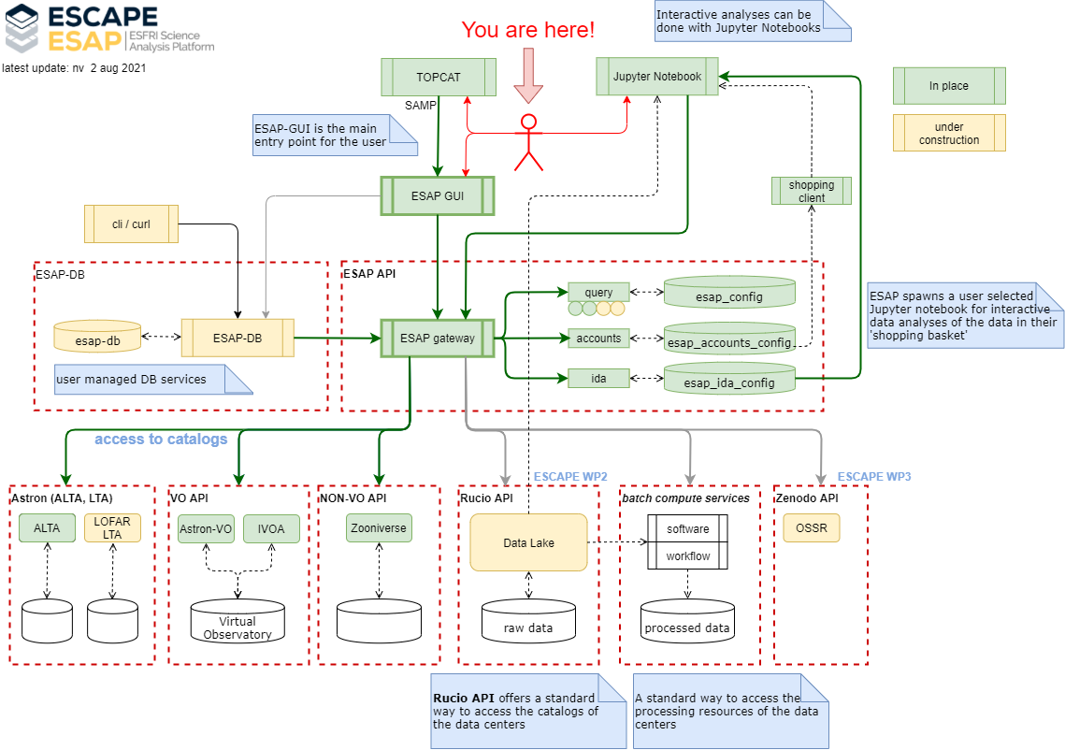
And here!
And here!

Slide 3
Integration goals
Make it possible to query data published through the VO.
  Currently the implementation is basically a proof of concept (using ADQL).
  This is only covering a subset of TAP services, which is a limited set.
  Ideally access to SIAP (images), SSAP (spectra), TAP (tables) data, etc.
  Providing access to the data itself, and to the metadata that comes with it.
In the VO, metadata is key. We need to be careful about how we want to handle the full metadata.

Slide 4
Ideas and questions
Query to a TAP, SIAP, SSAP service (anything to add?)
  Response is in VOTable format, which is basically XML
  This can be shared through the shopping basket.
    Hosted on the ESAP server, with download link to the notebook?
    Parsing the VOTable to JSON directly in the basket?
  Metadata contains the link to the data, which can then easily be taken out of the VO table by pyVO in Jupyter
Single query page is not covering the whole range of possible queries (e.g. for solar and solar system).
But… We already have SAMP support. Is there a compelling reason to not just use your favourite VO tool for querying and ESAP for the brokering with the notebook?

