Slide 1
WP5 – WP2
Yan Grange, Muhammad Aditya Hilmy, Riccardo Di Maria

Slide 2
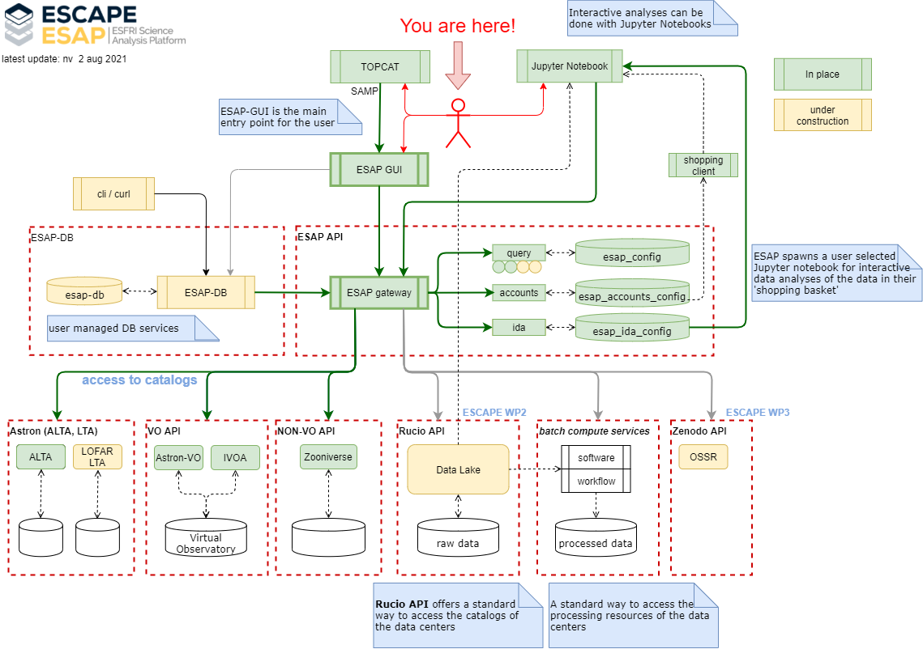
And here!

Slide 3

Demo time!
DLaaS: Using Rucio in a Jupyter Lab notebook to access data, targeted at the ‘amateur end user’

Slide 4
Integration goals
Make data in Rucio findable from ESAP
  Basic search capabilities
    Select scope, query DIDs by name
    Does this make sense (looking mostly at accelerator people)?
Add DID to shopping basket
Shopping basket read out in the DLaaS Jupyter notebook
  DlaaS: parse the json sent to notebook
  Installing ESAP jupyter bindings in DLaaS kernel?
Download data in notebook, processing

Slide 5
Plans and questions
Search capability was partially implemented by Hugh before.
  Worked with Nico to implement tokens, but that didn’t work yet.
  Getting token from
First select scope, then search DID based on name.
  Do we want more parameters to query on (e.g. metadata fields?)
Upload from DLaaS?
Adding rules to a file from the ESAP search?
  That would be awesome, because we could move data close to the compute before downloading, but may need some extra dev effort on the ESAP side.
  Alternatively: is this supported in the notebook?

