Slide 1




LSST/Vera Rubin precursor: Subaru HSC
Galaxy Zoo: Cosmic Dawn
James Pearson, Hugh Dickinson, Stephen Serjeant
Galaxy Zoo Team
Notes:
Through the support of ESCAPE, I'm working with Hugh Dickinson and Stephen Serjeant at the Open University on an LSST/Vera Rubin precursor citizen science project, Galaxy Zoo: Cosmic Dawn.
This forms the latest iteration of Galaxy Zoo, which is the longest running and most popular project on the Zooniverse citizen science platform.

Slide 2
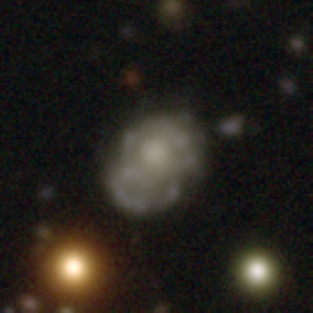
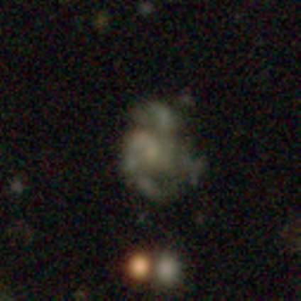
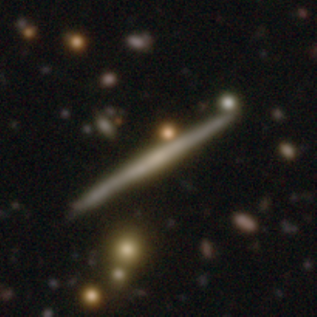
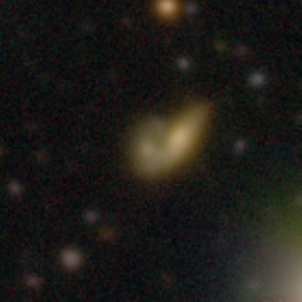
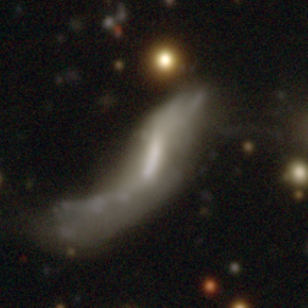
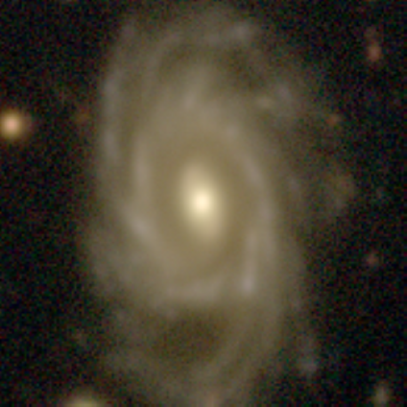
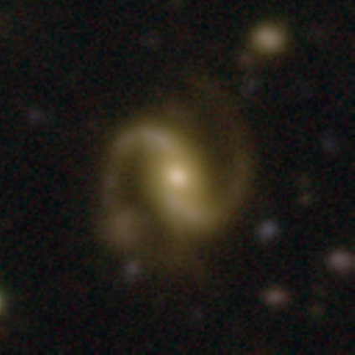
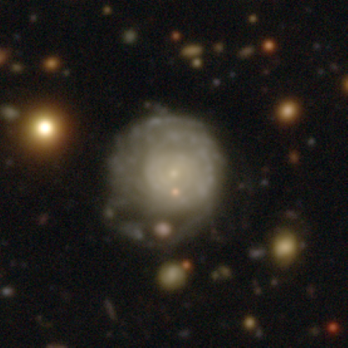
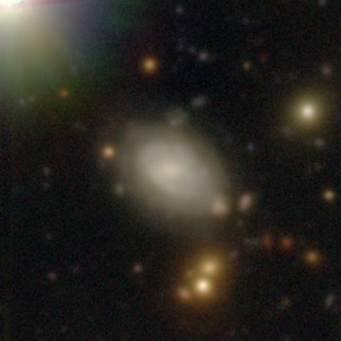
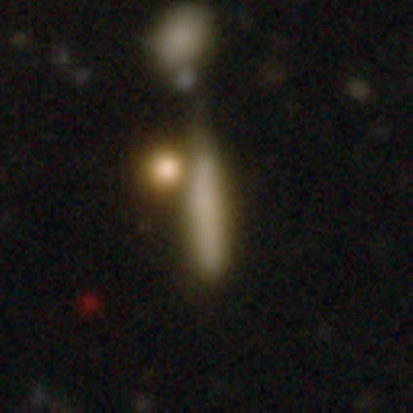
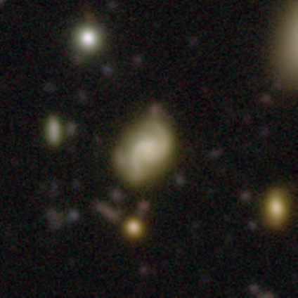
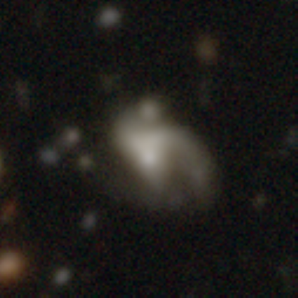
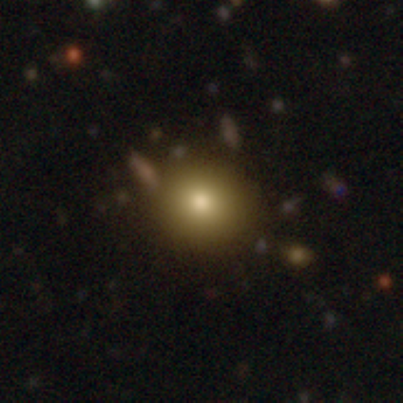
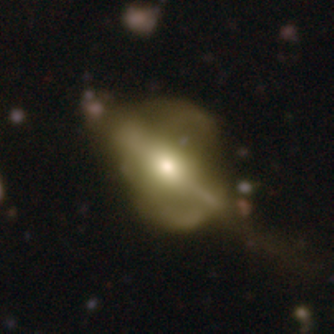
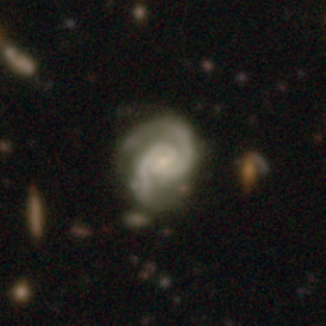
Galaxy Zoo
https://www.zooniverse.org/projects/zookeeper/galaxy-zoo
Notes:
A core aim of extragalactic astronomy is to study how galaxies form and evolve over cosmic time.
Galaxies come in a variety of shapes, from ball-like ellipticals to those with grand spiral arms, so to study their evolution requires large numbers of classified galaxies.
Citizen science helps play a crucial role in the examination of such large data sets.

Slide 3
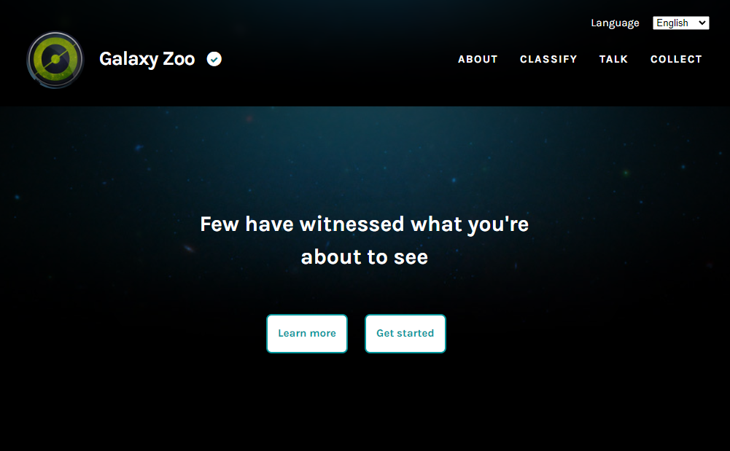
Galaxy Zoo
https://www.zooniverse.org/projects/zookeeper/galaxy-zoo
Notes:
Zooniverse:
The Zooniverse is the world’s largest and most popular platform for people-powered research (citizen science).
This research is made possible by volunteers - more than a million people around the world who come together to assist professional researchers.
Galaxy Zoo (1/2):
The Galaxy Zoo project asks volunteers to classify images of galaxies based on their visual appearance.
This gives the public the opportunity to contribute meaningfully to scientific discovery, while also helping to inspire the next generation of students and scientists.

Slide 4
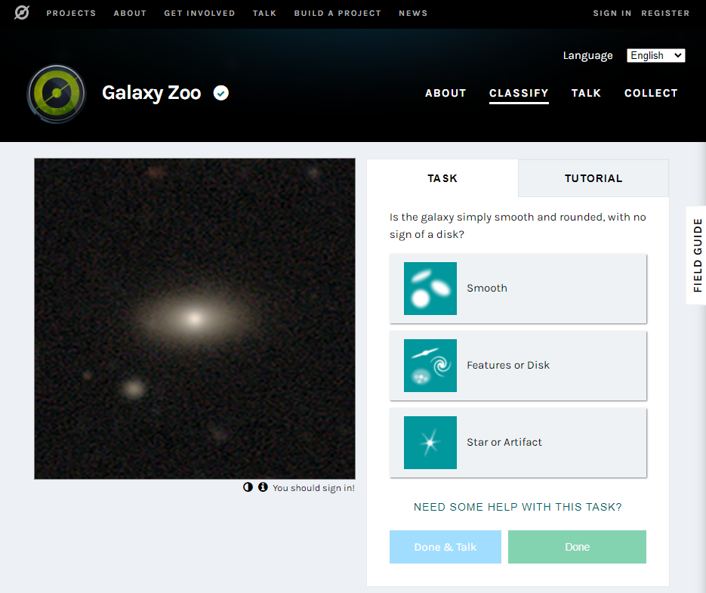
Galaxy Zoo
https://www.zooniverse.org/projects/zookeeper/galaxy-zoo
Notes:
Galaxy Zoo (2/2):
The project has seen multiple iterations, over its 15-year lifespan.
Volunteers examine an image and answer Galaxy Zoo’s decision tree of questions, such as:
Is the galaxy smooth or featured?
Is there any sign of a spiral arm pattern?
How tightly wound are the spiral arms?
Is there a central bulge or bar?
Is the galaxy merging with another?
Are there any rare features, such as gravitational lensing arcs?

Slide 5
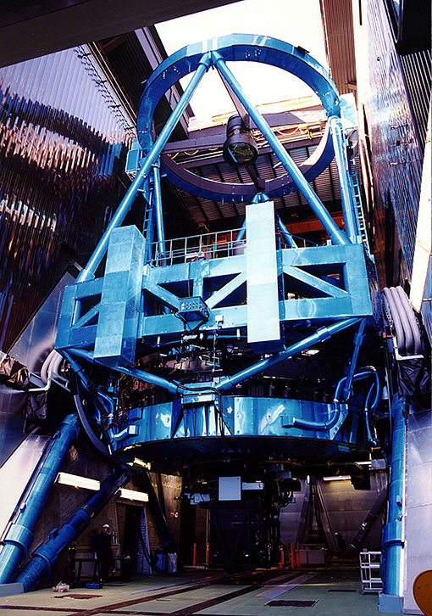

Galaxy Zoo: Cosmic Dawn
https://www.zooniverse.org/projects/zookeeper/galaxy-zoo
Citizen science galaxy classification using Subaru Hyper Suprime-Cam (HSC) imaging from the Hawaii Two-0 (H20) Cosmic Dawn survey.
Cosmic Dawn
Multi-wavelength survey of the Euclid Deep and Calibration fields – some of the darkest and most observable fields on the sky.
Aims to understand the co-evolution of galaxies, black holes, and the dark matter haloes that host them across cosmic time.
Notes:
This new iteration, Galaxy Zoo: Cosmic Dawn, is creating crowdsourced classifications of galaxies in images taken by the Hyper Suprime-Cam (HSC) on board the (8.2m) Subaru telescope on the summit of Mauna Kea in Hawaii (pictured right), as part of the Hawaii Two-0 (H20) Cosmic Dawn survey.
Cosmic Dawn Survey:
The Cosmic Dawn Survey is a (50 sq deg) multi-wavelength survey of some of the darkest fields on the sky.
The scientific aim is to understand the co-evolution of galaxies, black holes, and the dark matter haloes that host them over cosmic time.

Slide 6
Galaxy Zoo: Cosmic Dawn
https://www.zooniverse.org/projects/zookeeper/galaxy-zoo
H20
Ultra-deep Subaru HSC imaging of the two primary Euclid deep calibration fields, including the Euclid Deep Field North (EDF-N).
Studying galaxy evolution out to z = 7 (<800 million years after the Big Bang).
Galaxy Zoo project
Hundreds of thousands of H20 HSC images of the (10 sq. deg.) EDF-N.
Notes:
One facet of Cosmic Dawn is the H20 survey:
Uses ultra-deep Subaru HSC imaging of the two primary Euclid deep calibration fields, including the Euclid Deep Field North (EDF-N).
Aims to push the boundaries of extragalactic astronomy by studying galaxy evolution out to high redshift (z = 7, <800 million years since the Big Bang).
The Project:
Presents volunteers with hundreds of thousands of H20’s deep multi-band images of the 10 sq. deg. Euclid Deep Field North (EDF-N).

Slide 7
Galaxy Zoo: Cosmic Dawn
https://www.zooniverse.org/projects/zookeeper/galaxy-zoo
Benefits
LSST Rubin precursor: mapping provides multiband ground truth sets for use in training deep learning models.
Euclid precursor: mapping the EDF-N provides initial classifications for rapid follow-up of the most interesting objects.
Higher-end resolution and deep multiband imaging for statistically studying both higher redshift sources and low surface brightness features.
Expands the lists of interesting objects, including those from serendipitous discovery.
Notes:
Benefits
HSC is a precursor for LSST Rubin, with this classification work providing multiband ground truth sets for use in training deep learning models (e.g., for strong lens finding).
Mapping the EDF-N acts as a precursor for the Euclid survey, through providing initial classifications for rapid follow-up of the most interesting objects.
Higher-end resolution over an intensely studied area and deep multiband imaging allows for studying both higher redshift sources and low surface brightness features.
Expands the lists of interesting objects, including those from serendipitous discovery.

Slide 8
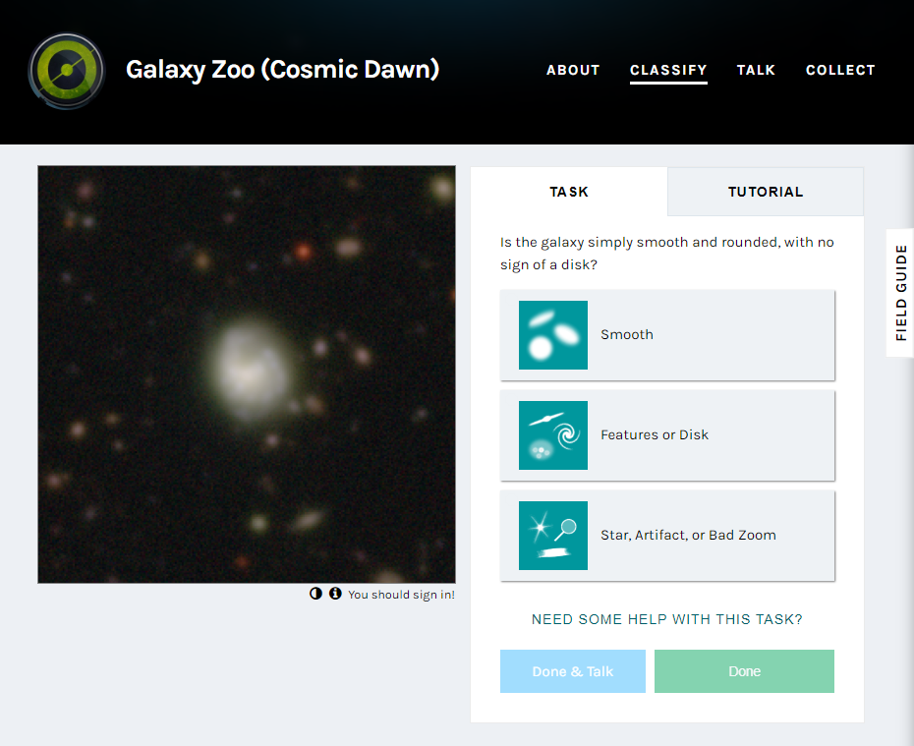
Galaxy Zoo: Cosmic Dawn
https://www.zooniverse.org/projects/zookeeper/galaxy-zoo
Notes:
Current Progress (1/3)
The HSC data have been converted to PNG cutouts using a new colour scaling, due to most sources having higher redshifts.

Slide 9
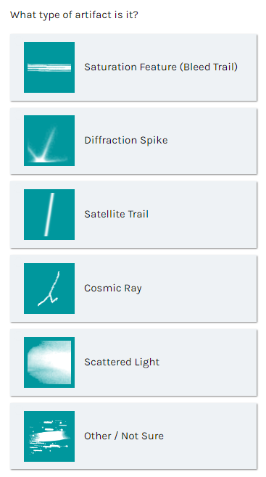
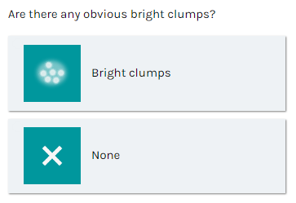
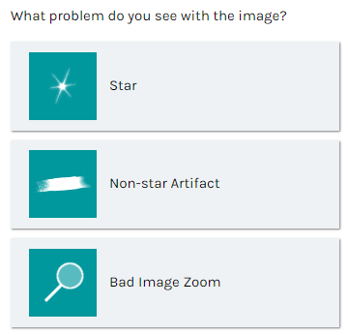

Galaxy Zoo: Cosmic Dawn
https://www.zooniverse.org/projects/zookeeper/galaxy-zoo
Notes:
Current Progress (2/3)
The Galaxy Zoo decision tree has been updated to include:
an extra question on clumpy features,
an expansion of the “star or artifact” option to include a “bad image zoom” option, and a question on classifying the type of any artifacts they encounter, to aid the H20 team improve their data reduction and modelling,
a greater emphasis on identifying gravitational lenses, due to rarity.

Slide 10
Galaxy Zoo: Cosmic Dawn
https://www.zooniverse.org/projects/zookeeper/galaxy-zoo
Potential Publications
General data release paper
Strong gravitational lens discoveries
Clumpy galaxy statistics
Low surface brightness features
Barred galaxy discoveries and statistics
Interesting cases of utilising machine learning (Zoobot)
Galaxy mergers identified by GZ, and their correlation with AKARI/Spitzer data
Correlations between Galaxy Zoo morphology and IR luminosity
Notes:
Future Publications
At the end of the project, in addition to a data release paper, the volunteers’ classifications will also serve to generate multiple publications, including
the detection of strong gravitational lenses,
statistics of clumpy galaxies (see Hugh’s talk up next), and
examinations of galaxies with low surface brightness features,
(LSB tidal features are a powerful means to identify systems which have undergone recent mergers and accretions)

Slide 11
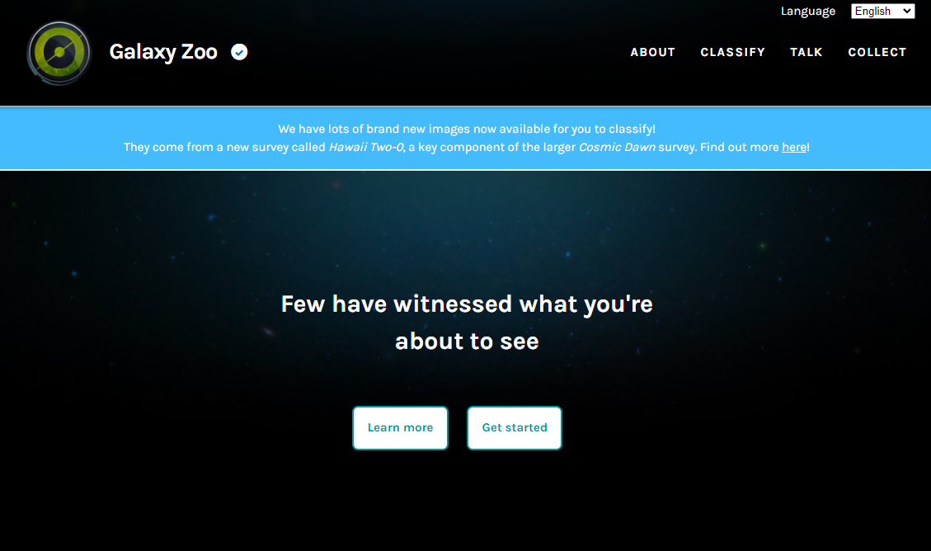

Galaxy Zoo: Cosmic Dawn
https://www.zooniverse.org/projects/zookeeper/galaxy-zoo
Notes:
Current Progress (3/3)
Galaxy Zoo: Cosmic Dawn has recently had its public launch, which was accompanied by a blog post written by the H20 team.
As of two weeks ago, there have been over 230,000 classifications made by volunteers.
So please feel free to join in! (Thank you for listening!)

Slide 12
Thanks for listening!
https://www.zooniverse.org/projects/zookeeper/galaxy-zoo
Notes:
Thanks for listening!

Slide 13
Galaxy Zoo: Cosmic Dawn
https://www.zooniverse.org/projects/zookeeper/galaxy-zoo
Summary
Galaxy Zoo is the longest running Zooniverse citizen science project, classifying galaxies based on their visual morphologies.
Galaxy Zoo: Cosmic Dawn forms its next iteration, using deep multi-band Subaru HSC imaging of the EDF-N, with data from the H20 Cosmic Dawn survey.
Benefits include:
  Studying higher-z sources and those with LSB features,
  Expanding the list of interesting objects (e.g. through serendipitous discovery),
  Mapping the EDF-N acts as a precursor for Euclid by providing initial classifications for rapid follow-up,
  Project acts as a precursor for Rubin LSST by creating multiband ground truth sets for training deep learning models.
Notes:
Summary
Galaxy Zoo is the longest running Zooniverse citizen science project, classifying galaxies based on their visual morphologies.
Galaxy Zoo: Cosmic Dawn forms its next iteration, using deep multi-band Subaru HSC imaging of the EDF-N, with data from the H20 Cosmic Dawn survey.
Benefits include:
Studying higher-z sources and those with LSB features,
Expanding the list of interesting objects (e.g. through serendipitous discovery),
Mapping the EDF-N acts as a precursor for Euclid by providing initial classifications for rapid follow-up,
Project acts as a precursor for Rubin LSST by creating multiband ground truth sets for training deep learning models.

