Slide 1



Managing Citizen Science from ESAP
James Pearson, Hugh Dickinson
Notes:
Managing Citizen Science from ESAP
Earlier we heard about ESCAPE’s Work Package 5, the ESFRI Science Analysis Platform (ESAP). At the Open University, supported by ESCAPE and EOSC Future, we have worked on a subject that combines Work Packages 5 and 6, through managing citizen science projects using ESAP. We’ll give a quick rundown of why this is beneficial and the progress we’ve made in this area.
====================================
Note: EOSC Future is an EU-funded H2020 project that is implementing the European Open Science Cloud (EOSC) to which ESCAPE services will contribute.

Slide 2
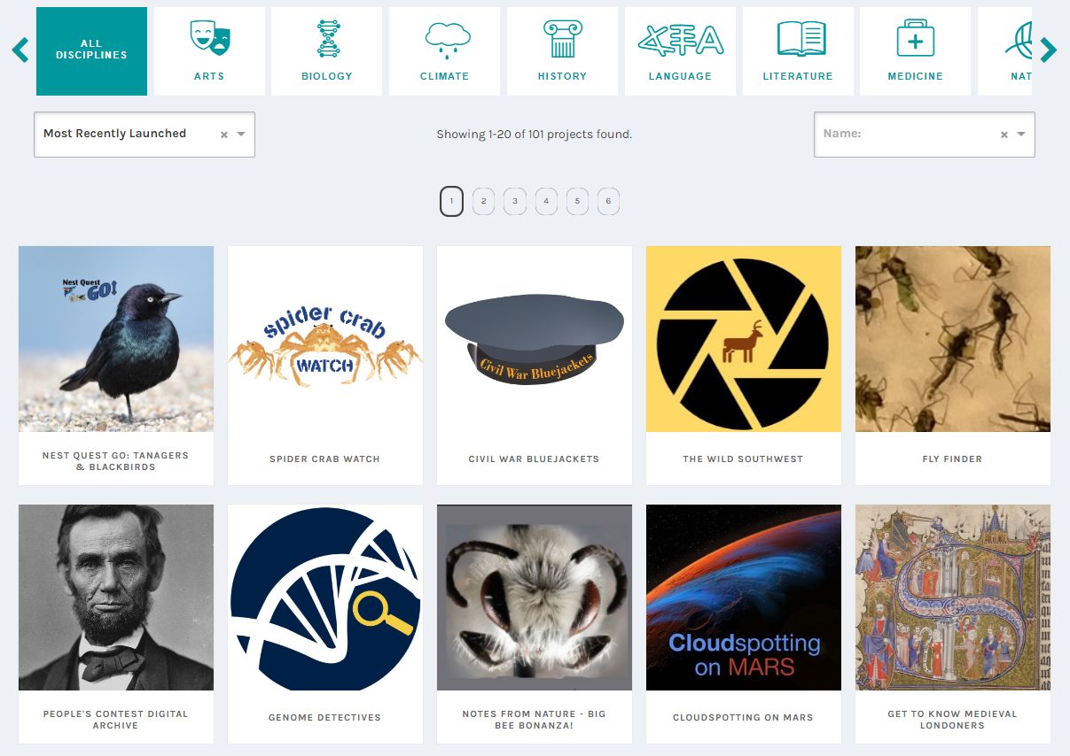
Zooniverse Projects
Notes:
Zooniverse:
The Zooniverse is the world’s largest and most popular platform for citizen science.
It allows professional researchers to set up scientifically-driven crowdsourced data mining experiments across all ranges of disciplines, from Art and History to Climate and Space.
These projects are presented publicly so that members of the public can take part, essentially acting as a biological computer capable of processing complex challenges and data sets.
This has allowed more than a million people around the world to come together to assist professional researchers, giving everyone the opportunity to contribute meaningfully to scientific discovery.

Slide 3
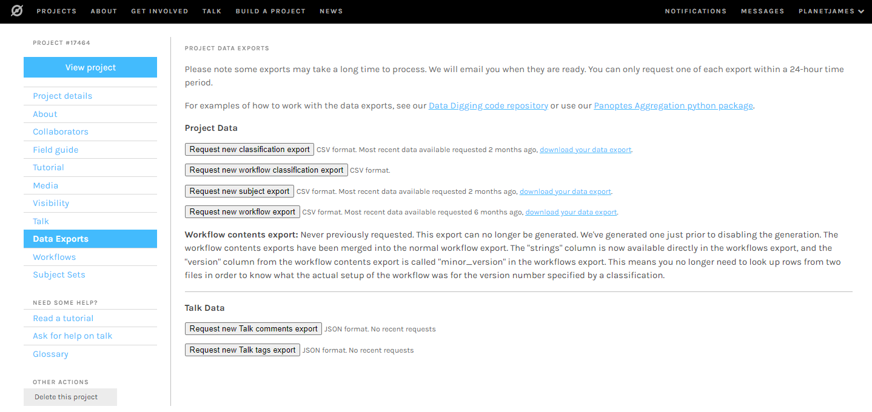
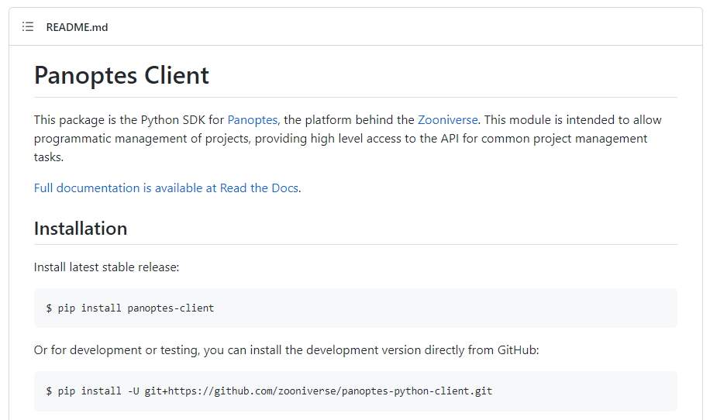
Zooniverse Projects
Notes:
Project Building:
The Zooniverse platform has guides on the basics of setting up and managing projects through their Project Builder web interface (shown here in the background).
But Zooniverse also has a backend API, called Panoptes, which can allow for more advanced project building and management options.
Researchers can access these options through the Panoptes Python client (seen on the right), but this has been challenging for researchers to use.

Slide 4
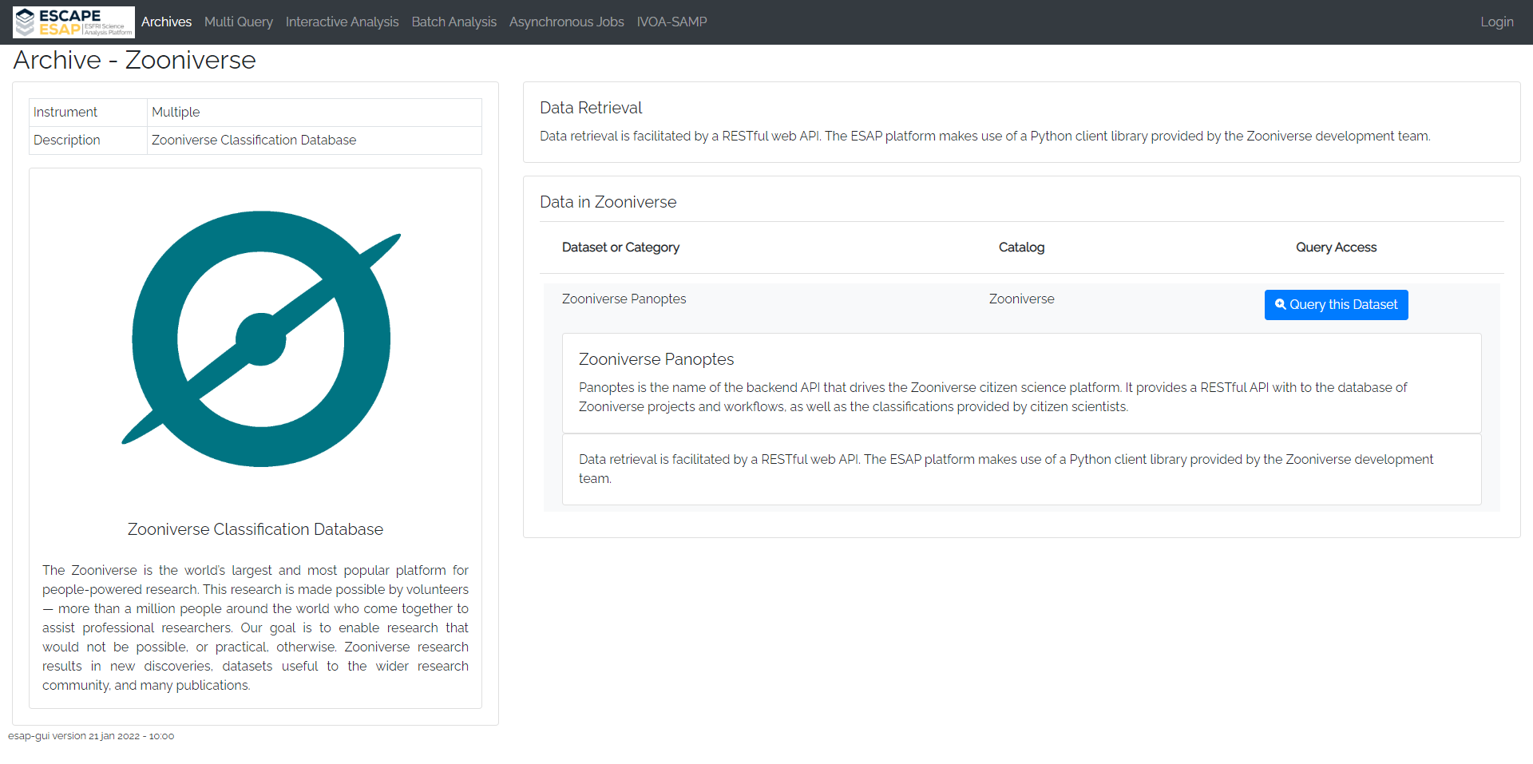
ESFRI Science Analysis Platform (ESAP)
Notes:
ESAP:
So, to facilitate the advanced creation of citizen science projects for ESFRI partners, and foster interest in ESCAPE from researchers, we turned to the Science Analysis Platform.
Through the ESAP GUI, ESAP has the functionality for storing and running Jupyter notebooks as Interactive Analysis workflows.
The ESAP Archives also allow one to retrieve data from external sites, and the Zooniverse Classification Database has been integrated into this via the Panoptes API.

Slide 5
Managing Citizen Science from ESAP
Aim:
  Develop a suite of tutorial workflows and material demonstrating the creation and management of Zooniverse citizen science projects through ESAP.
Notebooks and documentary materials demonstrate:
  Advanced Zooniverse project building for subject creation and upload, attaching metadata, and providing training and feedback to volunteers,
  Integrating with the Zooniverse’s Caesar engine for aggregation of results and advanced subject retirement rules.
  Accessing the ESAP Shopping Basket to download data for aggregation.
  Integrating Zooniverse projects with existing deep learning frameworks, including pre-filtering subjects and creating detailed subject retirement rules.
  Setting up an active learning framework to simultaneously improve both deep learning performance and the experience of volunteers.
Notes:
Aim:
Hence, the aim of this work is to aid researchers by developing a suite of easy-to-use template workflows and material that can be used to create and manage new Zooniverse projects through ESAP.
Presented as Jupyter notebooks, these tutorials streamline interaction with the Zooniverse back-end (Panoptes), and demonstrate:
advanced project building techniques for managing subject sets and metadata, and setting up volunteer training and feedback,
using Zooniverse's Caesar engine for aggregation of results and advanced subject retirement rules, and
accessing the ESAP Shopping Basket to download data for aggregation.
Also demonstrated are the ways in which deep learning models can be combined with Caesar to make projects more efficient, from pre-filtering subjects, to creating detailed subject retirement rules, to setting up an active learning cycle to simultaneously improve both deep learning performance and the experience of volunteers.

Slide 6
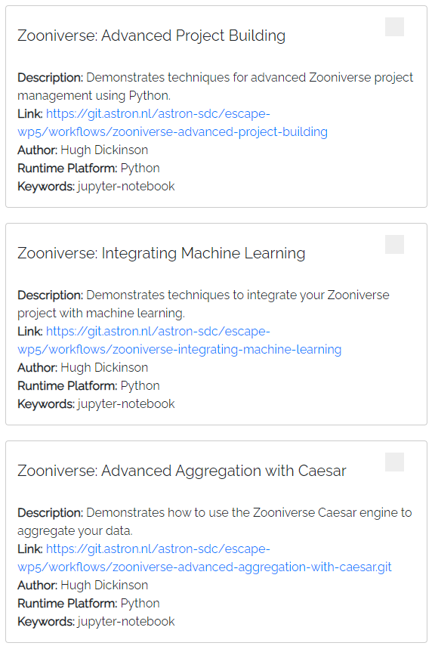
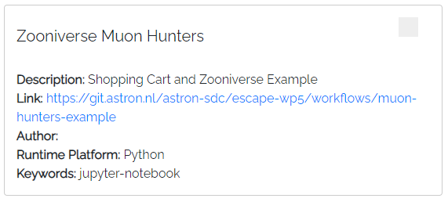
Current Progress
Tutorial Jupyter notebooks.
Recorded walkthroughs of these tutorials.
Speech-to-text documentation of these recordings, for greater accessibility.
Notes:
Current Progress:
Created tutorial notebooks with detailed documentation, including links to external documentation and websites such as the Project Builder.
Recorded walkthroughs of these notebooks.
Speech-to-text documentation of these recordings, for greater accessibility (that can be easily auto-translated for the EU).

Slide 7
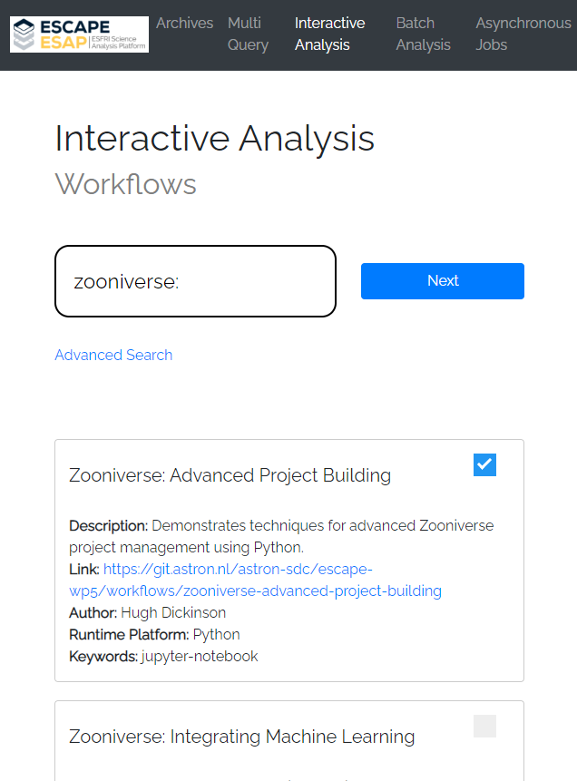
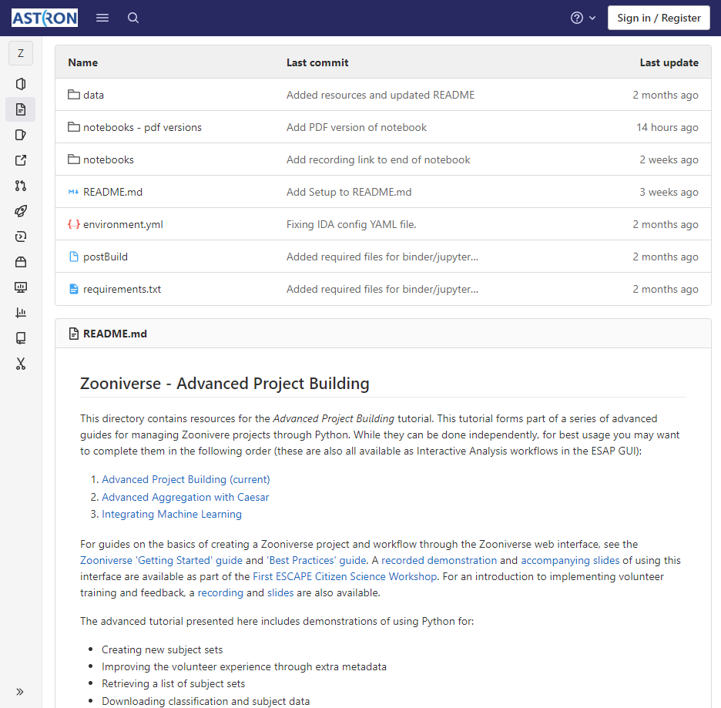
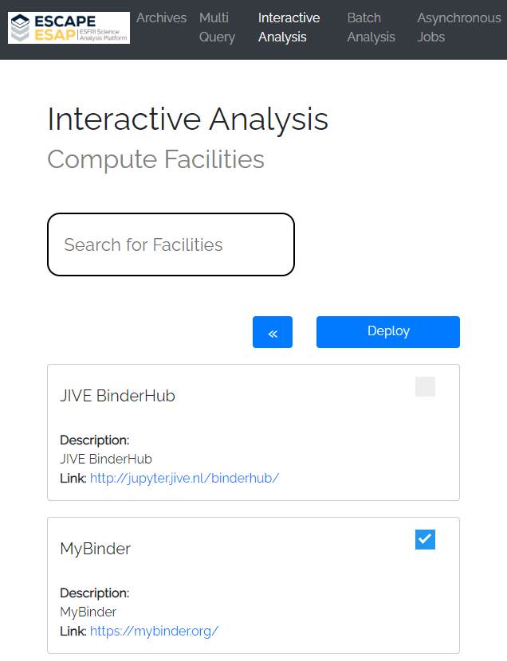
Current Progress
Notes:
The material is stored and maintained on the ESAP’s ASTRON GitLab, and accessible through the ESAP GUI.
For example, I can search the Interactive Analysis workflows for one of them, in this case the Advanced Project Building workflow.
Selecting that, I then click “next” and select a Compute Facility, in this case I deploy the workflow to a MyBinder instance.

Slide 8
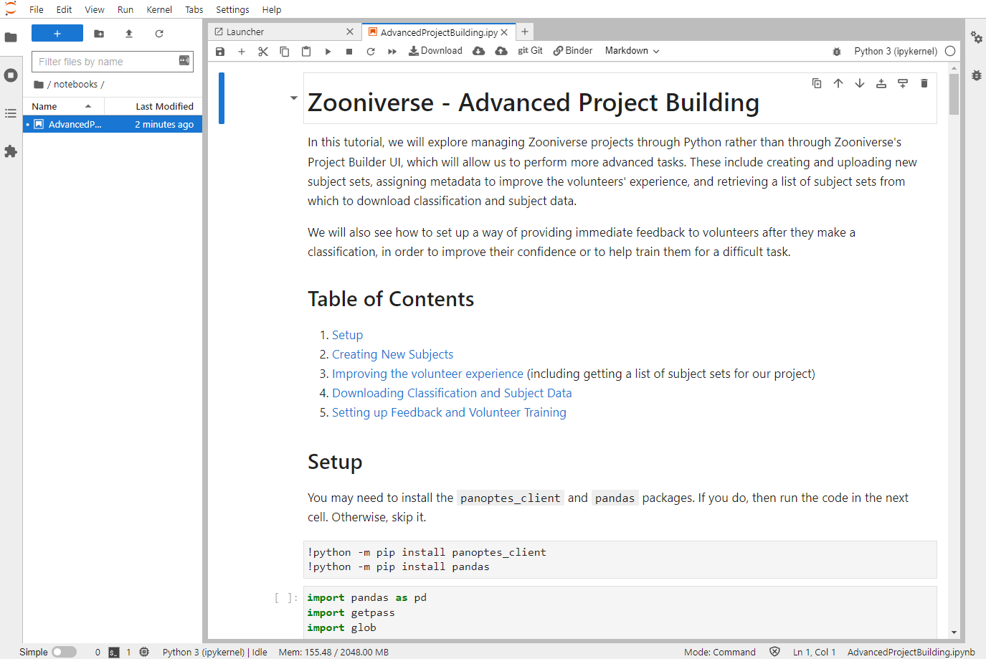
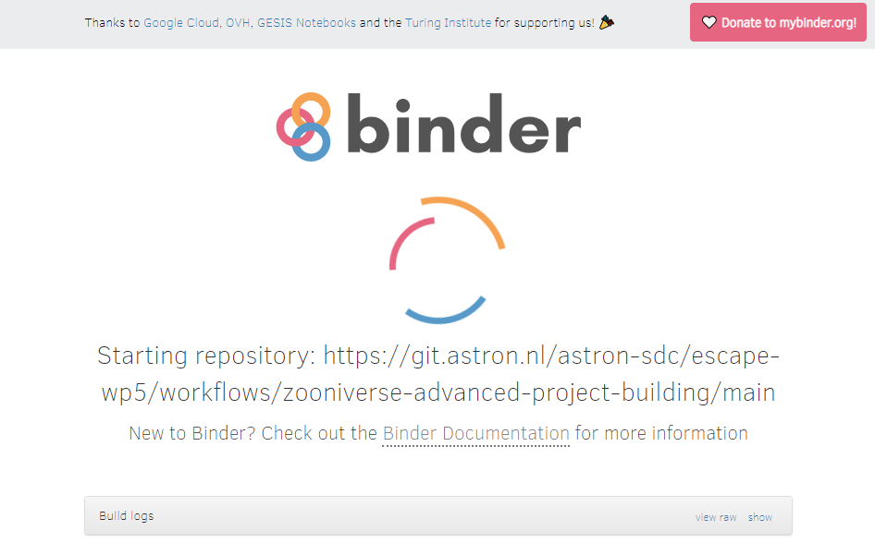
Current Progress
Notes:
Binder then gets set up, and soon I’m presented with a JupyterLab containing the workflow, with the tutorial notebook (on the right) ready to use.

Slide 9
What’s Next?
Notes:
So, what’s next?
Well, Galaxy Zoo classifications become publicly available after the project has finished. So, how best can we help researchers utilise these results?

Slide 10
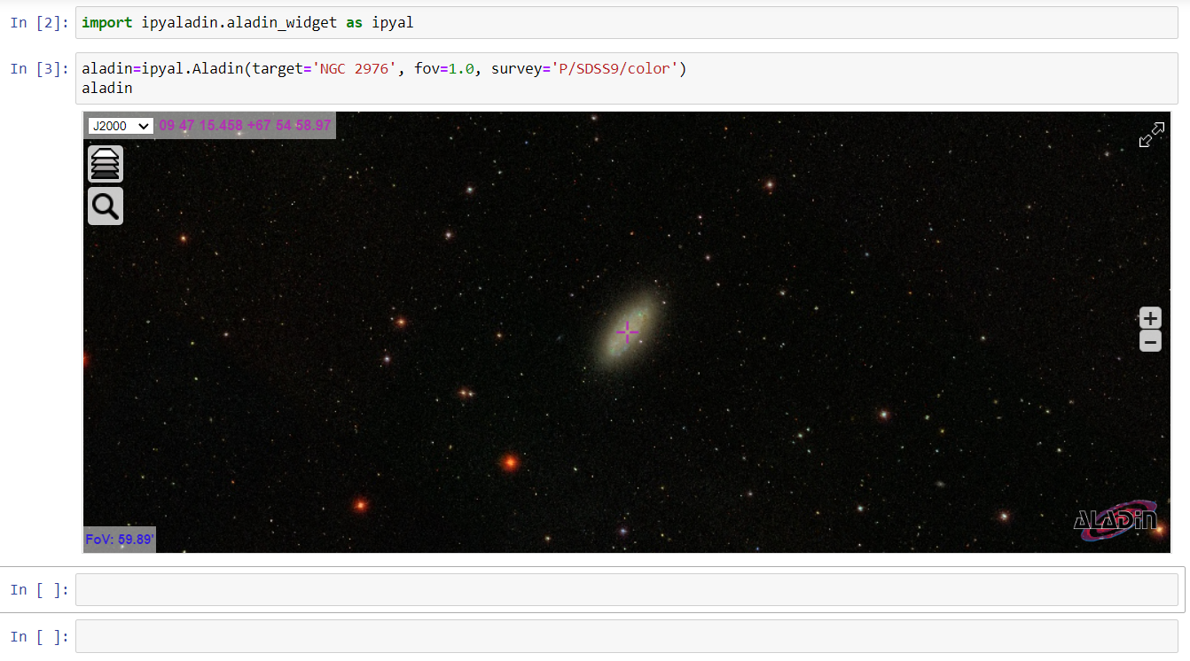
What’s Next?
Notes:
Our aspiration is to develop a Virtual Observatory (VO) tool for data exploration that can seamlessly access Zooniverse classifications of astronomical objects (e.g., using a TAP server/service).
So, for example, you might start with this iPyAladin widget in a notebook…

Slide 11
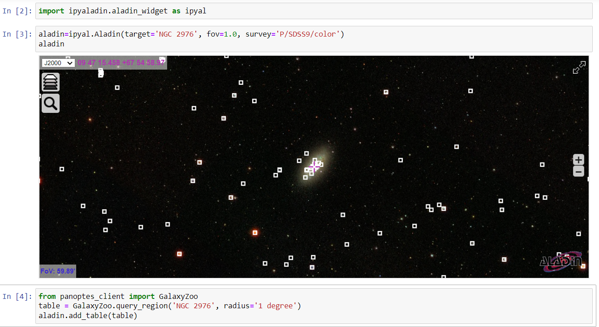
What’s Next?
Notes:
…and then load a module called, say, ‘GalaxyZoo’ from Zooniverse’s backend API Panoptes that can be used to search a region of sky.

Slide 12
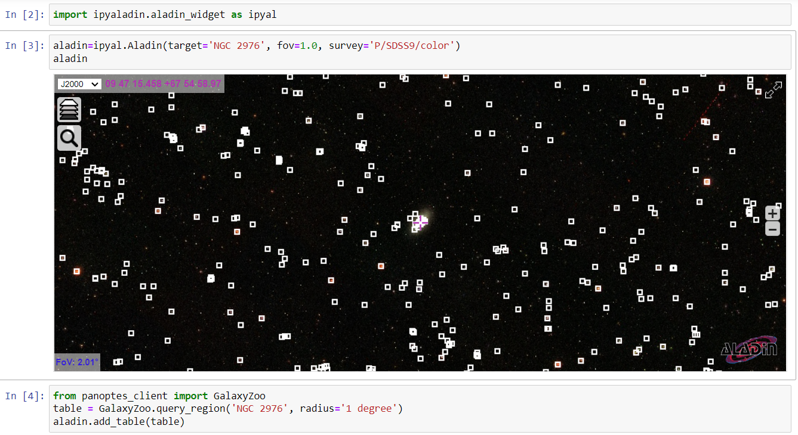
What’s Next?
Notes:
Galaxy Zoo projects have classified a huge number of objects, so we can zoom out a bit.

Slide 13
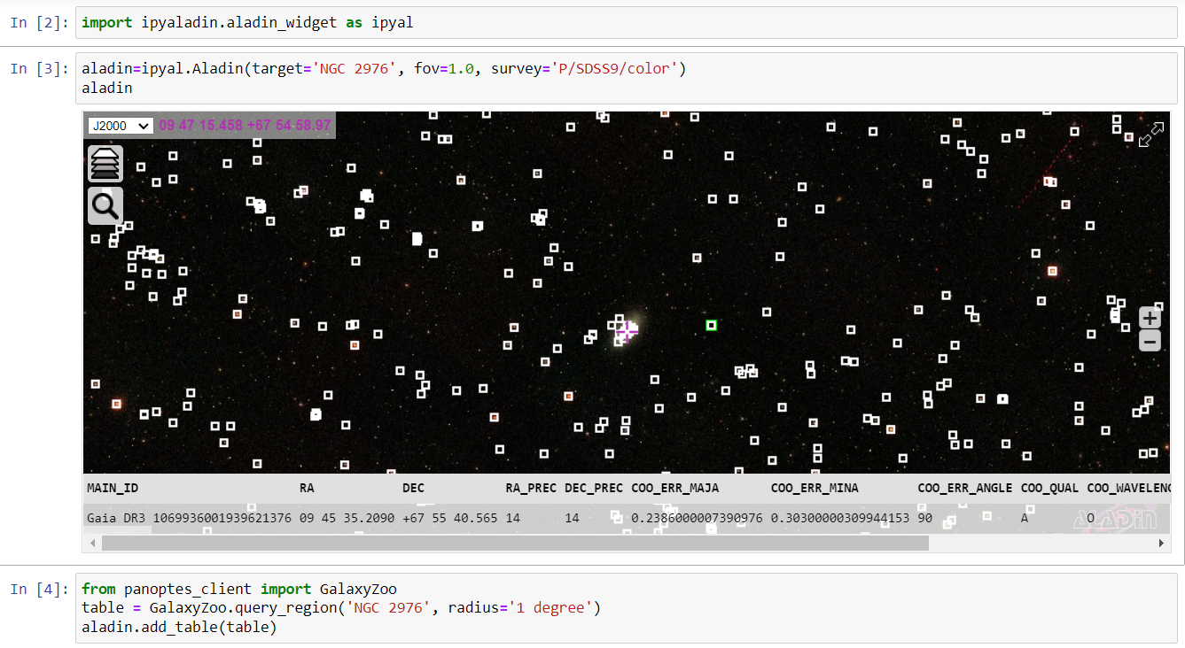
What’s Next?
Notes:
This would create “first class” VO data consisting of galaxies in the VO with labelled Galaxy Zoo morphologies (perhaps even specifying which iteration of GZ).
Researchers could then access this data in conjunction with data from other surveys to harness the power of citizen science for their own work.

Slide 14
Thanks for listening!
In summary, this work allows:
professional scientists to combine the powers of both ESAP and Citizen Science for their research,
volunteers to engage even further with this research and with astronomy in general.
Notes:
Combined with the earlier tutorial material, this work allows professional scientists to combine the powers of both ESAP and Citizen Science for their research, as well as allowing volunteers to engage even further with this research and astronomy in general.
And with that, thank you for listening!

Slide 15
Summary
The Zooniverse platform for people-powered research gives everyone the opportunity to contribute meaningfully to scientific discovery.
To aid researchers, we have developed a suite of easy-to-use workflows and material for managing Zooniverse projects through ESAP, demonstrating:
  advanced project building techniques,
  using Zooniverse's Caesar engine for aggregation of results and advanced subject retirement rules,
  accessing the ESAP Shopping Basket,
  integrating with deep learning models to make projects more efficient, including setting up an active learning cycle.
Recorded walkthroughs of these notebooks, with speech-to-text documentation for greater accessibility, are available.
We hope to develop a Virtual Observatory (VO) tool for seamless data exploration of galaxies in the VO with labelled Galaxy Zoo morphologies.
Notes:
Summary
The Zooniverse platform for people-powered research gives everyone the opportunity to contribute meaningfully to scientific discovery.
To aid researchers, we have developed a suite of easy-to-use workflows and material for managing Zooniverse projects through ESAP, demonstrating:
advanced project building techniques,
using Zooniverse's Caesar engine for aggregation of results and advanced subject retirement rules,
accessing the ESAP Shopping Basket,
integrating with deep learning models to make projects more efficient, including setting up an active learning cycle to simultaneously improve both deep learning performance and the experience of volunteers.
Additionally, we have recorded walkthroughs of these notebooks, with speech-to-text documentation for greater accessibility.
We hope to also develop a Virtual Observatory (VO) tool for seamless data exploration of “first class” VO data, consisting of galaxies in the VO with labelled Galaxy Zoo morphologies.

