Slide 1
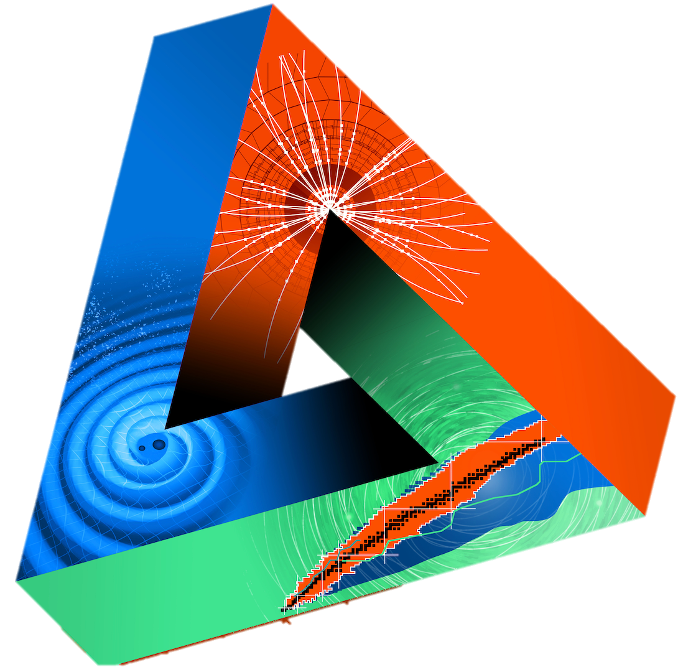



OPEN DATA
for ApPEC-ECFA-NuPECC
JENAS Seminar - Orsay, 14 October 2019
Giovanni LAMANNA
LAPP, Laboratoire d’Annecy de Physique des Particules
CNRS-IN2P3

Slide 2
Outline
EOSC and the H2020 ESCAPE:
“A community cluster effort for data-research”
“From Open Science to Open Data and Reproducible Science”
Where we (ApPEC-ECFA-NuPECC) stand and where we can go:
“Challenges, visions and needs”

Slide 3
European Open Science Cloud (EOSC)
An European Commission action in response of the union member states shared policy about Open Science:
  EOSC is a cloud for research data in Europe that allows universal access to data through a single online platform.
  EOSC will federate existing resources across national data centres, e-infrastructures, and research infrastructures, allowing researchers and citizens to access and re-use data produced by other scientists.
  Respective capacities and domain-based heterogeneous needs of scientific stakeholders make the EOSC implementation a real challenge.

Slide 4

Towards an (AstroNet)-ApPEC-ECFA-NuPECC cooperative framework
Funded by the European Union’s Horizon 2020 - Grant N° 824064

Slide 5
Astronomy and Particle Physics
ESCAPE convenes a large scientific community and a large number of ESFRI RIs:
  Astronomy and accelerator-based particle/nuclear physics facilities for a multi-probe approach to understand the Universe
  Leveraging two major complementary excellences in data stewardship:
  i) the astronomy Virtual Observatory infrastructure;
  ii) long-standing expertise of the particle physics community in large-scale
  distributed computing and big-data management.

Slide 6
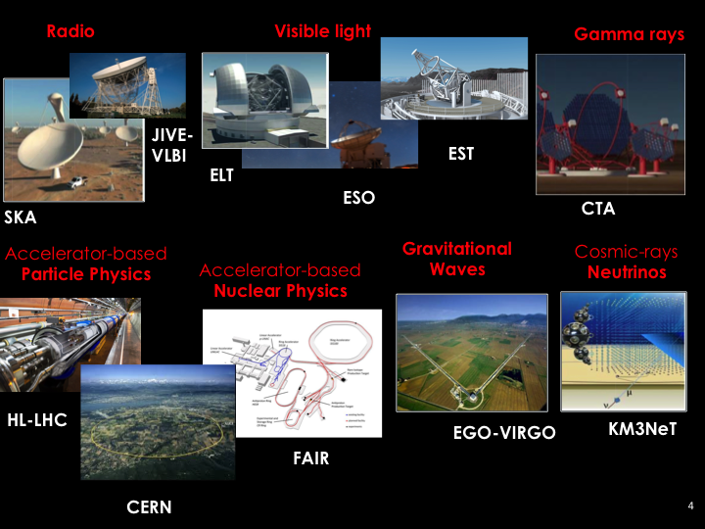

Slide 7
From Open Science …
Open science has become a pillar of the current national and international views and political programmes of governments, research funding bodies, and forums.
Three main ambitions for that:
  1) Change the way citizens could perceive research and public investments for research.
  2) Enable opportunities offered by the digital revolution to allow everybody to participate in the scientific process by accessing research data.
  3) Accelerate the discoveries and increase scientific value by sharing data and by transferring knowledge within scientific communities.

Slide 8
… to Open Data
‘Open data’ does not mean ‘free data’
  ( and, furthermore, depending on what ‘data’ is being referred to, conditions governing its access and reuse will always be applied. )
‘Open data’ means support an uptake a set of guiding principles about the way to plan and produce scientific data:
  ‘FAIR’ Data Principles: ‘Findable, Accessible, Interoperable, and Reusable’.
  But sharing data is not enough…

Slide 9
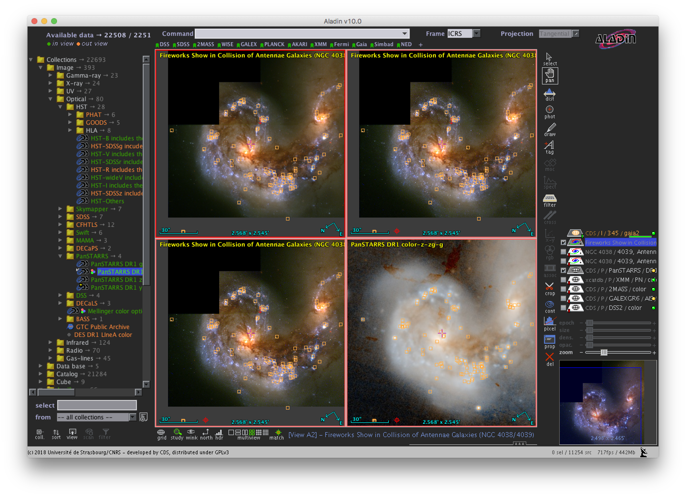
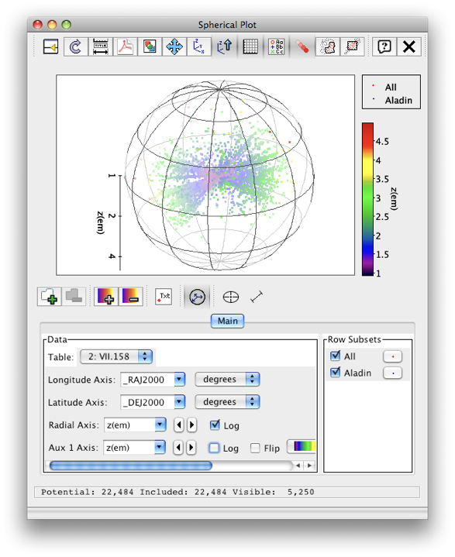
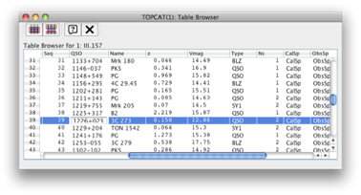
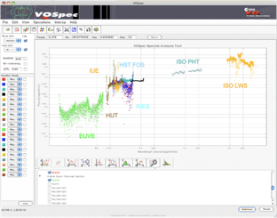
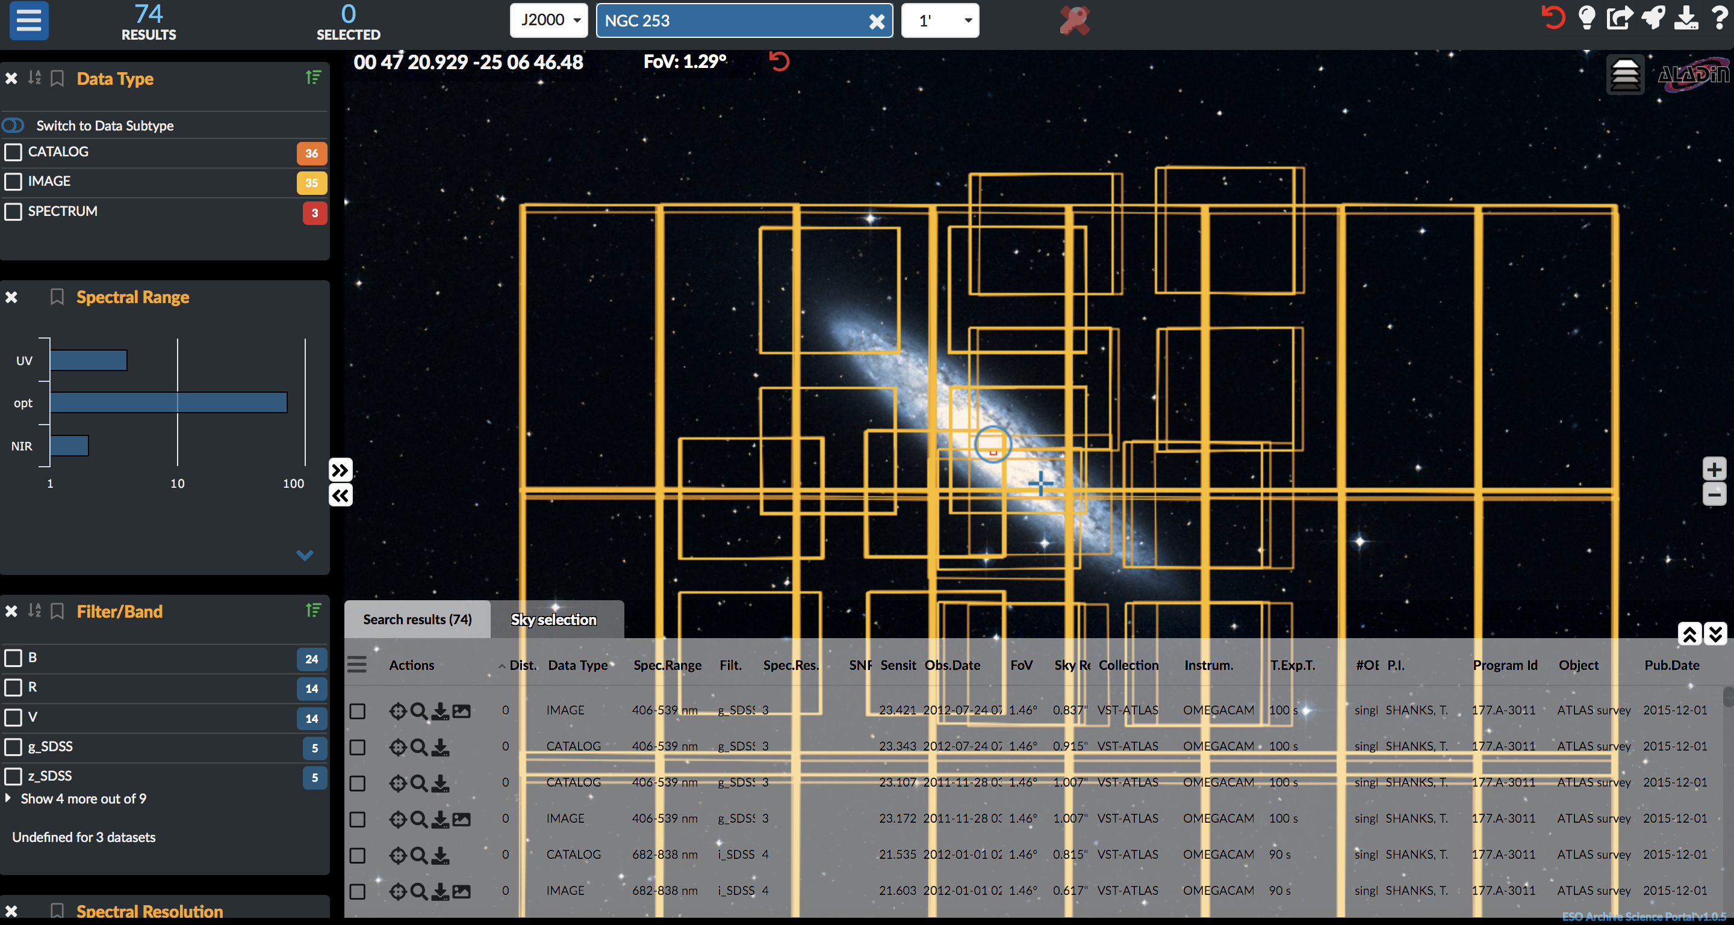
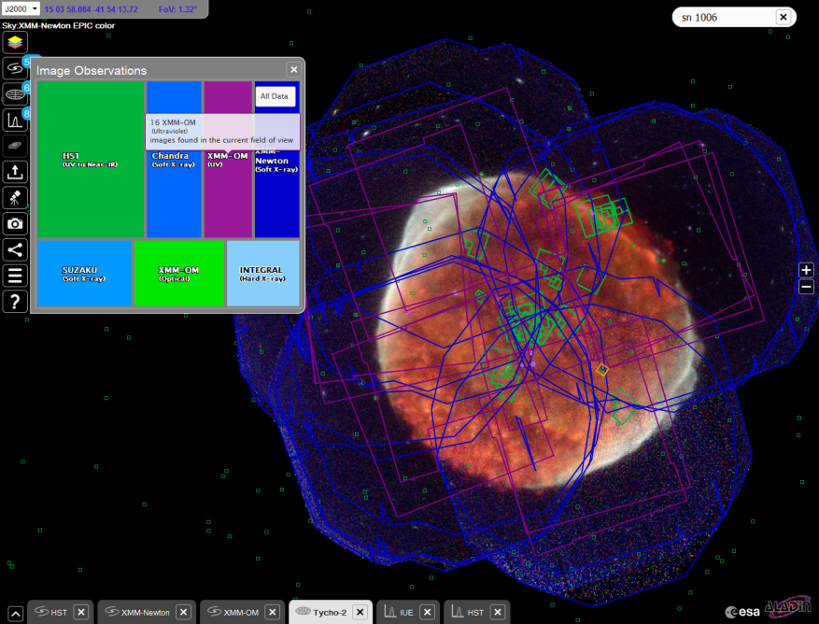

Open Data in Astroparticle
Current/next generation facilities (SKA, CTA, Virgo, KM3NeT, etc.) providing “data products” within the Virtual Observatory (VO). VO is an operational framework for interoperable access to data and services across all areas of astronomy
Spectral tools
ESO Science Portal
ESA Sky
VO as a pioneer of FAIR data sharing framework, populated by major data providers (space and ground based) that is heavily used by the community, e.g. including ESA and ESO (VO embedded) services.

Slide 10



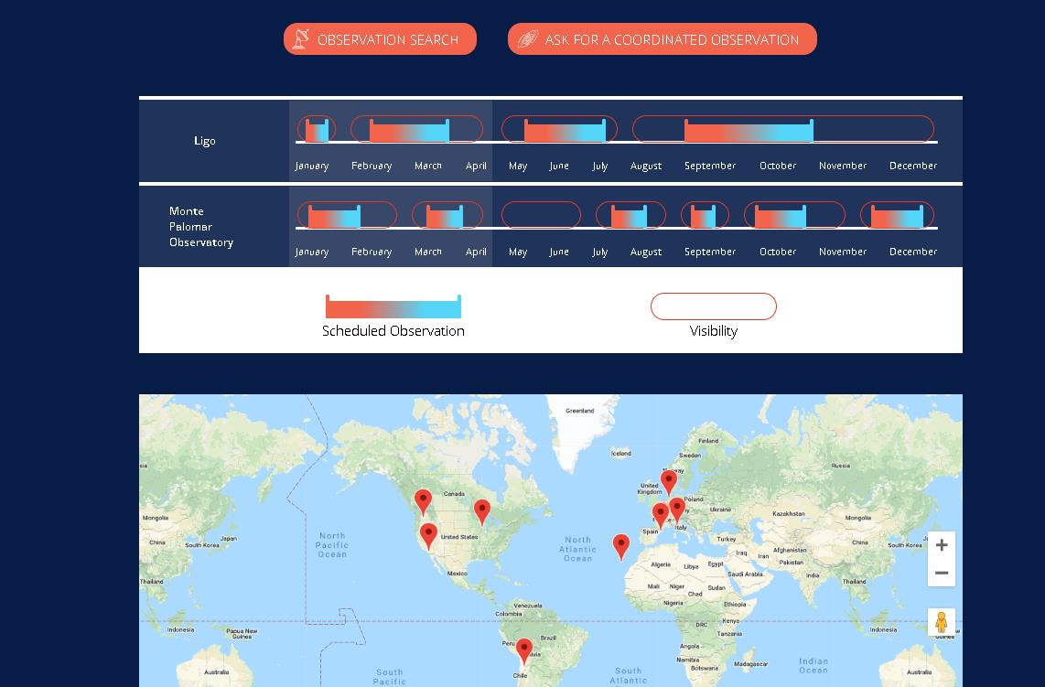
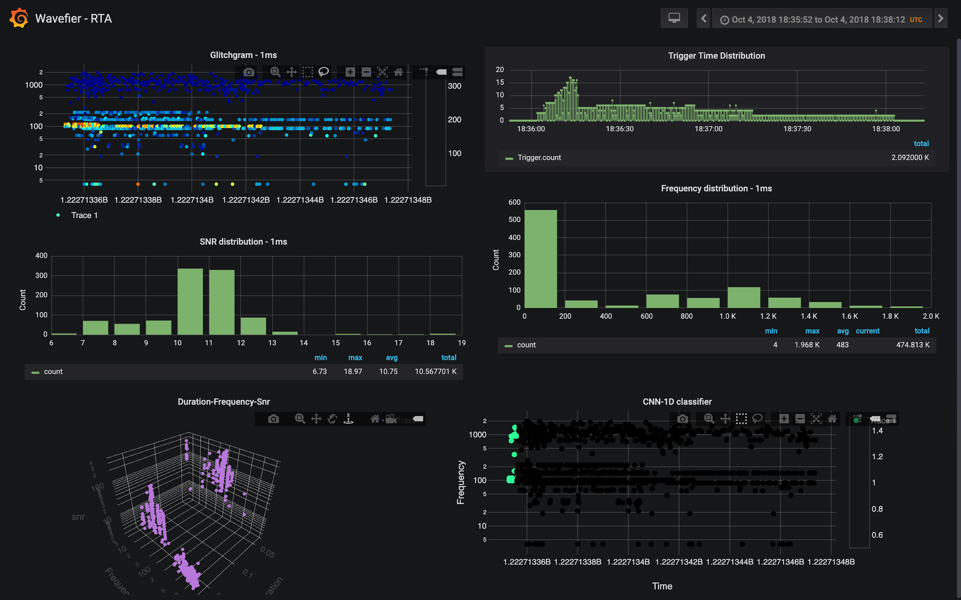
Open Data in Astroparticle
Data isn’t limit to the digitally-encoded bits and includes the software for analysis.
Open-source software is the oldest declination of open-science (as a reaction to a monopole of proprietary services, i.e. GNU/Linux).
Next generation astronomical experiments, being operated as observatories, commit to providing open access to data and analysis software (CASA for SKA; ctools, Gammapy and GammaLib for CTA, etc.).
Multi-messenger data analysis practices promotes new software (including scheduling, target filtering, machine learning methods, real time transient signal classifier, etc.)

Slide 11
Open Data in Particle Physics
Early-days of Open Data in HEP but :
Great strides in providing open access to research publications
LHC/CERN open data endeavours focused on education
Data preservation is and has been the main issue.
Data already quite “accessible” - Large number of scientists in the experiments getting hands on coveted data by joining these experimental collaborations.
More fundamental motivations for open data in the future:
“What about more exploratory studies where the theory hasn’t yet been invented?
What about engaging undergraduate students?
What about examining old data for signs of new physics?”
(Jesse Thaler)

Slide 12
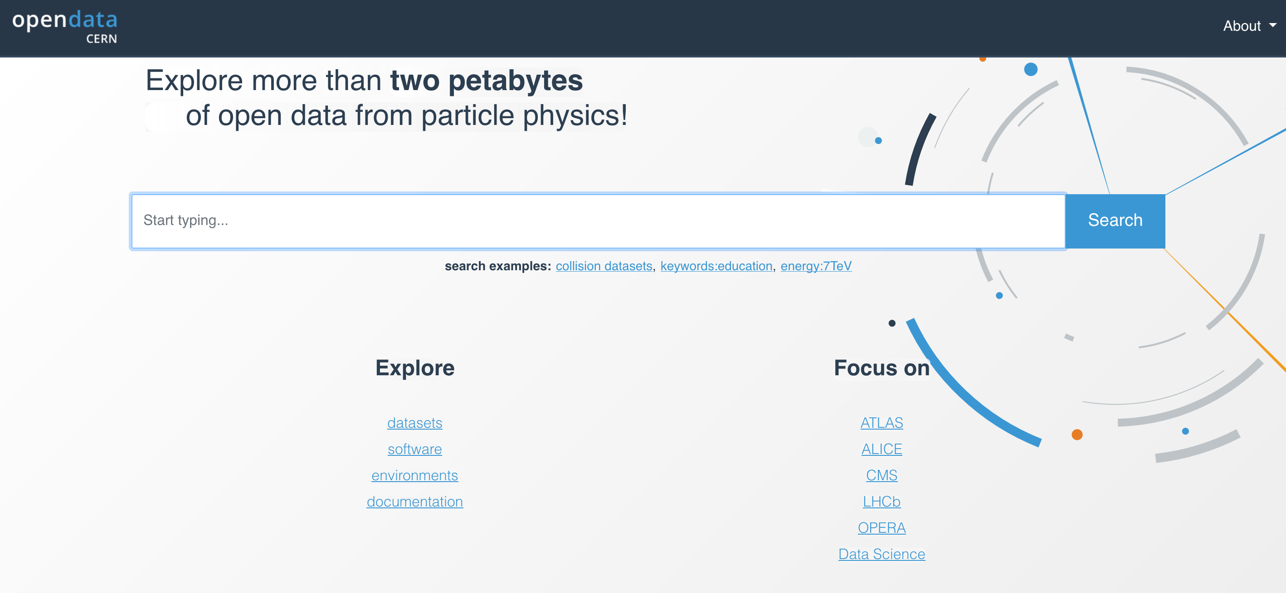
Open Data in Particle Physics
Today CERN’s open-data portal hosts and serves data including many software tools and virtual machines to run the analysis code.

Slide 13






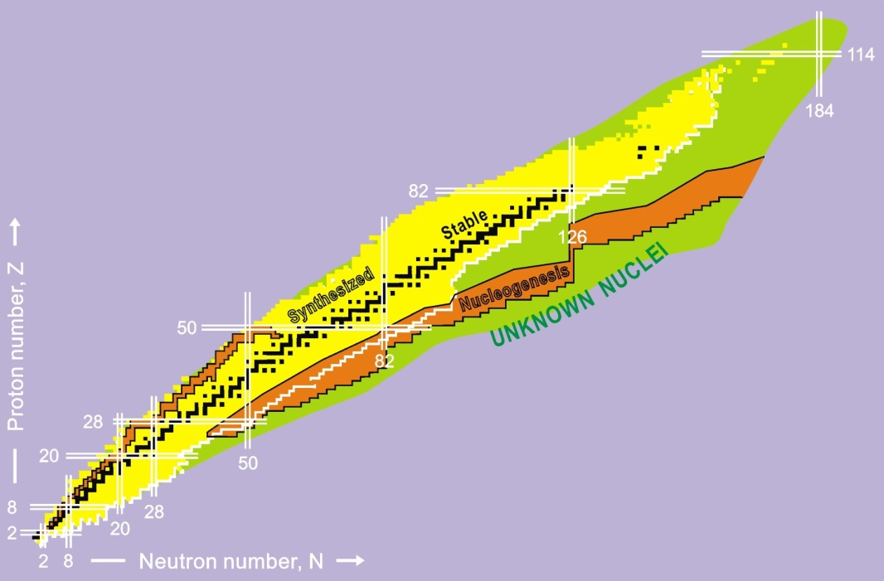
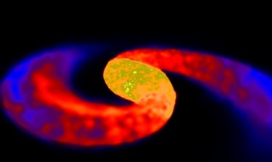

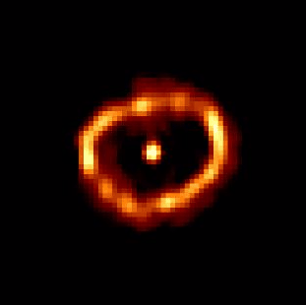

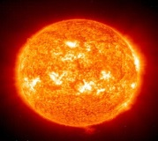
Open Data in Nuclear Physics
Early-days of Open Data in Nuclear Physics with clear opportunities and constraints.
A two-fold context:
Nuclear facilities for science: “open facilities” exploited for multidisciplinary research (e.g. industrial research, medical sensible data, etc.) imply embargo and proprietary data.
Nuclear research data: fundamental research and key data for astrophysics when matter at extreme conditions is studied as the one in giant planets, stars, and during stellar explosions and collisions (not different compared to HEP).
Neutron Star Merger
Type I Supernova
Nova
Type II Supernova
Sun

Slide 14
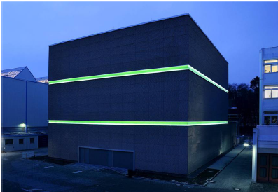
Open Data in Nuclear Physics
Open data in NP research (e.g. FAIR at GSI, SPIRAL2 at GANIL et al. ) is mainly a global “data management policy” issue.
From policy to services for data FAIRness:
Nuclear physics for multidisciplinary science: requires central metadata, standard data format, software tools (for facility exploitation and data access), services for scheduling, archive and data embargo monitoring.
Nuclear research data: data preservation (as for HEP), data access, science-ready data for “interoperability” (ex. ApPEC and NuPECC synergies) and … scientific computing are the main topics.
GANIL/Spiral2 example: a project conducted for nuclear physics data-workflow has produced a “Data Management Strategy”
At FAIR-GSI the FAIRness is planned for a consistent data management system including large data volumes computing and storage services

Slide 15
This is not all …..
… what we can do together ?

Slide 16





European Science Cluster of Astronomy & Particle physics ESFRI research infrastructures
31 partners (including 2 SMEs)
7 ESFRI projects & landmarks: CTA, ELT, EST, FAIR, HL-LHC, KM3NeT, SKA
2 pan-European International Organizations: CERN, ESO (with their established infrastructures and observatories).
3 supporting ERA-NET initiatives: NuPECC, ASTRONET, APPEC
1 involved initiative/infrastructure: EURO-VO
2 European research infrastructures: EGO and JIV-ERIC
Budget: 15.98 M€
Started: 1/2/2019
Duration: 42 months (end date 31/7/2022)
Grant number: 824064
Coordinator: CNRS-LAPP
Formal commitment of their legal entities and management boards required by EC

Slide 17
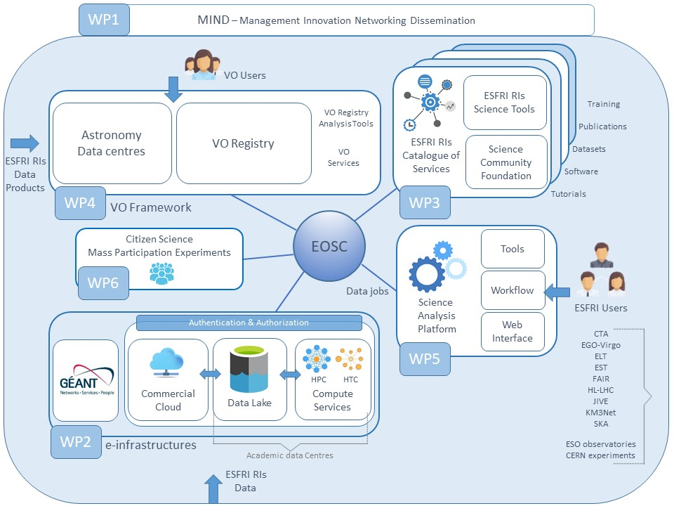
The ESCAPE partners have identified the key challenges of common interest with mutual and wide-ranging benefit to all concerned for open data

Slide 18
ESCAPE for open data: FAIRness and computing
DATA LAKE : data FAIRness requires a new model for federated computing and storage to face the (overall) Exabyte scale of data volumes of next generation ESFRI RIs.
  The astrop. next RIs (such as SKA et al.) will operate as “observatories”. World-wide scientists have open access to science-ready data and potentially lower-level data for further analysis through regional centres. Long-term preservation and access.
  The HL-LHC data challenges and the quality of the network implies the evolution from hierarchical (WLCG) to regional distributed data centres.
  FAIR-GSI has similar needs and follows the same path.
  For all: increasing offer of large-scale heterogeneous CPU-only resources (grid, HPC, public and commercial cloud, volunteer computing) ; CPU and storage resources are no longer always co-located as it is in the GRID.

Slide 19














Involved science and supporting RI
Supporting
Data Lake : a cloud of data services for open access and open science
The backbone are well experienced large national data centers supporting the ESFRIs in ESCAPE
The Data Lake as underlying data infrastructure to manage and serve data to the user communities

Slide 20
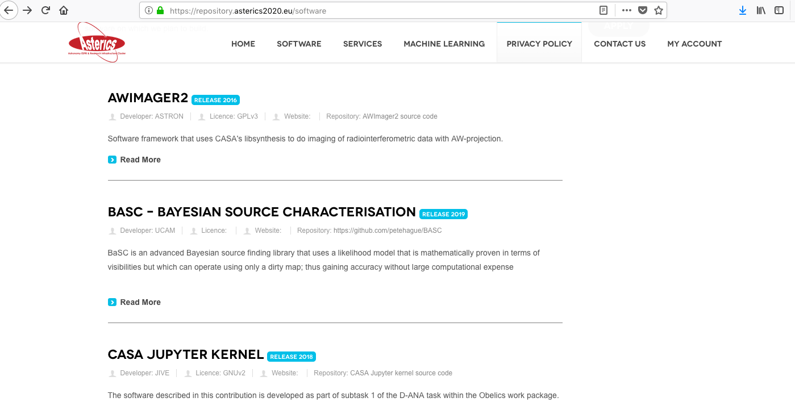
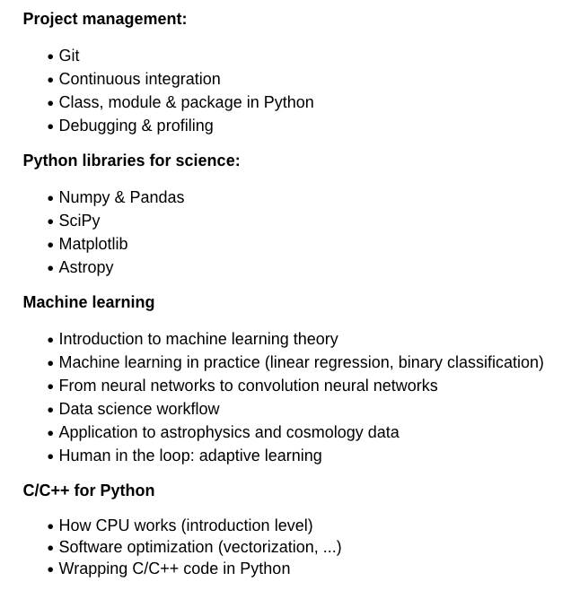

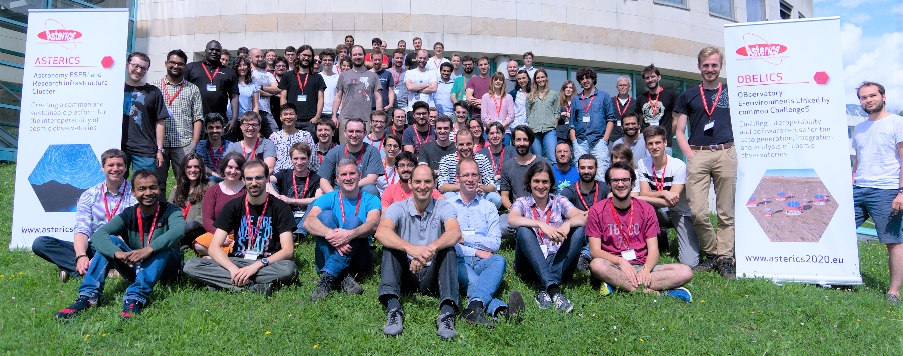
ESCAPE for Open Data: FAIRness and software
Analysis software preservation and open source enable actual internal or external community reuse of research outputs and open reproducibility of science.
From ASTERICS (cluster precursor) to ESCAPE: implementation of a community-based approach for the continuous development of shared software.
Establish a “foundation” to support "scientific software" as a major component of the ESFR-RI “data” to be stored and displayed in EOSC via dedicated community-based catalogues
Pursue the interoperability, software re-use and cross-fertilisation (including SMEs)
Training of researchers and data scientists.

Slide 21
The ESCAPE partners have identified the key challenges of common interest with mutual and wide-ranging benefit to all concerned for open data

Slide 22





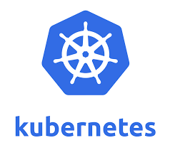
ESCAPE for open data: FAIRness and analysis platform
Building a common (among ESFRI projects encompassed within ESCAPE) prototype science analysis platform for any researcher:
  Data gathering and discovery (access to data lake)
  Access to software & services (through the ESCAPE software catalogues)
  Customised processing & workflows (of any single scientist uploaded in the system)
  Interface with large-scale computing infrastructure (HTC and HPC)
  Adds analytics and visualisation
  Archiving users’ results (certified and acknowledged)
Data and results reused
Analysis interface
(Batch/Interactive)
Workflows
(RI-released, Standard, User-defined)
Scalable remote cloud
Some largely adopted/studied technical solutions…

Slide 23
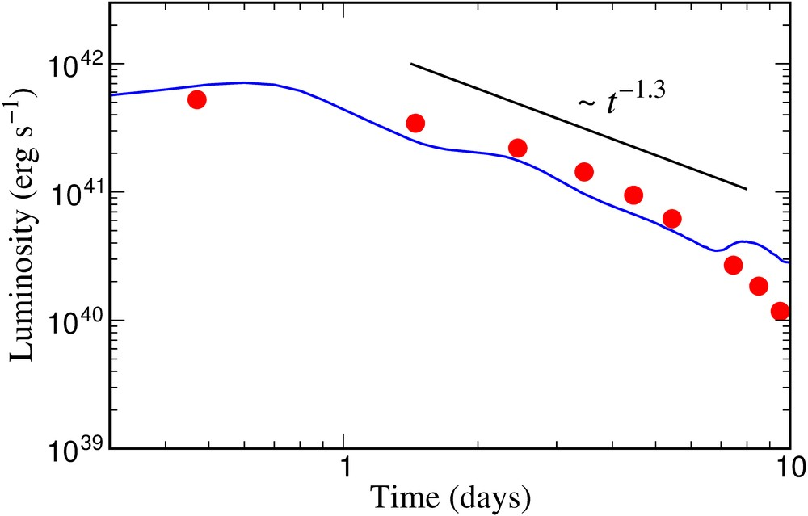
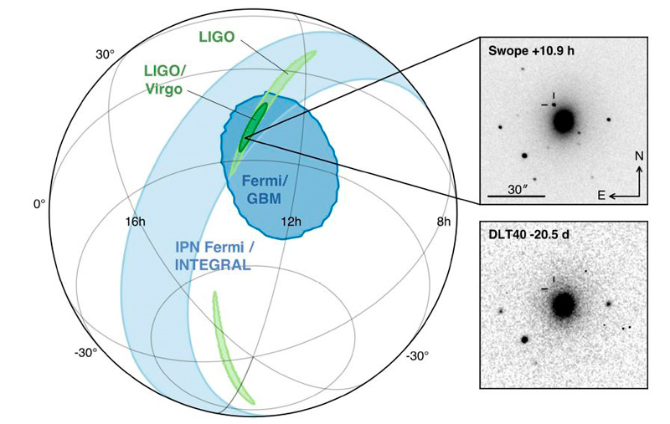
ESCAPE for open data: FAIRness towards “VRE”
Reminder : 3rd pillar of Open Science :
Accelerating discoveries and increasing scientific value by sharing software and knowledge within scientific communities.
“Science test projects” to validate the ESCAPE towards “virtual research environments”:
Some potential examples to pursue:
Dark Matter: From legacy data of gamma-ray dwarf galaxy observations to … … Data registry and software through multi-messengers data for Indirect Dark Matter search, Direct search, Accelerator results, models and phenomenological studies.
From high-energy detection of GRBs to … …Multi-lambda, nuclear astrophysics,
Gravitational Waves and relativistic
astrophysics computational modelling.
… and many others (potentially)….
Metzer, Martinez-Pinedo, Arcones et al. (2010)
Astrophys. J. 848, L17 (2017)

Slide 24
EOSC and FAIRness: consequences/questions
The costs for each ESFRI project for the continuous maintenance of open-source tools for analysis, together with services and computing resources to access its data, would constrain the openness to only a limited level of data complexity.
The foundation approach is a partial shift of responsibility for access to quality-certified scientific data from the facility to the community on a longer term.
This implies an increase of costs that will have to be supported (by EOSC ?) transversally and a commitment to guarantee sustainability.

Slide 25
ApPEC-ECFA-NuPECC vs EOSC : cooperative paths
Increasing scientists and projects involved in the « open-science» cluster
Endorsing and formally acknowledging the community “foundation” approach in order to directly connect researchers to decision boards.
Appoint a transversal reflection group to work on the assessment on whom the operation costs of Big-Science “data reuse” (within EOSC) should be charged on (e.g. national or pan-European agencies, the legal entities operating the facilities, the EC, the EOSC governance body, etc.)

Slide 26
Conclusions and perspectives
EOSC aims at being the infrastructure for open science consumption.
A series of implications for the ApPEC-ECFA-NuPECC boards:
Establish a reference federated digital repository for the sustainability of scientific data preservation independently on the lifetime of each single research infrastructure
Apply rules and operate an authority to inquire adoption of data management plan and certified open archival model (such as ISO OAIS) by each new facility/data producer
Define and support credit systems, acknowledgement, standard licences, and certification for the results of all researchers engaged in co-operative work that allow all to reap the benefits of open science.

Slide 27
Thank you for your attention

