Slide 1
The ESCAPE Project
2nd ESFRI-EOSC Workshop
Giovanni Lamanna, LAPP/CNRS
7th October 2020
https://projectescape.eu/

Slide 2
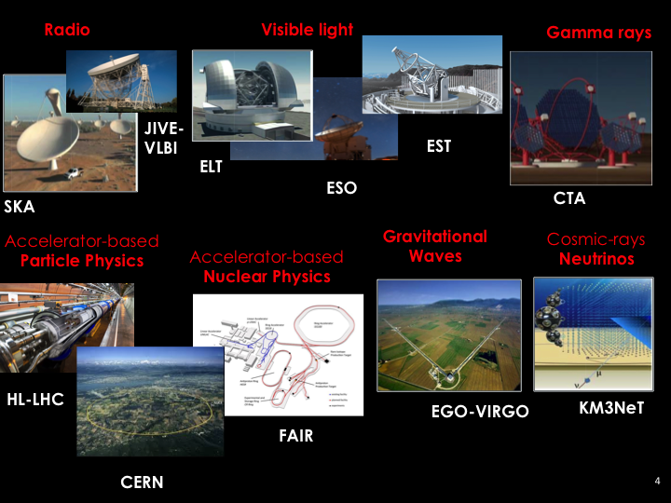

Slide 3
ESCAPE: Astronomy and Particle Physics ESFRIs
Builds on communities’ complementary excellences in data stewardship:
  Astronomy Virtual Observatory infrastructure
  HENP expertise in Exabyte-scale data management and large-scale distributed computing
Builds on existing inter-RI synergies, intersections.
Recognises that ESCAPE communities will be Exascale data generators,
early adopters of ICT and data management innovations, push state-of-the-art.
Both Observatory- and Facility- operations require global, open access to data,
long term curation, and sustainability.

Slide 4































ESCAPE consortium
ESCAPE convenes a large scientific community
31 partners (including 2 SMEs)
7 ESFRI projects & landmarks: CTA, ELT, EST, FAIR, HL-LHC, KM3NeT, SKA
2 pan-European International Organizations: CERN, ESO (with their world-class established infrastructures, experiments and observatories).
4 supporting thematic national consortia : HEP (CERN) and ECFA, NuPECC, ASTRONET, APPEC
1 involved initiative/infrastructure: EURO-VO
2 European research infrastructures: EGO and JIV-ERIC
Budget: 15.98 M€
Started: 1/2/2019
Duration: 48 months (end date 31/1/2023)
Coordinator: CNRS
Home page: https://projectescape.eu ; Twitter: @ESCAPE_EU

Slide 5
ESCAPE Work Programme
Data Lake:
  Build a scalable, federated, data infrastructure as the basis of open science for the ESFRI projects within ESCAPE. Enable connection to compute and storage resources.
Software Repository:
  Repository of "scientific software" as a major component of the “data” to be curated in EOSC. Implementation of a community-based approach for the continuous development of shared software and for training of researchers and data scientists.
Virtual Observatory:
  Extend FAIR standards, methods, tools of the Virtual Observatory to a broader scientific context; demonstrate EOSC ability to include existing platforms
Science Platforms:
  Flexible science platforms to enable the analysis of open access data
Citizen Science:
  Open gateway for citizen science on ESCAPE data archives and ESFRI community CS projects

Slide 6
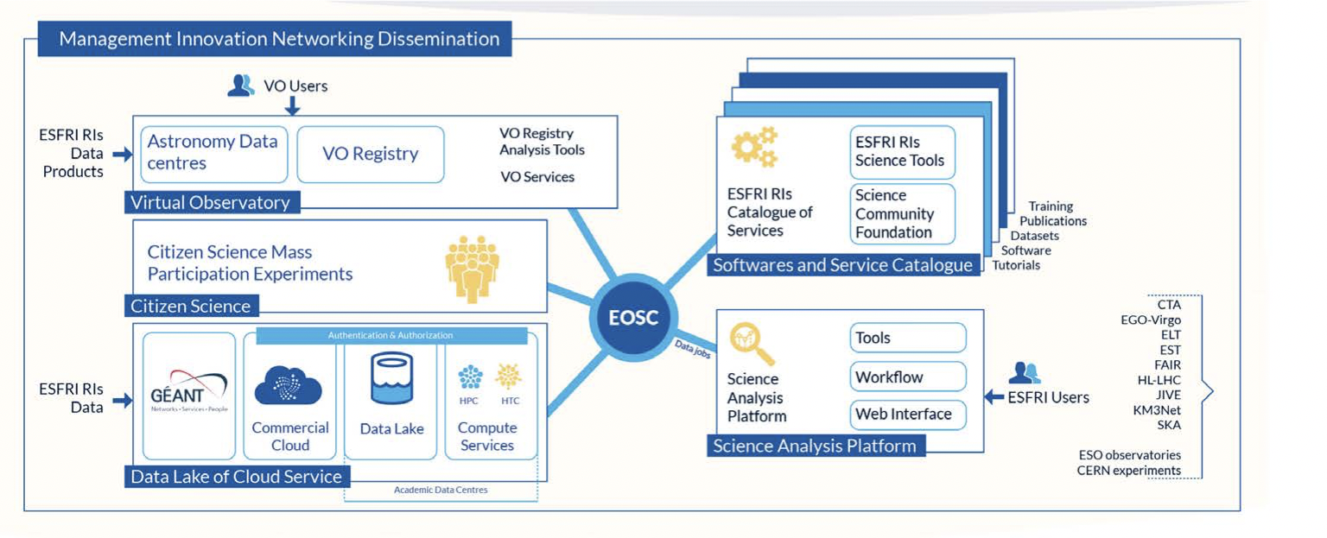
ESCAPE contributions : building a thematic EOSC cell

Slide 7
Data Lake concept
Storage Orchestration Services
Federation through token-based AAI
Policy-driven data replication and distribution
Distributed storage for reliability, accessibility, sustainability
Serving data, remote, cached, streaming, to heterogeneous compute facilities
Hide complexity – transparent access to data
Storage
Asynchronous
Data Transfer
Services
Storage
Data (Lake)
Infrastructure
Distributed Storage
Storage
Storage
Volatile
Storage
Storage
Content Delivering and Caching Services
Data Center
Data Center
Grid Compute
Grid Compute
Cloud Compute
HPC
Compute
@HOME
Grid Compute
Compute
Infrastructure
Compute Provisioning

Slide 8
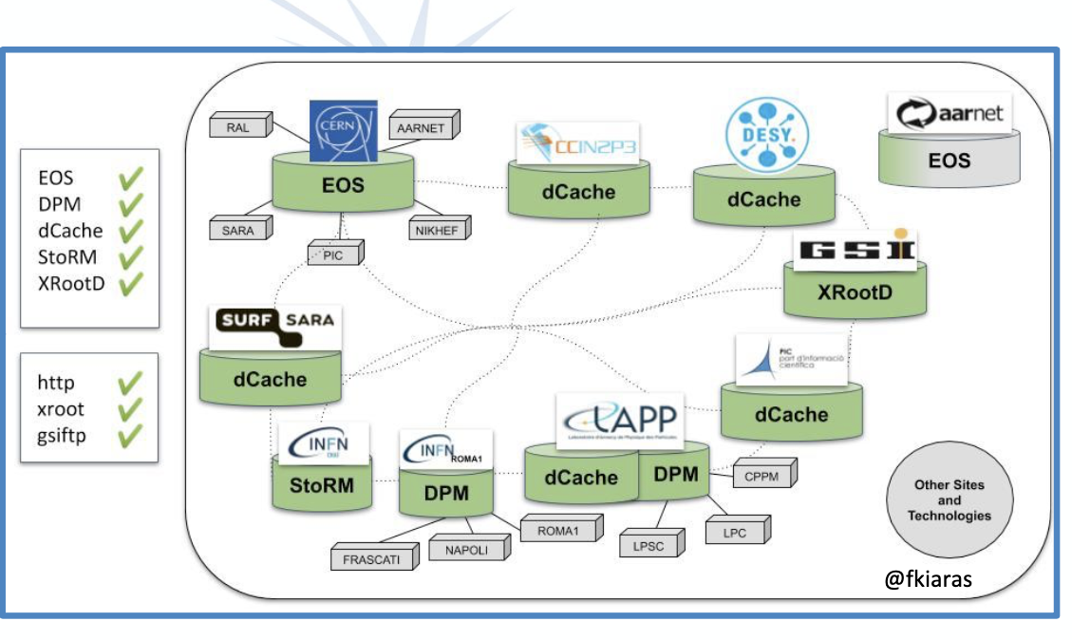
Data Lake status
In progress: data injection and replication demonstrators, soon followed by pipeline data analysis tests with LHC, CTA, LOFAR, LSST, SKA, Virgo.

Slide 9
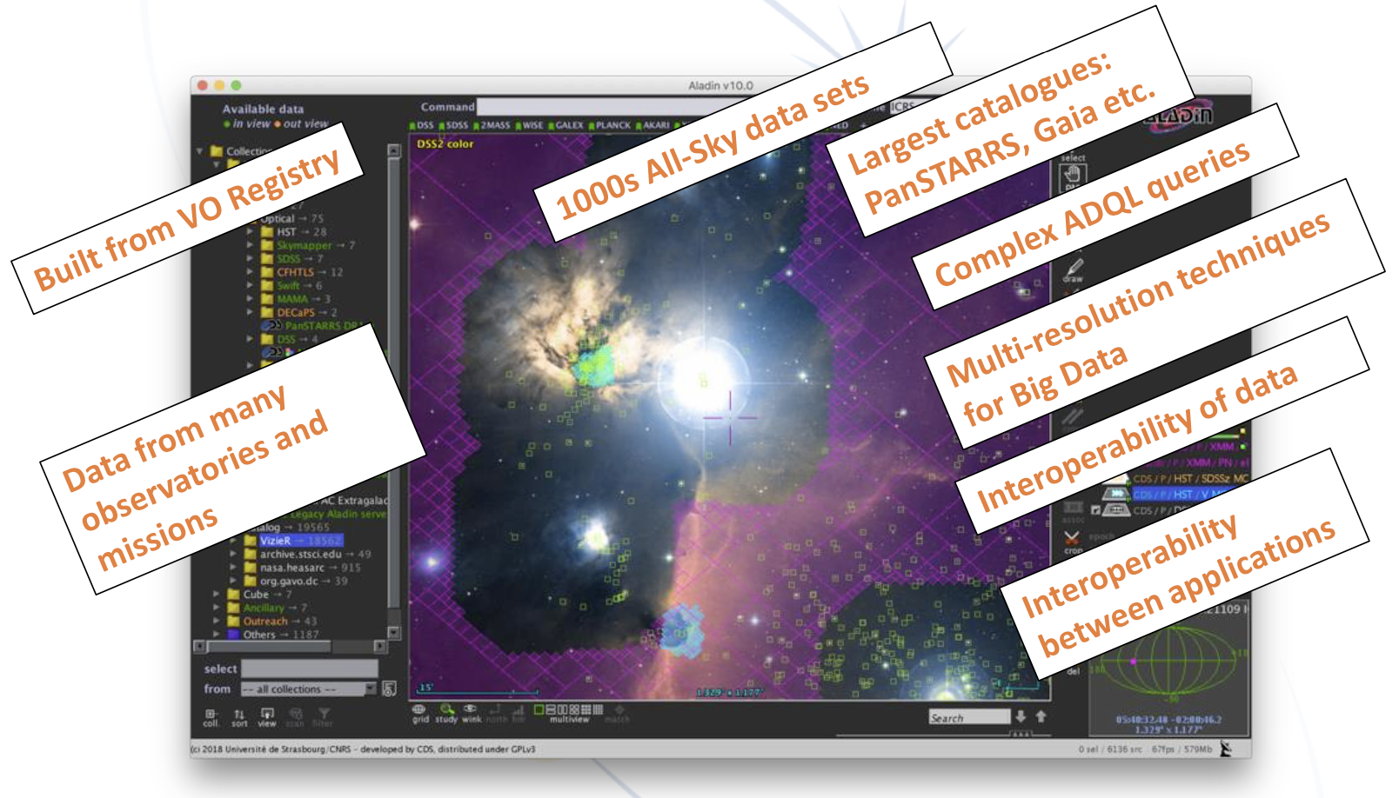
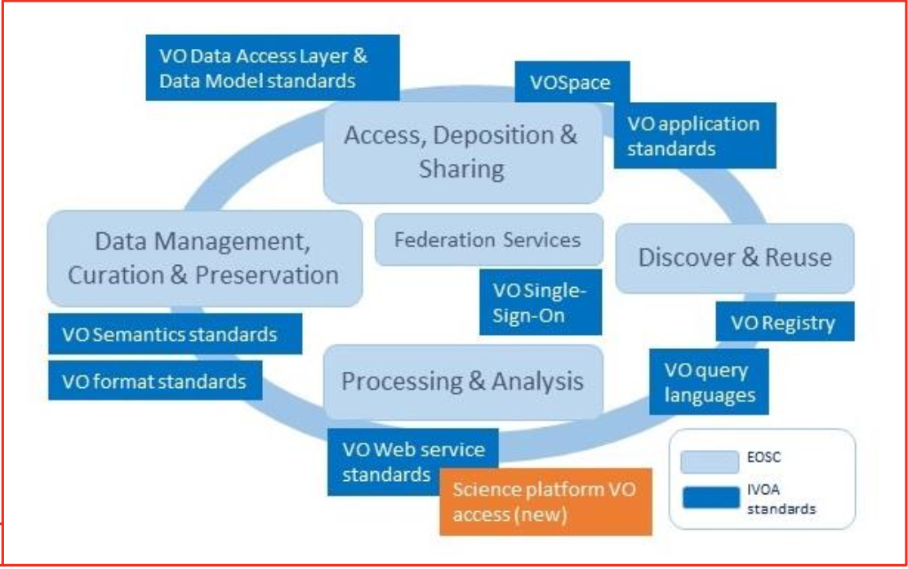
Virtual Observatory
ESFRI-VO-EOSC connection:
Map VO framework into EOSC
VO Registry in EOSC
Portfolio of Astronomy VO services
Contribution to EOSC hybrid cloud
Containerised domain-specific services
Training – interoperable data schools
Ensuring EOSC connects with VO and astronomy needs
7/10/20

Slide 10
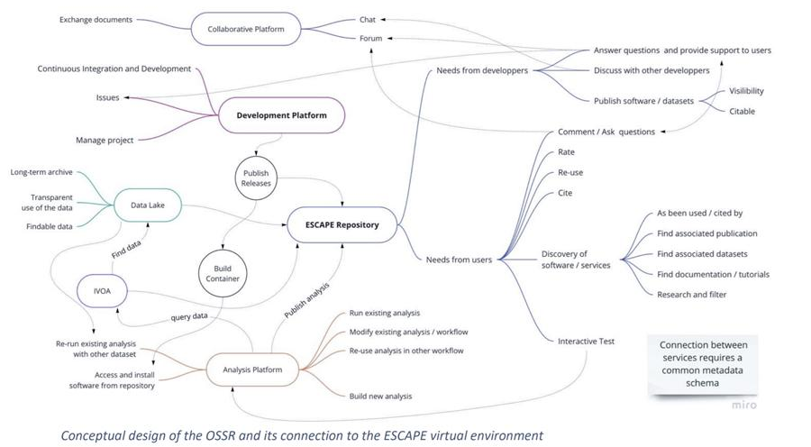
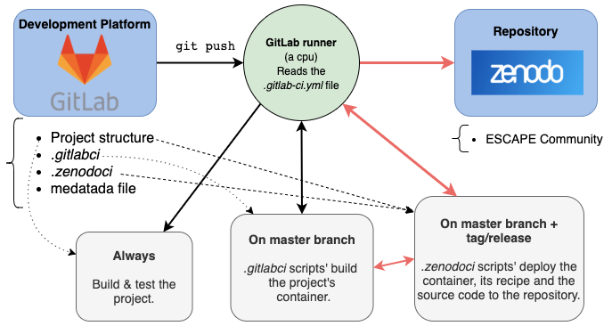
ESCAPE repository: building up a Virtual Research Environment
Aim: expose the tools of the ESCAPE ESFRI projects in a repository under the EOSC catalogue of services
Objectives:
  continuous development,
  deployment, exposure and preservation
  of software/tools/services
  interoperability, software re-use and cross-fertilisation
  open innovation environment for open standards,
  common regulation and shared (novel) software for
  multi-messenger & multi-probe data

Slide 11
Test Science Projects
TSPs are proposed to demonstrate multi-domain science integration across ESCAPE
  demonstrate new cutting edge open science capabilities, making use of the services implemented within ESCAPE
  feedback on the capabilities delivered by ESCAPE
  benefit real science goals in exploring synergies between the ESFRIs and largely among three scientific communities Astrophysics/Astroparticle, accelerator-based Particle and Nuclear Physics (supported by consortia of EU member states research agencies and institutes within JENAA)
A top-down endorsement for a bottom-up approach based on Expression of Interests (EoI) subscribed by researchers

Slide 12
Test Science Projects
Dark Matter TSP:
understand the nature of dark matter by collecting data, analysis pipelines and results from complementary astronomy, particle and nuclear physics sources on a broad platform that will be ultimately be hosted on the EOSC Portal.
exploit synergies and complementarities across different communities, creating a unique link between dark matter as a fundamental science question and the Open Science ESCAPE services needed to answer it.
Extreme Universe & Gravitational waves TSP:
do ‘frontier’ multi-messenger science to understand extreme matter and particle processes in strongly curved space-time.
combine astronomy and e-infrastructures and focus on data organisation
organise data from different wavelengths/messengers - and different types of extreme astrophysical transients (SNe, GRBs, FRBs, TDEs) - so that they can be easily gathered, analysed and modelled holistically, and not remain fragmented as present.
Linked to two corresponding JENAA EoIs
(with already about 1000 subscribed scientists)

Slide 13
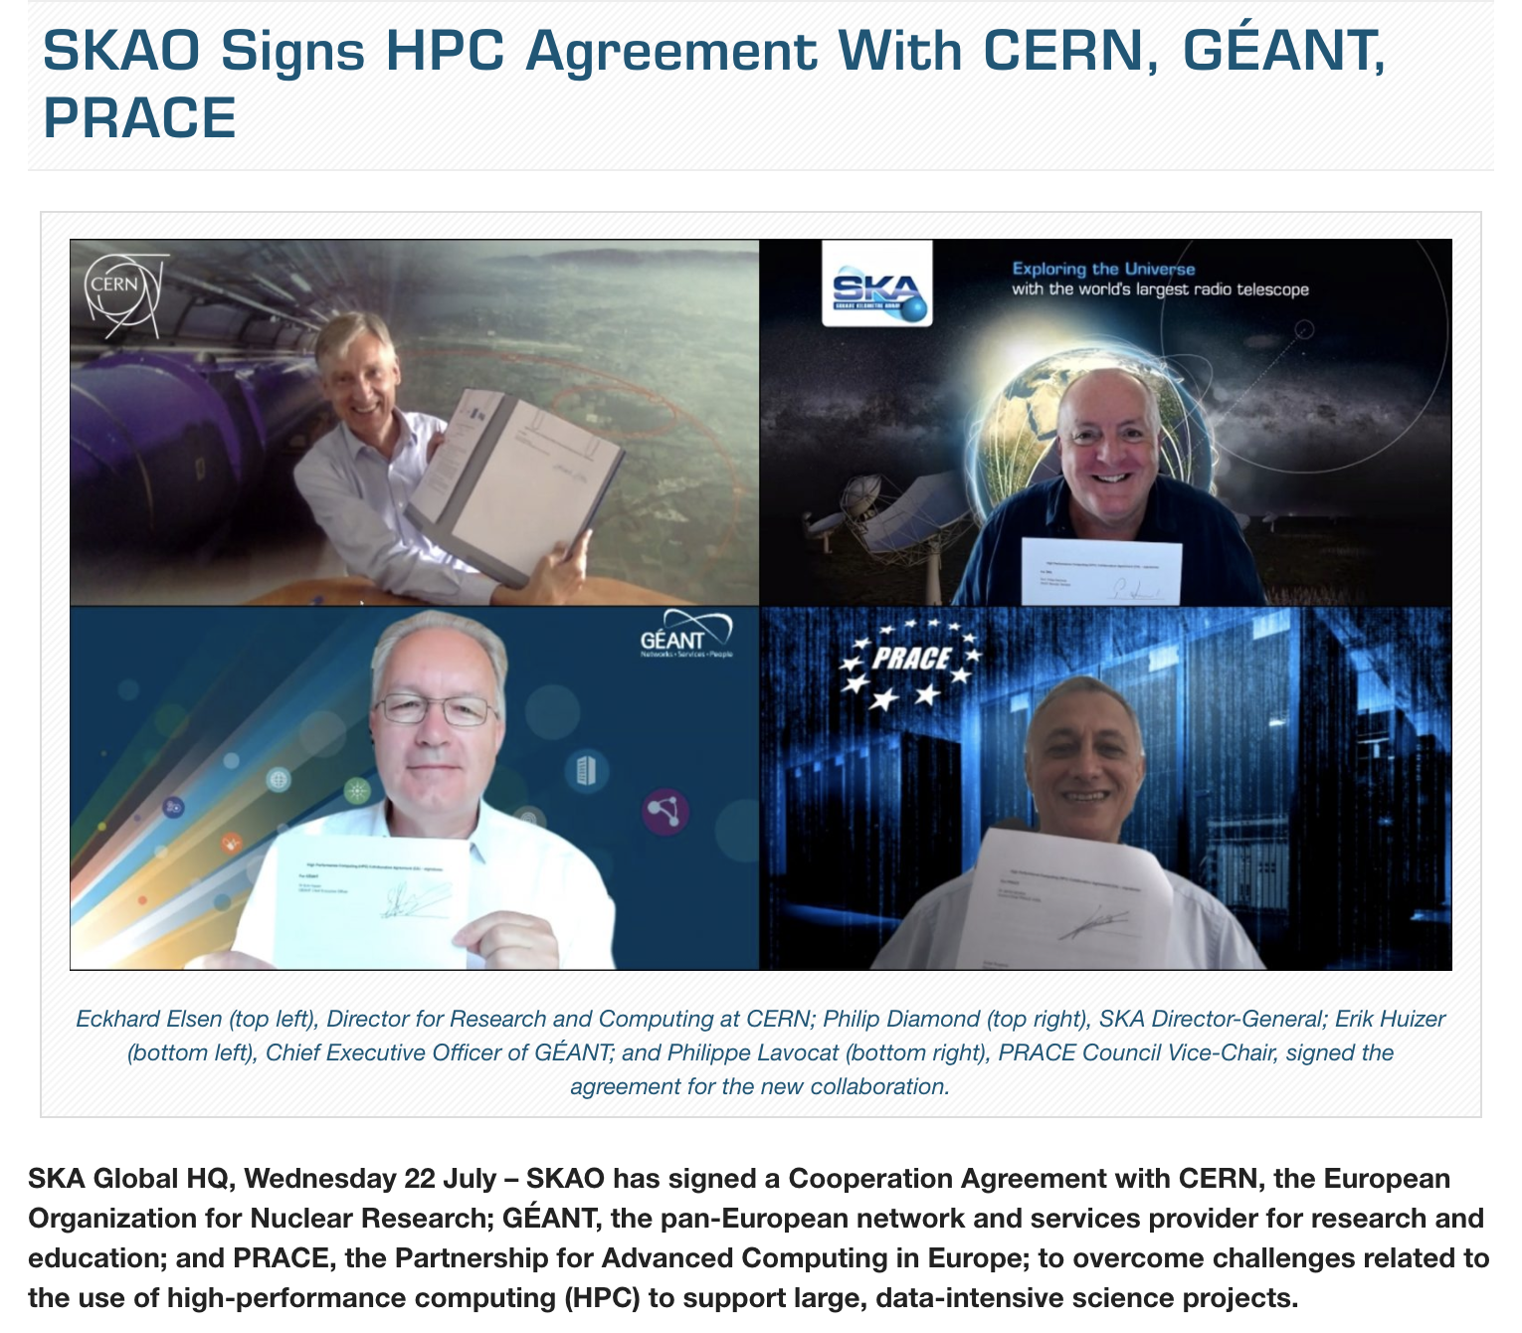
ESCAPE synergies
Part of ESCAPE work programme is to work with PRACE and GÉANT
Recent agreement is aligned with ESCAPE goals
ESCAPE will collaborate on demonstrators and common aspects
  e.g. AAI, data delivery to PRACE

Slide 14












ESCAPE synergies
Explore, plan and support potential ESCAPE industrial engagement
Co-developments with digital SMEs, e.g.
  Wavefier: real-time Classifier for transient signals in Gravitational Waves
  Gamma-Learn: real-time machine learning pipeline for Gamma-ray astronomy
IDEFICS project (Computing, Data and Businesses for Training and Innovation in Scientific Computing and for Society)
  Under the European Regional Development Fund programme, and French Regional Funds CNRS-LAPP has developed cooperation with networks of regional industrial companies, e.g. CIMES, USMBFond et al. (on data and digital uptake, deep learning training, co-developments, etc. )
Many industrial ICT cooperation schemes (within ESCAPE ESFRI RIs)
Outlook into the future (e.g. Horizon Europe) :
  ESCAPE community proposals for EOSC connections with the Common European Data Spaces.
  Industrial (manufacturing), health and skills data space
  Green deal and Energy data space

Slide 15

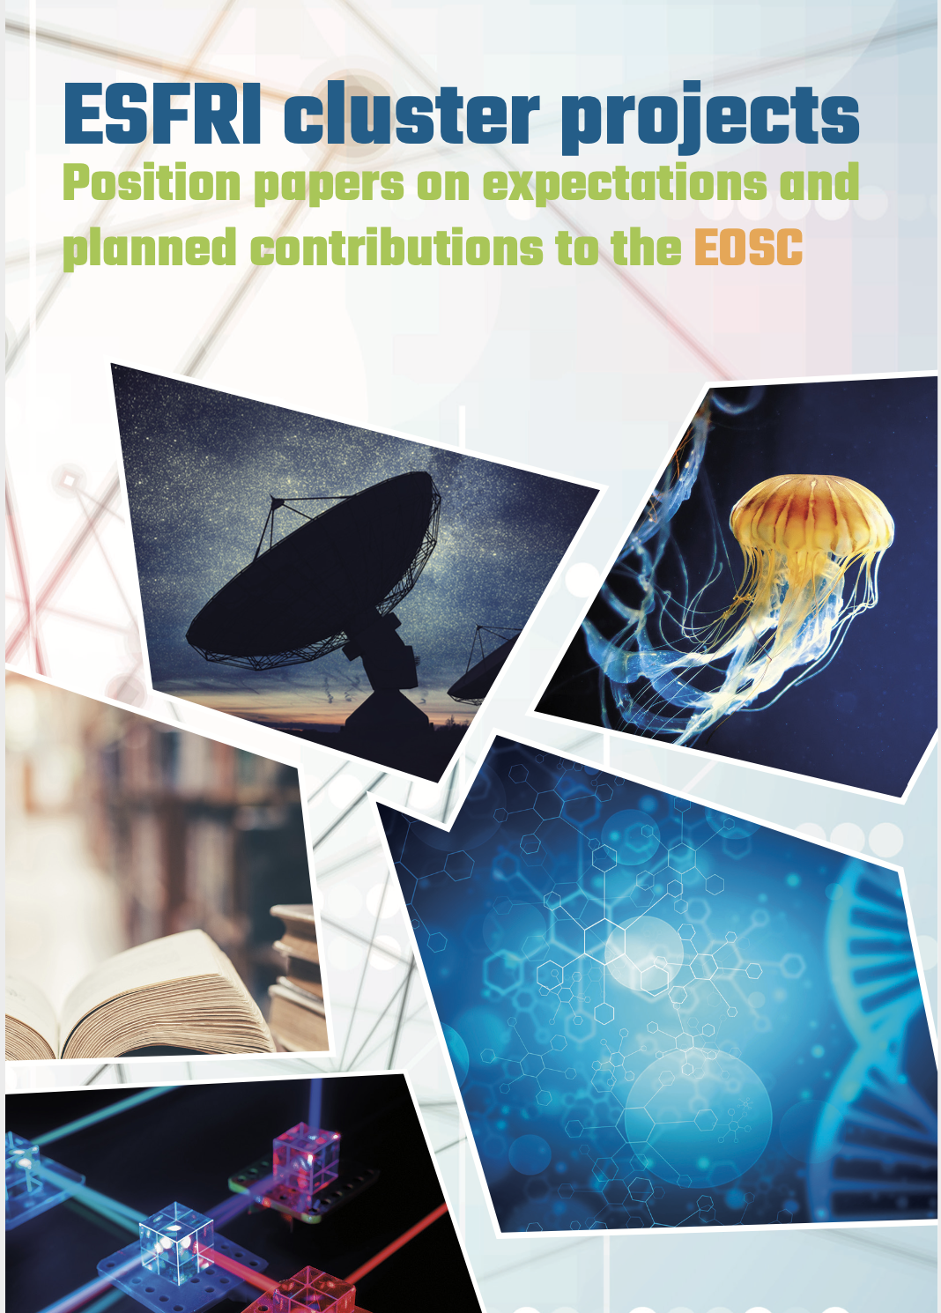
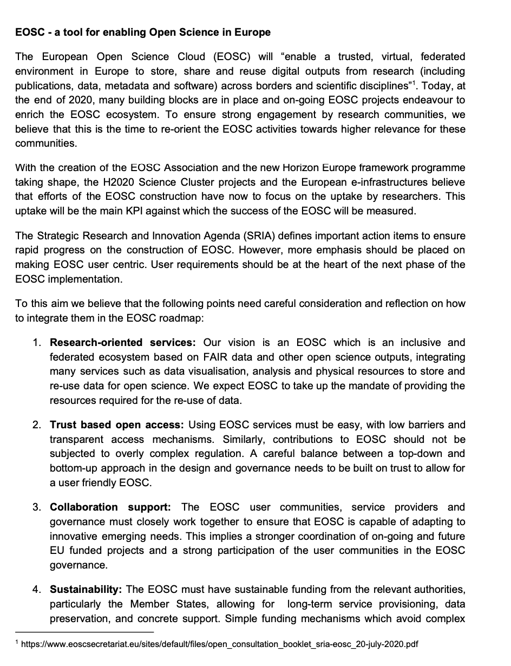




Broader synergies with other research clusters
https://zenodo.org/record/3675081#.X2R2PJNLhTY
https://zenodo.org/record/4044010#.X2oaYtaxVcs
Notes:
Here should emphasise common interests: base AAI infrastructure, share DMPs, share use cases; could also be kernel of EOSC technical steering group

Slide 16
Summary
ESCAPE brings together Astronomy, Astrophysics, Astro-Particle, High Energy and Nuclear Physics communities
  Common interests in Exabyte-scale FAIR data management and open science
  Objectives are science-driven (multi-messenger/multi-probe key approach) as well as commonality and synergies across infrastructure, services and tools.
Broader synergies within a large scientific community and for innovation/society
  Test Science Projects (TSP) to enhance researchers commitment in Open Science and building EOSC by focusing on transdisciplinary scientific objectives
  Committing in and leveraging ESCAPE for industrial engagement in the future
Broader synergies with the other ESFRI science cluster projects
  All acting in concert towards the EOSC – aligned goals and common interests across a broad range of European Research actors

