Slide 2
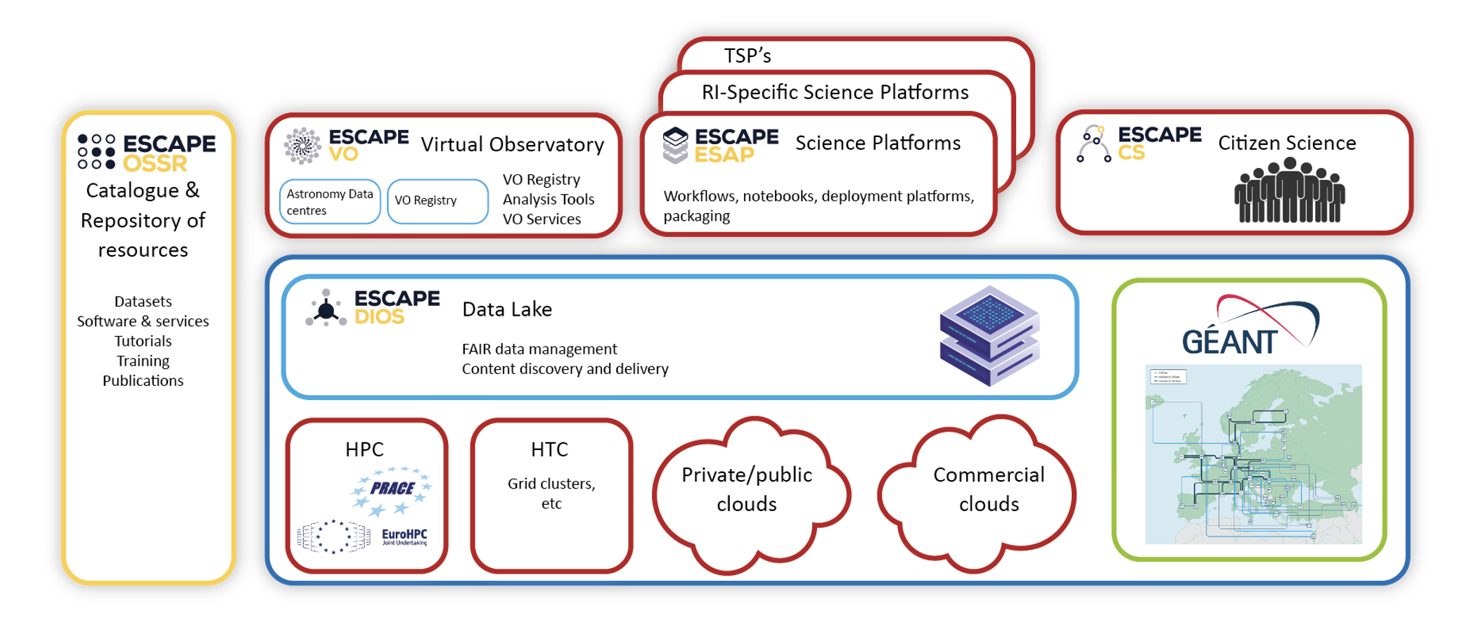
ESAP in the ESCAPE Cluster

Slide 3
What I talk about when I talk about science platforms
Access and share your data and results
Work with advanced analysis tools
Integrate with a wide variety of other services
Logo credits to upstream projects

Slide 4
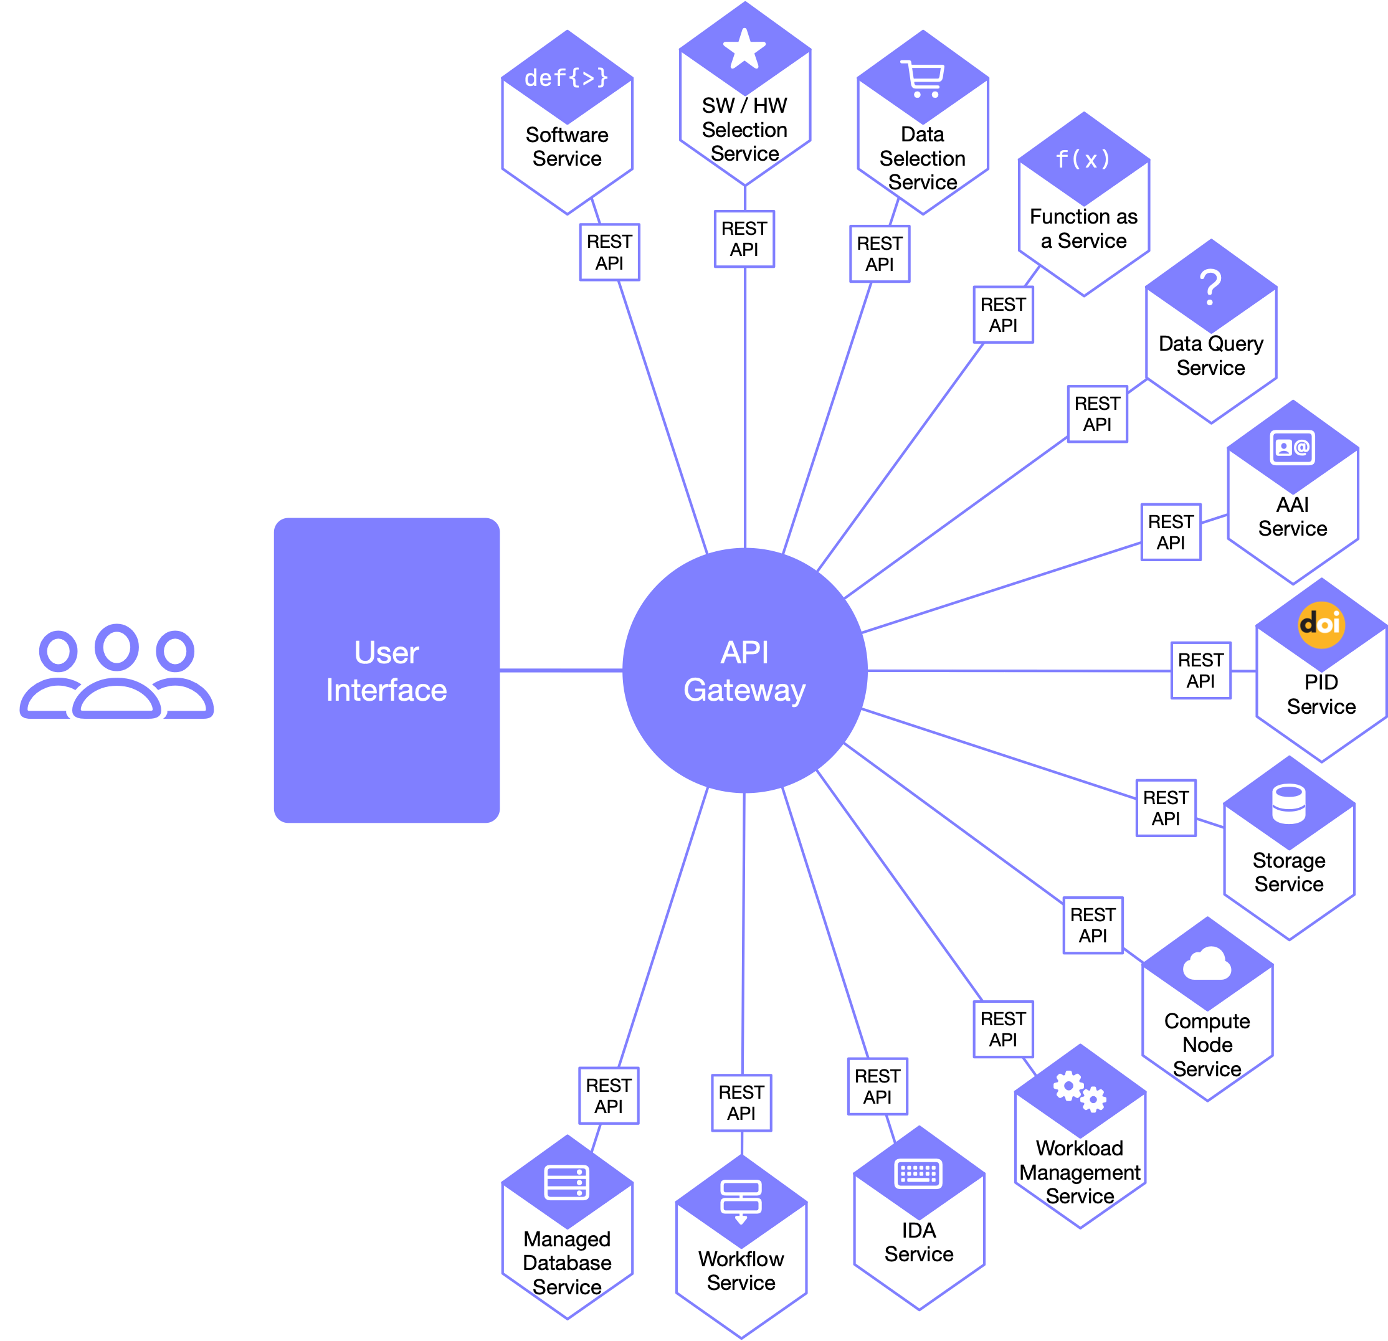
ESAP: The Service Hub
A focal point for integrating diverse services which are drawn from other providers.
Two core components:
Web UI;
API Gateway.
At the heart of a range of pluggable, independent services.
Designed to be robust & extensible.

Slide 5
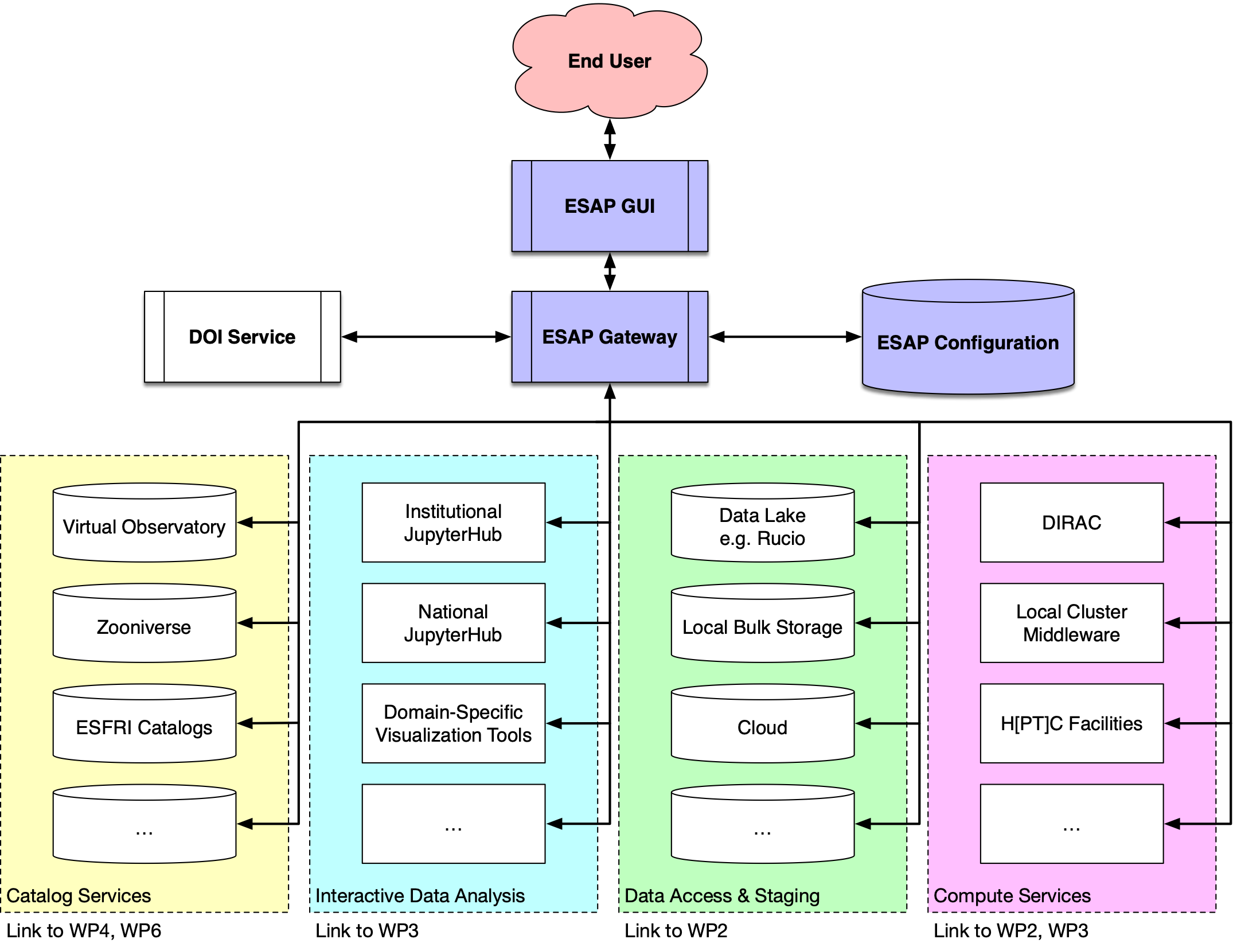
ESAP and ESCAPE Services
ESAP makes connections across the various services that the ESCAPE project has been building...
...and integrates with other services developed elsewhere.
ESAP ships with a collection of plugins that integrate with common services e.g. BinderHub, IVOA.
ESAP is a toolkit that RIs, projects, and other providers can use to build their own science platform
CEVO, CS
OSSR
DIOS
DIOS, OSSR

Slide 6
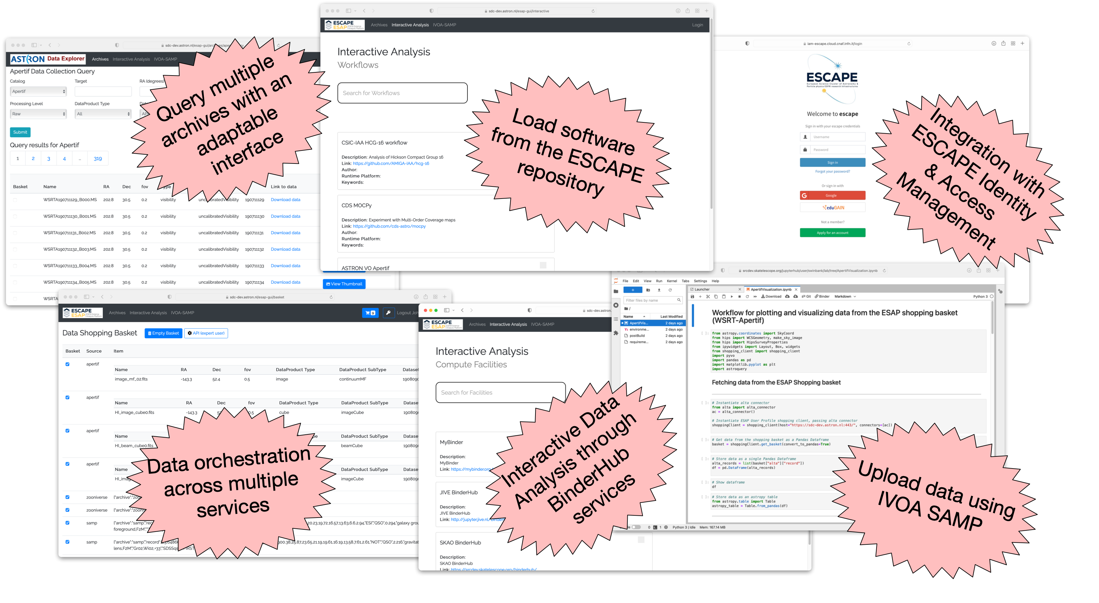
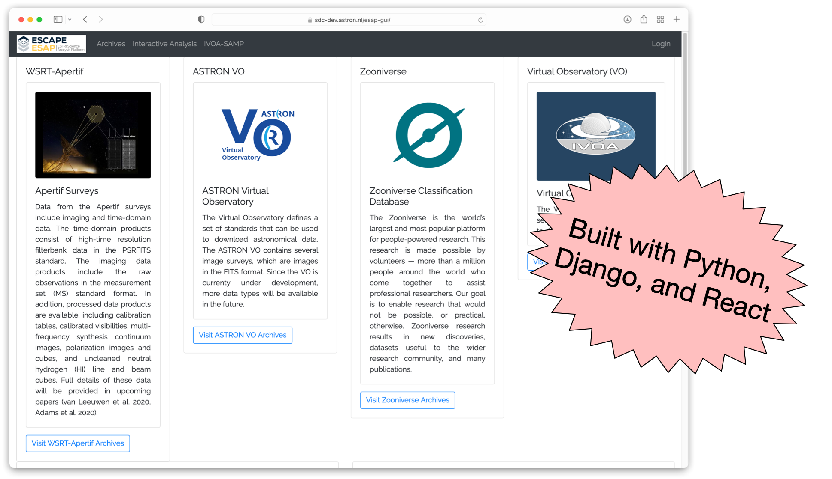
ESAP in action

Slide 7
Special Guest Stars
Gareth Hughes CTAO ESAP within CTAO and its data challenges
James Collinson SKAO ESAP within the SKA Regional Centre development effort

Slide 8
Future Plans

Slide 9
Technical Challenges & Opportunities
ESAP Technical Improvements:
Improved provenance tracking & robust PID support — and FAIRness?
Data sharing & collaborative workflows.
Persistent development & analysis environments.
Richer understanding of the semantics of and relationships between data products.
Federation between ESAP instances.
Sustaining ESAP:
Ongoing open source development and maintenance.
Safety and security.
Continued effort to integrate new ESFRI services as they become available.
The core of a virtual research environment.
Common standards:
Move beyond the current explosion of bespoke science platforms to common standards and platforms that provide federated access to compute, analysis, archive etc services.
Build relationships with platforms from other major projects, e.g. Vera C. Rubin Observatory.
A “Virtual Observatory” for science platforms?

Slide 10
References
ESCAPE:
https://www.projectescape.eu
ESAP Installation & Deployment:
https://git.astron.nl/astron-sdc/escape-wp5/esap-deployment
ESAP documentation:
https://git.astron.nl/astron-sdc/esap-api-gateway/-/wikis/home
WP5 code repositories:
https://git.astron.nl/astron-sdc/escape-wp5
Issues and outstanding work:
https://git.astron.nl/groups/astron-sdc/escape-wp5/-/issues

