Slide 1
ESCAPE Citizen Science overview
Stephen Serjeant, for: Rita Meneses, James Pearson, Hugh Dickinson, Luigi Colucci, Maud Coppel
ESCAPE Webinar, 5th December 2022

Slide 2
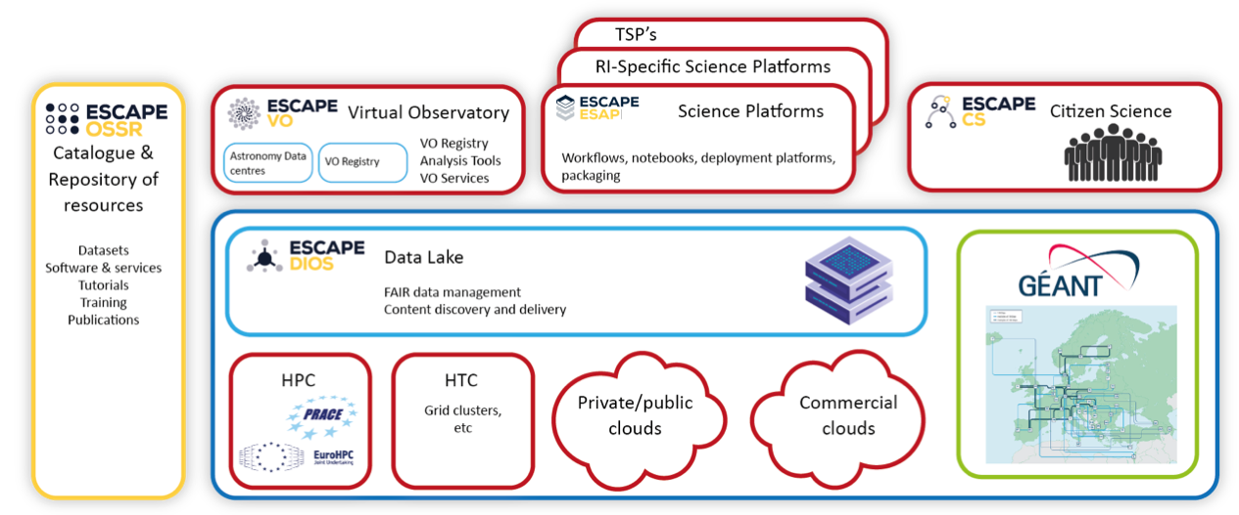
Improve access to data and tools through citizen science crowdsourcing experiments for most of the facilities in the ESCAPE remit.
Based on slide by G. Lamanna

Slide 3
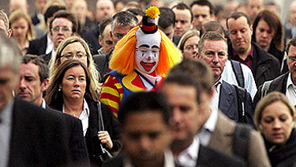
newsbiscuit.com

Slide 4
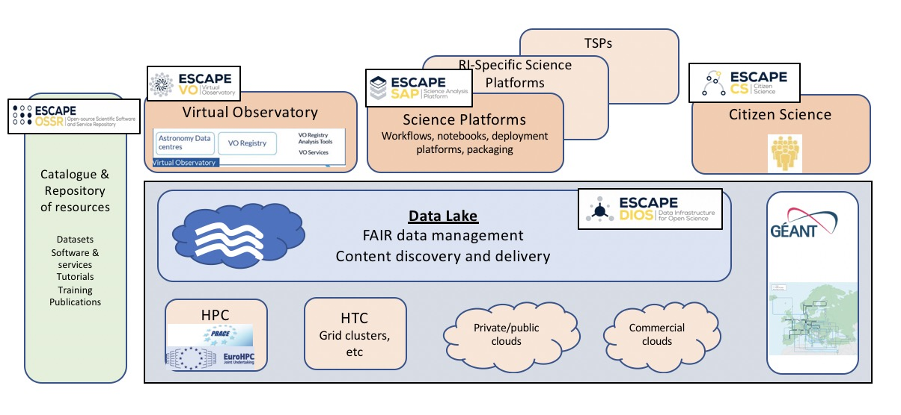
Based on slide by G. Lamanna

Slide 5
Based on slide by G. Lamanna

Slide 6
Based on slide by G. Lamanna

Slide 7
Based on slide by G. Lamanna

Slide 8
?
Based on slide by G. Lamanna

Slide 9
ESCAPE Citizen Science Roadmap:
Citizen Science Demonstrators:
  Open the science related ESFRIs (and their pathfinders/precursors) to the general public by creating, managing and operating a harmonised suite of mass participation experiments for these facilities
  Develop/adapt machine-learning tools for deciding when subjects are well characterised and for volunteer classification reliability
  Create embedded educational resources
  Create online forums for two-way dialogue with professional scientists, for participant volunteers to take their interest further, improving transparency of the scientific process.

Slide 10
ESCAPE Citizen Science Roadmap:
Legacy resources:
  Notebook and documentary materials demonstrating web-interface based and programmatic (scriptable) Zooniverse project management including project and workflow creation, subject creation and upload, adding training and feedback to subjects,
  Notebook and documentary materials demonstrating integration with the Zooniverse’s Caesar engine for advanced aggregation and efficient subject retirement.
  Notebook demonstrating how to integrate Zooniverse projects with existing machine learning frameworks and combine volunteer classifications with machine learning predictions.
  Notebook and documentary materials demonstrating how to set up an active learning framework to continuously train machine learning models using volunteer classifications of optimally selected subjects.

Slide 11

Science-inclined
public
⇌
Experts

Slide 12
KM3NeT:
  REINFORCE project, Gwenhaël de Wasseige
SKA: Pathfinder LOFAR:
  Radio Galaxy Zoo LOFAR, Martin Hardcastle
Vera Rubin LSST:
  Precursor Subaru HSC: Galaxy Zoo Comic Dawn, James Pearson
  Precursor SuperWASP: SuperWASP Black Hole Hunters, Hugh Dickinson
  Precursor SDSS: Galaxy Zoo Clump Scout, Hugh Dickinson
Managing citizen science from ESAP:
  Hugh Dickinson and James Pearson

Slide 13

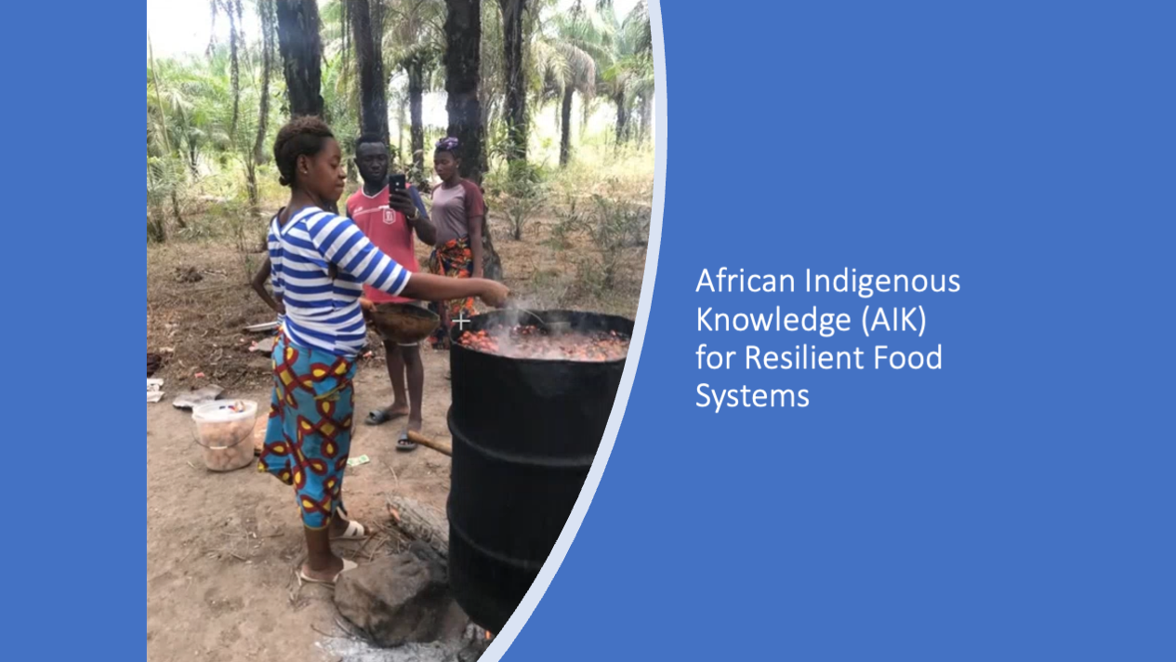

Slide 14
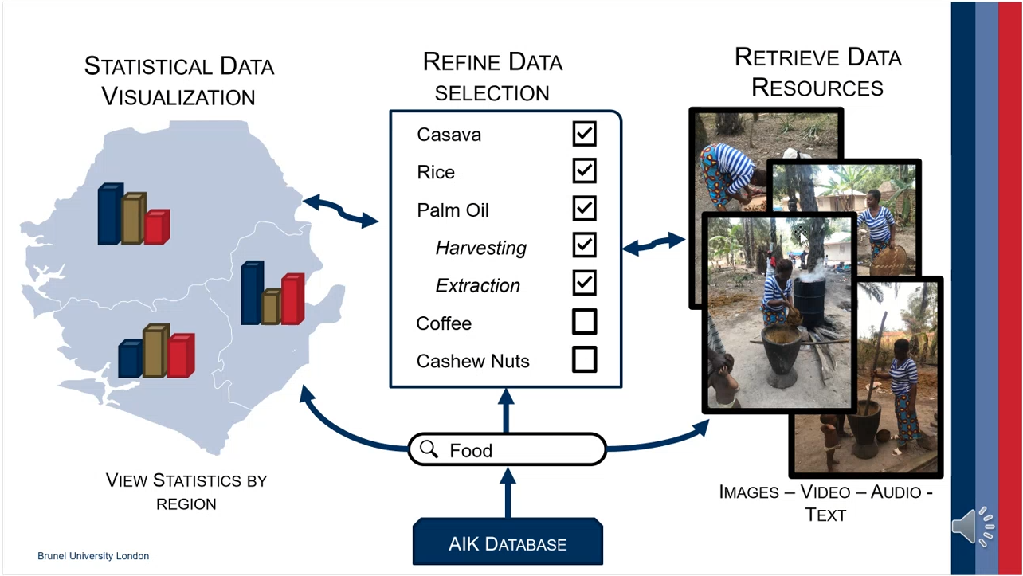
African Indigenous Knowledge (AIK)
Notes:
Aim & Expected Outcomes:
Exploring the potential of the STFC’s data science and citizen science expertise to develop an interactive, digital, open infrastructure that pulls together African indigenous agriculture and food systems data from multiple sources.
Transformative innovation in the food system, creating a fundamental shift in the way the UK and local governments support sustainable, modern food production efforts in Africa.
Want to ask volunteers to identify things in images: foods, whether they're being harvested or extracted, etc. Could use the mobile phone version of Zooniverse so that those in Sierra Leone and places with limited internet can participate (and those with little internet experience).

Slide 15
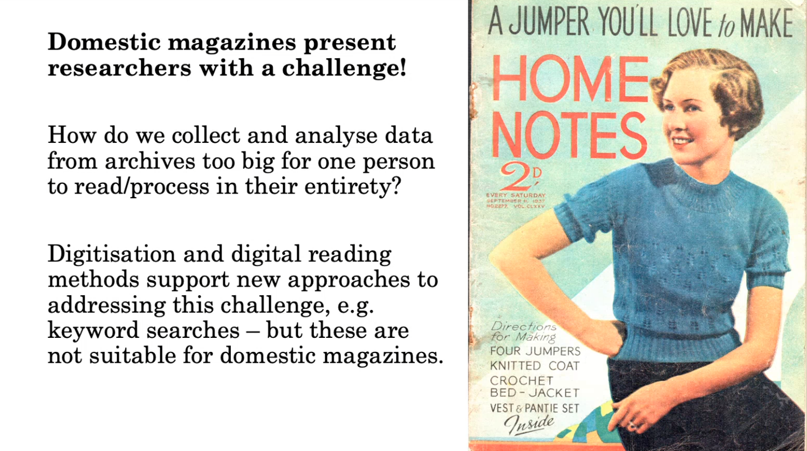
Knitting Patterns in Domestic Magazines
Notes:
Dataset:
Scanned domestic magazines from the Knitting & Crochet Guild’s (KCG) Collection.
Knitting & Crochet Guild’s (KCG) Collection: This guild is a charity dedicated to the study and practice of knitting and crochet in the UK. Its collection is the largest in the UK, and attracts a global community of makers, researchers, and enthusiasts.
Large quantity of information to classify: Woman’s Weekly alone has 2080 issues over a forty-year period, each containing 30-60 pages.
Alternatives to citizen science, such as digitisation and digital reading methods, support new approaches to addressing this challenge (e.g. keyword searches), but these are not suitable for domestic magazines:
Many are still in copywrite, so few are digitised.
A lot of information is visual – pictures of jumpers, etc.
Project Benefits:
It will test the feasibility of crowdsourcing for collecting data from magazines containing both written and visual information that, if successful, could be used to classify a much wider range of content.

Slide 16
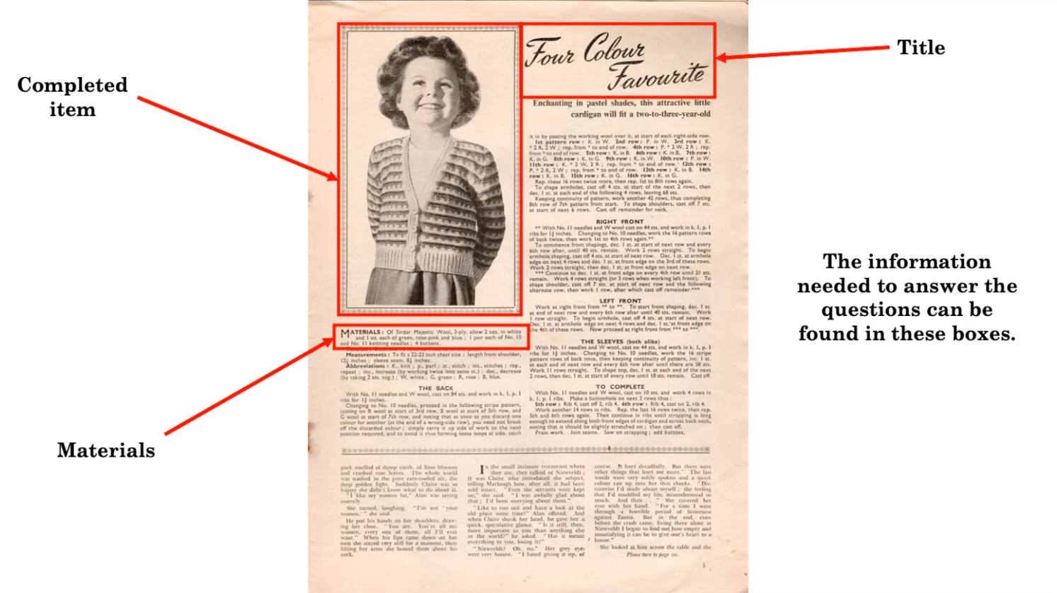
Knitting Patterns in Domestic Magazines
Notes:
Led by Dr Ellie Reed (Brunel University)
Summary:
Characterising knitting and crochet patterns found in domestic women’s magazines (e.g. “Woman’s Weekly”) printed in Britain from 1900-1949.
Volunteers asked to answer questions about each knitted/crocheted item, such as the type of craft, type of item, materials used, and intended wearer.
Context and Reasoning:
Domestic magazine = a magazine targeting women with information about homemaking and personal matters. They provide knowledge about ordinary women’s daily lives. Typically contained guidance on a range of topics (cooking, cleaning, childcare, fashion, beauty, health, dressmaking, craft projects, fiction, adverts, problems page).
The patterns and items in domestic magazines provide a window into the social priorities of many women in the first half of the 20th century (e.g., the fashion, time, and money they have to spend).
Researching their role in the development of knitting:
Positioning knitwear at the forefront of women’s fashion.
Working to generate mass consumer base for yarn and pattern markets.
Putting the practice of knitting and crochet at the centre of women’s lifestyles and identities.
Vital role in the soaring popularity of knitting during this time.

Slide 17
With thanks to: Hugh Dickinson, James Pearson, Rita Meneses, Luigi Colucci, Maud Coppel

Slide 18
Where next for citizen science in EOSC?
What limits the take up of crowdsourced data mining in EOSC?
  Trust in the reliability? Skills at aggregating the data? Temptation just to pay Amazon MT?
  Seeing science results will help
  Seeing it work up close will help
  Build multi-disciplinary exemplar experiments following ESCAPE model
  Create worked examples of plug-and-play notebooks for running projects in EOSC
Improve integration with other EOSC services, eg VO, AAI, virtuous circle with ESAP ML (for large projects)
Open data standards in FAIRsharing.org?
Dedicated EOSC task force for citizen science?
Funding for ESAP platform for multi/inter-disciplinary citizen science?

Slide 19
