Slide 1
ESAP Within the SKA Regional Centre Development Effort
ESCAPE WP5/WP6 Webinar
5th December 2022
Dr. James Collinson
Operations Data Scientist

Slide 2
Overview
SKA Regional Centres (SRCs)
Capabilities to meet challenges of SKAO data
High level architectural vision
ESCAPE prototyping activities
Science platform and data lake for SKAO use cases
Bringing compute to the data
ESCAPE’s legacy within the SKAO
Current SRC Network prototyping activities
Other benefits: collaborators, cloud techs, best practices

Slide 3
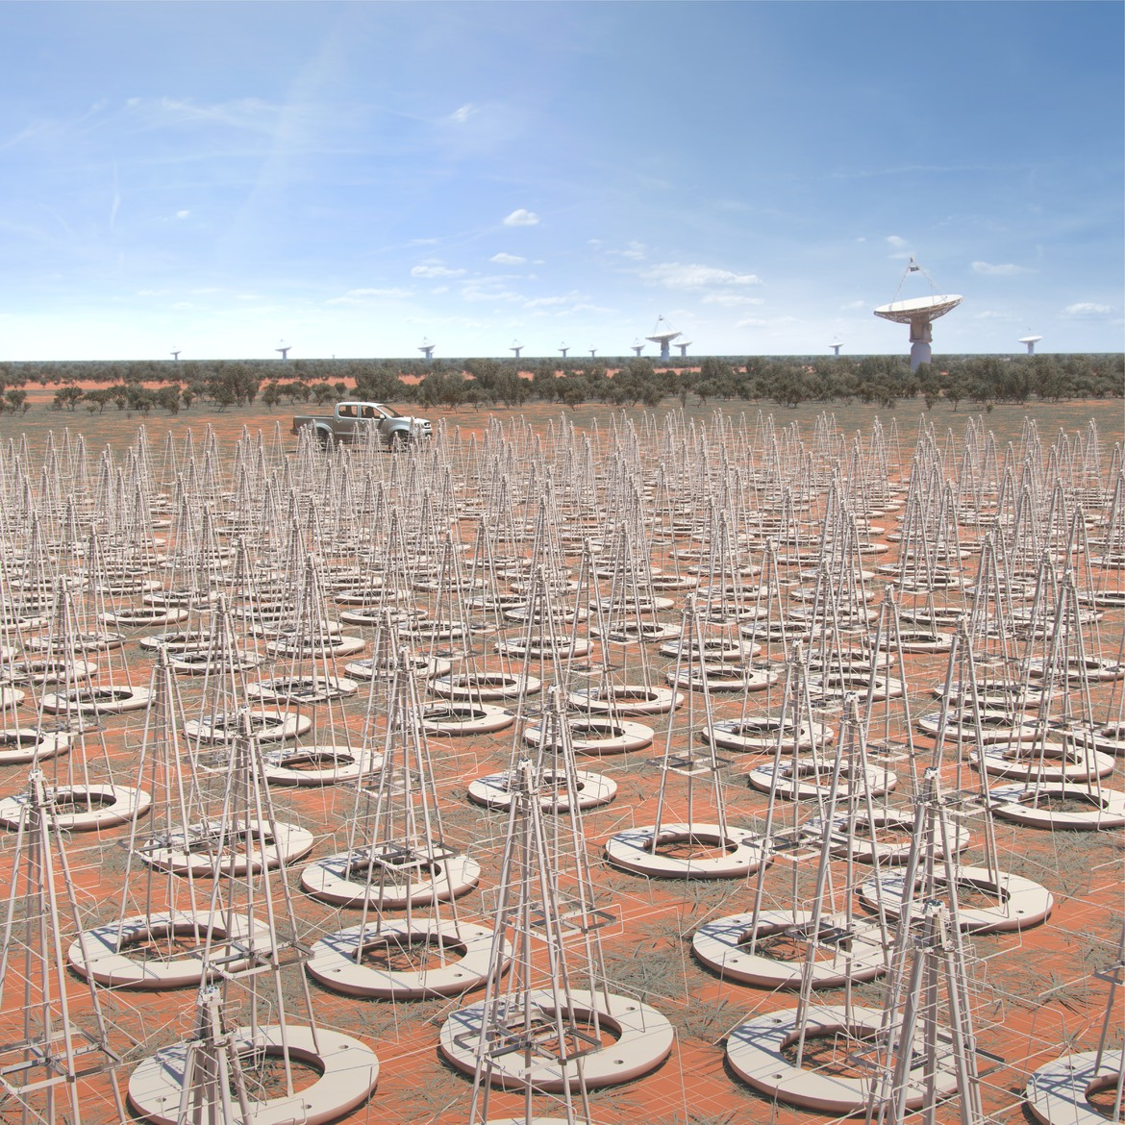
The SKA Project
SKA MID
Karoo, South Africa
197 dishes
0.35 - 15 GHz
65K frequency channels
SKA LOW
Murchison, Western Australia
133K antennas
50 - 350 MHz
65K frequency channels
Test systems already taking data. Main science programmes from ~2028/9. 50 year lifetime.

Slide 4
SKA Regional Centres: SKAO data processing stages
SKA Regional Centres
2 Pb/s
9 Tb/s
8 Tb/s
100 Gb/s
SKA LOW
SKA MID
20 Tb/s
9 Tb/s
100 Gb/s
* Data rates approximate

Slide 5
The SRC Vision
"To ensure that scientists can access SKA data products and use them to make discoveries"

Slide 6
SKA Regional Centre Capabilities
Science Enabling Applications
Distributed Data Processing
Analysis Tools, Notebooks,
Workflows execution
Machine Learning, etc
Computing capabilities provided by the SRCNet to allow data processing
Data Discovery
Visualization
Discovery of SKA data from the SRCNet, local or remote, transparently to the user
Advanced visualizers for SKA data and data from other observatories
Support to Science Community
Interoperability
Support community on SKA data use, SRC services use, Training, Project Impact Dissemination
Heterogeneous SKA data from different SRCs and other observatories
Data Management
Dissemination of Data to SRCs and Distributed Data Storage
Notes:
Data management at the heart of the capabilities.
Challenges include:
Storing SKAO data growing at up to 700 PBytes each year will be a challenge (plus user-generated data too).
Several million dollars per year in new data, for one copy
Global data management within SRCNet should enable best possible use to be made of available storage resource to avoid (reduce) unnecessary duplication
Support mirroring of popular data products to enhance user experience

Slide 7
SKA Regional Centre Capabilities
Science Enabling Applications
Distributed Data Processing
Analysis Tools, Notebooks,
Workflows execution
Machine Learning, etc
Computing capabilities provided by the SRCNet to allow data processing
Data Discovery
Visualization
Discovery of SKA data from the SRCNet, local or remote, transparently to the user
Advanced visualizers for SKA data and data from other observatories
Support to Science Community
Interoperability
Support community on SKA data use, SRC services use, Training, Project Impact Dissemination
Heterogeneous SKA data from different SRCs and other observatories
Data Management
Dissemination of Data to SRCs and Distributed Data Storage
Notes:
Data management at the heart of the capabilities.
Challenges include:
Storing SKAO data growing at up to 700 PBytes each year will be a challenge (plus user-generated data too).
Several million dollars per year in new data, for one copy
Global data management within SRCNet should enable best possible use to be made of available storage resource to avoid (reduce) unnecessary duplication
Support mirroring of popular data products to enhance user experience

Slide 8
SRC Logical View
Users
Science Platform
Interface (API layer)
Metadata query Science Data Discovery
Authentication
Who?
Permissions?
Data Logistics
Globally distributed storage sites
Compute Resource Management
Work sharing

Slide 9
SRC Logical View
Users
Science Platform
Interface (API layer)
Metadata query Science Data Discovery
Authentication
Who?
Permissions?
Data Logistics
Globally distributed storage sites
Compute Resource Management
Work sharing

Slide 10
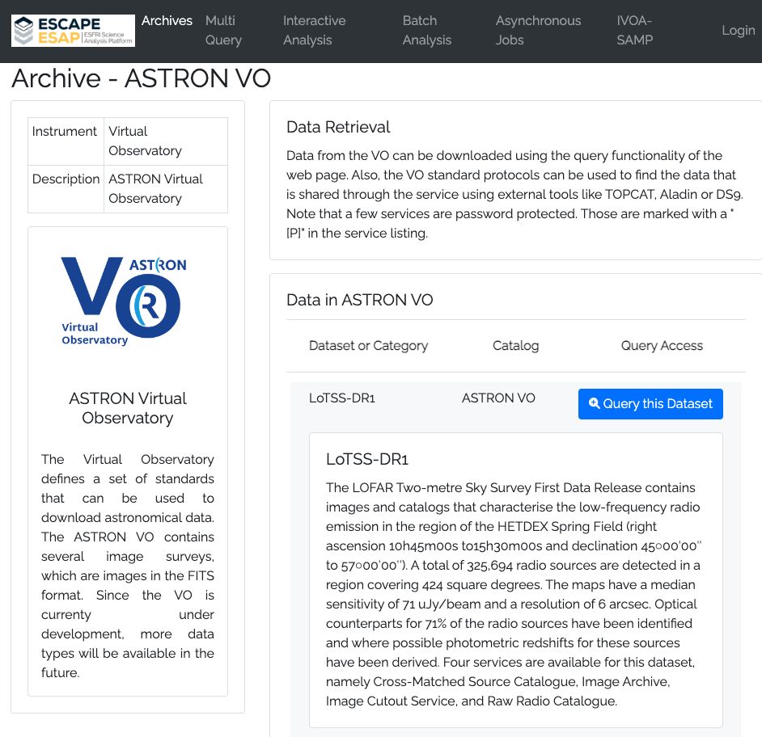
ESCAPE prototyping - SKAO
Precursor data archives in ESAP (thanks to ASTRON folks!)
Helps inform decisions on archive structure

Slide 11
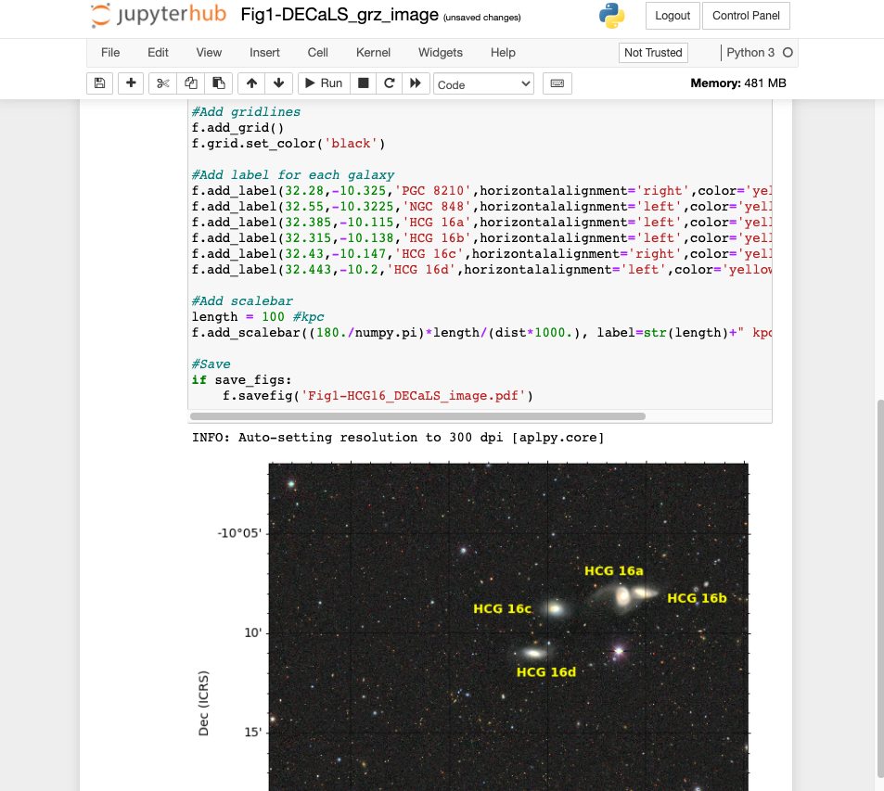
ESCAPE prototyping - SKAO
JupyterHub on STFC Cloud
Augmentations for SKA
Indigo IAM authentication
Persistent storage volumes
Binder service to dynamically build environments
Dask Gateway (WIP) – provision ephemeral compute clusters on demand

Slide 12
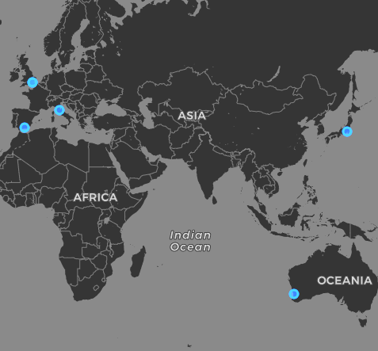
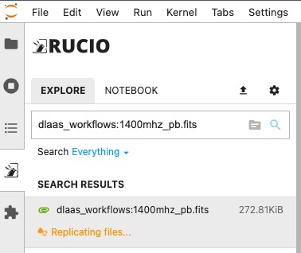
ESCAPE prototyping - SKAO
SKAO Rucio instance
RSEs at SKAO sites
Full mesh automated functional tests
Integrated with JupyterHub prototype - ‘datalake as a service’

Slide 13
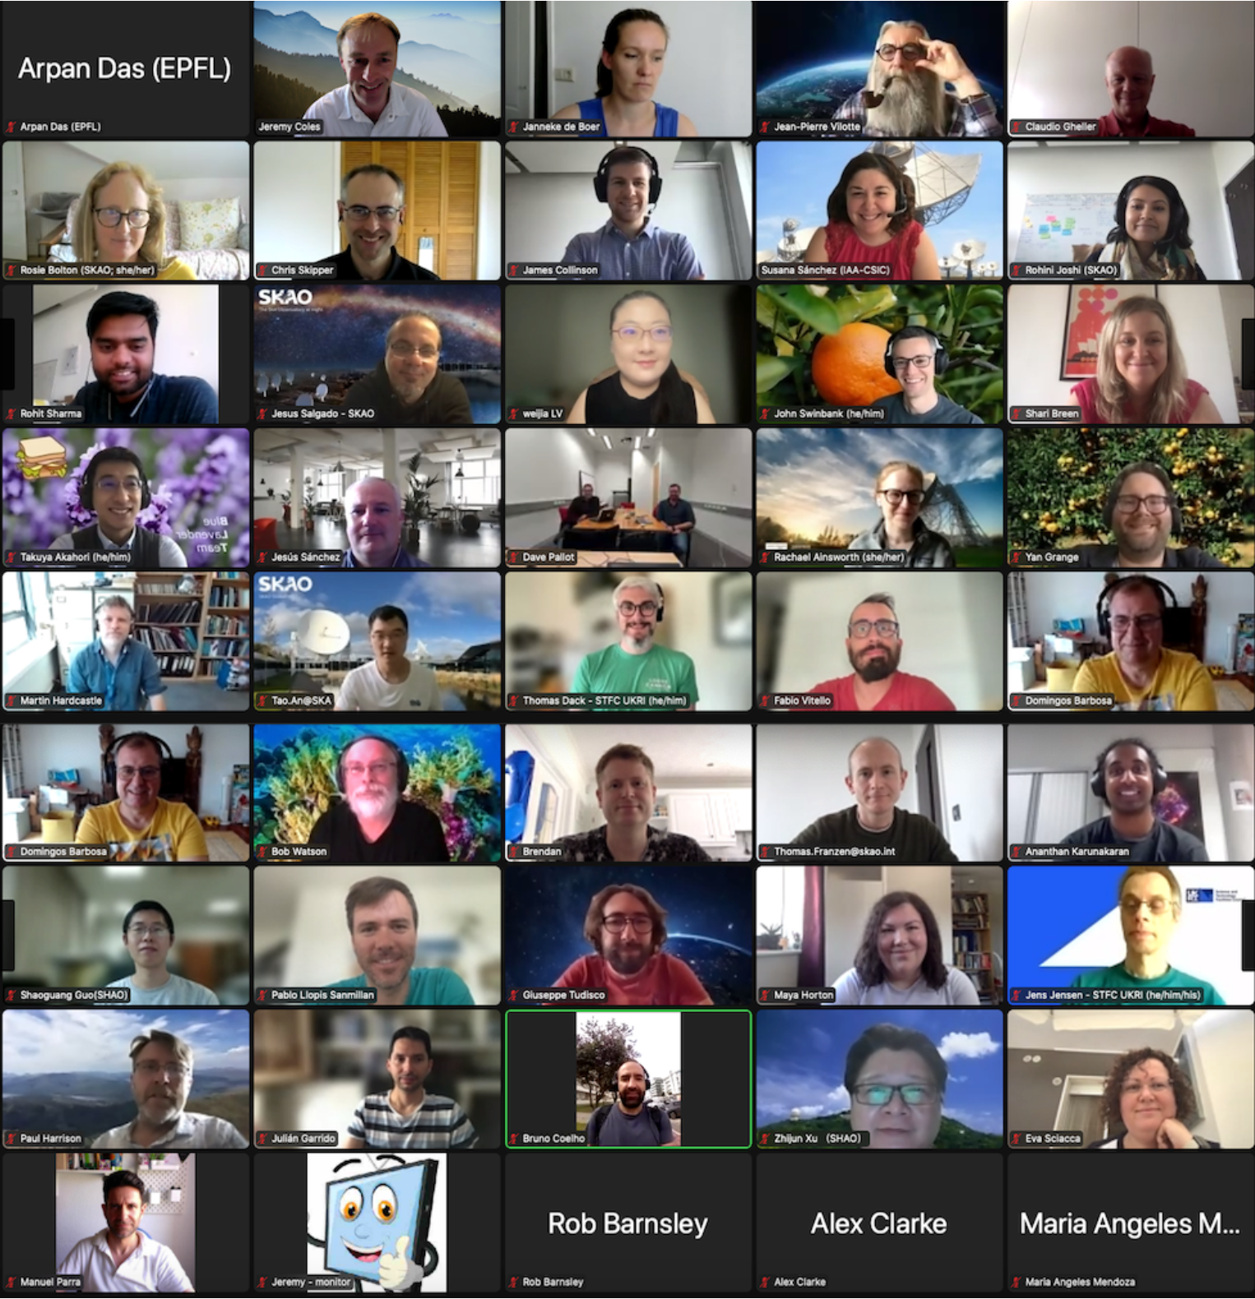
SRC Network Prototyping - 2022 onwards
Global team of development teams
12 countries plus SKAO
~1000 dev days every 3 months, set to grow
ESCAPE candidates further assessed include Rucio, ESAP, Indigo IAM
ESCAPE collaborations will continue!

Slide 14
SRC Network Prototyping - 2022 onwards
"Science Data Challenges" are a great way to engage community with SKA, and prototype Regional Centres are already supporting science teams
Science Data Challenge Support good use case for proto-SRC
Initial prototypes build towards Architecture review and implementation phase

Slide 15
Other Benefits of ESCAPE
Collaborations - experts in range of fields
A number of ESCAPE members are now involved in SRC prototyping (ASTRON, IAA)
Will continue to work with the contacts we have made (collaboration agreements with e.g. CERN/CTAO)
Service operations experience
Data lake ops
Kubernetes deployments
Automated integration testing

Slide 16
Thanks to all our collaborators!

