Slide 1
ESAP within
Cherenkov Telescope Array and its Data Challenges
Gareth Hughes
CTAO

Slide 2
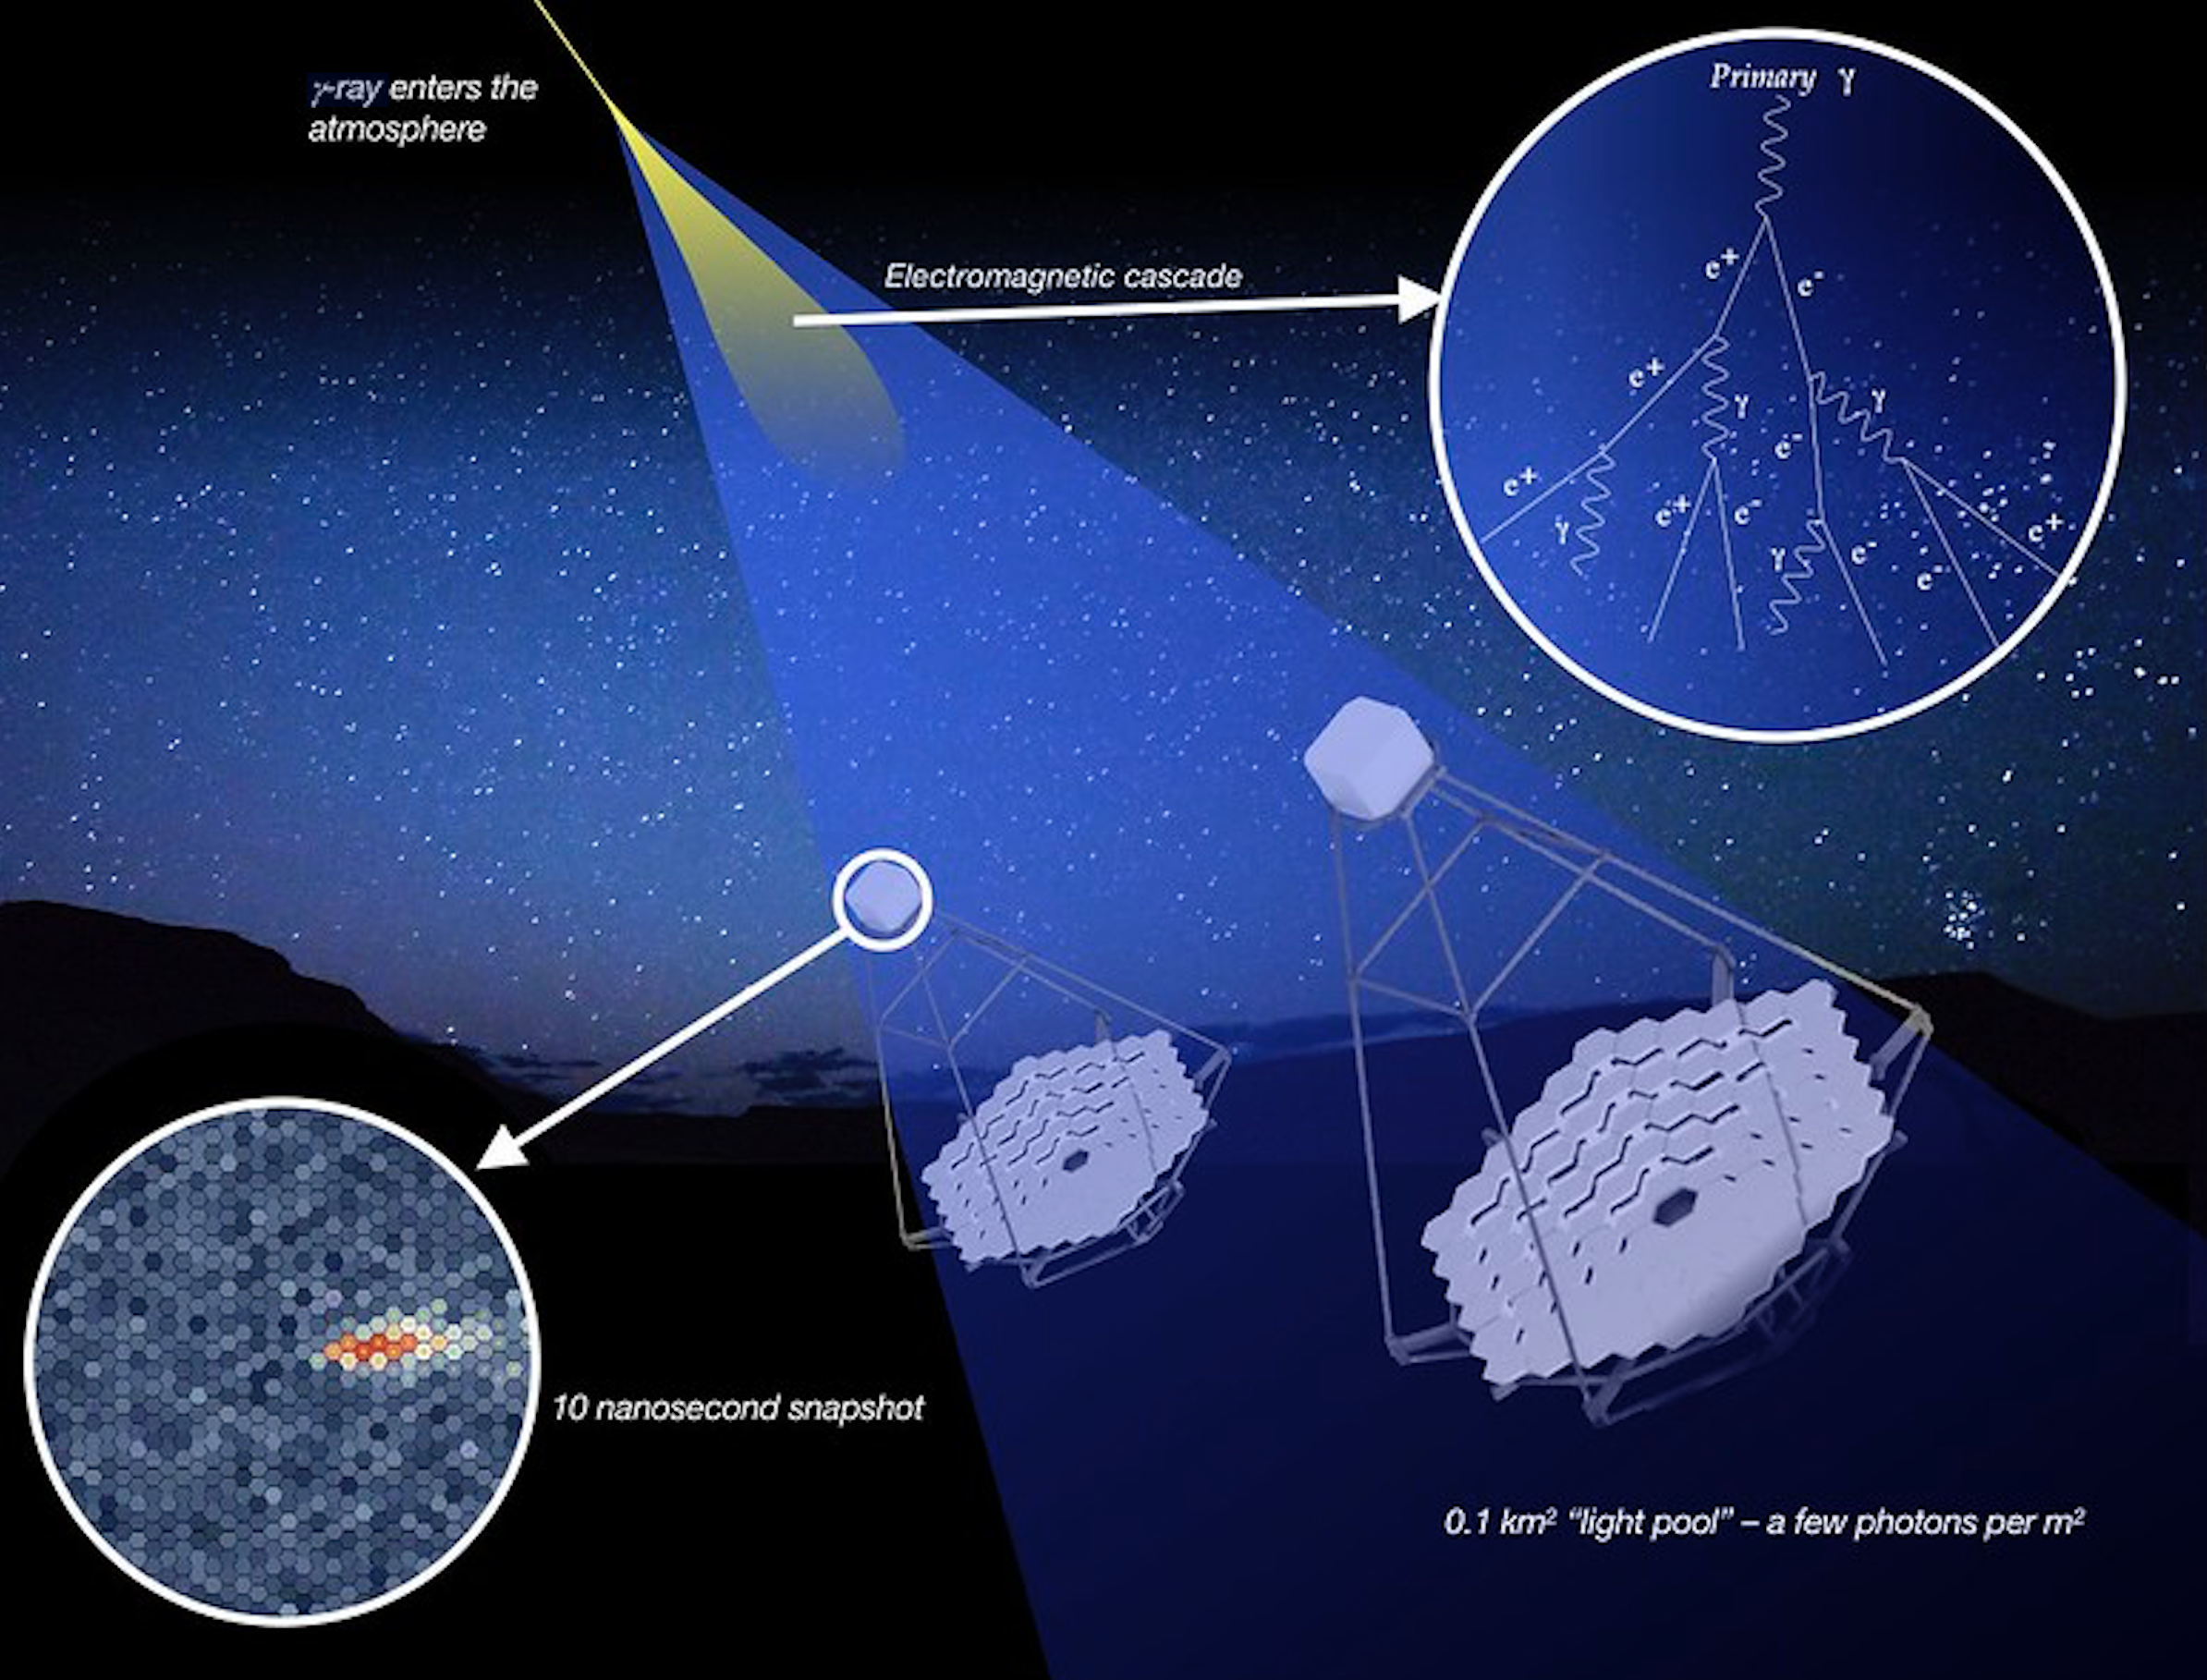
Atmospheric Gamma-ray Astronomy
Young field of Astronomy
  First attempted in 1960s
  First detected source in 1989 (Crab Nebula)
Gamma rays & cosmic rays create airshowers in the atmosphere
Secondary particles generate Cherenkov light
This light creates a brief feint flash of blue/UV light on the ground
If you collect and image this light onto a fast camera you can reconstruct the direction and energy of the primary particle

Slide 3
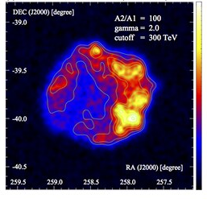
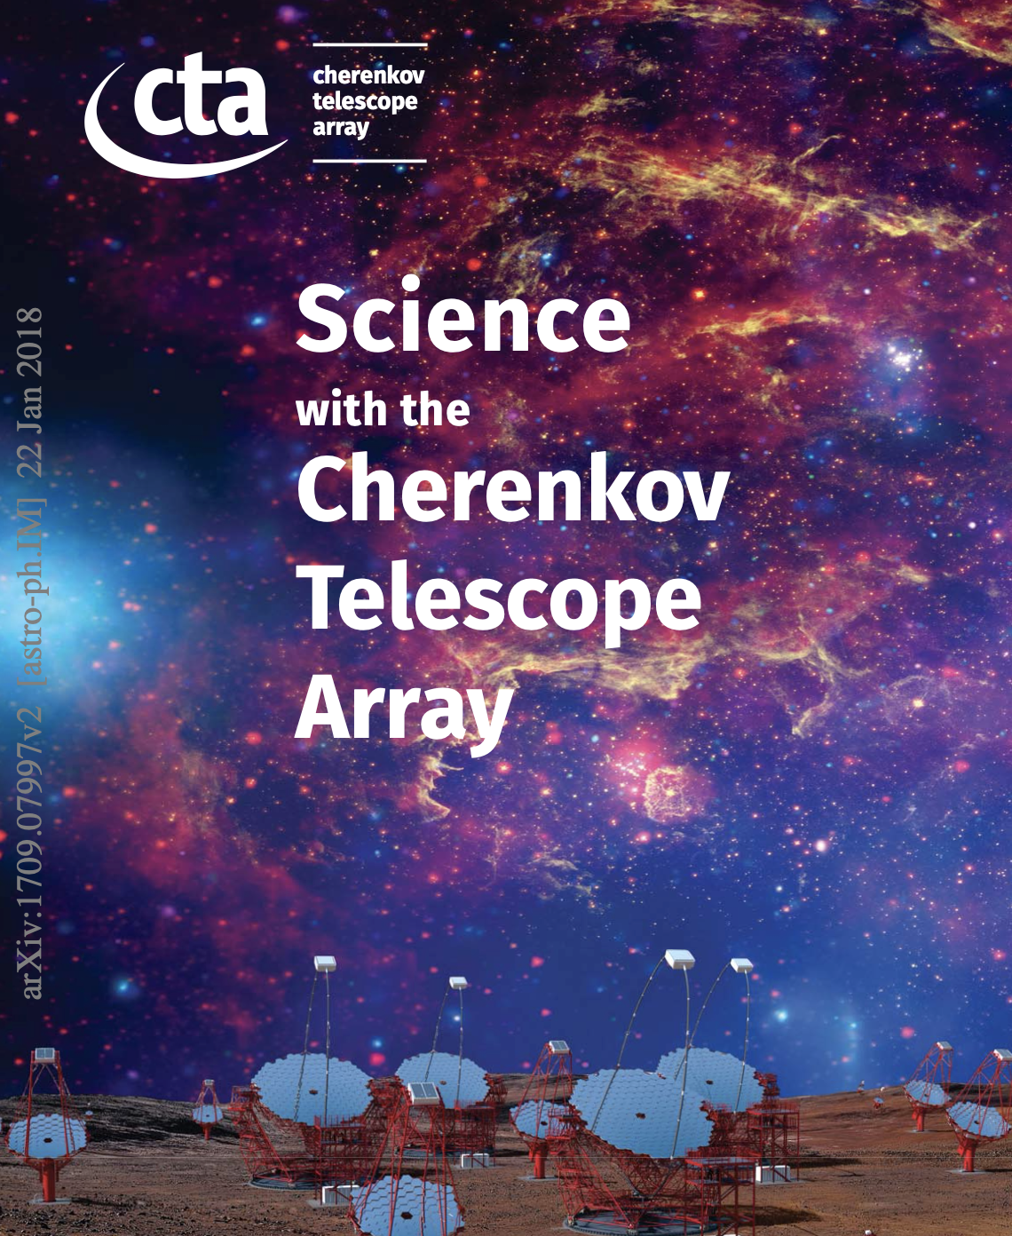
Atmospheric Gamma-ray Astronomy
Theme 1: Understanding the Origin and Role of Relativistic Cosmic Particles
  What are the sites of high-energy particle acceleration in the Universe?
  What are the mechanisms for cosmic particle acceleration?
  What role do accelerated particles play in feedback on star formation and galaxy evolution?
Theme 2: Probing Extreme Environments
  What physical processes are at work close to neutron stars and black holes?
  What are the characteristics of relativistic jets, winds and explosions?
  How intense are radiation fields and magnetic fields in cosmic voids, and how do these evolve over cosmic time?
Theme 3: Exploring Frontiers in Physics
  What is the nature of dark matter? How is it distributed?
  Are there quantum gravitational effects on photon propagation?
  Do axion-like particles exist?
https://arxiv.org/abs/1709.07997

Slide 4
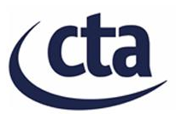
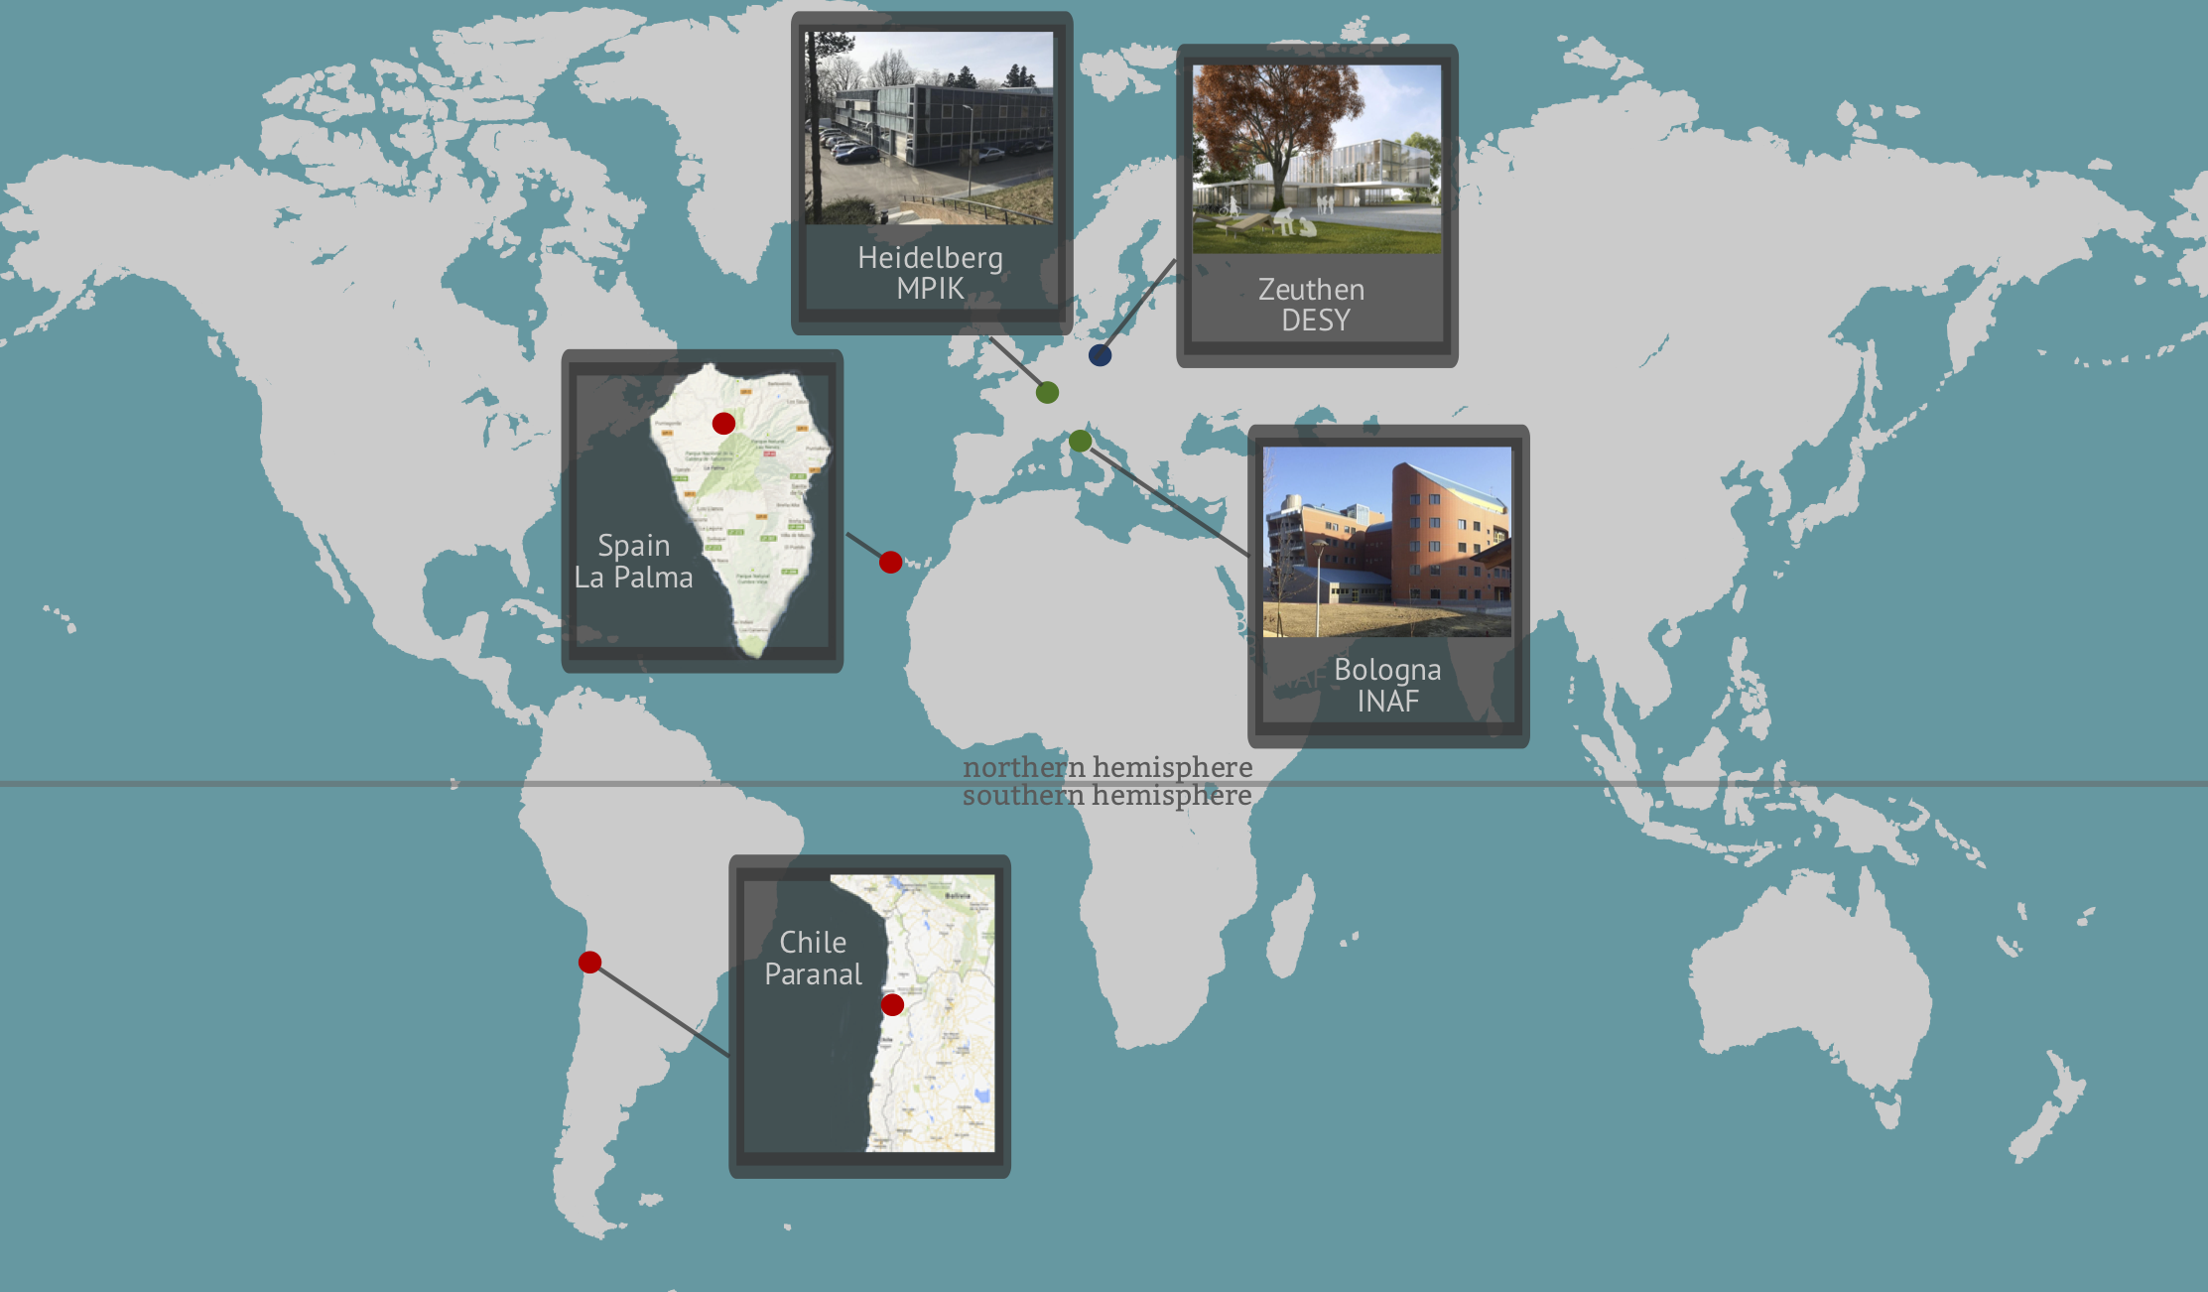
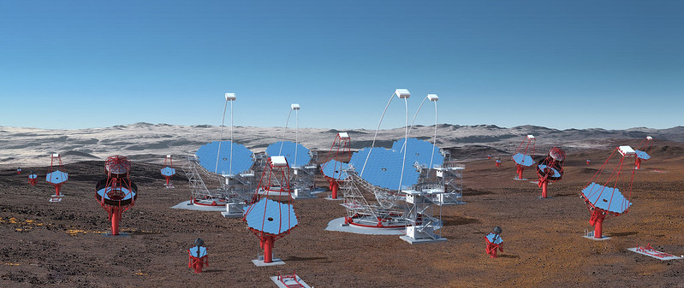
Cherenkov Telescope Array Observatory
https://www.cta-observatory.org/
The first ground-based gamma-ray observatory
CTAO provides to the User Community:
  a science portal for access to products and services
  High-quality data and science tools
ESAP offers to the ESFRIs:
  main building blocks to build platforms tailored for specific purposes
  ability to explore workflows:
    CTAO users executing a science analysis
    (finding data, workflow, software)
    UIs for CTAO staff to do data management tasks (batch processing)
    Science data challenge (interactive processing)

Slide 5
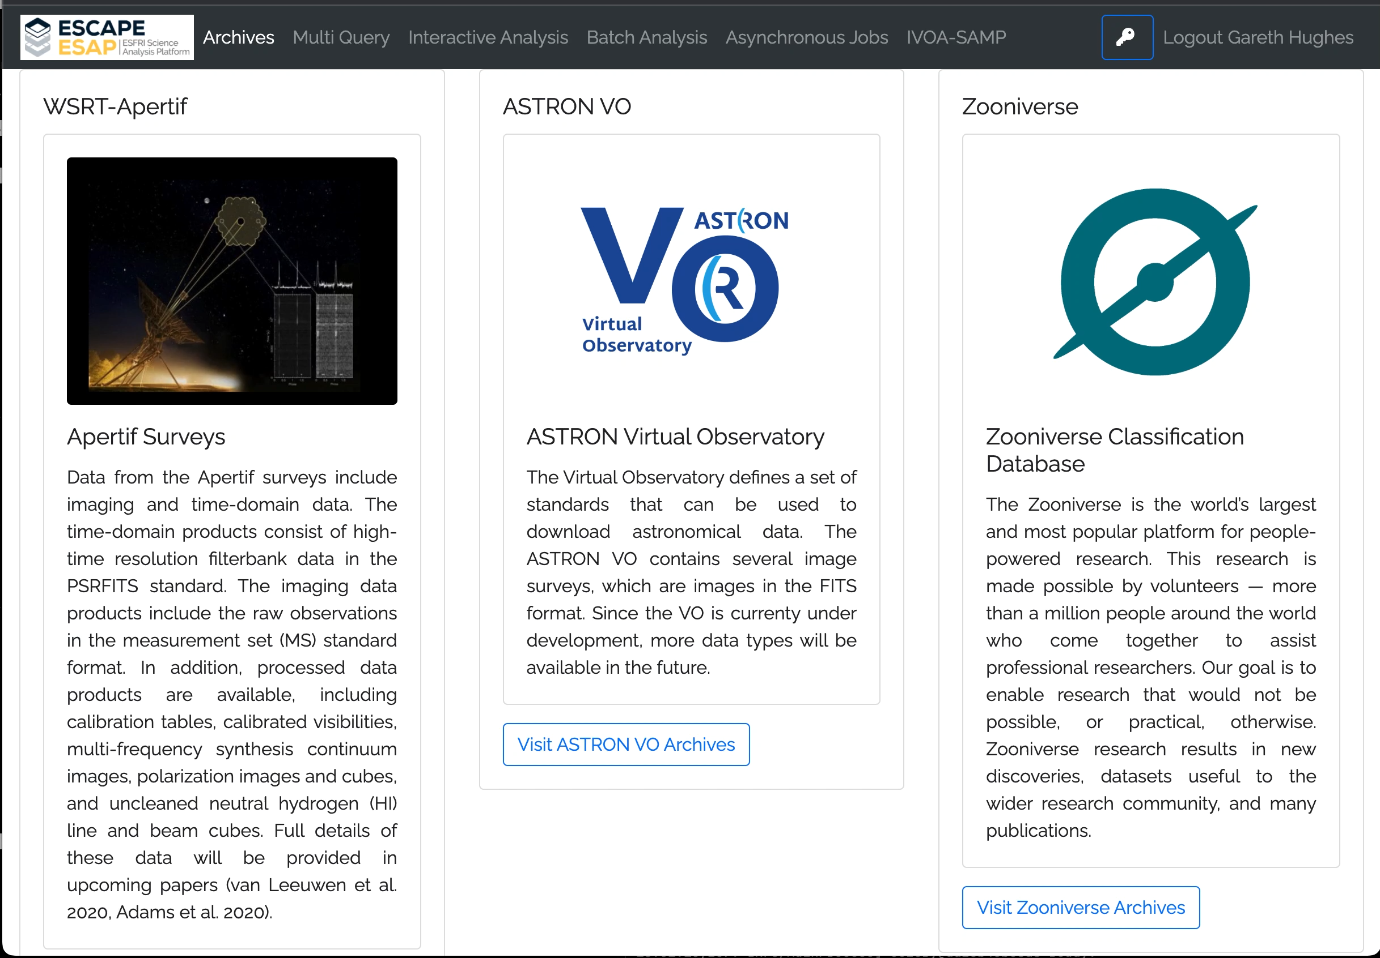
Modularity: Adding Services
The ability to easily add services to a platform makes it versatile
  The ESAP makes it simple to add an archive or service to the platform
If a service has an API then it can be connected and queried through the ESAP
Enables cross collaboration and linking of data and workflows
A simple example of this is using the eOSSR python library developed in WP3/OSSR
  We can now query the Zenodo archive to look for anything linked to ESCAPE and CTAO
  For example, the CTAO Instrument response functions

Slide 6
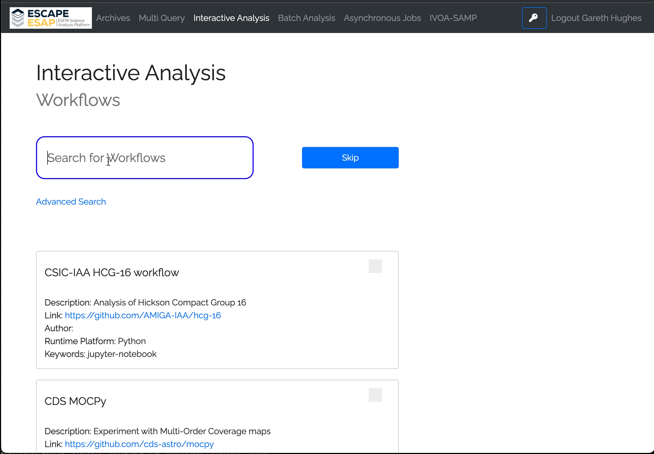
ESAP and Analysis Workflows: a tool for CTAO Users and Staff
ESAP facilitates the connection of software, data and interactive analysis
The CTAO Science Portal needs to offer data and services to its users and staff
  This will allow users to interact with data
  It can also help foster cross collaboration and joint analysis
  Could be used to support observatory staff
Both Gammapy and AGNpy were onboarded to the OSSR/WP3
  Gammapy: open-source Python package for gamma-ray astromomy and will form the basis of the CTAO science analysis tools
  AGNpy: software package developed by high-energy astrophysicists to compute of the photon spectra produced Active Galactic Nuclei
  The workflow shown uses both Gammapy and AGNpy to fit the Spectral Energy Distribution of the BL Lacertae blasar

Slide 7
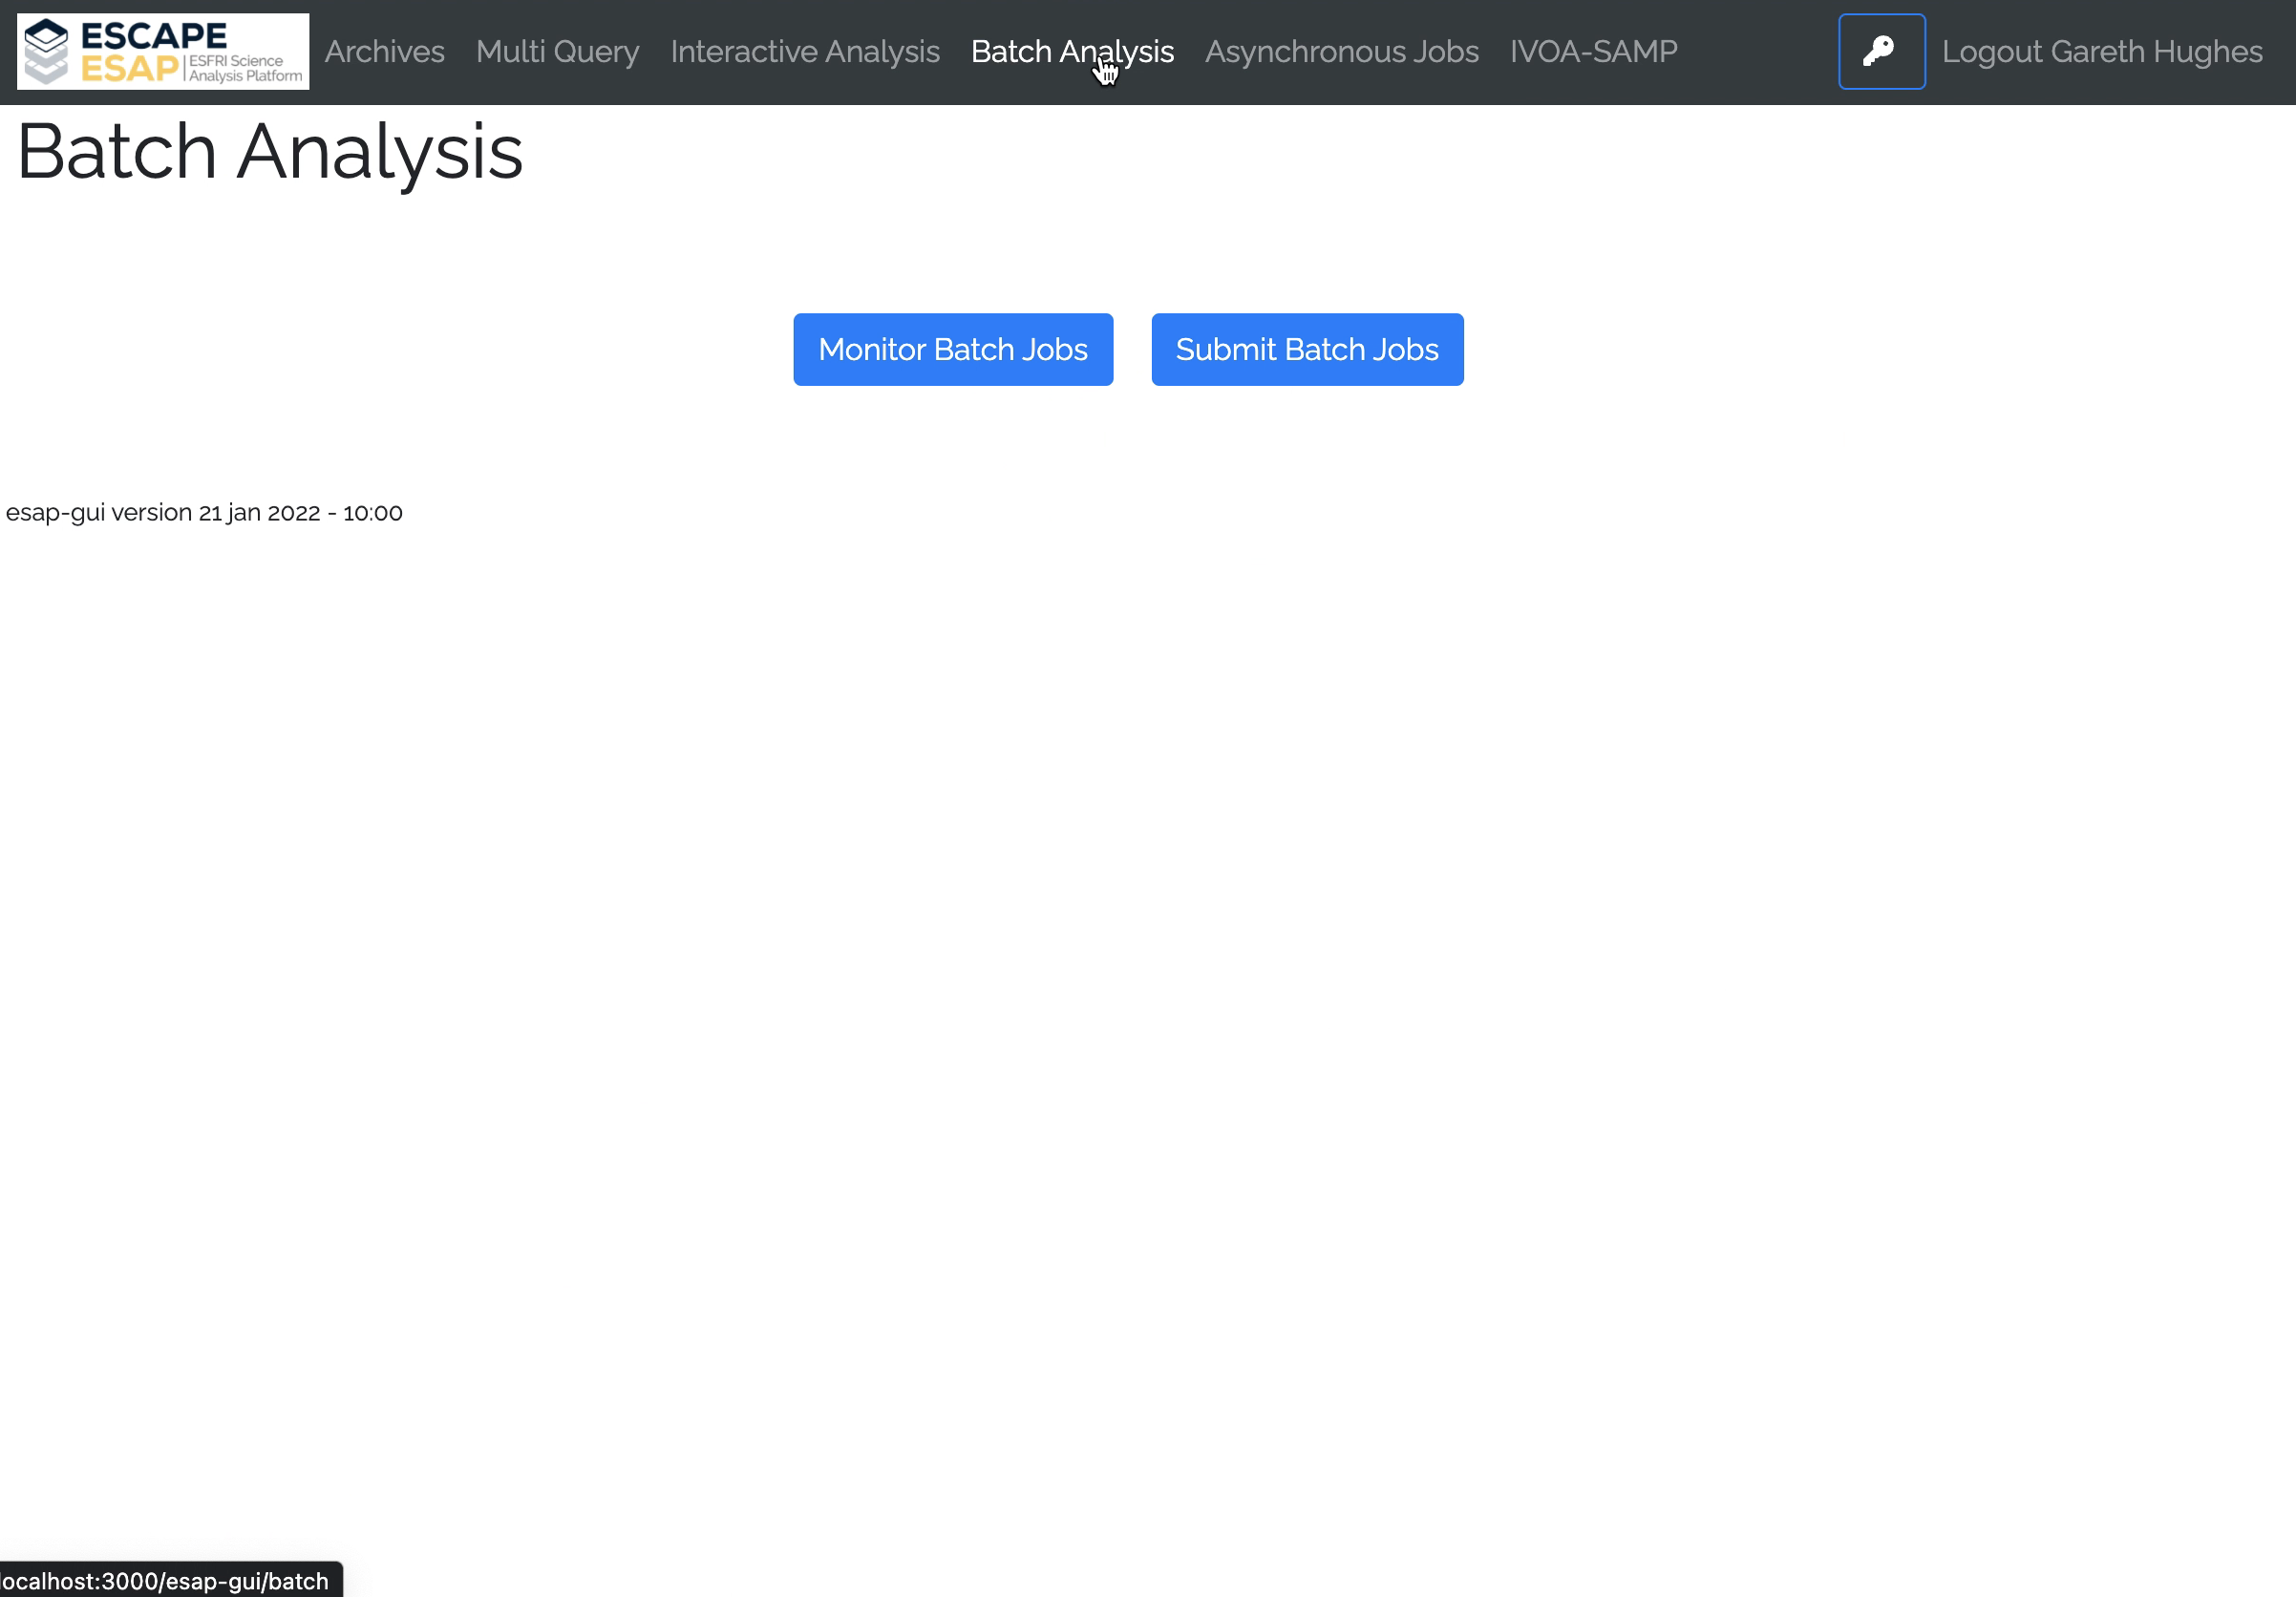
ESAP and Batch Processing
CTAO needs to internally manage data processing at PByte-scale:
  Service task of the Observatory
  Automated batch processing needed
  Data could be spread across multiple data centers
  CTAO staff would be able to launch data management tasks
A batch API and asynchronous worker component was developed to connect the ESAP to CTADIRAC
  CTAO uses DIRAC as its workload management software
Given the correct setup jobs can be launched

Slide 8
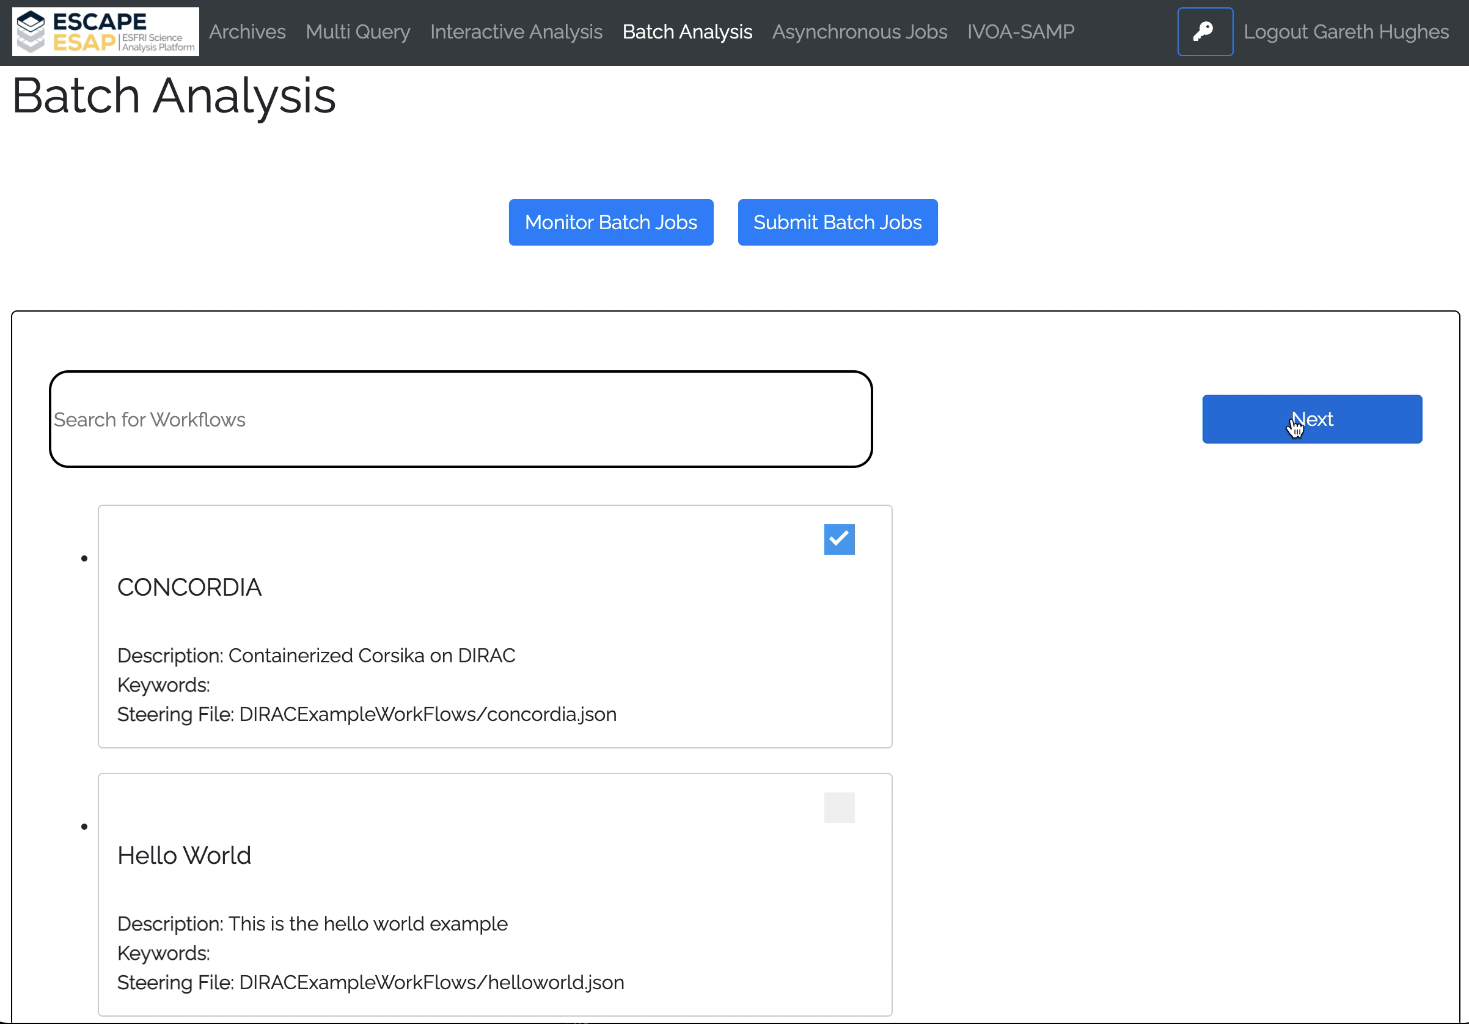
ESAP and Batch Processing
Groups with access to a DIRAC system should be able to easily customize an ESAP to launch and monitor batch jobs
Workflow:
  A user can define a steering file
    work ongoing with IVOA and CEVO to define standards
  This tells the ESAP where to find a containerized version of your program
  From there you can modify the parameters and submit the job
  The jobs submitted can then be monitored via the Async worker or a custom Batch component
Example
  Links to WP3/OSSR CONCORDIA group
  Potential links to ongoing and future work in WP2/DIOS
In the future DIRAC will move to tokens making this process significantly easier

Slide 9
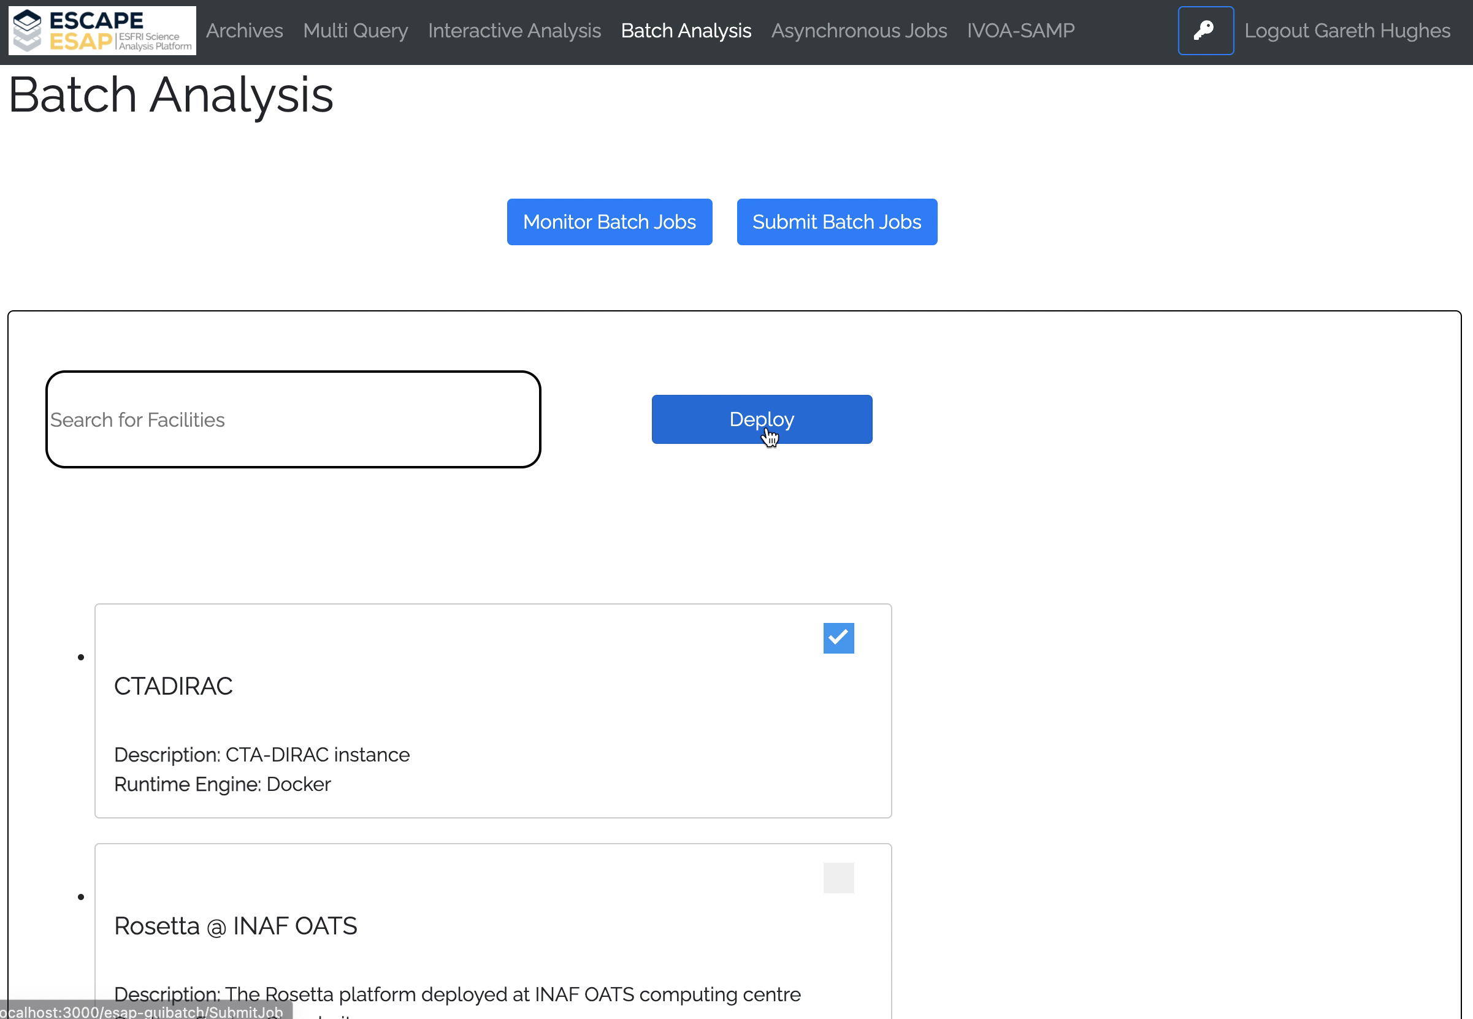
ESAP and Batch Processing
Groups with access to a DIRAC system should be able to easily customize an ESAP to launch and monitor batch jobs
Workflow:
  A user can define a steering file
    work ongoing with IVOA and CEVO to define standards
  This tells the ESAP where to find a containerized version of your program
  From there you can modify the parameters and submit the job
  The jobs submitted can then be monitored via the Async worker or a custom Batch component
Example
  Links to WP3/OSSR CONCORDIA group
  Potential links to ongoing and future work in WP2/DIOS
In the future DIRAC will move to tokens making this process significantly easier

Slide 10
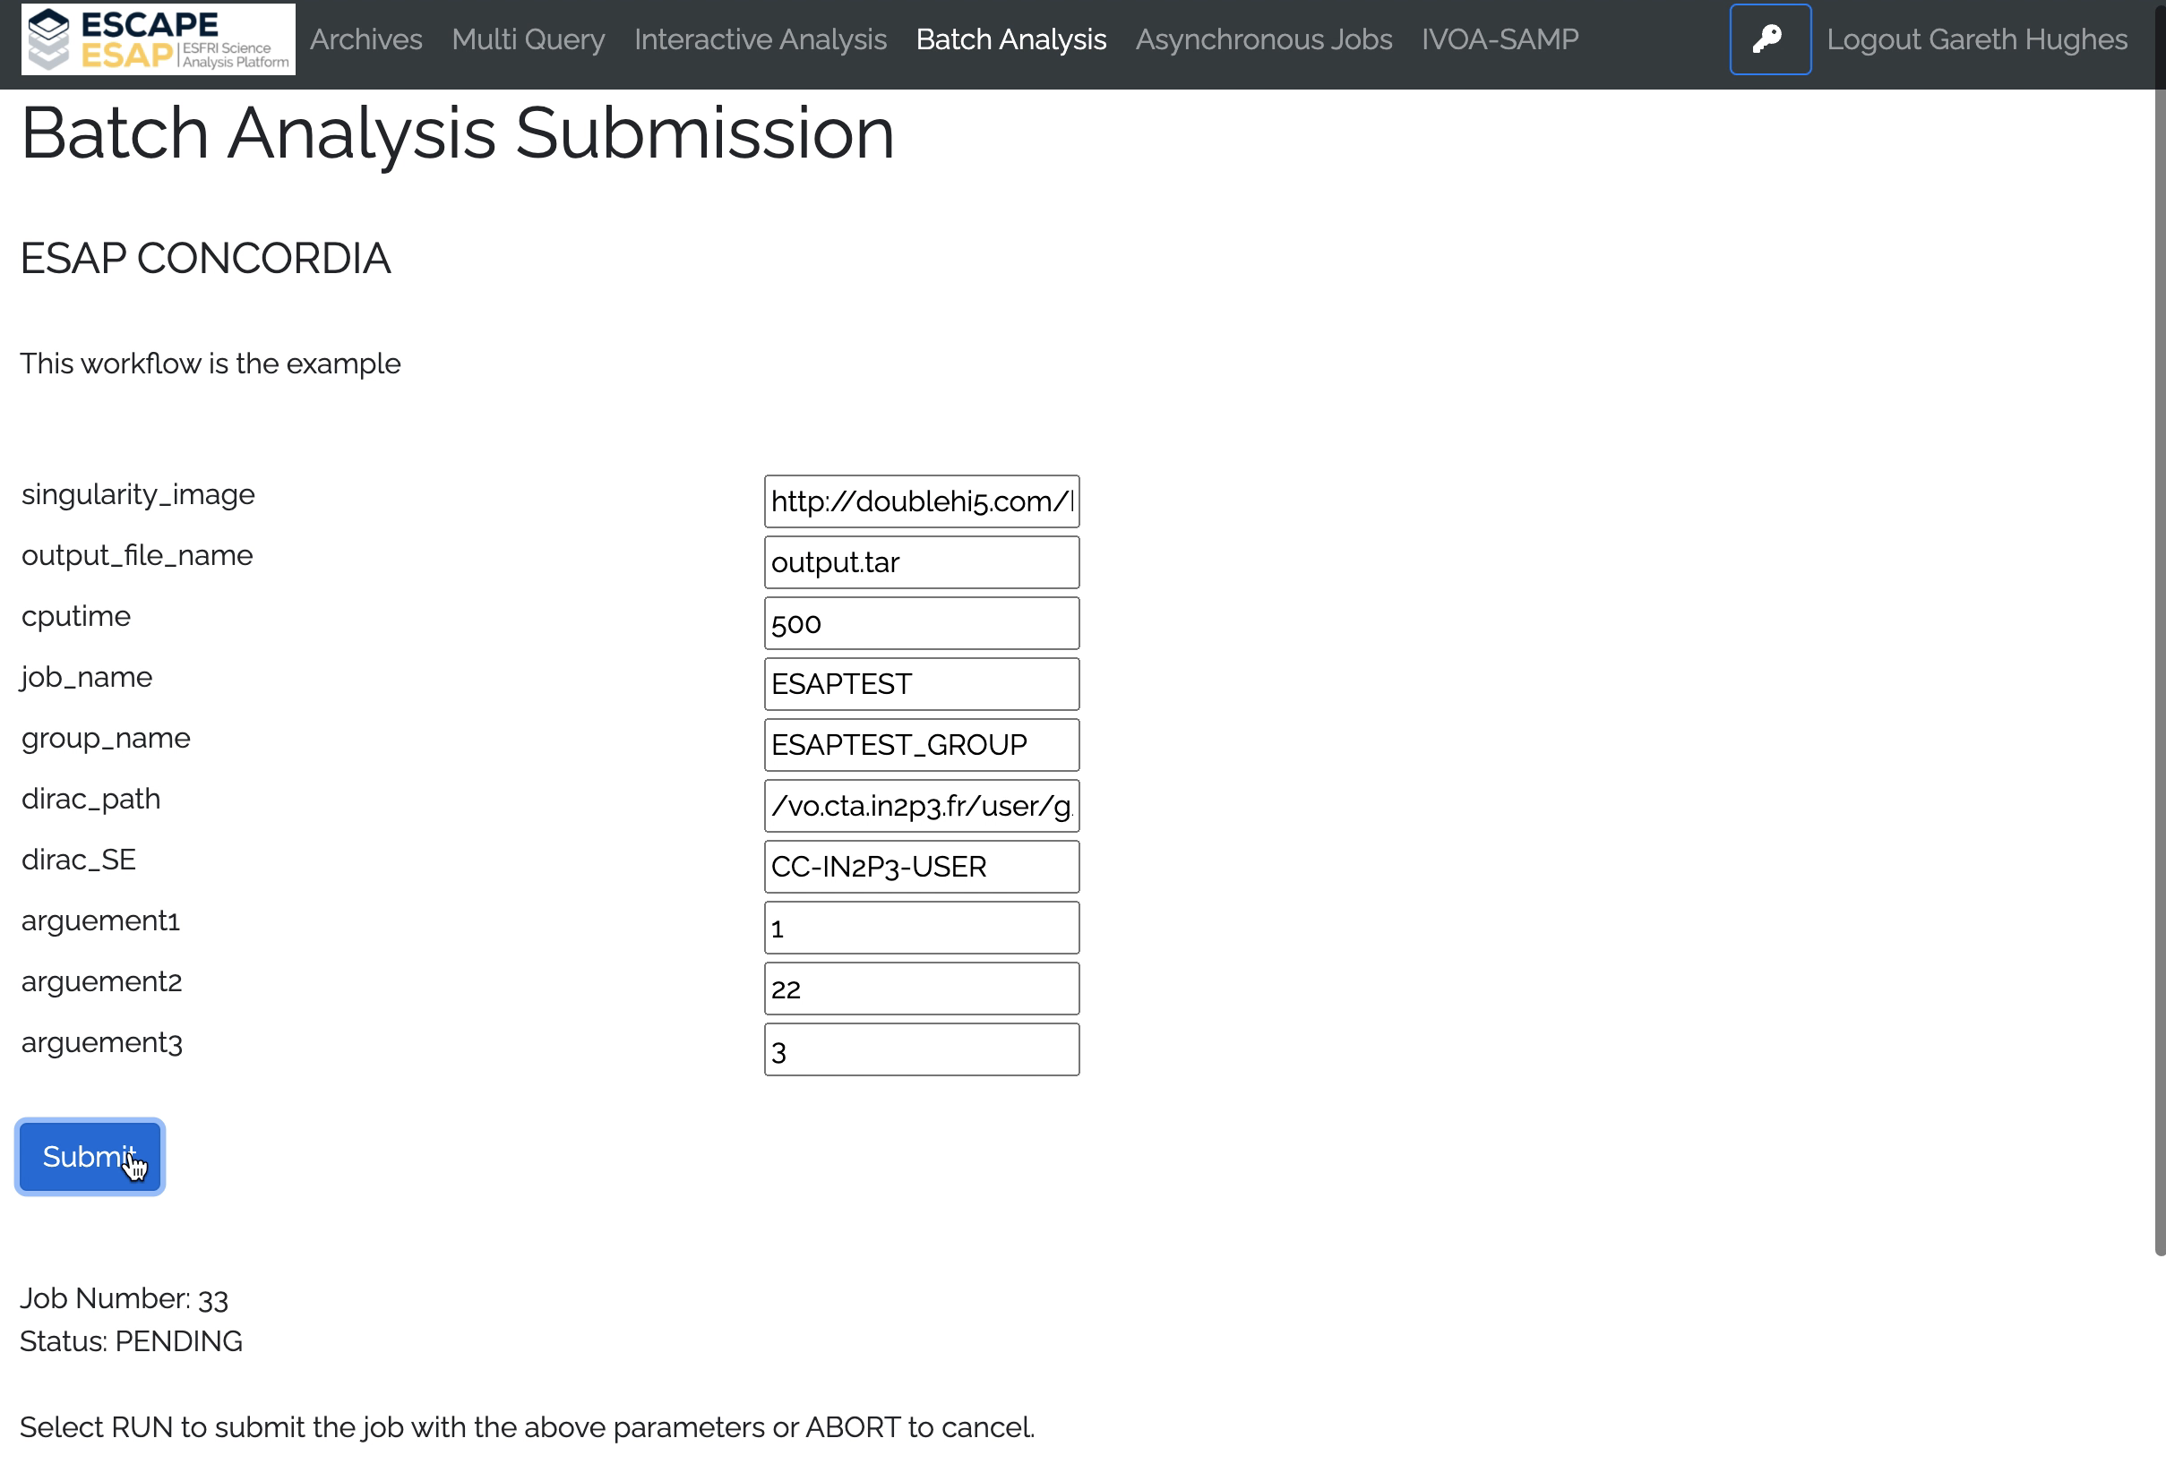
ESAP and Batch Processing
Groups with access to a DIRAC system should be able to easily customize an ESAP to launch and monitor batch jobs
Workflow:
  A user can define a steering file
    work ongoing with IVOA and CEVO to define standards
  This tells the ESAP where to find a containerized version of your program
  From there you can modify the parameters and submit the job
  The jobs submitted can then be monitored via the Async worker or a custom Batch component
Example
  Links to WP3/OSSR CONCORDIA group
  Potential links to ongoing and future work in WP2/DIOS
In the future DIRAC will move to tokens making this process significantly easier

Slide 11
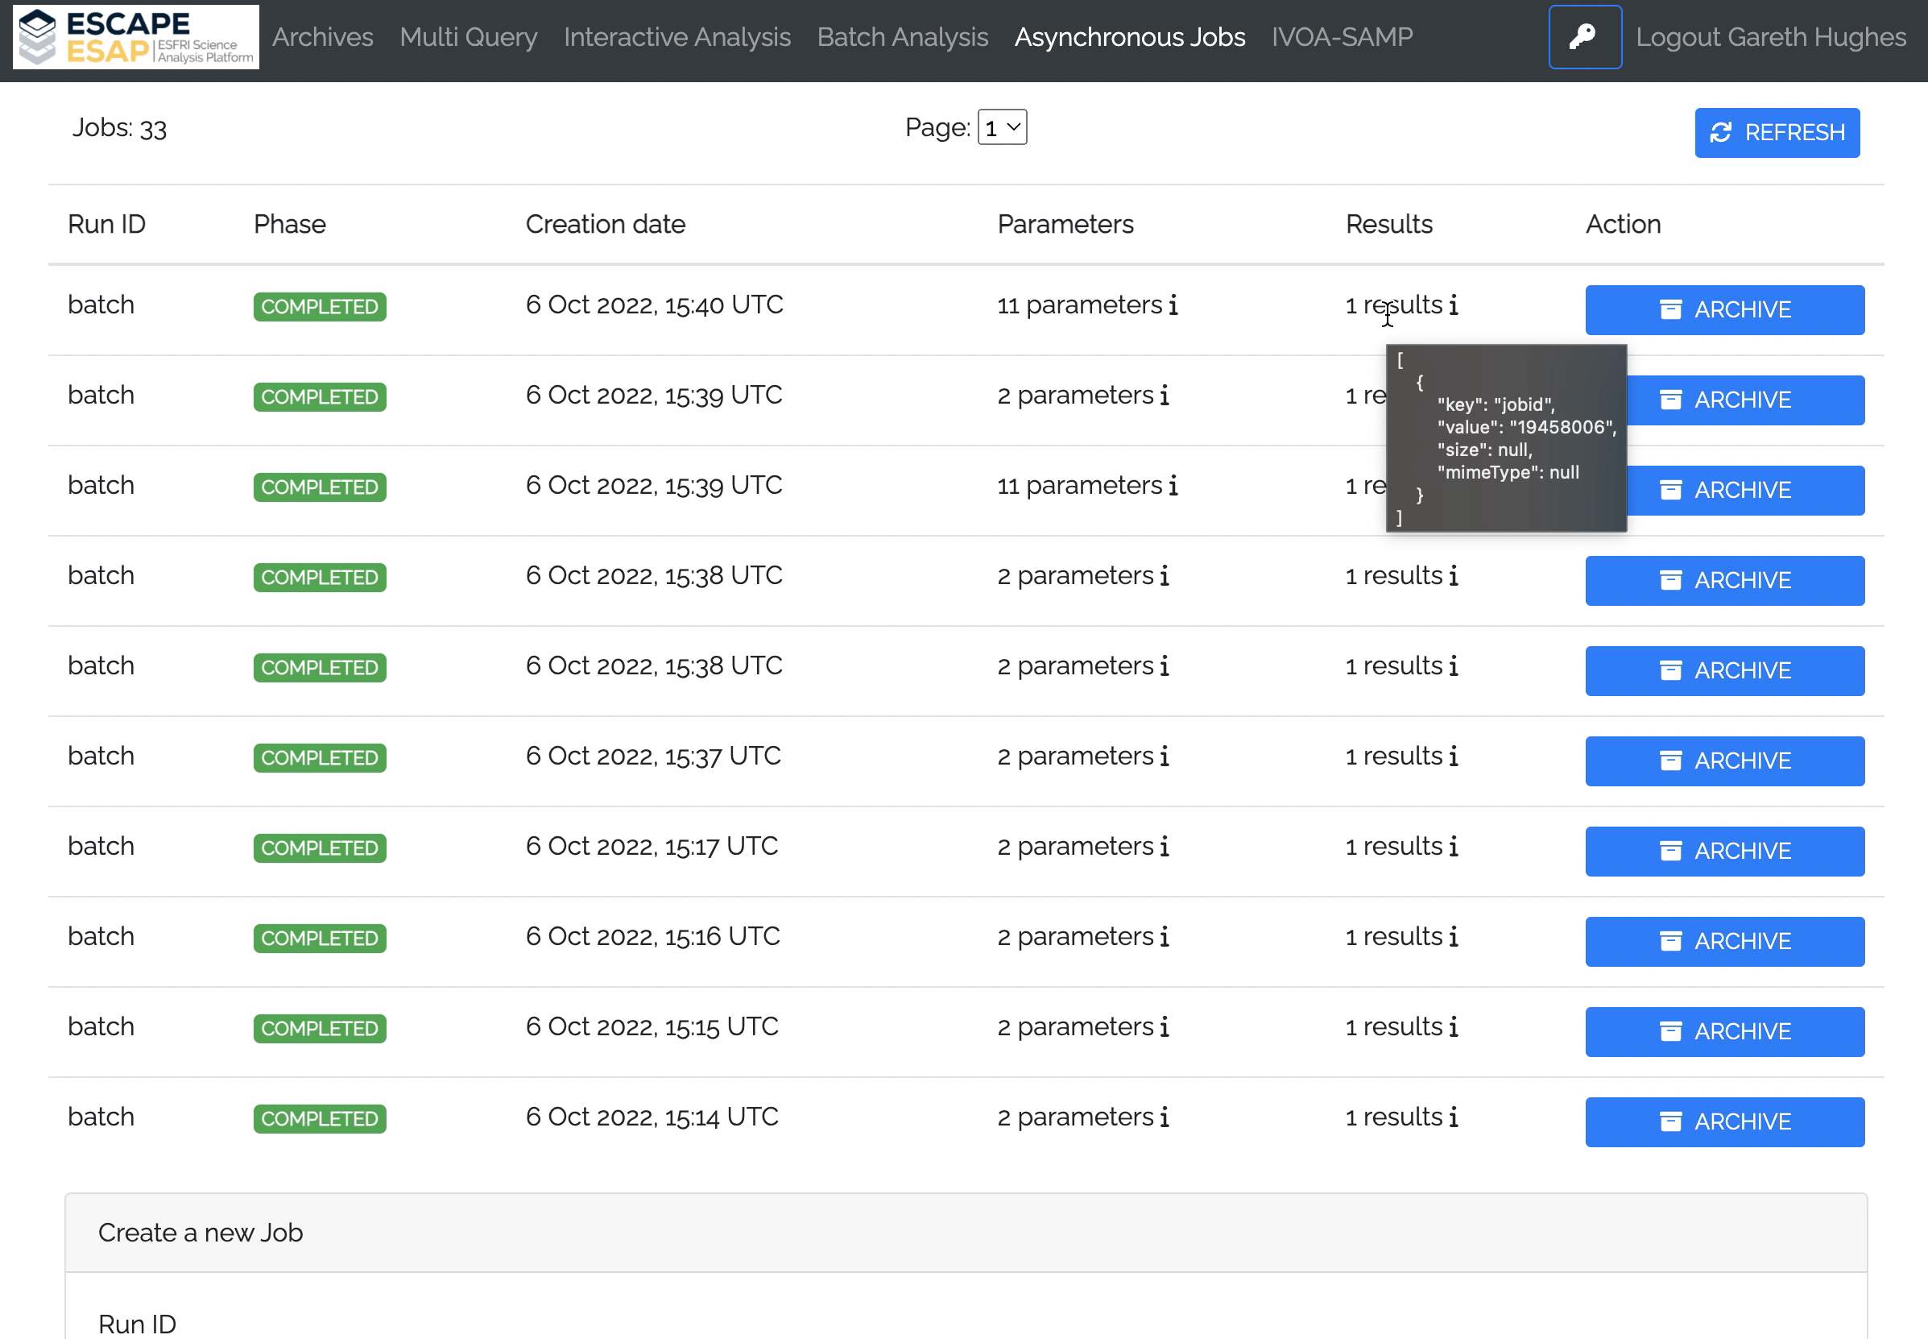
ESAP and Batch Processing
Groups with access to a DIRAC system should be able to easily customize an ESAP to launch and monitor batch jobs
Workflow:
  A user can define a steering file
    work ongoing with IVOA and CEVO to define standards
  This tells the ESAP where to find a containerized version of your program
  From there you can modify the parameters and submit the job
  The jobs submitted can then be monitored via the Async worker or a custom Batch component
Example
  Links to WP3/OSSR CONCORDIA group
  Potential links to ongoing and future work in WP2/DIOS
In the future DIRAC will move to tokens making this process significantly easier

Slide 12
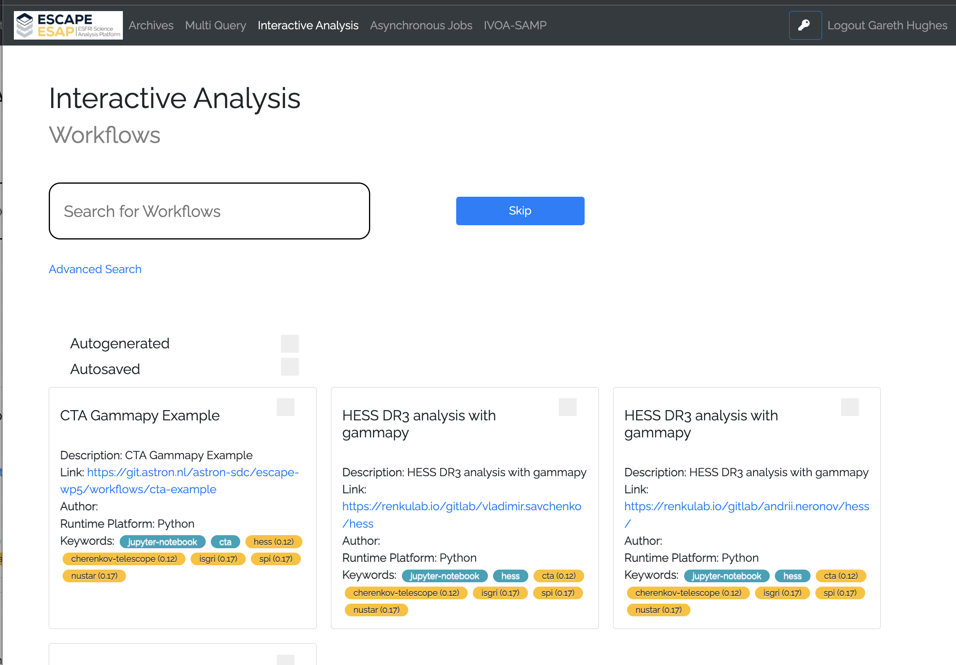
Exploring the ESAP for potential use in a
Science Data Challenge
Science Data Challenge a way to engage with CTAO users
CSCS & Observatoire de Paris have deployed versions of ESAP
  Using Kubernetes on one of the future CTAO Data Centers (CSCS)
  With the aim to investigating how it might be used for a CTAO data challenge
They found it could be easily customized for example:
  github based login
  addition of workflows
  advanced search options and use of metadata
A binderhub instance has also been added and made available to the platform
  This work is being fed back into WP5/ESAP
For a Data Challenges the workflows would need to be persistent

Slide 13

Conclusions
The ESAP provides an excellent toolbox from which one can build and tailor a Science Platform
CTAO has been able to identify key technologies and ideas which it will further investigate in the future
CSCS and Observatoire de Paris colleagues have been able to deploy their own version of the ESAP and customize it, to investigate possible use for a Science Data Challenge
We look forward to further work together on these topics in future collaborations

