Slide 2
Apertif DR1
Yan Grange, Mattia Mancini, Hanno Holties and the Apertif team

Slide 3
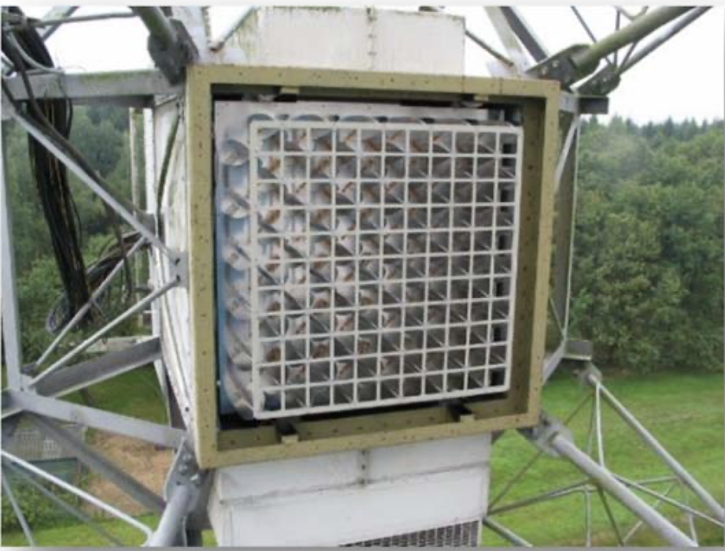
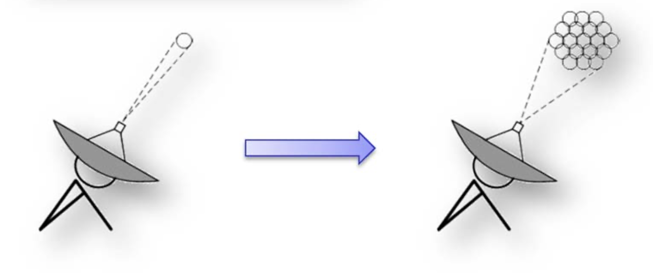
Apertif, Phased Array Feeds for the WSRT
Transform the WSRT into an efficient 21-cm survey facility
17x Survey speed increase
SKA Pathfinder

Slide 4
Apertif (imaging)
Original 4 year legacy survey program
~350 sq degree medium deep survey (10x12 hr)
~3500 sq deg wide survey (1x12 hr)
Radio continuum, polarization and neutral hydrogen
Role of environment & interaction on galaxy processing
Finding the smallest galaxies
Connecting cold gas to AGN
Understanding the faint radio population
Studying magnetic fields in galaxies

Slide 5
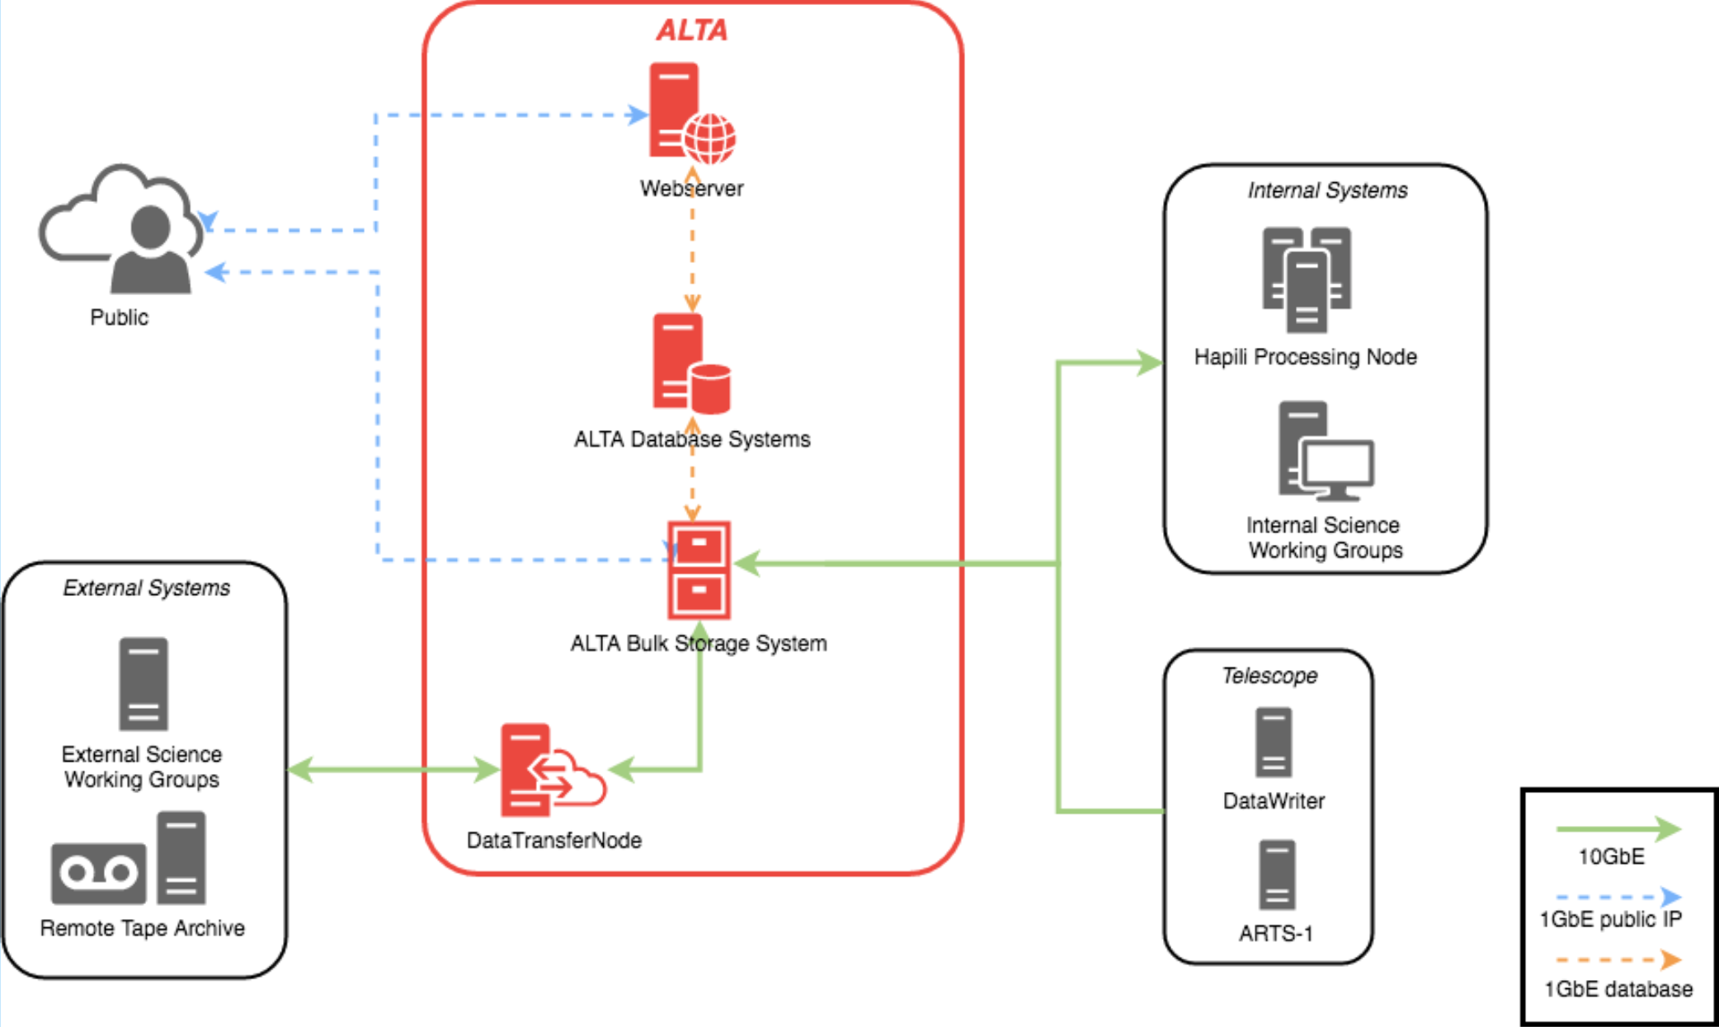
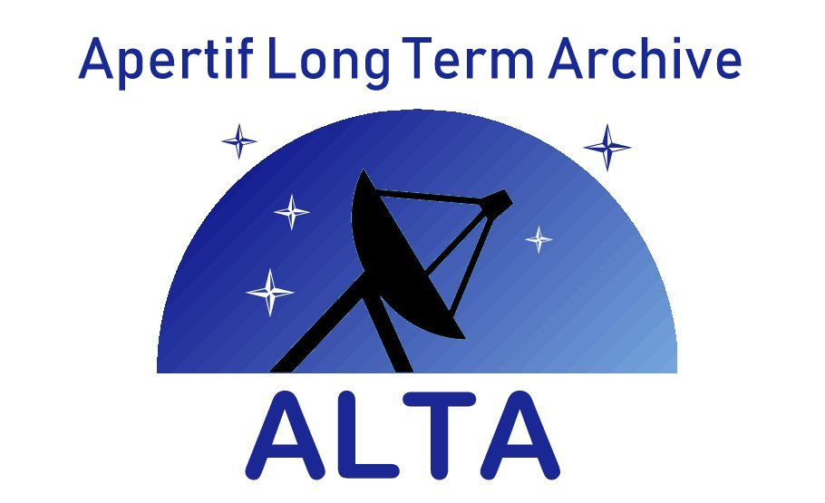
ALTA – the Apertif Long-Term rchive
ALTA is the main source of Apertif data.
VO interface is the main interface for external user access
ASTRON (Dwingeloo): Online storage (including ‘nearline’ object store)
SURFsara (Amsterdam): Offline storage (including online cache & staging)
Using IRODS for internal data management
https://alta.astron.nl

Slide 6
The DR1 data set – the released products
Type | Discovery | Access
Raw observational data
Full time, Stokes and spectral resolution calibrated visibility data
Calibration tables
Inspection plots
Continuum images
Polarization images and cubes
Line and dirty beam cubes

Slide 7
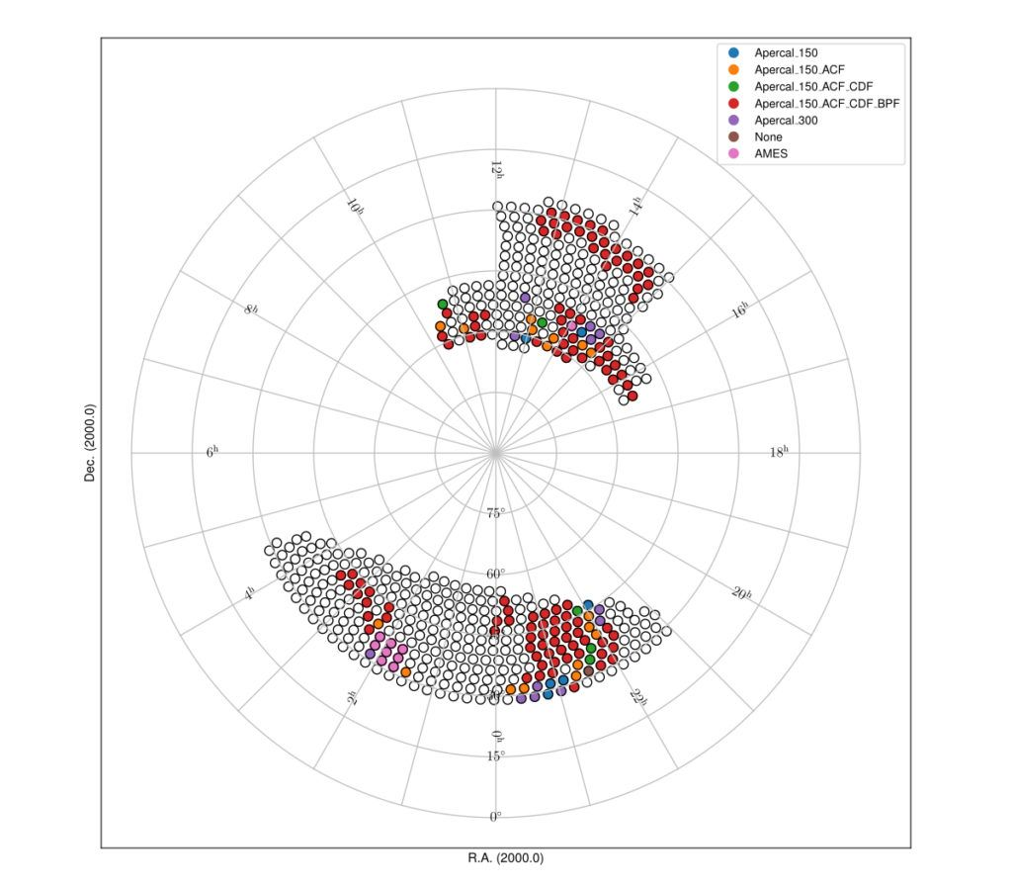
The DR1 data set – wrt the full survey

Slide 8
The DR1 data set – product quality
Validation of continuum data products by assessing they meet the resolution requirements, minimum sensitivity requirements, and have no significant image artifacts.
Other data types released based on validation of corresponding continuum product!
Most polarisation cubes also pass their own validation, since the criteria are comparable.
Line cubes get flagged “G”ood, “O”kay or “B”ad depending on severity of artifacts.

Slide 9
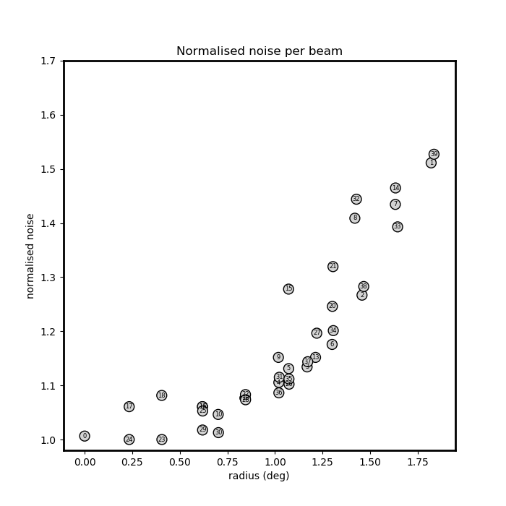
The DR1 data set – beam noise

Slide 10
And now… The demo!

Slide 11
And now… The demo!

Slide 12
Coming soon: ARTS DR1
Apertif also has a timing survey of FRBs
Working on table for PSRFITS, couple to Obscore.
Thanks Baptiste, Markus for discussions!
Document this for Radio-IG (actual standard would be neat; why am I asking for more work…)?
Discussing how to handle non-detection data vs detection data.
Probably going yo use a view
﻿

Slide 13
Closing remarks
Currently we only have an image HiPS. Cube HiPS may be a good addition.
Looking forward to other surveys with externally-hosted data (e.g. LOTSS DR2 coming Q3/4 2021).
Any feedback is very welcome :)
﻿
http://hdl.handle.net/21.12136/B014022C-978B-40F6-96C6-1A3B1F4A3DB0

