Slide 1
The EOSC Association: Advancing Open Science
Prof. Marialuisa Lavitrano
EOSC Association vice president
Email: info@eosc.eu
11th June 2021
ESFRI science clusters’ workshop
Slides by EOSC Association

Slide 2
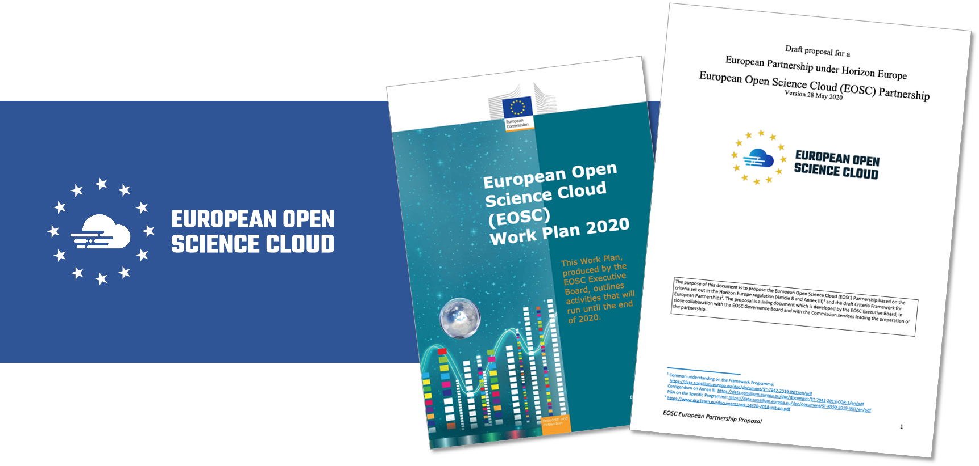
Where do we come from?
The shared vision between the EC, MS&AC and a large community
The decision of the governing bodies to institute a Co-programmed Partnership as the best instrument to collectively achieve this vision
Notes:
The shared vision between the EC, MS&AC and a large community
The decision of the governing bodies to institute a Co-programmed European Association as the best instrument to achieve that vision “to overcome the fragmentation and to provide a framework for collaboration and pooling of resources at European, national, regional and institutional levels.”
This instrument requires the incorporation of a new legal entity: the EOSC Association which will have as members all relevant stakeholders in the EOSC ecosystem and will enter into a contractual agreement with the European Commission to direct the Partnership under Horizon Europe

Slide 3
EOSC Governance Model 2021-2027
The new governance model agreed with EU countries for the next EOSC implementation phase after 2020 will be tripartite including:
The EU represented by the Commission
The European research community represented by the EOSC Association
EU countries and countries associated with Horizon Europe represented through a Steering Board to be set up in 2021 outside of the EOSC Association
European Commission
EOSC Association
Steering Board
Joining the EOSC Association
=
Joining the EOSC Partnership!

Slide 4
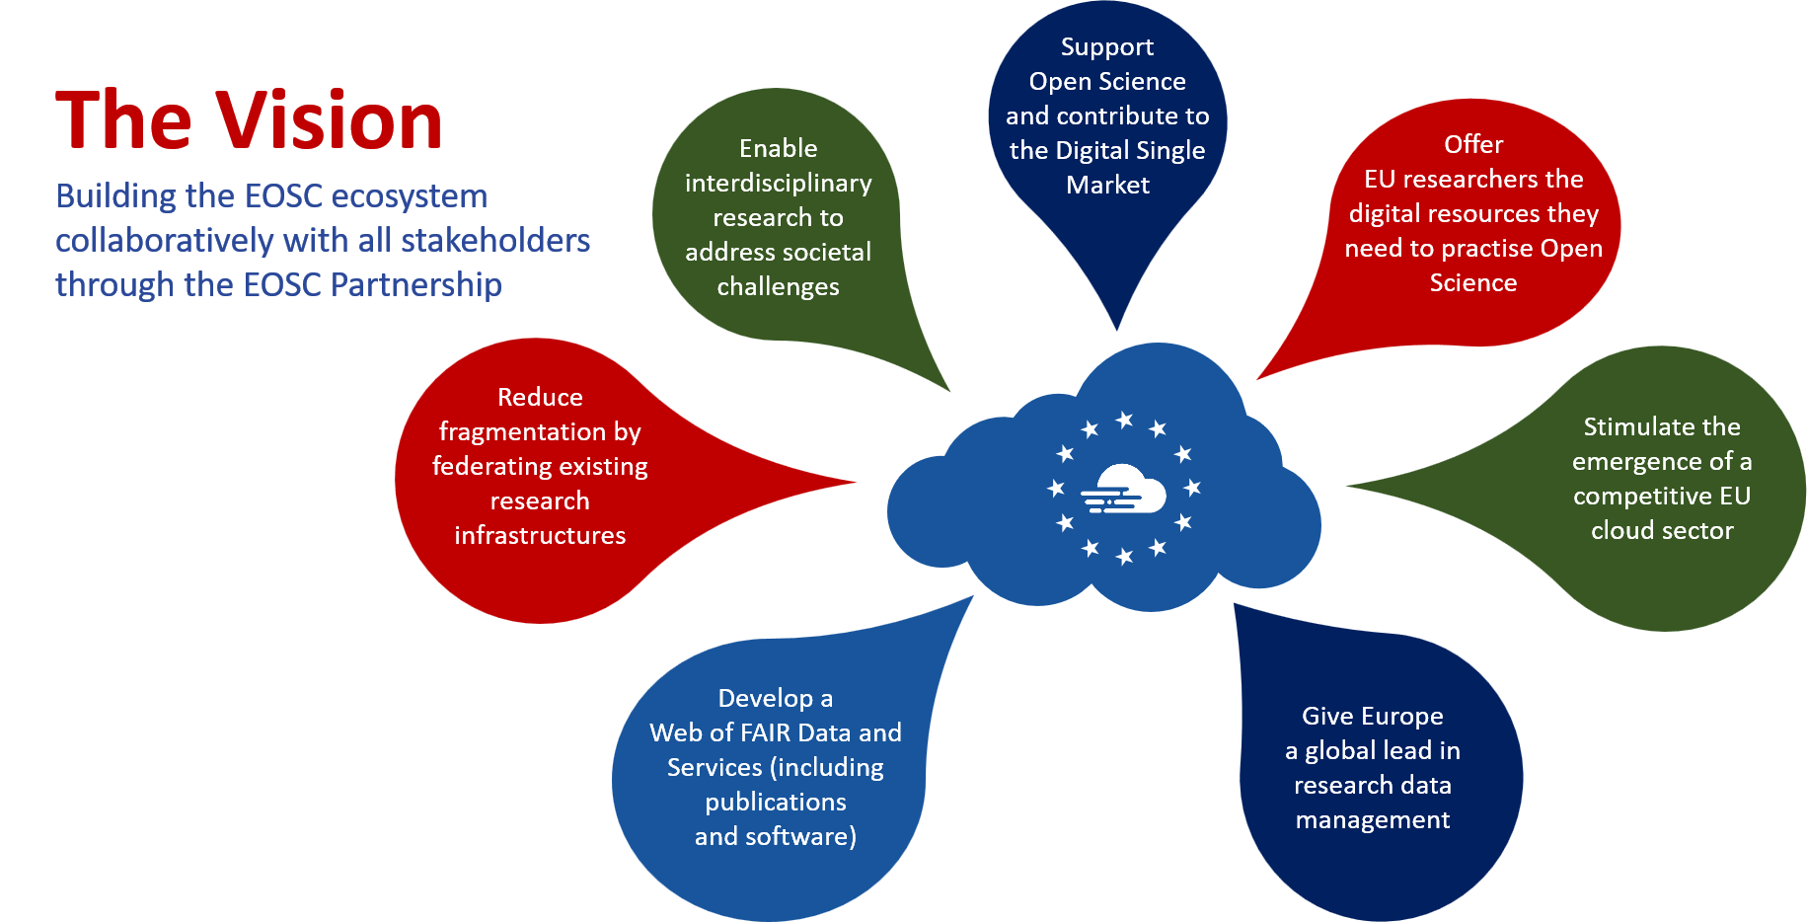
6/11/21

Slide 5
Priorities for EOSC implementation Stage 1 2021-2022
Ensure that Open Science practices and skills are rewarded and taught, becoming the new normal
Enable the definition of standards, and the development of tools and services, to allow researchers to find, access, reuse and combine results
Establish a sustainable and federated infrastructure enabling open sharing of scientific results

Slide 6
EOSC-ecosystem objectives tree
(EOSC Strategic Research Implementation Agenda v1.0)

Slide 7
Guiding principles for EOSC
The overarching principle for developing EOSC is that research has to be at the centre of the EOSC initiative.
Multi-stakeholderism
EOSC will succeed if and only if it follows a multi-stakeholder approach;
Openness
EOSC will ensure research artefacts be ‘as open as possible, as closed as necessary’;
FAIR principles
EOSC research artefacts need to be findable, accessible, interoperable and reusable;
Federation of infrastructures
EOSC will federate existing and upcoming data- and e-infrastructures;
Machine-actionable
EOSC will strike the right balance between machines and people in delivering the services that will serve the needs of European scientists.
Notes:
The shared vision between the EC, MS&AC and a large community
The decision of the governing bodies to institute a Co-programmed European Association as the best instrument to achieve that vision “to overcome the fragmentation and to provide a framework for collaboration and pooling of resources at European, national, regional and institutional levels.”
This instrument requires the incorporation of a new legal entity: the EOSC Association which will have as members all relevant stakeholders in the EOSC ecosystem and will enter into a contractual agreement with the European Commission to direct the Partnership under Horizon Europe

Slide 8
Timeline of EOSC iterations towards a MVE
(EOSC Strategic Research Implementation Agenda v1.0)

Slide 9
The EOSC Association
Four founding members (CESAER, GEANT, GARR, CSIC)
Was started as AISBL* on Wednesday 29th July 2020
Obtained Royal Decree on Friday 11th September 2020
First General Assembly on 17-12-2020 elected President and Board
Research Performing; Research Funding and Service Proving organisations
Now 153 members and 63 observers (62% - 8% - 30%) (April 2021)
A European Co-programmed Partnership, between the EC and the EOSC Association, MoU to be signed 23 June 2021
Joining the EOSC Association = Joining the EOSC Partnership!
*international non-profit association under Belgian law
Notes:
The shared vision between the EC, MS&AC and a large community
The decision of the governing bodies to institute a Co-programmed European Association as the best instrument to achieve that vision “to overcome the fragmentation and to provide a framework for collaboration and pooling of resources at European, national, regional and institutional levels.”
This instrument requires the incorporation of a new legal entity: the EOSC Association which will have as members all relevant stakeholders in the EOSC ecosystem and will enter into a contractual agreement with the European Commission to direct the Partnership under Horizon Europe

Slide 10
EOSC membership by status
As of the end of April 2021
Members: 153
Observers: 63
Notes:
The Association is comprised of Members and Observers. All Members have a presence in an EU Member State (MS) or Associated Country (AC), or any other country associated with the EU Framework Programme for Research and Innovation. Observers may be established outside this area.

Slide 11
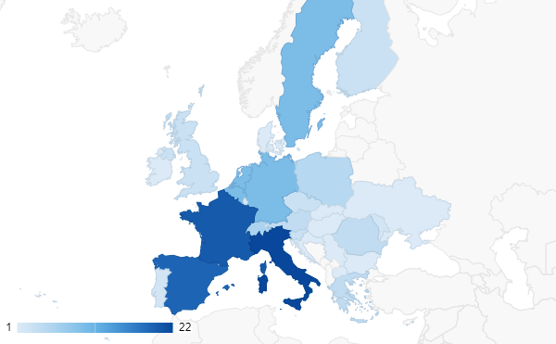
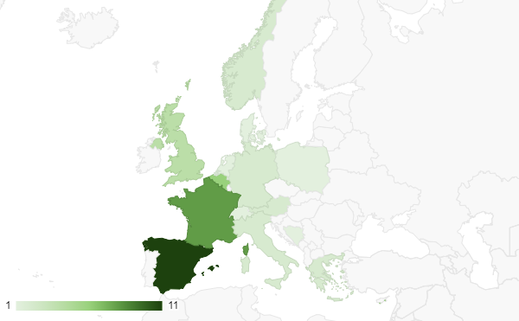
EOSC Association membership geographical spread
153 Members
~63 Observers
How to join the Association: https://www.eosc.eu/join-association
6/11/21

Slide 12
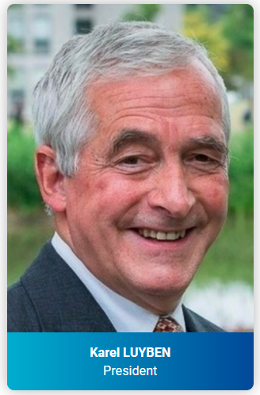
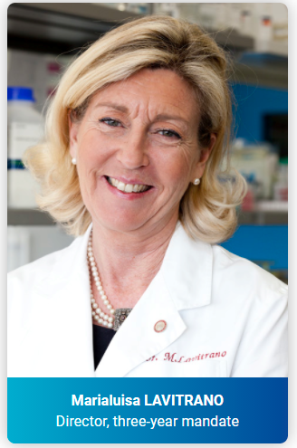
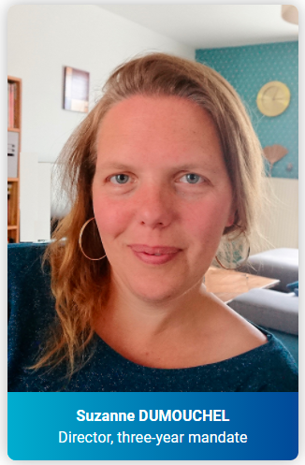
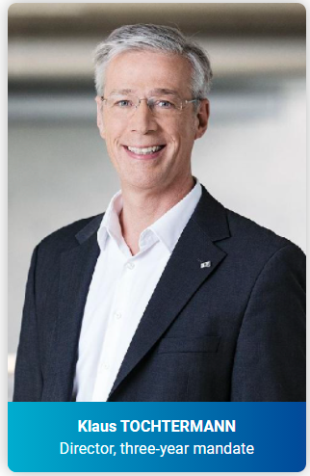
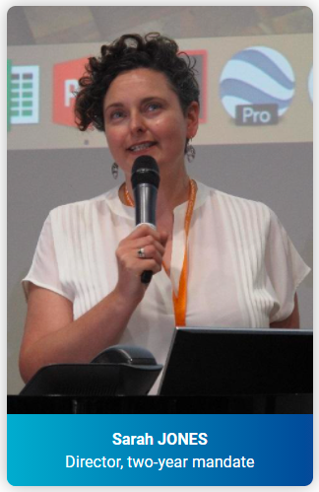
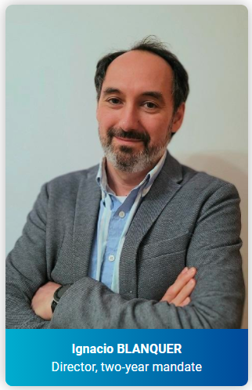
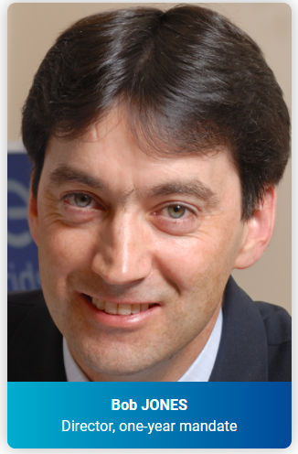
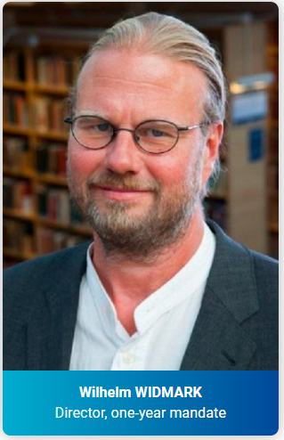
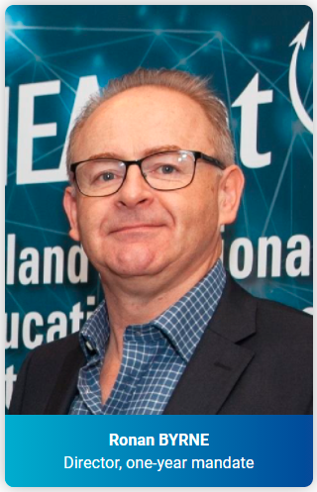
Board of Directors
Karel Luyben, CESAER & President
Klaus Tochtermann, ZBW & Director 3-year mandate
Marialuisa Lavitrano, University Milano – Bicocca & Director 3-year mandate
Suzanne Dumouchel, CNRS & Director 3-year mandate
Sarah Jones, GÉANT & Director 2-year mandate
Ignacio Blanquer, UPV & Director 2-year mandate
Ronan Byrne, HEAnet & Director 1-year mandate
Bob Jones, CERN & Director 1-year mandate
Wilhelm Widmark, University of Stockholm & Director 1-year mandate

Slide 13
The EOSC Association
Mission: Advancing Open Science to accelerate the creation of new knowledge, inspire education, spur innovation and promote accessibility and transparency
To provide a single voice for advocacy and representation for the broader EOSC stakeholder community.
To promote the alignment of European Union research policy and priorities with activities coordinated by the Association.
To enable seamless access to data through interoperable services that address the entire research data life cycle, from discovery to storage, management, analysis and re-use across borders and scientific disciplines
Notes:
The shared vision between the EC, MS&AC and a large community
The decision of the governing bodies to institute a Co-programmed European Association as the best instrument to achieve that vision “to overcome the fragmentation and to provide a framework for collaboration and pooling of resources at European, national, regional and institutional levels.”
This instrument requires the incorporation of a new legal entity: the EOSC Association which will have as members all relevant stakeholders in the EOSC ecosystem and will enter into a contractual agreement with the European Commission to direct the Partnership under Horizon Europe

Slide 14
What are the EOSC Advisory Groups / Task Forces
A structure to allow Association members and others to help steer the implementation of EOSC
Groups should liaise with EOSC projects and offer feedback and advice
Identify strategic gaps and areas for investment to input to SRIA
EOSC Association members can propose and lead groups. Externals can also be members
Task Forces are groups within the AGs who undertake activities to implement certain aspects of EOSC according to their topic

Slide 15
Task Force topics
Implementation of EOSC
Rules of Participation compliance monitoring
PID policy and implementation
Researcher engagement and adoption
Technical challenges on EOSC
Technical interoperability of data and services
Infrastructure for quality research software
AAI Architecture
Metadata and data quality
Semantic interoperability
FAIR metrics and data quality
Research careers and curricula
Data stewardship curricula and career paths
Research careers, recognition and credit
Upskilling countries to engage in EOSC
Sustaining EOSC
Defining funding models for EOSC
Long-term data preservation

Slide 16
The role of science clusters in EOSC
The science clusters (ENVRI-FAIR, EOSC-Life, ESCAPE, PaNOSC, SSHOC) are making major contributions to the EOSC as the key means of engaging research Infrastructures and their user communities
The EOSC roadmap (SRIA version 1) foresees contributions from the science clusters that stretch beyond the lifetime of the science cluster projects

Slide 17
Science Clusters contributions to EOSC objectives
Engage with researchers and promote the adoption of open science practices by research communities
Participate in the definition of standards, and the development of tools and services that allow researchers to find, access, reuse and combine results
Establish a sustainable and federated infrastructure enabling open sharing of scientific results

Slide 18
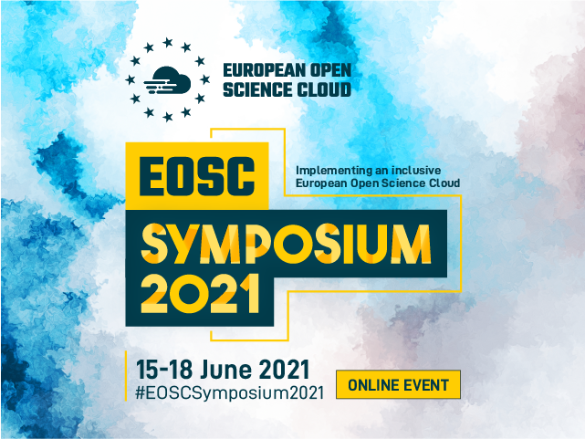
EOSC Symposium 2021
EOSC Ecosystem explored
Focus on AG topics and engagement with the community
Registration & Programme

Slide 19
Any questions?
Thanks!

