Slide 1
Social Sciences and Humanties Open Cloud
Realising the Social Sciences and Humanities part of the European Open Science Cloud

Slide 2
Project:
Type of action & funding:
Research and Innovation action
(INFRAEOSC-04-2018)
Partners: 48 (23 beneficiaries + 25 LTPs)
SSH ESFRI Landmarks and Projects & international SSH data infrastructures
Project budget: € 14,455,594.08
Project website: www.SSHOpenCloud.eu
Duration: 40 months (January 2019 – 30 April 2022)
Objectives:
creating the social sciences and humanities (SSH) part of European Open Science Cloud (EOSC)
maximising re-use through Open Science and FAIR principles (standards, common catalogue, access control, semantic techniques, training)
interconnecting existing and new infrastructures (clustered cloud infrastructure)
establishing appropriate governance model for SSH-EOSC

Slide 3
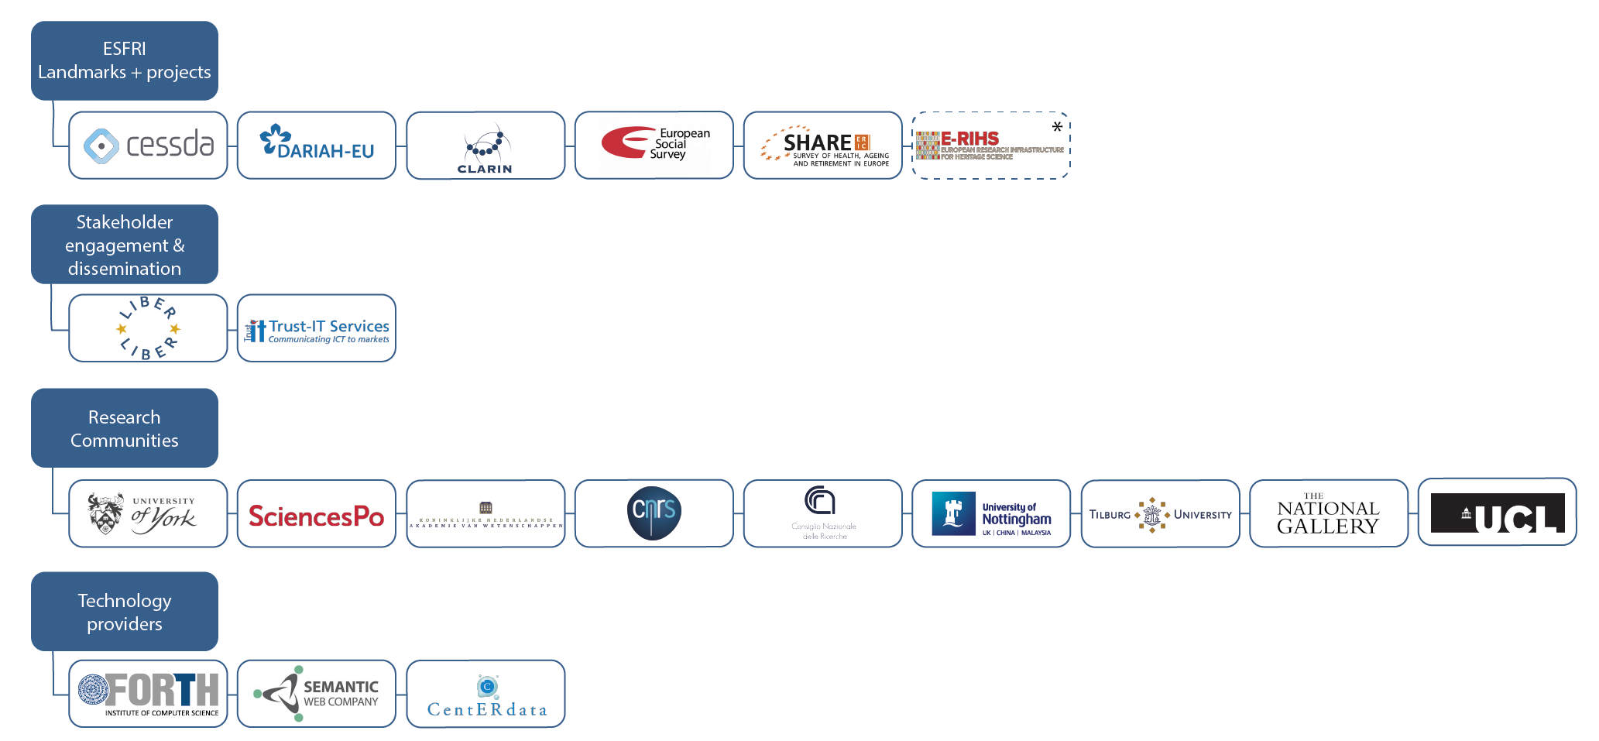
SSHOC Partners
*E-RIHS is not a legal partner in the SSHOC project but we connect to the E-RIHS community through the Institutum Archaeologicum Germanicum.

Slide 4
ESFRI domain distribution

Slide 5
Tools & Services after SSHOC – ca. 40 potential cross-domain functionality
Tools & Services
Virtual collection manager – for composing combinations of tools & data
Metadata conversion between (SSH) standards
Aioli Platform for documenting and annotating cultural heritage artefacts
SSHOC Trust Support (for certification of EC trusted repositories)
SSH Open Marketplace
The Social Sciences and Humanities’ gateway to EOSC
Training
Training Discovery Toolkit
Directory of Trainers
Website
Entrypoint to EOSC

Slide 6
Potential Collaboration Activities Pillar A & B – from SSHOC perspective
Pillar A: Inter-Cluster common data services co-developments
Technical
Processing of sensitive data in the cloud
AAI, incl. CESSDA-INSTRUCT Science Project in EOSC Future
FAIR testing tools (e.g. F-UJI in FAIRsFAIR)
Data Citation (Scholix, connecting publications and data – and software)
Virtual Research Environments (how to set up VRE’s)
Remote access solutions
EOSC Future for pilots/pathfinders through Science Projects
Training with certification
Directory of Trainers

Slide 7
Potential Collaboration Activities Pillar A & B – from SSHOC perspective
Pillar B: Delivery Content to EOSC with Science Projects
Data Spaces (focus on content, not technology)
COVID – Infectious Diseases, e.g. BY-COVID (submitted) Use Cases (Life & Social)
Ecosystems (bio, eco, …)
Cultural Heritage (Humanities-PaNOSC)
Democracy: Linked Open Data & Knowledge Graph
Co-creation
International organisations (DDI, RDA, ARDC (Australia), OECD, …)
GAIA-X partners on specific themes
Citizens

Slide 8
EOSC Association & EC
How to position in EOSC Association
HE Work Programme on Research Infrastructures
Working Groups
General Assembly
Towards ESFRI, ERIC-Forum, other umbrella organisations
EC RTD and CNECT

Slide 9
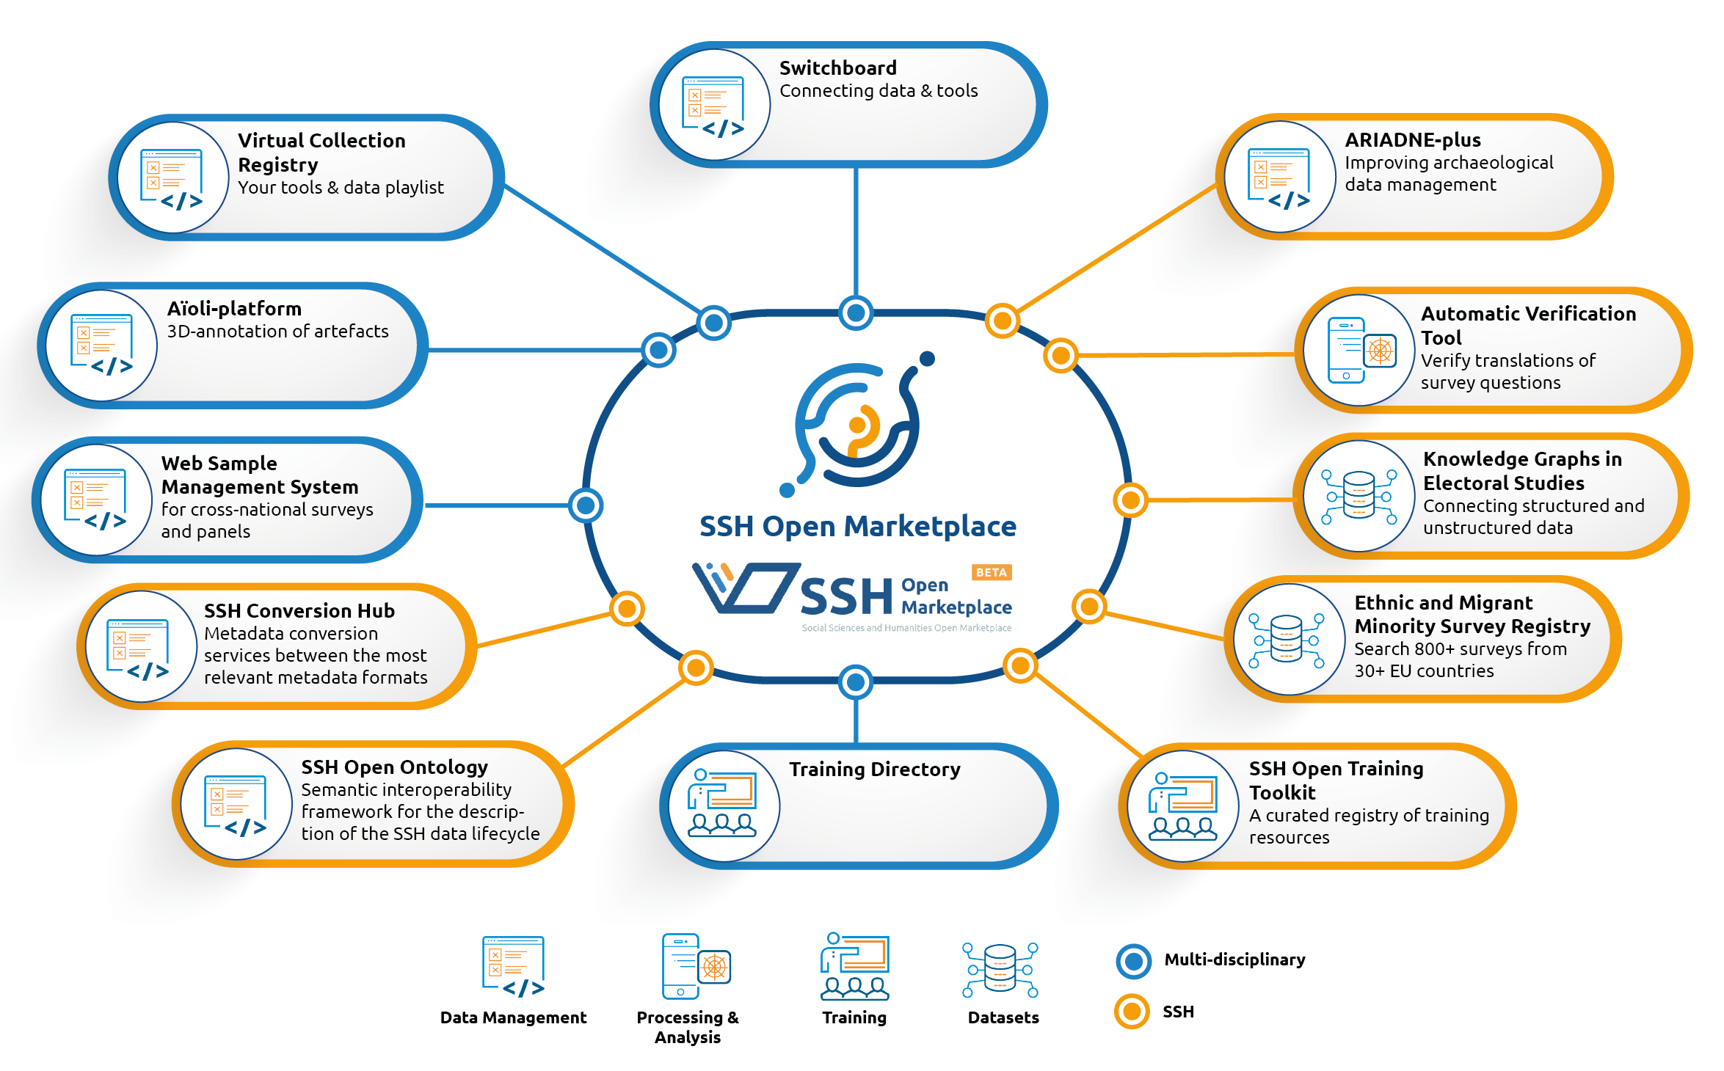
SSHOC Key Exploitable Results

Slide 10
Thank you for your attention!
Join our community
https://www.sshopencloud.eu
@SSHOpenCloud
info@sshopencloud.eu
/in/sshopencloud

