Slide 1
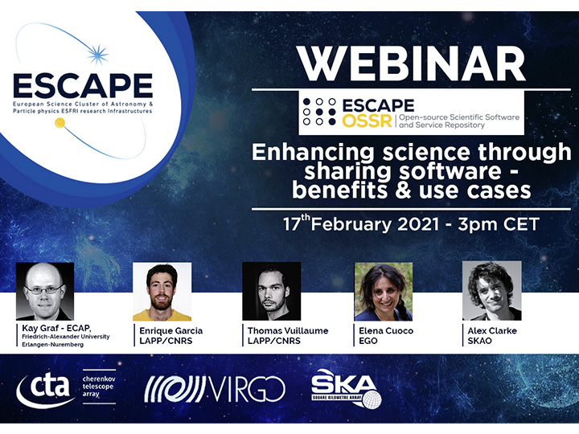

Slide 2
Enhancing science through sharing software – benefits & use cases
What’s Next and Closing Remarks
Kay Graf, ESCAPE OSSR Team Leader & General Manager at ECAP, Friedrich-Alexander University Erlangen-Nuremberg
ESCAPE OSSR Webinar - 17/02/2021

Slide 3
What’s Next and Closing Remarks
OSSR implements an open, inclusive repository (catalogue) for the Astrophysics, Astroparticle Physics and Particle Physics community
You can benefit from:
Onboarding science products into a FAIR, trust-worthy repository
Definition of best practices and standards; recognition of software as first-class open science product
Cross-fertilization through co-development, re-use and innovation
Technical implementations
Next Steps:
Finalise implementation
Continue software/service onboarding from partners
Integration into EOSC portal and Certification

Slide 4
Q&A
Feel free to ask your questions

Slide 5
Enhancing science through sharing software – benefits & use cases
Thank you!
Kay Graf, ESCAPE OSSR Team Leader & General Manager at ECAP, Friedrich-Alexander University Erlangen-Nuremberg
ESCAPE OSSR Webinar - 17/02/2021

Slide 6
Join our community!
Follow us on Twitter: @ESCAPE_EU
Follow us on LinkedIn: linkedin.com/company/projectescape/
Subscribe to our Newsletter: https://projectescape.eu/#mc_embed_signup

