Slide 1
ESCAPE and its wide synergies for a long-term perspective June 11 2021
Elena Cuoco, EGO & Scuola Normale
Inputs from Giovanni Lamanna and Ian Bird
https://projectescape.eu/

Slide 2
ESCAPE: European Science Cluster of Astronomy & Particle physics ESFRI research infrastructures
We bring together the astronomy, astro-particle, particle and nuclear physics communities

Slide 3
ESCAPE cluster main goals
Improve access to data and tools to unlock innovation for the society at large.
Provide data with FAIR principles: Findable, Accessible, Interoperable, Reusable
Build a European cross-border and multi-disciplinary open innovation environment for science, while connecting EOSC and ESFRI.
Facilitate interdisciplinary and networked research between different ESF/RI and digital SME
Adoption of common approaches for data management
Educate and train the scientific and wider user communities

Slide 4
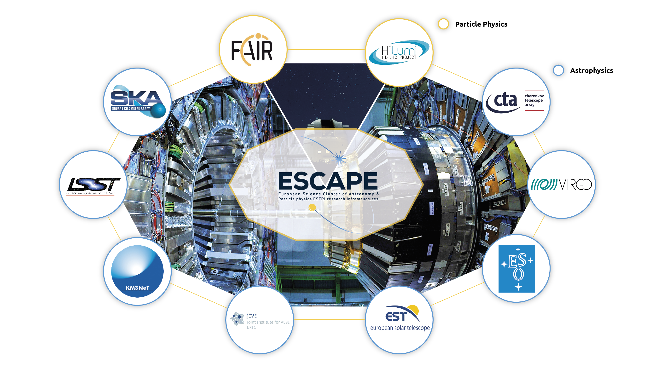
ESCAPE PARTNERs
The ESCAPE cluster comprises world-class research facilities in astronomy and particle physics. ELT, CTA, SKA, KM3NeT, EST, HL-LHC, FAIR, JIV-ERIC, LSST, EGO-Virgo.
(Credit: ESCAPE)

Slide 5
ESCAPE consortium
31 partners (including 2 SMEs)
7 ESFRI projects & landmarks: CTA, ELT, EST, FAIR, HL-LHC, KM3NeT, SKA
2 pan-European International Organizations: CERN, ESO (with their world-class established infrastructures, experiments and observatories).
2 European research infrastructures: EGO and JIV-ERIC
1 involved initiative/infrastructure: EURO-VO
4 supporting European consortia: APPEC, ASTRONET, ECFA and NuPECC.
Budget: 15.98 M€
Started: 1/2/2019
Duration: 48 months (end date 31/1/2023)
Coordinator: CNRS-LAPP
Formal commitment of their legal entities and management boards required by EC

Slide 6
ESCAPE consortium
Each RI legal entity commits together with a sub-set of associated national stakeholders.
The Director of each ESFRI/ RI is a member of the ESCAPE Supervisory Committee (E-SC)
The Chairs of national thematic consortia of Universities and Research Institutes such as APPEC, ASTRONET, ECFA, NuPPEC and an ESA representative in the ESCAPE External Advisory Board (E-EAB)
As per H2020 INFRAEOSC-04-2018 call - CLUSTER MEMBERSHIP and PARTNERSHIP

Slide 7
ESCAPE Work Programme
Data Lake:
Build a scalable, federated, data infrastructure as the basis of open science for the ESFRI projects within ESCAPE.
Software Repository:
Repository of "scientific software" as a major component of the “data” to be curated in EOSC.
Virtual Observatory:
Extend the VO FAIR standards, methods and to a broader scientific context; prepare the VO to interface the large data volumes of next facilities.
Science Platforms:
Flexible science platforms to enable the open data analysis tailored by and for each facility as well as a global one for transversal workflows.
Citizen Science:
Open gateway for citizen science on ESCAPE data archives and ESFRI community

Slide 8
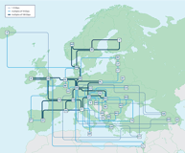
ESCAPE EOSC cell
Promoting, implementing and committing to Open Science
TSP’s
RI-Specific Science Platforms
Catalogue & Repository of resources
Datasets
Software & services
Tutorials
Training
Publications
Virtual Observatory
Science Platforms
Workflows, notebooks, deployment platforms, packaging
Citizen Science
Data Lake
FAIR data management
Content discovery and delivery
HPC
HTC
Grid clusters, etc
Private/public clouds
Commercial clouds
Notes:
Data Lake:
Build a scalable, federated, data infrastructure as the basis of open science for the ESFRI projects within ESCAPE. Enable connection to compute and storage resources.
Software Repository:
Repository of "scientific software" as a major component of the “data” to be curated in EOSC. Implementation of a community-based approach for the continuous development of shared software and for training of researchers and data scientists.
Virtual Observatory:
Extend the VO FAIR standards, methods and to a broader scientific context; prepare the VO to interface the large data volumes of next facilities.
Science Platforms:
Flexible science platforms to enable the open data analysis tailored by and for each facility as well as a global one for transversal workflows.
Citizen Science:
Open gateway for citizen science on ESCAPE data archives and ESFRI community

Slide 9
Why Science Cluster?
Build a Community
Interdisciplinary
Virtual Research Environment in EOSC framework
Cross-Domain R&D
FAIR data
Open to External Stakeholder (digital SME)
support synergies
enhance researchers’ participation in EOSC
reaching new communities and Research Infrastructures
future prospective for sustainability
Notes:
The Science “Cluster” is a very powerful concept:
Recognising synergies to build a coordinating community platform;
Integrating Physicists , data-scientists, computer science researchers, and digital SMEs;
ESCAPE is Virtual Research Space for Open Science, committed to EOSC implementation and sustainability;
ESCAPE is a platform for cross-domain R&Ds and FAIR-data uptake in response to the European Data Strategy.
The ESCAPE communities support the evolution of the work-programme:
supporting synergies (strong inter-cluster dialogue towards a shared vision)
enhancing researchers’ participation in EOSC
leveraging synergies, reaching new communities and Research Infrastructures (RIs)
evaluating future prospective for sustainability and role of the cluster

Slide 10
Enhance researchers’ participation in EOSC
…through (Test) Science Projects - TSPs
Originally part of the ESCAPE work programme, proposed to validate ESCAPE services for Open Science at the end of the project, ESCAPE-TSP concept finds consensus and evolves for a larger impact.
Stimulating and/or cooperating inter-domain open science (JENAA)
“bench” concept to enhance researchers’ participation in open science and cross-domain scientific research (and guiding the EOSC architecture).
Included in EOSC Future

Slide 11
Enhance researchers’ participation in EOSC
TSPs are multi-domain science integration across ESCAPE
demonstrate new cutting edge open science capabilities, making use of the services implemented within ESCAPE
feedback on the capabilities delivered by ESCAPE
benefit real science goals in exploring synergies between the ESFRIs and largely among three scientific communities Astrophysics/Astroparticle, accelerator-based Particle and Nuclear Physics (supported by consortia of EU member states, Universities/Institutes )
1. Dark Matter Science Project
2. Extreme Universe & Gravitational waves Science Project
A top-down endorsement for a bottom-up approach based on Expression of Interests (EoI) subscribed by researchers

Slide 12
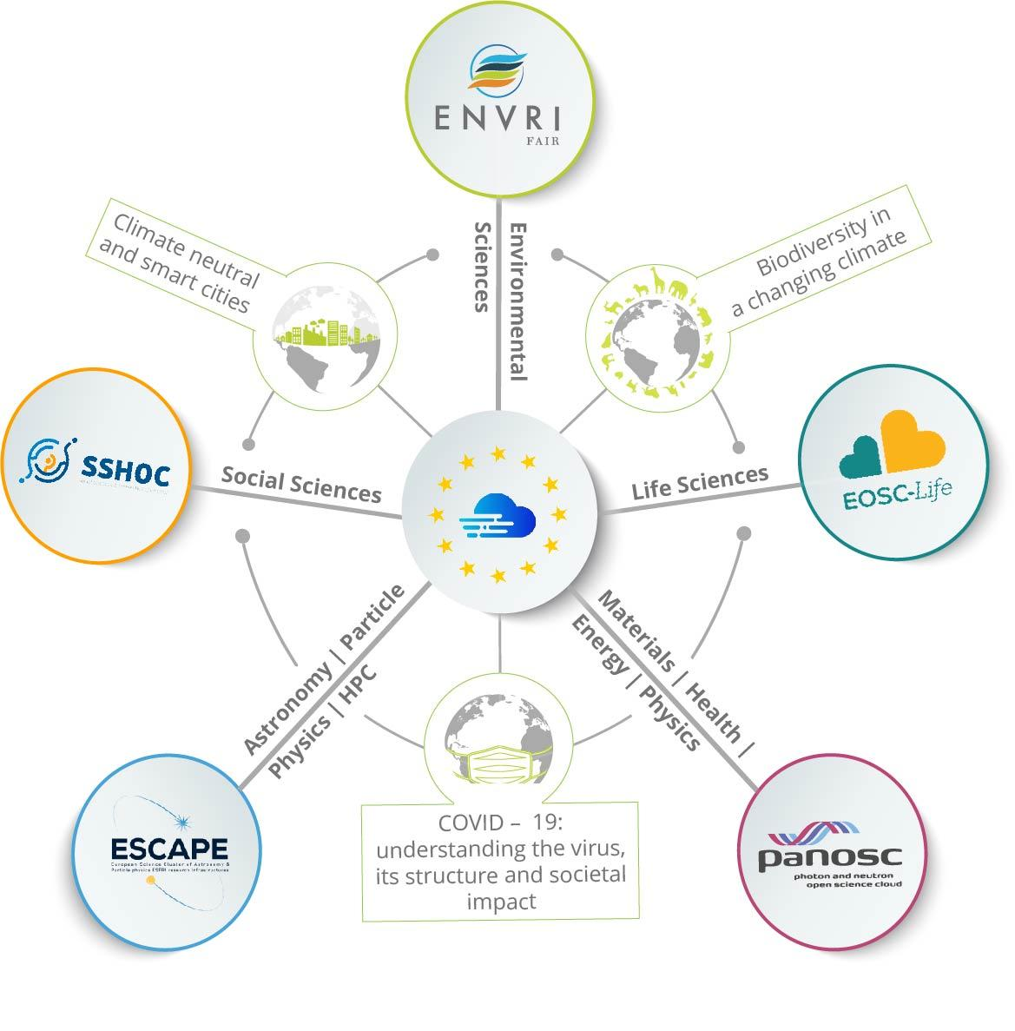
Reaching new communities
Synergy between Science Clusters
&
e-infrastructures
EOSC Service Delivery
Innovation capacity and procurement
Architecture and Interoperability
Design and Development of Portal Layers
Training and Skills
Integration of Community Services and Products
Dark Matter
Extreme Universe

Slide 13
Reaching new communities
ESCAPE Innovation Capacity and Procurement
Co-developments with digital SMEs, e.g.
Wavefier: real-time Machine Learning Classifier for transient signals in Gravitational Waves
Gamma-Learn: real-time Machine Learning pipeline for Gamma-ray astronomy
Combining ESCAPE with European Regional Development Fund programme ( ex. cooperation, training and innovation schemes for Society and Economy - IDEFICS @ LAPP)
Leveraging industrial ICT cooperation schemes (within ESCAPE ESFRI RIs)
ESCAPE results and actions for Open Science are reaching out (ex. Discussions in progress with ASTRI, DUNE, GANIL-SPIRAL2, FCC et al.) and becoming global (e.g. USA, Japan, etc.)

Slide 14
Future perspectives and role of Cluster
Certified open archive to be exploited by any new Big Science research facility to share innovation, practices and methods.
Any digital object from R&D and innovation works within the ESCAPE community should be FAIR and accessed from a single entry point
[…]
Outlook into the future (e.g. Horizon Europe) :
ESCAPE community proposals for EOSC connections with the Common European Data Spaces.
Industrial (manufacturing), health and skills data space
Green deal and Energy data space
Notes:
Certified open archive to be exploited by any new Big Science research facility (e.g. FCC) to share innovation, practices and methods about energy/water/heat management, environmental protection, etc.
Any digital object from R&D and innovation works within the ESCAPE community should be FAIR and accessed from a single catalogue (ex.: Solid-state, gaseous detectors et al. legacy data for further innovation; green technologies for detectors; nuclear and particle physics for health and society; co-creation with industries; interdisciplinary nuclear physics application; interconnections among astronomical telescopes and geoscience; new global EU approaches on micro-electronics, HPC, firmware and Quantum Computing/Technology

Slide 15
Future perspectives and role of Cluster
“Science Cluster” scheme is a potential model of “coordinating structure”, because it combines the top-down and bottom-up
ESCAPE towards a sustainable large domain platform, shaping and operating within EOSC

Slide 16
ESCAPE Future
Synergies
Communities overlap (astro/pp/np), new experiments mix communities
Common Funding Agencies
Co-located computing facilities
Strength and benefits
European Strategy for Particle Physics had strong input from ESCAPE domains
Consortia: ECFA, APPEC, NuPECC, Astronet, (+ JENAA) coordinate at a high level, and oversee ESCAPE
Strong coordinated voice and support to EC and EOSC Association.
Federated, collaborative infrastructures optimise use of available funding

Slide 17
ESCAPE Future
ESCAPE intends to remain as a collaboration after the end of the current project
Sustained thematic consortium for the sustainability of EOSC
Additional thematic RI’s are interested in participating
Many potential collaborative actions
Data Management at Exascale
Common software challenges
Cross-fertilisation of software tools and services
Building a platform for multi-messenger astronomy and cross-domain collaborations
Connection of data infrastructure to heterogenous computing

Slide 18
ESCAPE long term activity
Services for integration of the Exabyte scale data infrastructure supporting Open Science and FAIR data;
Interoperable data-analysis platform
Development and sustainability of the services for the software catalogue and workflow
Partnership with EuroHPC/Prace/FENIX to provide the services for integration of Data-Lake with HPC resources;
Collaborative scientific environment. Include new ESFRI and SME
Global integration of some of the above with global partners in USA, Australia and Africa

Slide 19
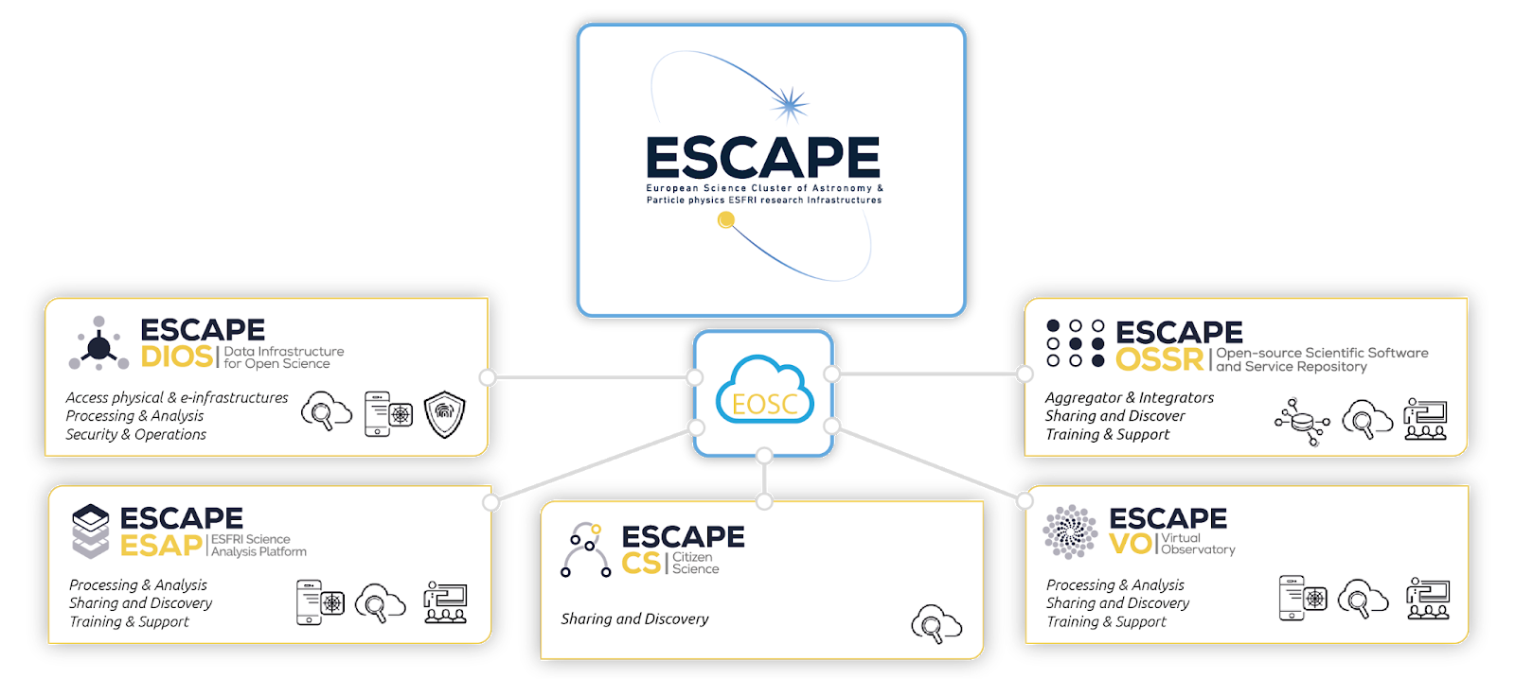
Summary
ESCAPE brings together Astronomy, Astrophysics, Astro-Particle, High Energy and Nuclear Physics communities
Broader synergies within a large scientific community and for innovation/society
Broader synergies with the other Science Clusters , e-infrastructures for EOSC

Slide 20
Thank you!
elena.cuoco@ego-gw.it

