Slide 1
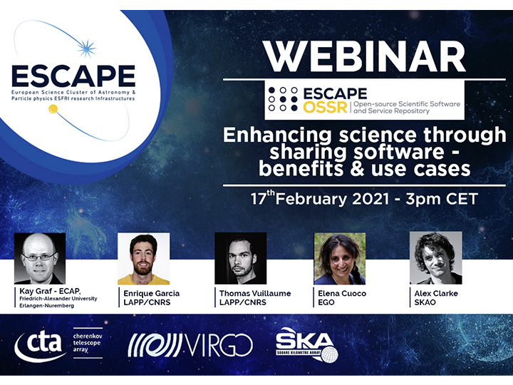

Slide 2
Enhancing science through sharing software – benefits & use cases
Exploring scientific data with innovative techniques
Elena Cuoco, European Gravitational Observatory and Scuola Normale Superiore
ESCAPE OSSR Webinar - 17/02/2021

Slide 3
Innovative workflow: why?
The amount of data generated by large astro and particle physics experiments is increasingly becoming a challenge for standard algorithms.
The need to have large data archives with easy access, to be able to label each object in an astrophysical catalog, as well as the need to classify noise or signal sources, without human intervention
We need to be ready for new data analysis paradigms when SKA, CTA, Km3NeT, Einstein Telescope, Vera Rubin, etc...will be operational

Slide 4
Joint analysis of large flux of data: real time analysis
Open access to data and software will enable new solutions for data analysis
We want to be able to easy find data from experiments, access their code and analyse the data
Gravitational Wave Alert systems to be fast enough for Electromagnetic follow up
Application to Data analysis workflows
Artificial Intelligence
We need to boost the send out of alterts for the multimessenger analysis

Slide 5
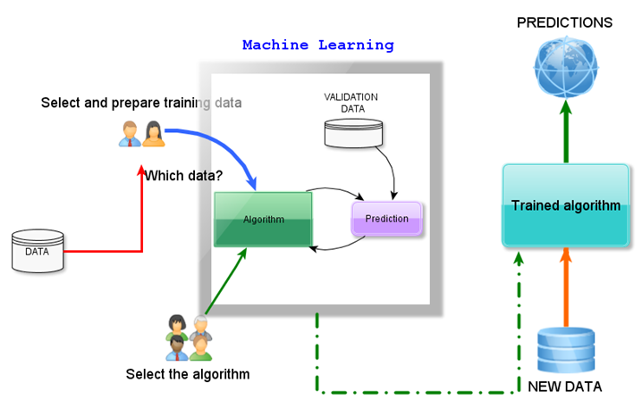
Machine learning workflow

Slide 6
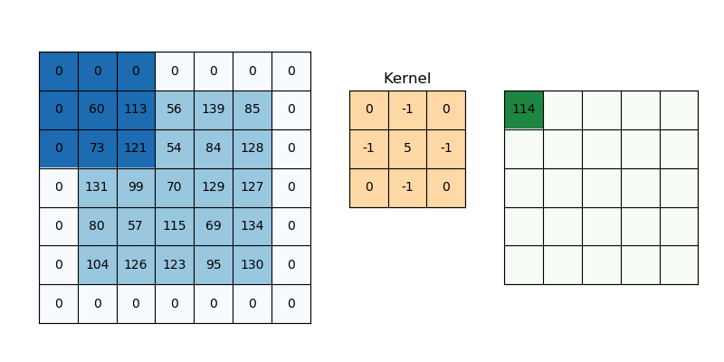
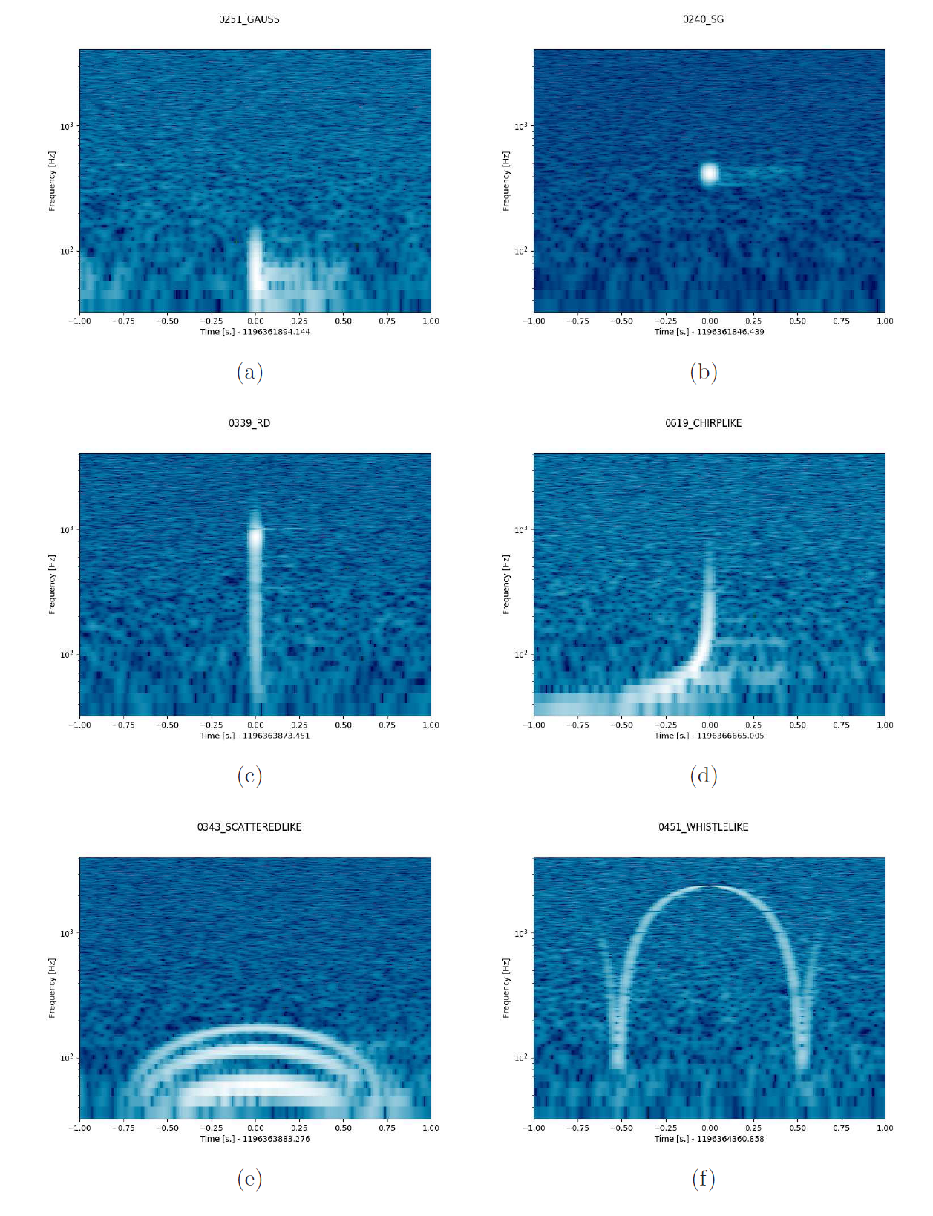
Deep learning: Convolutional Neural Network

Slide 7
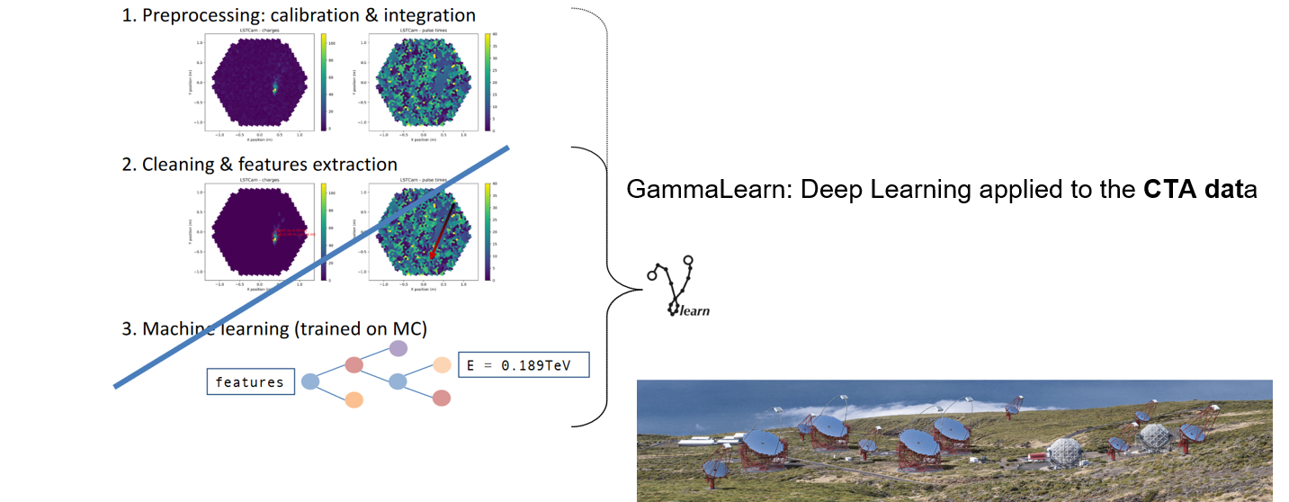
Machine Learning workflow in ESCAPE partners
KM3NeT-ORCA/ARCA
Cherenkov Telescope Array
Square Kilometre Array (SKA)

Slide 8
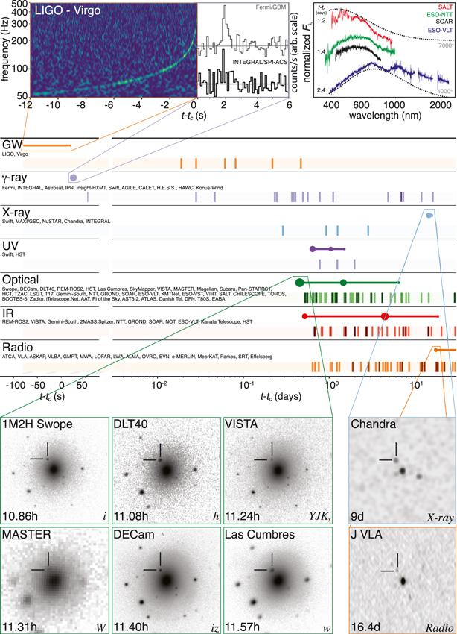
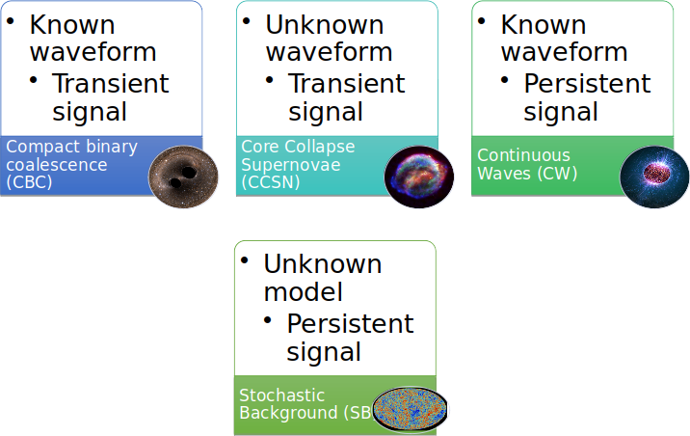
Multimessenger Astronomy and Gravitational Wave Transient signals
EM: supernovae emission, long GRB
EM: short GRB, kilonova
The Astrophysical Journal Letters, Volume 848, Number 2

Slide 9
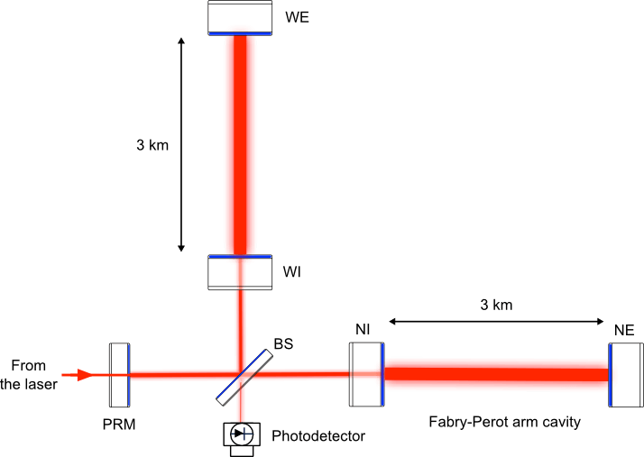
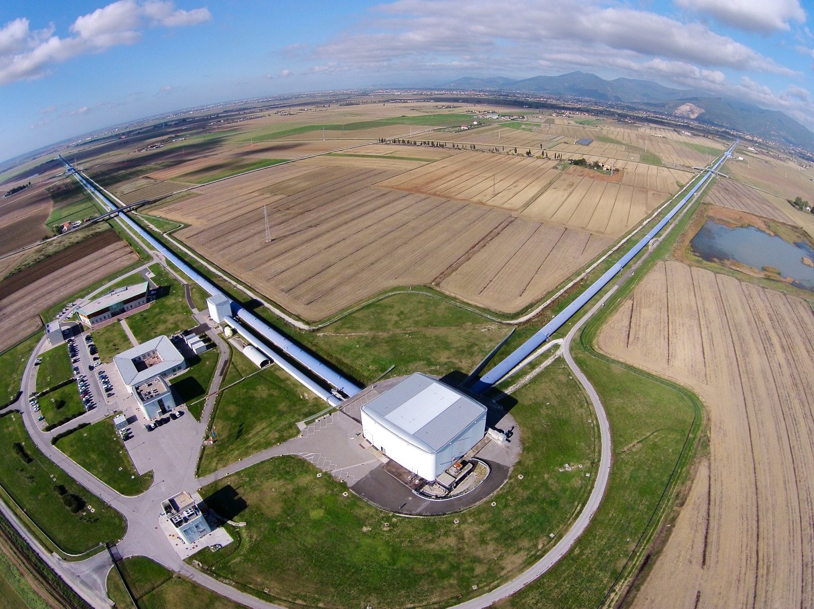
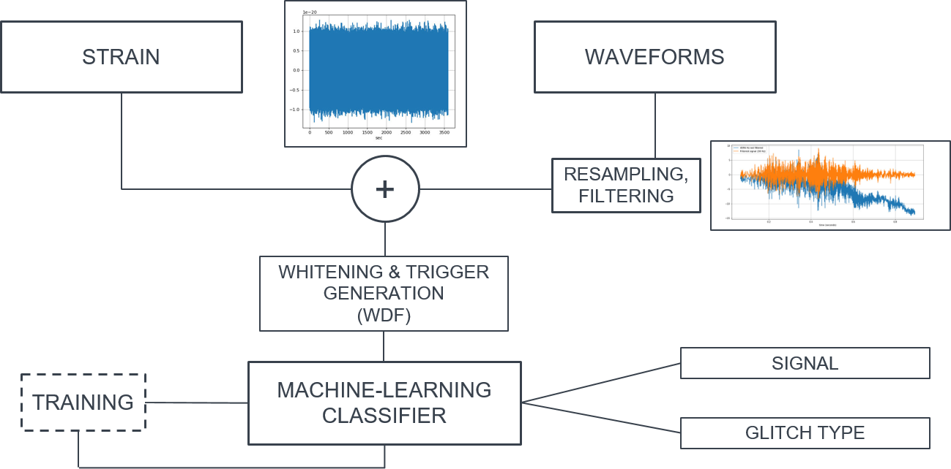
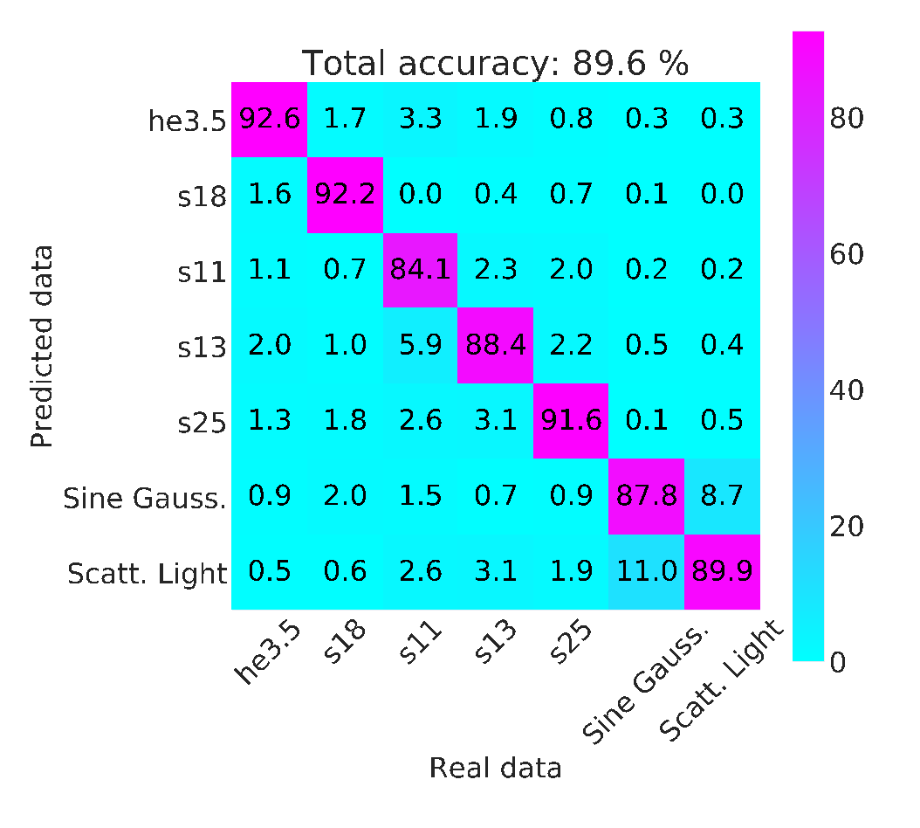
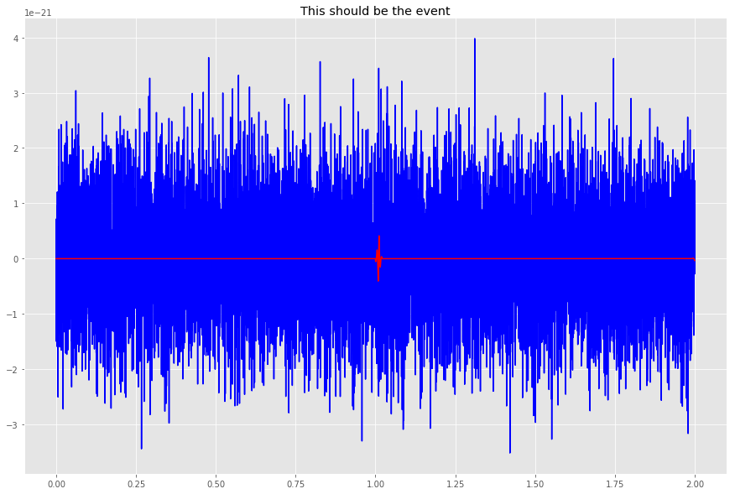
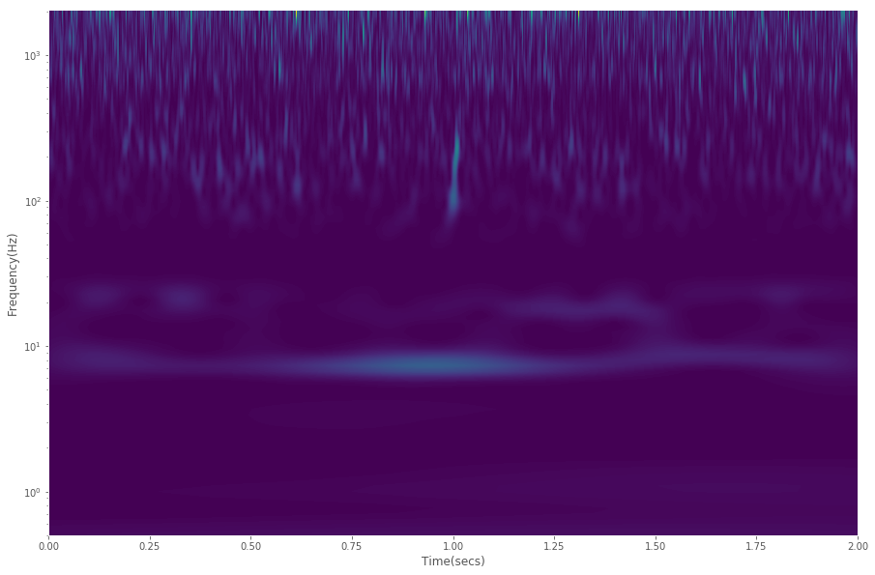
ML workflow for Gravitational Wave search
Iess, Cuoco, Morawski, Powell, https://doi.org/10.1088/2632-2153/ab7d31

Slide 10
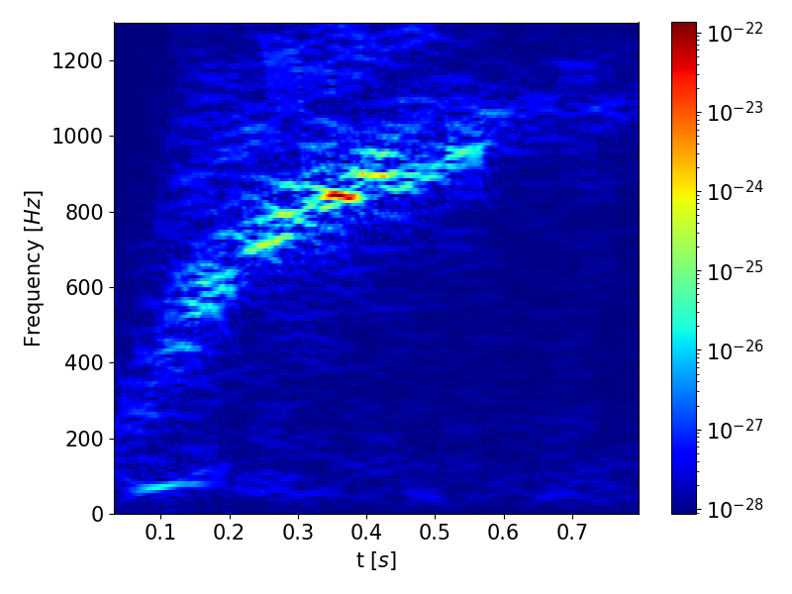
Innovation example: Hangar @Virgo
DATA VERSIONING WITH HANGAR
Open Source with Git-like semantics
Keep track of changes to data
Zero-cost branching
Merging between branches
Abstracted storage of data files on disk
Pushing and pulling changes to remotes
Alberto Iess, Filippo Quarenghi
Possibility to store and access time-frequency datasets with different spectrogram parameters
Access datasets based on distance and source properties
Decreased training time by removing «on the run» spectrogram generation
Reduced disk usage at VIRGO
HANGAR IN A VIRGO ML PIPELINE
Core-Collapse Supernova Classification
Store full science segments based on GPS starting times
Store individual time series or spectrogram samples around triggers

Slide 11
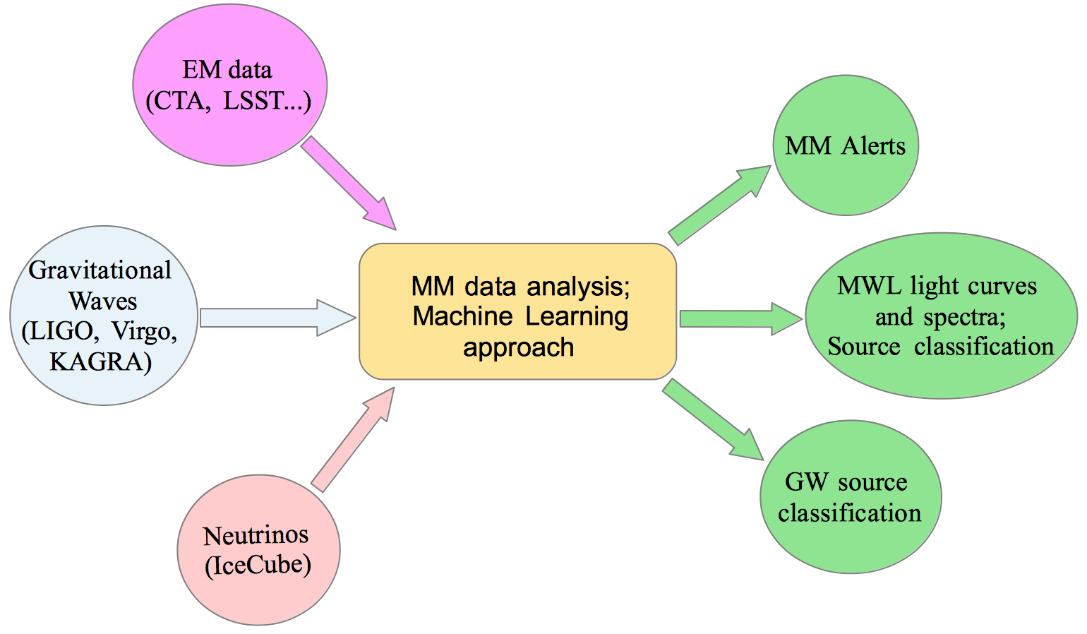
Real time multi-messenger analysis

Slide 12
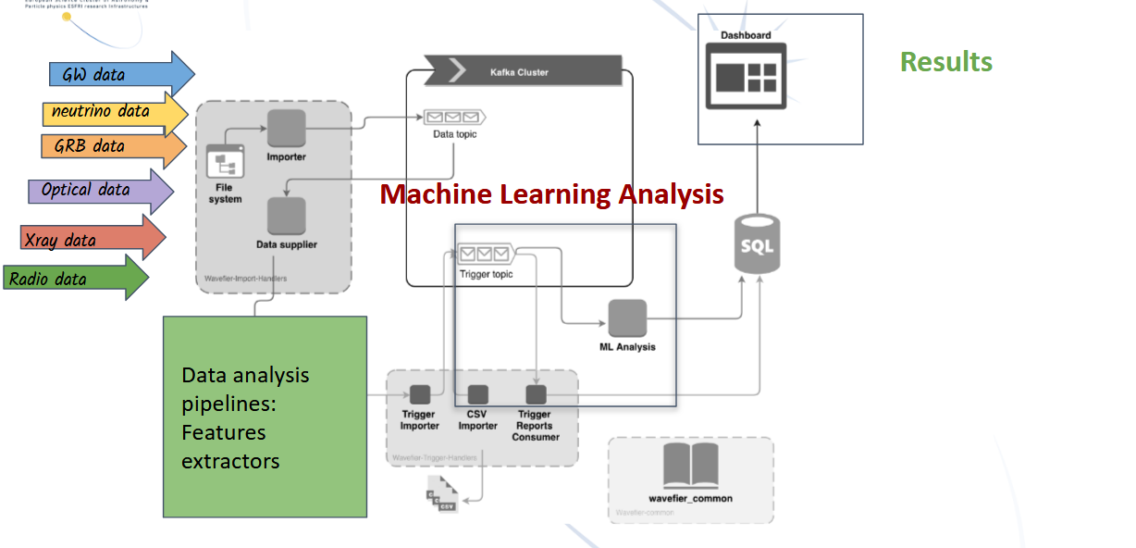
MultiMessenger Astronomy in ESCAPE & Wavefier
Cuoco, Patricelli, Chanial, Iess, Morawski, Vallero,…

Slide 13
Future Perspectives
With 3rd Generation GW detectors and the new astronomical facilities (LLST, ELT, SKA, CTA, KM3NET, ...), we should change the paradigma in the way we will do Multi-messenger astronomy.
Collaboration will be not simply follow up, but sharing data: open science, open data
Real-time analysis will be a keyword

Slide 14
Enhancing science through sharing software – benefits & use cases
Thank you!
Elena Cuoco, European Gravitational Observatory and Scuola Normale Superiore
Head of EGO data science office. COST Action CA17137 (G2net) chair. ESCAPE General Assembly chair.
Twitter: @elenacuoco www.elenacuoco.com elena.cuoco@ego-gw.it elena.cuoco@sns.it
ESCAPE OSSR Webinar - 17/02/2021

Slide 15
Join our community!
Follow us on Twitter: @ESCAPE_EU
Follow us on LinkedIn: linkedin.com/company/projectescape/
Subscribe to our Newsletter: https://projectescape.eu/#mc_embed_signup

