Slide 2
LOFAR use cases as experimented on the federated data lake
Yan Grange, Vishambhar Nath Pandey

Slide 3
LOFAR - science
From the first stars formed 13Gy ago to to yesterdays lightning on earth,
and anything in between

Slide 4
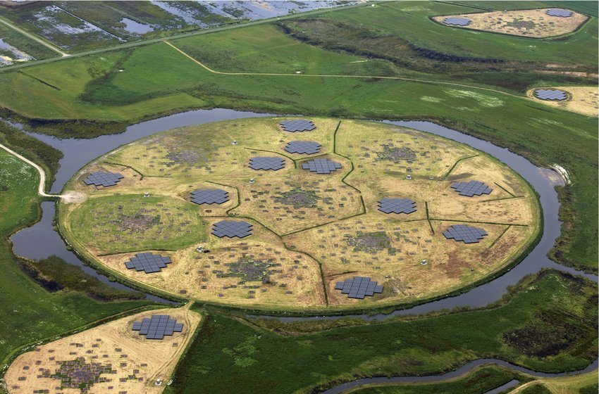
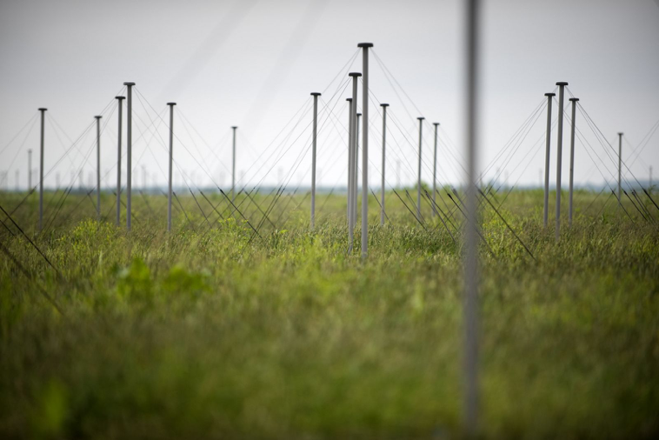
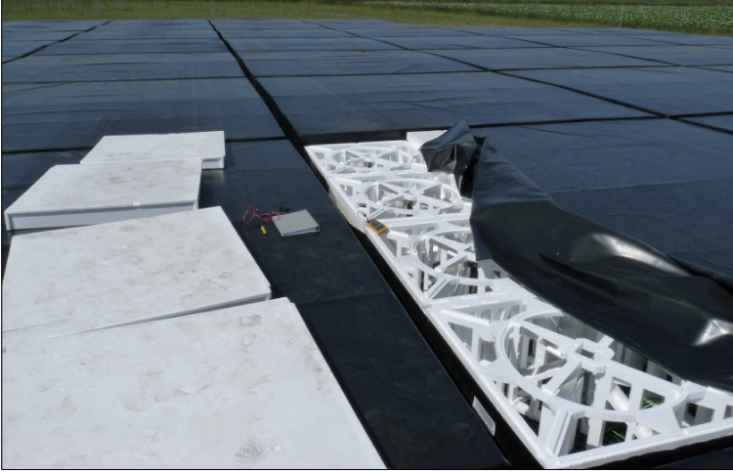
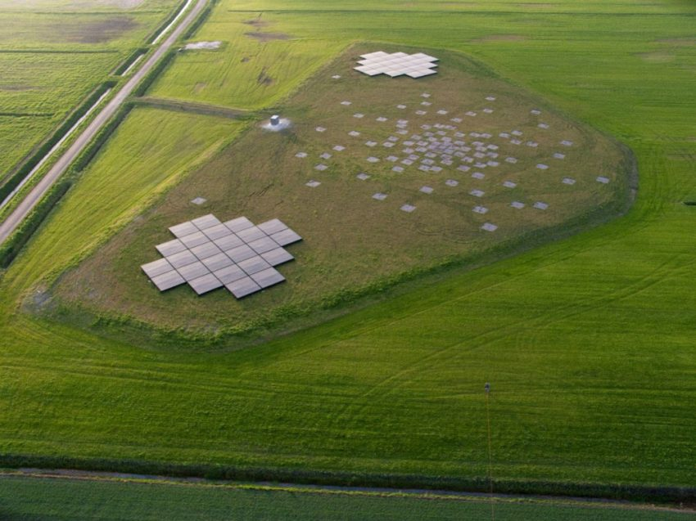
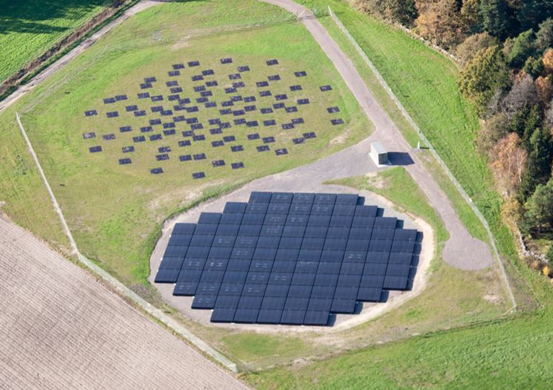
LOFAR - instrument
1,7m
Low-Band Antennas
10-90 MHz
1x
High-Band Antennas
110-240 MHz
38x
14x (+1)
5m

Slide 5
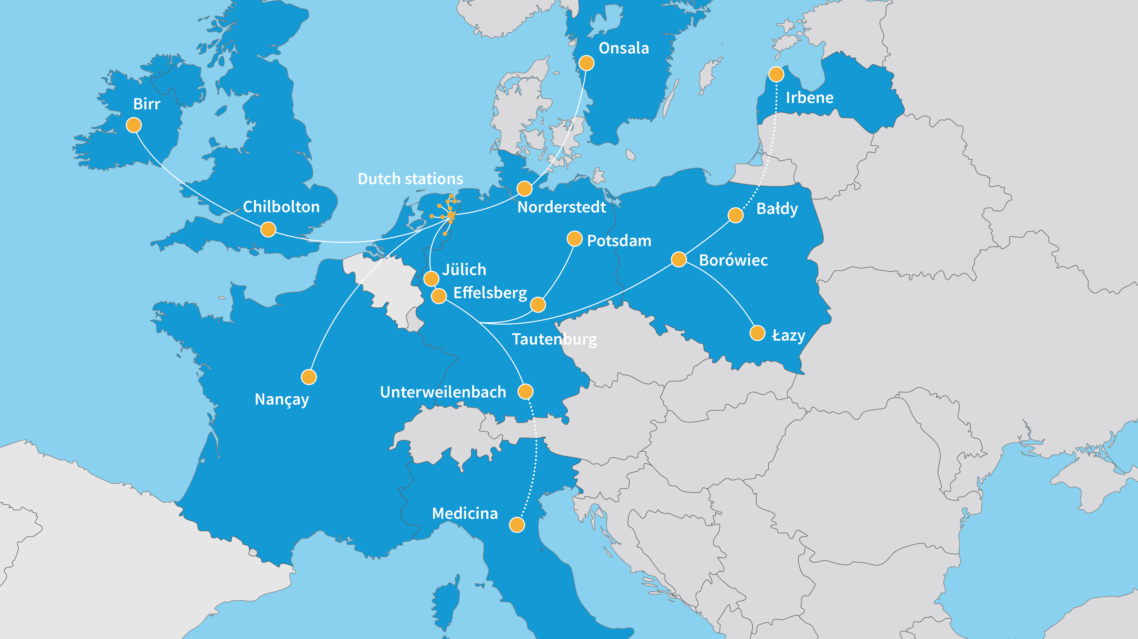
LOFAR - array

Slide 6
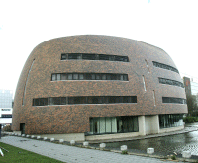
LOFAR – data flow
228 Gb/s

Slide 7
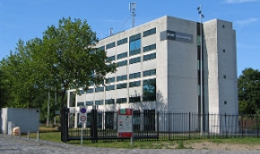
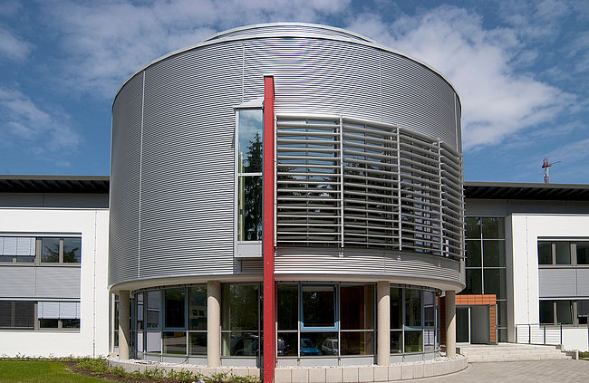
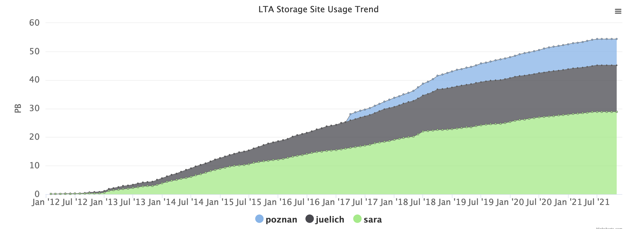
LOFAR – data flow
20 Gb/s
~7 PB/yr

Slide 8
DIOS, ESCAPE
LOFAR is not an ESFRI in ESCAPE. But SKA is and we are a prototype for SKA.
Goal of the exercise is to apply the Data Lake model to our workflow.
Currently data management is mostly in-house, location info is in the observational database. Not a lot of automation on where data from an observation goes

Slide 9
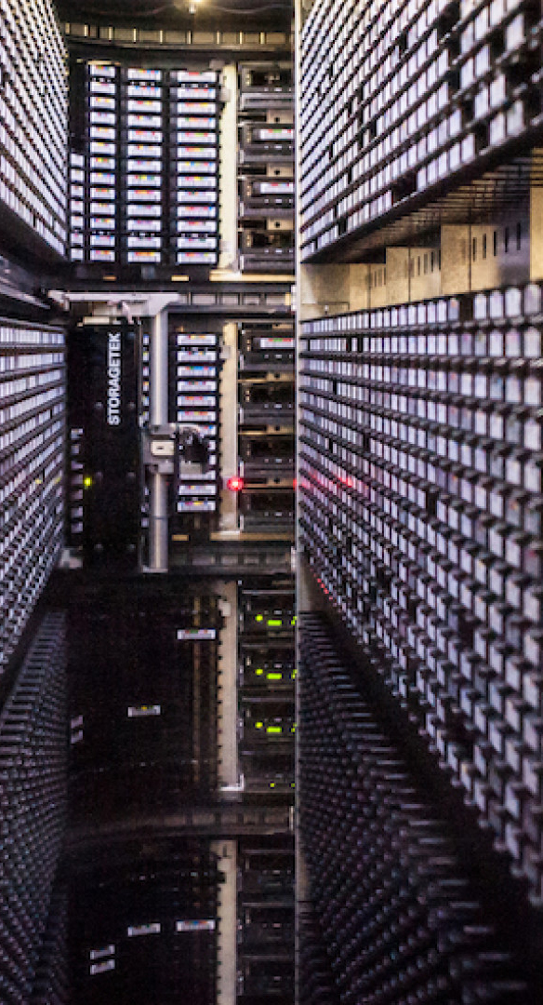
Use case 1: Data ingest
Data is generated in Groningen, and needs to be ingested into the archive.
There all data goes to tape (or in QoS lingo: cheap long-term storage).
Since someone requested the observation, we expect there to be requests to download it during the first week, so we keep it on disk for a week (or in QoS lingo: fast storage)
For the copy itself we want to be able to use custom tooling, and register the copied data in the Datalake.

Slide 10
Use case 2a: Data processing
Target
To correct for effects between the target and the telescope, we first observe a calibrator of which properties are well-known, compute corrections and apply them to the “target” (ie the source we want to observe).
Goal of the exercise: combine multiple files to a data set (i.e. an observation) and combine multiple observations to a single container.
+

Slide 11
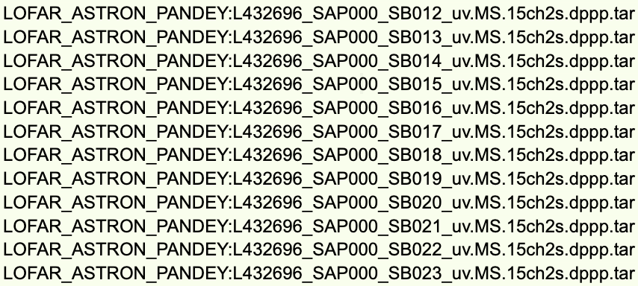
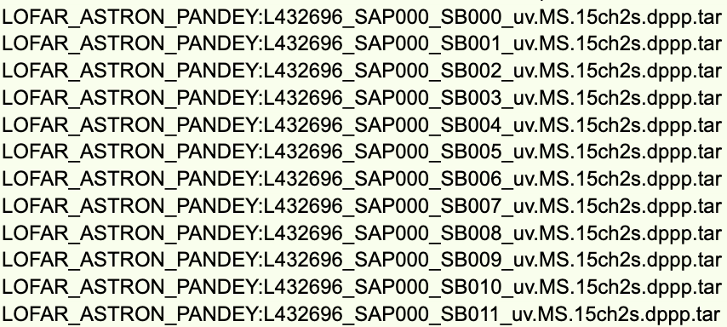
Use case 2a: Data processing
Observation consists of many several frequency bands (we all those subbands). For the experiment we created 3 ‘observations’ which are part of the same container (e.g. a calibrator and 2 targets).
Package
Set 1
Set 2
Set 3

Slide 12
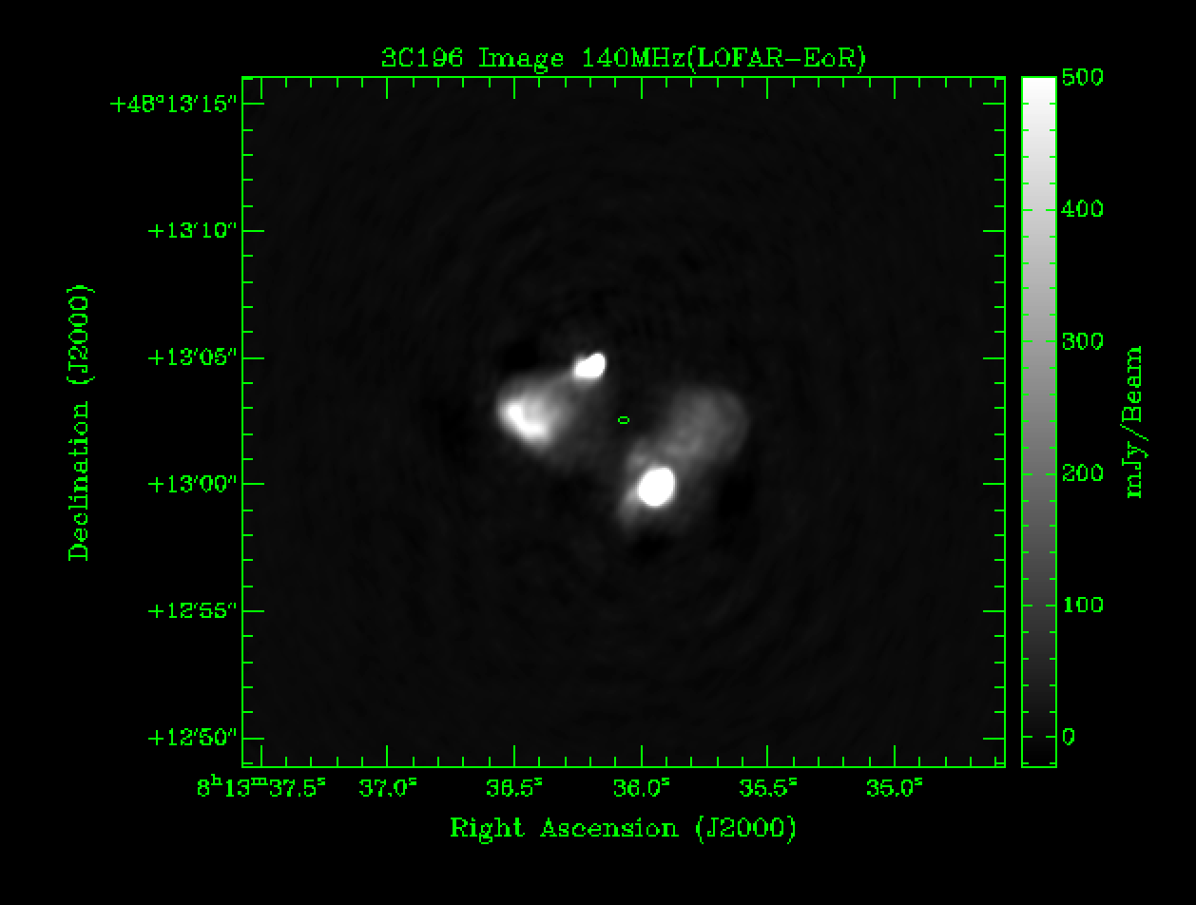
Use case 2a: a LOFAR image!

Slide 13
Use case 2b: Combining images
Now that we have a LOFAR image, we want to be able to combine this image, in the Datalake, with a publically available image from a telescope in a different wavelenth.
In ESCAPE, the ESAP work package is developing a science analysis platoform framework. This use case means to bring together:
ESCAPE ESAPfor querying both data sources
Virtual Observatory (ESCAPE Work Package 4) standards
Datalake as a Service (the Jupyter notebook that provides access to data in the Datalake)

Slide 14
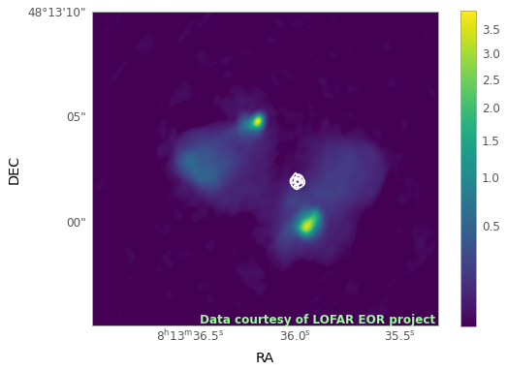
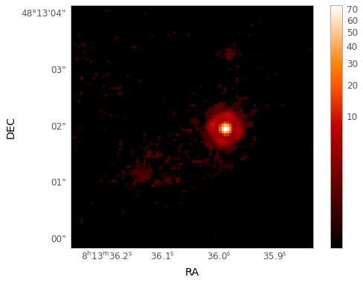
Use case 2b: Resulting image
LOFAR image of 3C196 with contours from a Hubble Space Telescope image of the same source (in white)!

Slide 15
DIOS for radio astronomy
Automating data placement and management has potential for facilities with a distributed archive
We continue to investigate how we could be using the DIOS architecture for our data management needs, taking into account where some extra investigations may be needed
e.g. synchronisation of metadata between the catalogue and the Datalake, public data access (both the authorisation as well as ease of use for one-off users), data embargoes (data is private for a year after it becomes fully public).
Of course, as a prototype for SKA and involved in the SKA Regional Centre work, also involved in the prototyping happening in the context of the SKA.

Slide 16
Ongoing efforts
Will be setting up our own Rucio instance (maybe together with others) to continue prototyping and getting a good handle on how to manage such an instance, also bringing the work past the ESCAPE project.
We have several projects with data streams that could be managed as an experiment, e.g. EoR project Groningen – Dwingeloo, MeerKAT data from Cape Town to Dwingeloo, …
Furthering the integration between the DIOS work and the other parts of ESCAPE.

