Slide 1
Populating EOSC for the Life Sciences
Niklas Blomberg, Project Coordinator
Michael Räß, WP8 lead

Slide 2
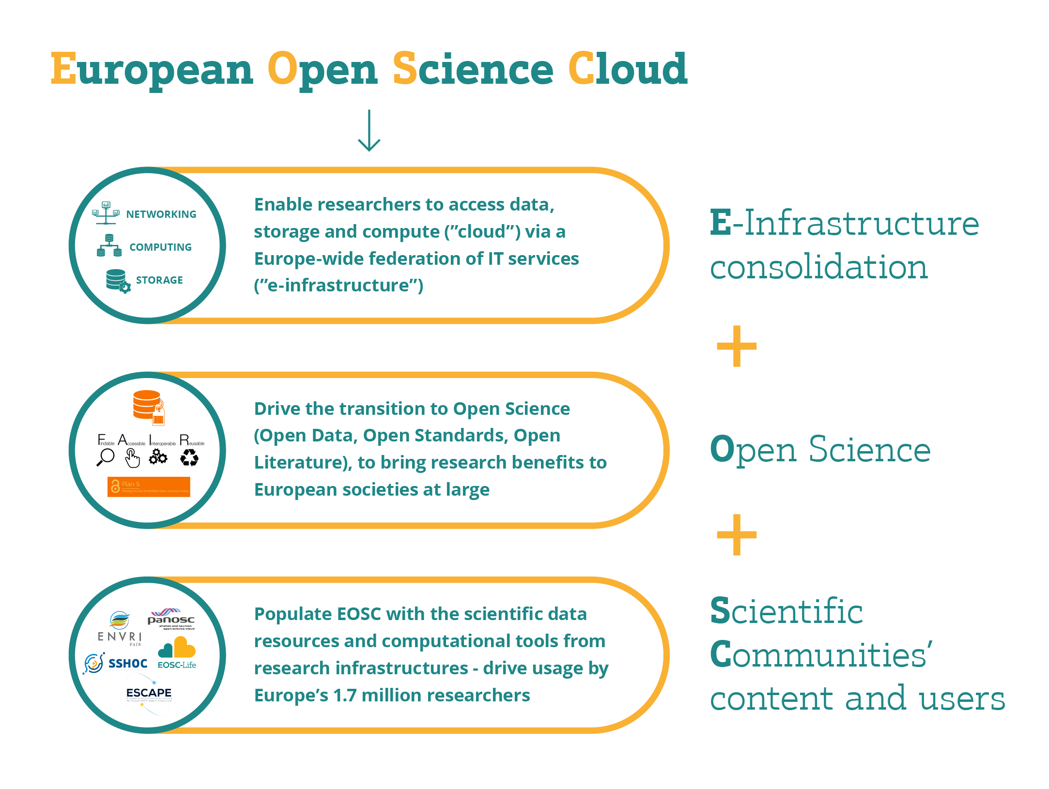
  EOSC landscape consolidating – and EOSC-Life is integral to this consolidation

Slide 3
Life science data is rich and diverse
Connecting digital life science data will allow us to address major challenges facing humanity
EOSC-Life provides solutions so that life scientists can make use of data, tools and workflows in the cloud
Notes:
Life science data is rich and diverse
The Life Science Research Infrastructures provide access to ad- vanced instruments and research facilities that describe biology from single molecules to ecosystems and long-term population cohorts.
Connecting digital life science data will allow us to address major challenges facing humanity
These include the 5 EU missions in Horizon Europe:
• Cancer
• Adaptation to climate change including societal transformation • Healthy oceans, seas, coastal and inland waters
• Climate-neutral and smart cities
• Soil health and food
EOSC-Life provides solutions so that life scientists can make use of data, tools and workflows in the cloud
Vast amounts of data are processed and analysed daily in the life sciences. EOSC-Life aims to make data, tools and analysis work- flows more findable, accessible, interoperable and reusable (FAIR) through cloud deployment of these resources.

Slide 4
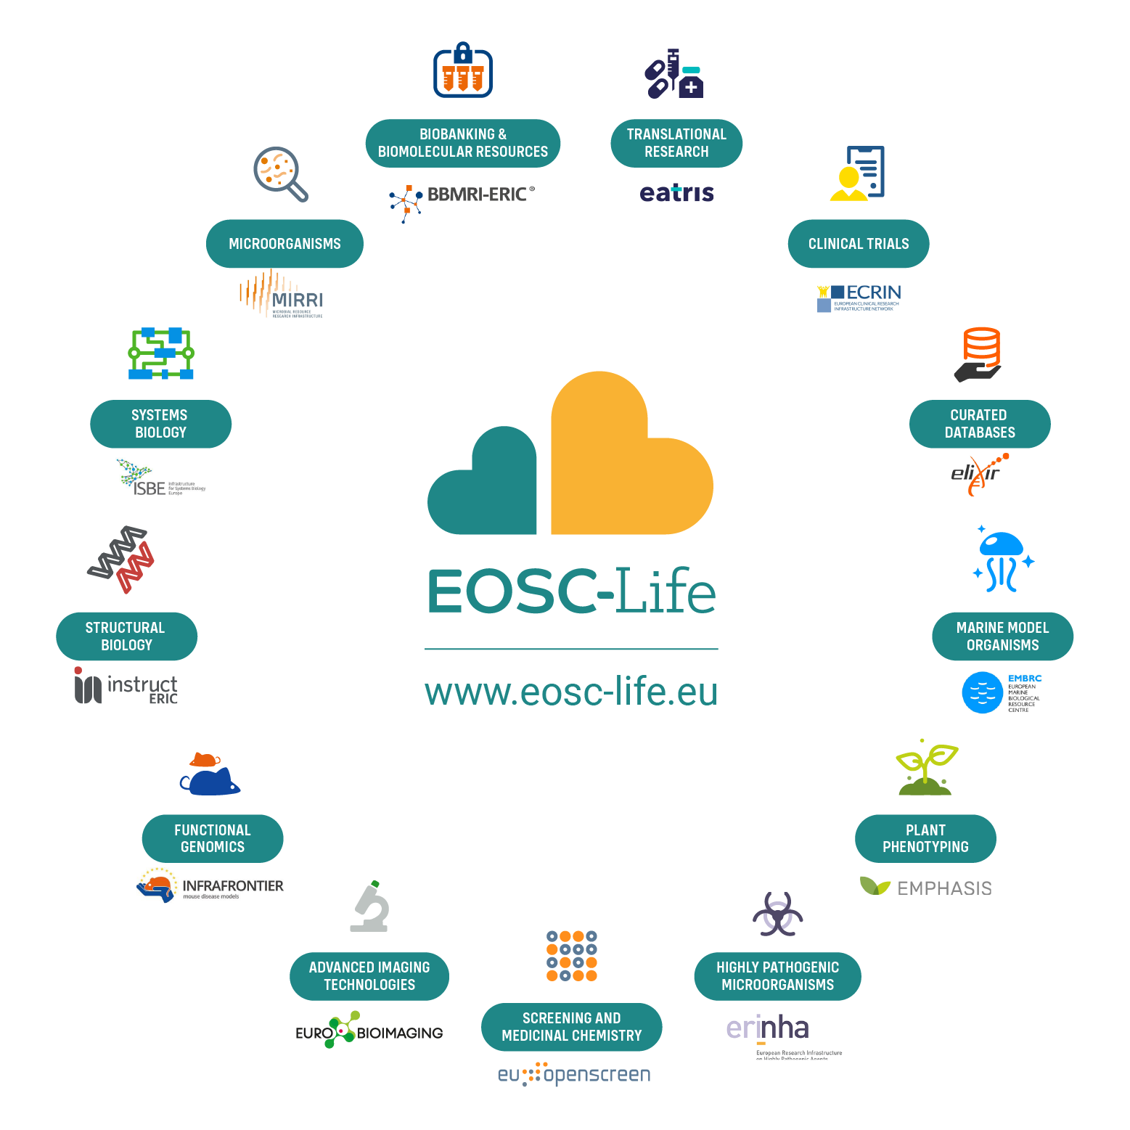
EOSC-Life
Establish EOSC-Life by publishing FAIR life science data resources in EOSC
Provide the policies, guidelines and processes for secure and ethical data reuse
Populate an ecosystem of innovative life science tools in EOSC
Enable data-driven research in Europe by connecting life scientists to EOSC via open calls for participation
Notes:
For example – we had a call before summer for datasets; work to publish the first cohort of FAIR RI data resources in the cloud is now underway
And
Resleased guideline documents on FAIR, secure data access with mapping of national capabilities
Several training events and hackathons to build capacity in RI’s for federated, cloud-based analytics in our tools work-package

Slide 5
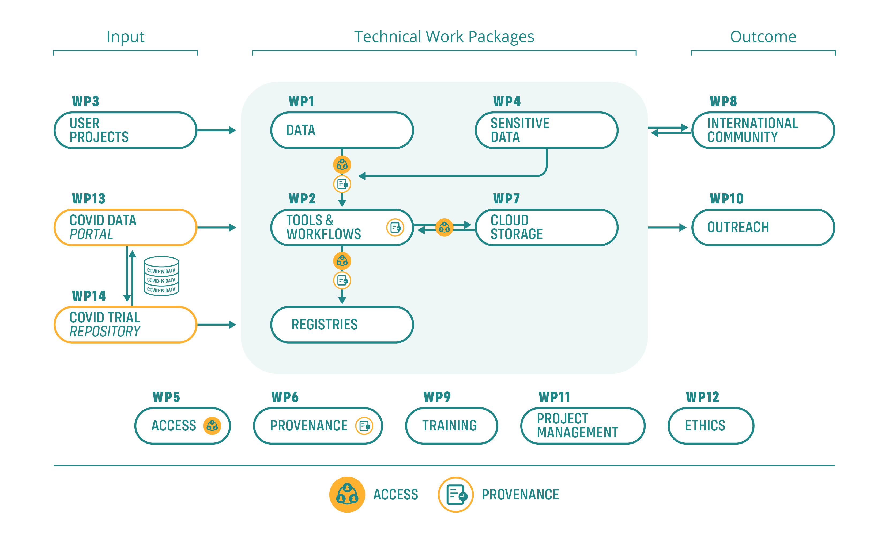
EOSC-Life prepares European life science for a new way of working
    People: skills, new capabilities and networks
    Experience and processes for consolidated RI service delivery
    Life science data resources, workflows, registries and other services
    Training materials, policies, guidelines (FAIR, Sensitive data)
Notes:
By populating EOSC-Life, we are not merely fulfilling a project’s goals—we are building tools and training people to make this the new normal for life science data. European scientists should be able to collaborate and reuse data regardless of where they are based. Training programmes, workshops and hackathons help to prepare our users for a new way of work- ing. Open calls and demonstrator projects guide our developments and create examples for other projects—illustrating the capabilities of EOSC-Life.

Slide 6
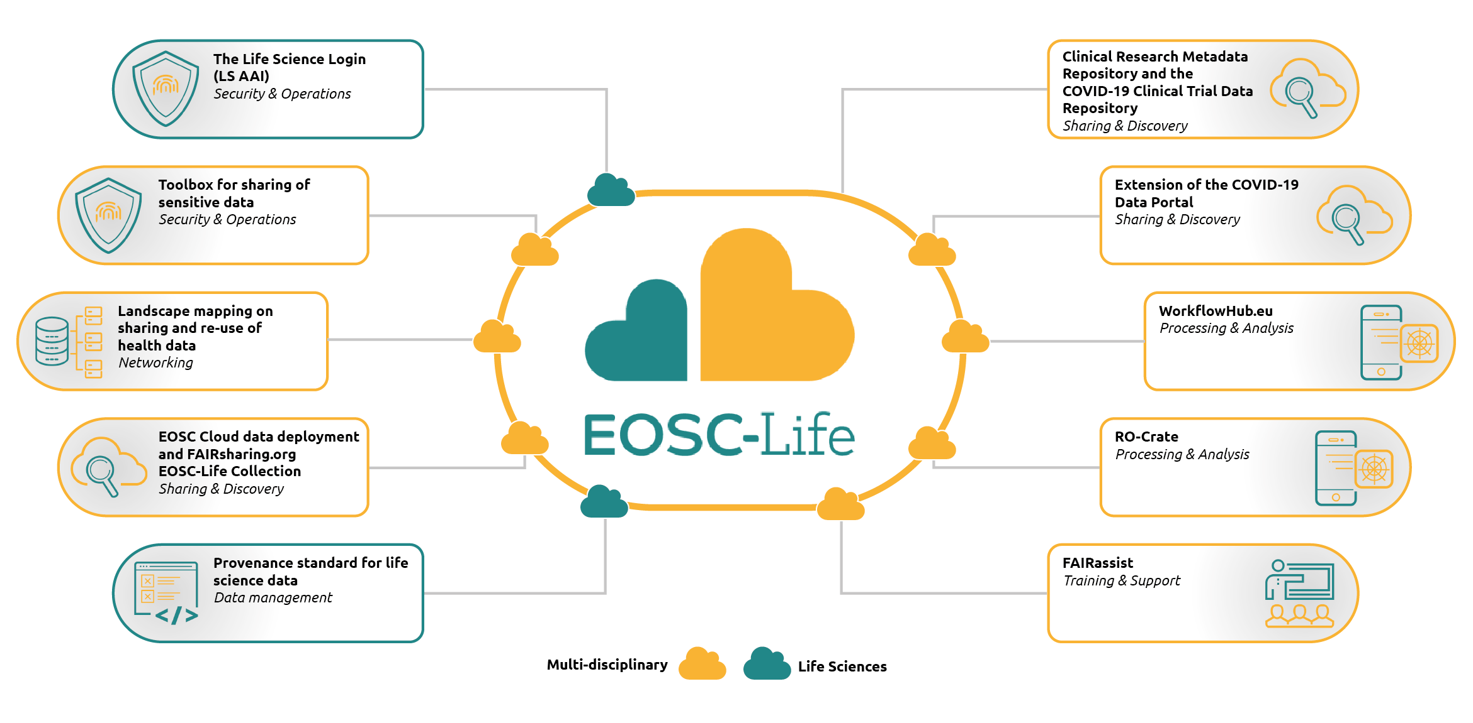
Exploitable results – EOSC Life

Slide 7
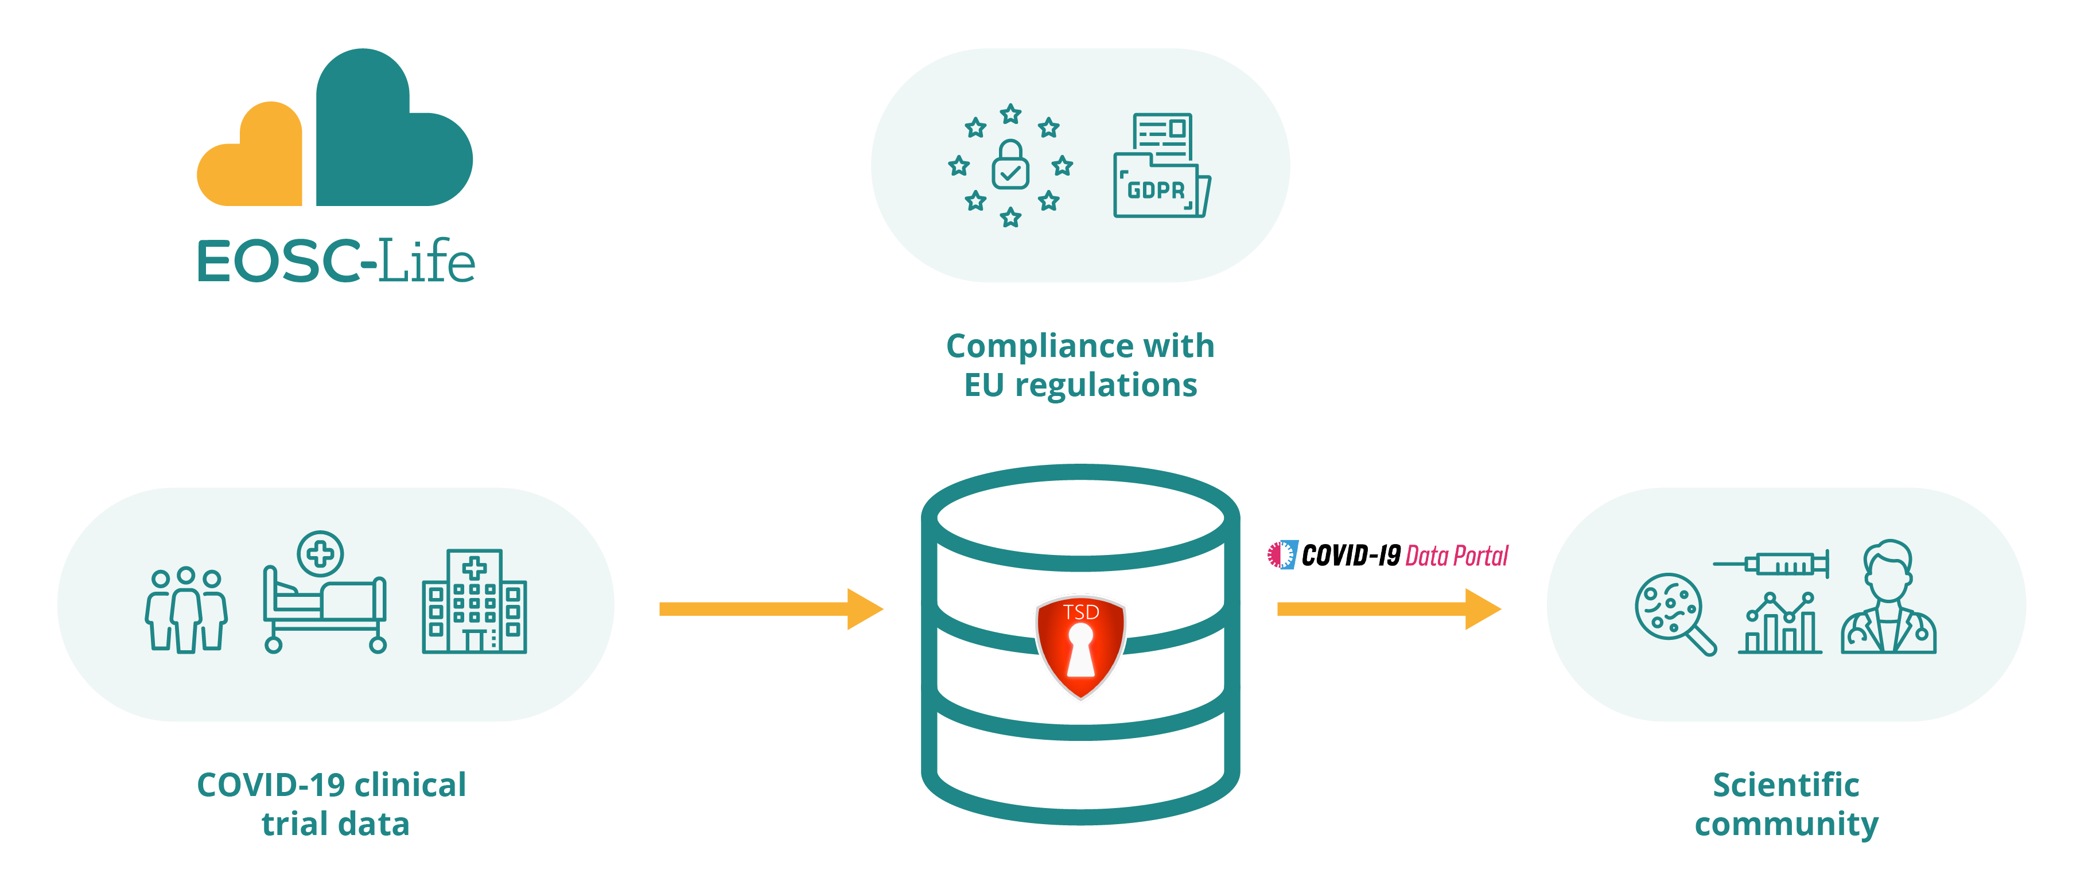
EOSC-Life’s response to the COVID-19 pandemic
    Supported International COVID-19 biohackathon with cloud resources
    Released WorkflowHub.eu 1 year early
    Building a repository to host COVID-19 clinical trial data
    Extension of the COVID-19 Data Portal
Notes:
Data sharing and digital tools are critical for the response to the pandemic. EOSC-Life partners and solutions were well positioned to respond quickly to the needs of our community with efforts such as:

Slide 8
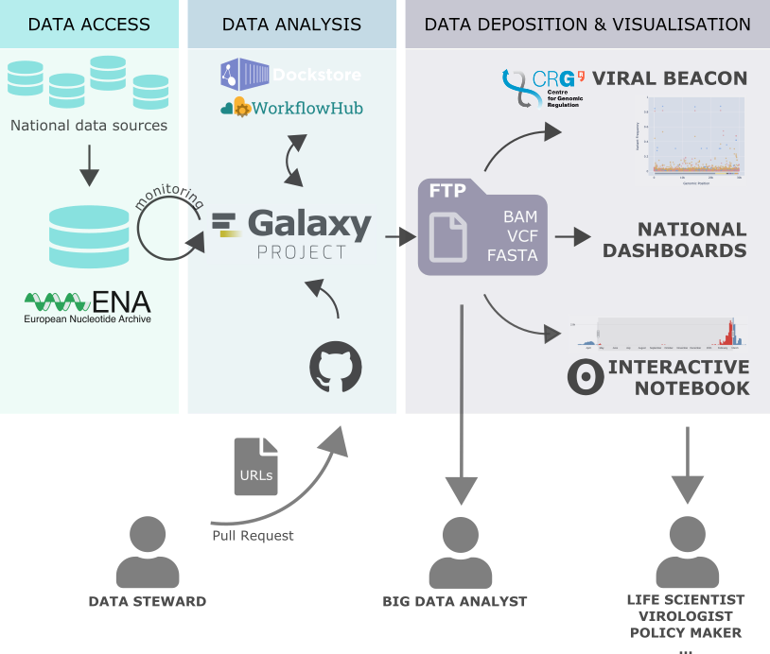
Galaxy for COVID: covid19.galaxyproject.org
Notes:
Take you through one example – on COVID, as very timely, but this is true in many other fields; we are starting a project with Historic England on

Slide 9



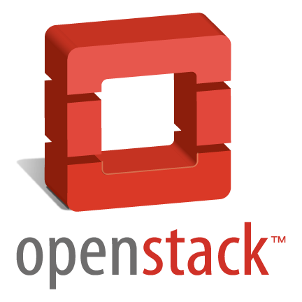






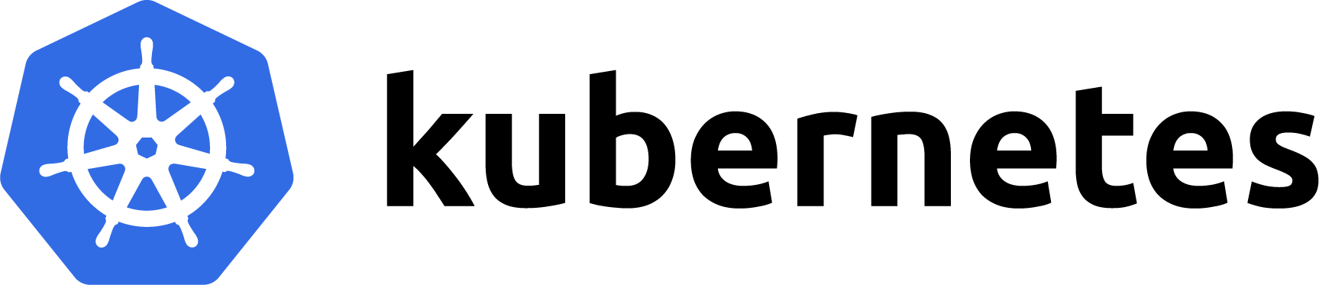
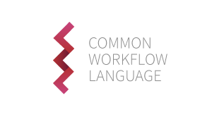


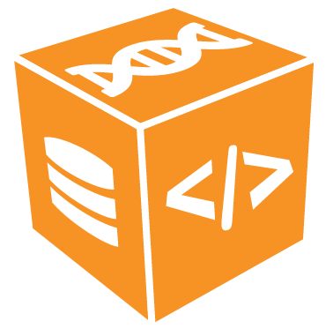



Need from Users, Developers and Infrastructure administrators
Drive the ELIXIR & EOSC-Life Tools ecosystems
Data
Various data sources
End User
Sys Admin
Tool Developer
Authentication
Infrastructure
Tools
Workflows
Cv
Packaging
…
Registries
Testing
c
OpenEBench
Galaxy WF-testing
Life monitor
BioContainers
Bio.Tools
Powered By

Slide 10
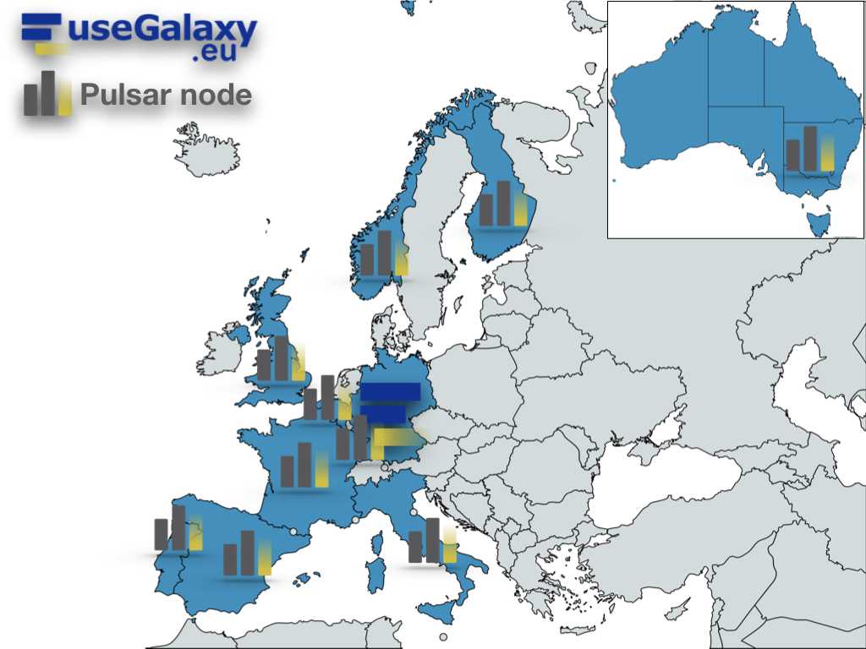
Distributed analysis
Pulsar network
The most innovative computing centers across
Europe are currently interested to share their
remote computation power to support the UseGalaxy.eu load:
DE, de.NBI cloud
IT, ReCaS-Bari
BE, Vlaams Supercomputer Centrum (VSC)
PT, Tecnico ULisboa
ES, Barcelona Supercomp. Center (INB-BSC)
NO, University of Bergen
CZ, CESNET
FI, CSC
UK, Diamond Light Source
FR, GenOuest
https://pulsar-network.readthedocs.io/en/latest/project/partners.html

Slide 11
EOSC-Life “Toolbox for sensitive data sharing”
Documented requirements for hosting/distributing and access control for sensitive data
Landscape analysis of national legal and ethical requirements for sensitive data sharing
Compile current assets into the EOSC-Life Toolbox for sensitive data sharing
Assembled from existing resources to create a toolbox for cloud management of sensitive data in general, and the European Open Science Cloud in particular.
Agreed Categorisation system with an initial 110 tagged resources
All reports and materials are Open Access and on Zenodo: 10.5281/zenodo.4483693, 10.5281/zenodo.4311093, 10.5281/zenodo.4311113, 10.5281/zenodo.4591010

Slide 12
EOSC-Life
Established EOSC-Life by publishing FAIR life science data resources in EOSC
Providing the policies, guidelines and processes for secure and ethical data reuse
Populating an ecosystem of innovative life science tools in EOSC
Enabling data-driven research in Europe by connecting life scientists to EOSC via open calls for participation
Notes:
For example – we had a call before summer for datasets; work to publish the first cohort of FAIR RI data resources in the cloud is now underway
And
Resleased guideline documents on FAIR, secure data access with mapping of national capabilities
Several training events and hackathons to build capacity in RI’s for federated, cloud-based analytics in our tools work-package

Slide 13
EOSC-Life - Points for discussion
Transition the focus in EOSC from principles and organisation to operations. Incorporate production services ‘as part of EOSC’
“Practicality” - focus on practical implementations, evidence of usability and concrete use cases rather than the sunlit uplands of theoretical perfection
Consider the roles of EOSC actors – b2b services and entry points for users (e.g. workflows as first-class citizens)
ESFRI have large established user-communities and production services – EOSC-Life and our other "cluster activities" build operational processes that link research outputs from RI services to the missions objectives and the open data targets of EOSC
ESFRIs have established solutions for domain-specific needs (e.g. data protection, ethics, compliance with Nagoya protocol)
Notes:
For example – we had a call before summer for datasets; work to publish the first cohort of FAIR RI data resources in the cloud is now underway
And
Resleased guideline documents on FAIR, secure data access with mapping of national capabilities
Several training events and hackathons to build capacity in RI’s for federated, cloud-based analytics in our tools work-package

