Slide 1
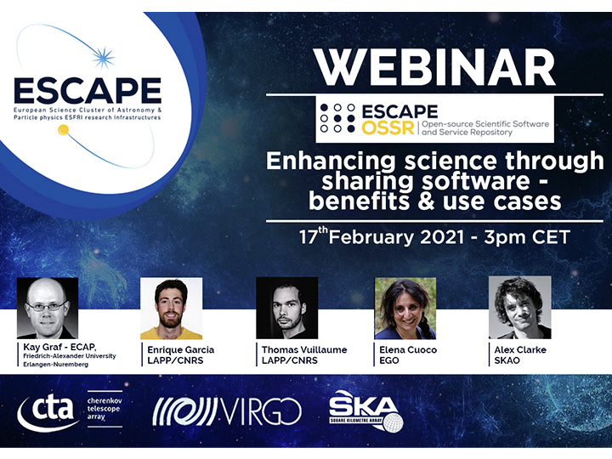

Slide 2
Enhancing science through sharing software – benefits & use cases
Data Challenges for the SKA
Alex Clarke, SKAO
a.clarke@skatelescope.org
On behalf of the team: Anna Bonaldi, Phillipa Hartley, Rosie Bolton, James Collinson, Rob Barnsley, Rohini Joshi
ESCAPE OSSR Webinar - 17/02/2021

Slide 3
Preparing users for SKA data access
Users will get data products via regional centres in their part of the world through a single portal
They will do most of the processing and analysis at these centres, rather than downloading data to their own computers
Data challenges are designed to represent the workflow of users interacting with SKA data products

Slide 4
Open science and reproducibility
Data challenges are being aimed at motivating users to follow best practices in their workflows
Coding standards
Style guide, documentation, comments, functions, classes, modular, version control
Publishing their code, data and workflow alongside the results
Zenodo/Github
Ensuring their workflow is reproducible
Documenting software dependencies, using containers

Slide 5
Towards full reproducibility
Peng 2011 (https://doi.org/10.1126/science.1213847)
(and Rachael Ainsworth, https://github.com/rainsworth/osip2019-containerisation-workshop)

Slide 6
Science Data Challenge 1 Source finding in images
https://astronomers.skatelescope.org/ska-science-data-challenge-1/
32000 by 32000 pixel images were provided at 560, 1400, 9200 MHz, at resolutions of 2.4, 1.2 and 0.6 arcseconds, respectively.Publishing their code, data and workflow alongside the results
A truth catalogue is provided for a small area of sky, but when the challenge ran in 2019 the full truth catalogue was not provided.
Participants submitted a catalogue of sources and were scored on how many they found and what they classified them as (star-forming galaxy, or steep/flat spectrum active galactic nuclei).
There was no requirement for participants to show their workflow, code, or demonstrate it was reproducible.

Slide 7
Science Data Challenge 1 Developing an example solution
https://astronomers.skatelescope.org/ska-science-data-challenge-1/
We made a containerised example solution after the challenge to demonstrate a variety of best practices in research and software development
Code is available on Github/Gitlab https://gitlab.com/ska-telescope/sdc/sdc1-solution
Data is available on Zenodo https://doi.org/10.5281/zenodo.4328029
Modular code structure, rather than one long script, means it’s easier to read, document, collaborate on, test, and reuse parts for other projects.

Slide 8
Science Data Challenge 1 Running the example solution
https://astronomers.skatelescope.org/ska-science-data-challenge-1/
Get Docker
Environment variable and aliases
Download data
Make the Docker image
Start the Container
In the Container, run sdc1_solution.py, which reproduces the entire workflow, producing output catalogues and scores, taking 3 hours

Slide 9
Science Data Challenge 1 Running the example solution
https://astronomers.skatelescope.org/ska-science-data-challenge-1/
Image preprocessing
Primary beam correction
Split out training sub-image
(Chunk images)
Source finding (training)
Model fitting (training)
Source finding (full)
Model prediction (full)
Score results

Slide 10
Science Data Challenge 1 Running the example solution
https://astronomers.skatelescope.org/ska-science-data-challenge-1/
Hopefully this helps share knowledge about technologies and techniques that enable more reproducible results, and people can use this example for future data challenges
Future science data challenges will test the reproducibility of results
Technologies like containers will become essential for future SKA data challenges, where you bring your software pipelines to the data at regional centres

Slide 11
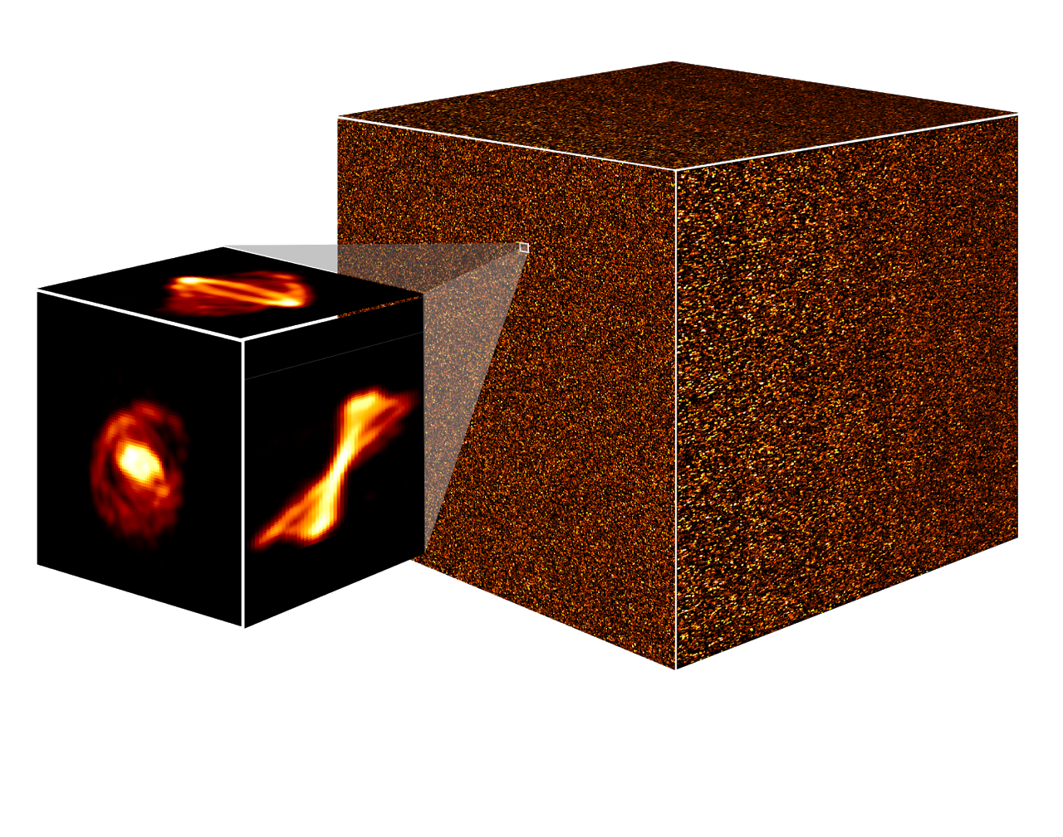
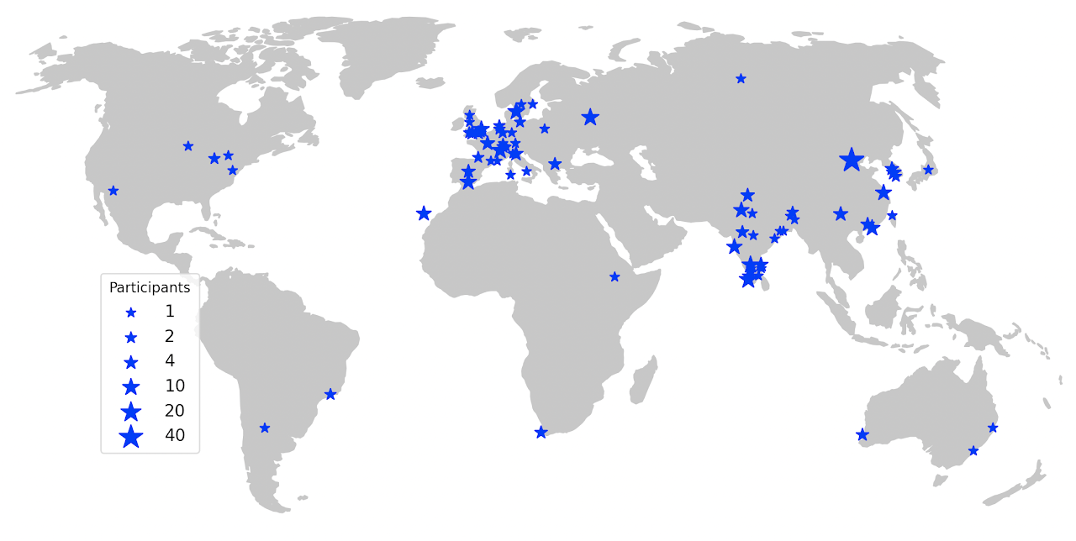
Science Data Challenge 2 Source finding in a 1TB image cube
https://sdc2.astronomers.skatelescope.org/sdc2-challenge
A simulated 3D image cube of the neutral hydrogen line, where participants must find sources.
Each team is given access to a computational resource provider acting as a regional centre (IRIS, INAF ICT, IAA-CSIC proto-SRC, GENCI-IDRIS, EngageSKA-UCLCA, CSCS-Piz Daint, China SKA proto-SRC, AusSRC-Pawsey)
The cube is hosted at these facilities and teams bring their pipelines to the data.
40 teams, 276 participants, representing 80 institutes and 23 countries
Awards will be given out for demonstrating reproducible results:: https://sdc2.astronomers.skatelescope.org/sdc2-challenge/reproducibility-awards

Slide 12
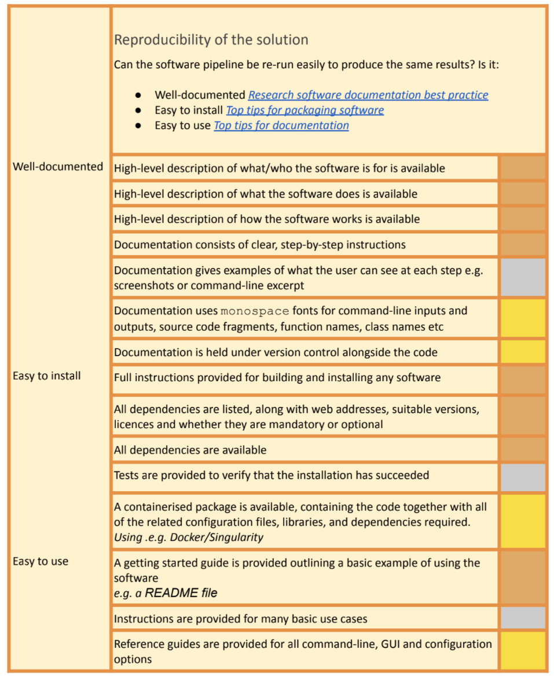
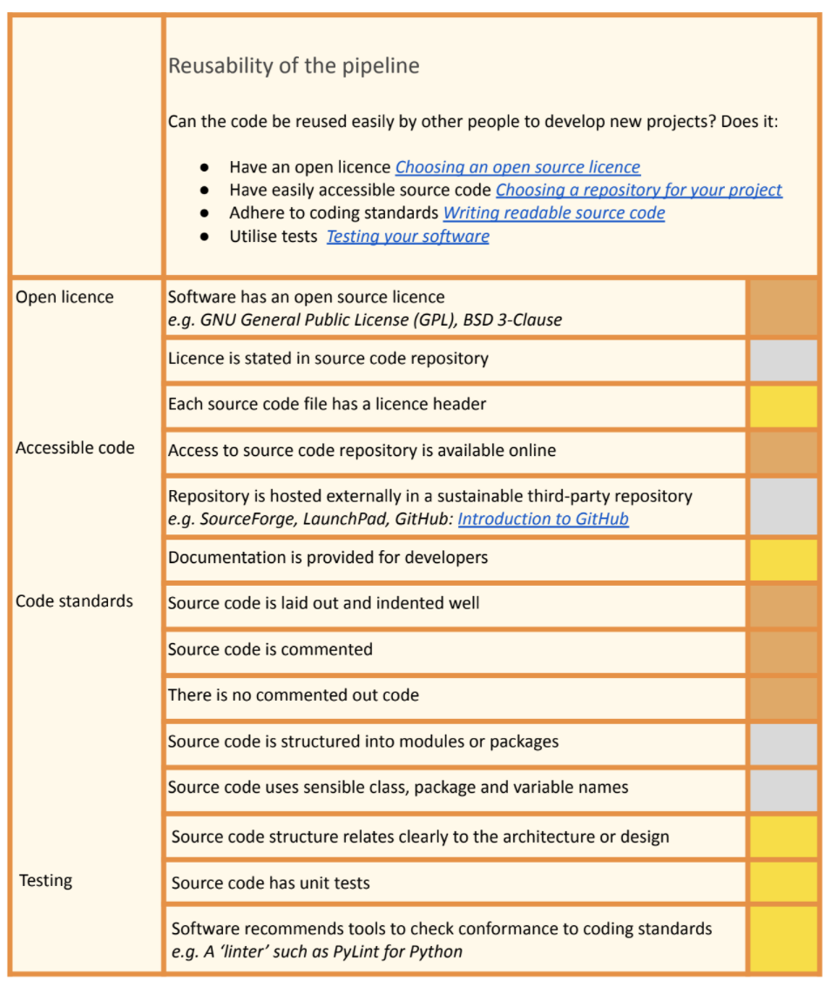
Science Data Challenge 2 Source finding in a 1TB image cube
https://sdc2.astronomers.skatelescope.org/sdc2-challenge
A simulated 3D image cube of the neutral hydrogen line, where participants must find sources.
Each team is given access to a computational resource provider acting as a regional centre (IRIS, INAF ICT, IAA-CSIC proto-SRC, GENCI-IDRIS, EngageSKA-UCLCA, CSCS-Piz Daint, China SKA proto-SRC, AusSRC-Pawsey)
The cube is hosted at these facilities and teams bring their pipelines to the data.
40 teams, 276 participants, representing 80 institutes and 23 countries
Awards will be given out for demonstrating reproducible results:: https://sdc2.astronomers.skatelescope.org/sdc2-challenge/reproducibility-awards

Slide 13
Conclusions
Data challenge 1 was a successful starting point, 9 teams competed, we developed an example solution afterwards
Data challenge 2 is running now (Feb-July) with 40 teams, stepping up data size and workflow expectations
We hope these data challenges will help prepare people for the kind of workflows that will be necessary with SKA data (but also relevant for any scientific data analysis)
A great platform for spreading the word amongst the community about relevant technologies, efficient workflows, best practices in coding, publishing data and code, reproducibility
Also helping a lot with our work on prototyping and developing technologies for the SKA regional centres
Thanks for listening

Slide 14
Enhancing science through sharing software – benefits & use cases
Thank you!
Alex Clarke, SKAO
ESCAPE OSSR Webinar - 17/02/2021

Slide 15
Join our community!
Follow us on Twitter: @ESCAPE_EU
Follow us on LinkedIn: linkedin.com/company/projectescape/
Subscribe to our Newsletter: https://projectescape.eu/#mc_embed_signup

