Slide 1
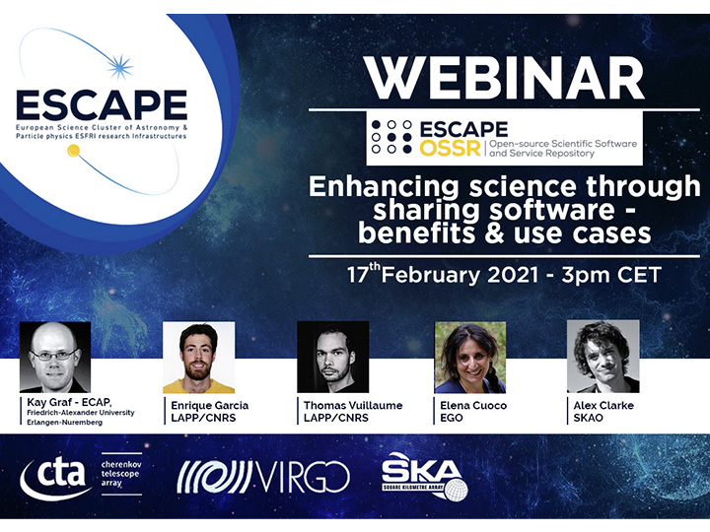

Slide 2
Enhancing science through sharing software – benefits & use cases
Encouraging common software developments
Thomas Vuillaume, LAPP, CNRS
ESCAPE OSSR Webinar - 17/02/2021

Slide 3
A un-exhaustive and biased overview of common developments in astroparticle physics under ESCAPE

Slide 4
agnpy
IndexedConv
ConCORDIA
gLike
machine learning and pipeline developments for CTA

Slide 5
AGNPY
Computation of multi-wavelength photon spectra produced by leptonic radiative processes in jetted Active Galactic Nuclei
Python open-source tool using the astropy ecosystem (affiliated package)
Core modules to model AGNs in a reproducible and reusable fashion

Slide 6
AGNPY
code in the OSSR:
documentation: https://agnpy.readthedocs.io/en/latest/
License: GNU General Public License v3.0
See the onboarding presentation
Cite as: Cosimo Nigro, Julian Sitarek, Matt Craig, & Paweł Gliwny. (2020, December 8). cosimoNigro/agnpy: v0.0.8 (Version v0.0.8). Zenodo. http://doi.org/10.5281/zenodo.4311271

Slide 7
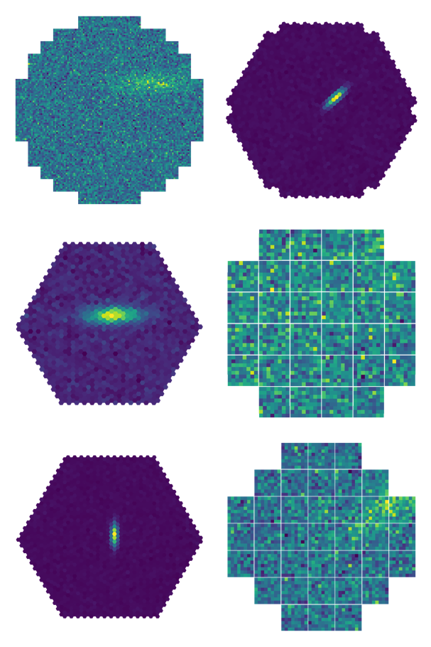
IndexedConv
True hexagonal neighborhood
1
2
3
Perform convolution and pooling operations on non-Euclidian grids of data as an alternative to masking or resampling the data
4
5
6
7
8
9
10
11
12
13
14
15
16
17
18
19
im2col
...
5
6
9
10
11
14
15
Developed to apply deep learning to CTA images
Generic solution that can be used to a large variety of problems with unconventional images

Slide 8
IndexedConv
Source code in the OSSR:
Documentation: https://indexed-convolution.readthedocs.io/en/latest/
License: MIT License
Cite as: Jacquemont, M.; Antiga, L.; Vuillaume, T.; Silvestri, G.; Benoit, A.; Lambert, P. and Maurin, G. (2019). Indexed Operations for Non-rectangular Lattices Applied to Convolutional Neural Networks. In Proceedings of the 14th International Joint Conference on Computer Vision, Imaging and Computer Graphics Theory and Applications - Volume 5: VISAPP, ISBN 978-989-758-354-4, pages 362-371. DOI: 10.5220/0007364303620371

Slide 9
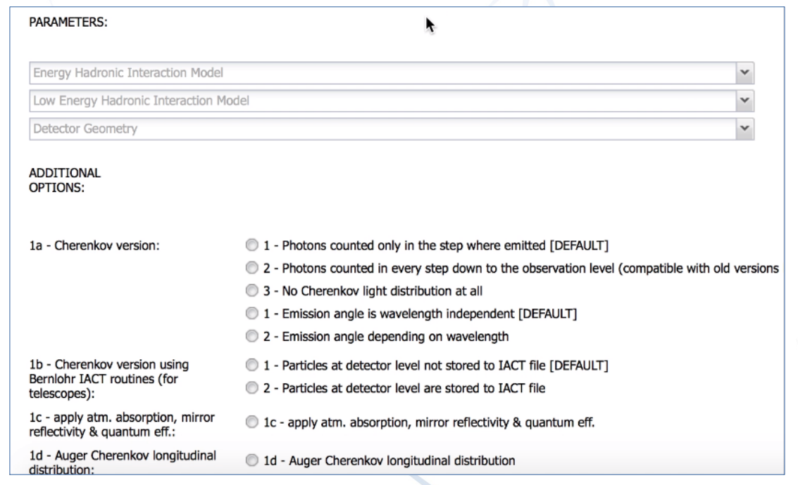
ConCORDIA
Containers for CORSIKA on DIRAC
Set of turnkey containers for CORSIKA simulations hosted on DIRAC
GUI/scripting environment to quickly tweak-tune new CORSIKA setup
Use DIRAC for intergration with ESCAPE Science Analysis Platform
Some use cases: KM3NeT, CTA, Muography…
Web GUI →

Slide 10
ConCORDIA
Developments in ESCAPE: https://gitlab.in2p3.fr/escape-corsika
To be released in the OSSR soon
See onboarding presentation

Slide 11
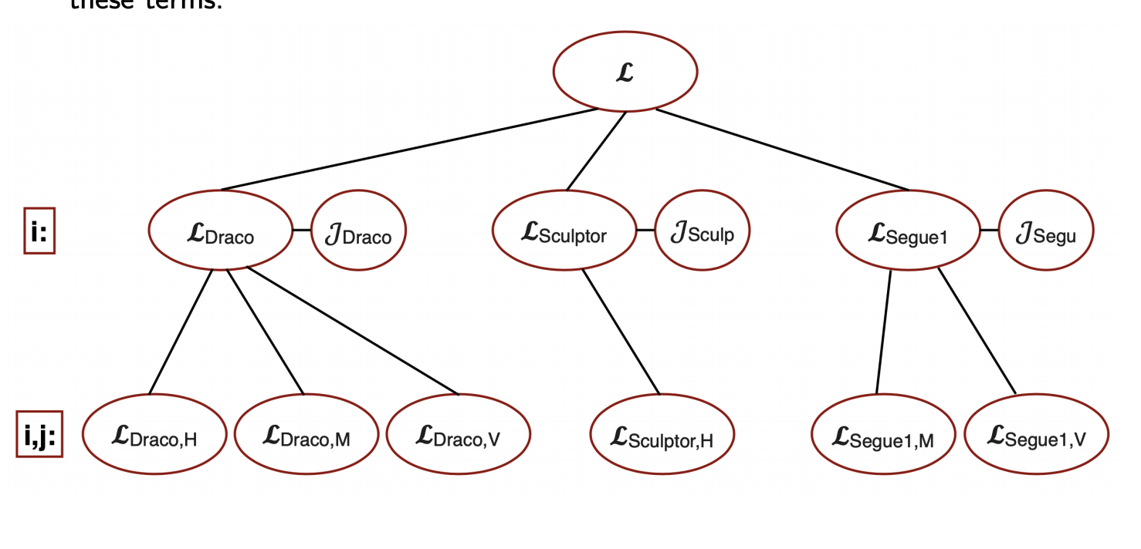
gLike
General-purpose ROOT-based code framework for the numerical maximisation of joint likelihood functions
one free parameter g for the joint likelihood function
Some use-cases – gLike can be used to estimate:
the number of signal events (with uncertainties) in a dataset whose background content is in turn estimated from an independent measurement in a signal-free control-region
intensity of a steady source of signal particles in the presence of background particles from datasets obtained under different experimental conditions and/or from different instrument using different data format
dark matter annihilation cross-section combining observations of dwarf spheroidal galaxies by different ground-based gamma-ray telescopes, satellite gamma-ray detectors, neutrino telescopes, ....
energy scale of quantum gravity by combining observations of fast gamma-ray flares observed by different ground-based gamma-ray telescopes.

Slide 12
gLike
Source code in the OSSR:
Devs and documentation: https://github.com/javierrico/gLike
License: GPL-3.0
Cite as: Javier Rico, Cosimo Nigro, dkerszberg, Tjark Miener, & Jelena Aleksić. (2020, September 14). gLike: numerical maximization of heterogeneous joint likelihood functions of a common free parameter plus nuisance parameters (Version v00.09.02). Zenodo. http://doi.org/10.5281/zenodo.4028908

Slide 13
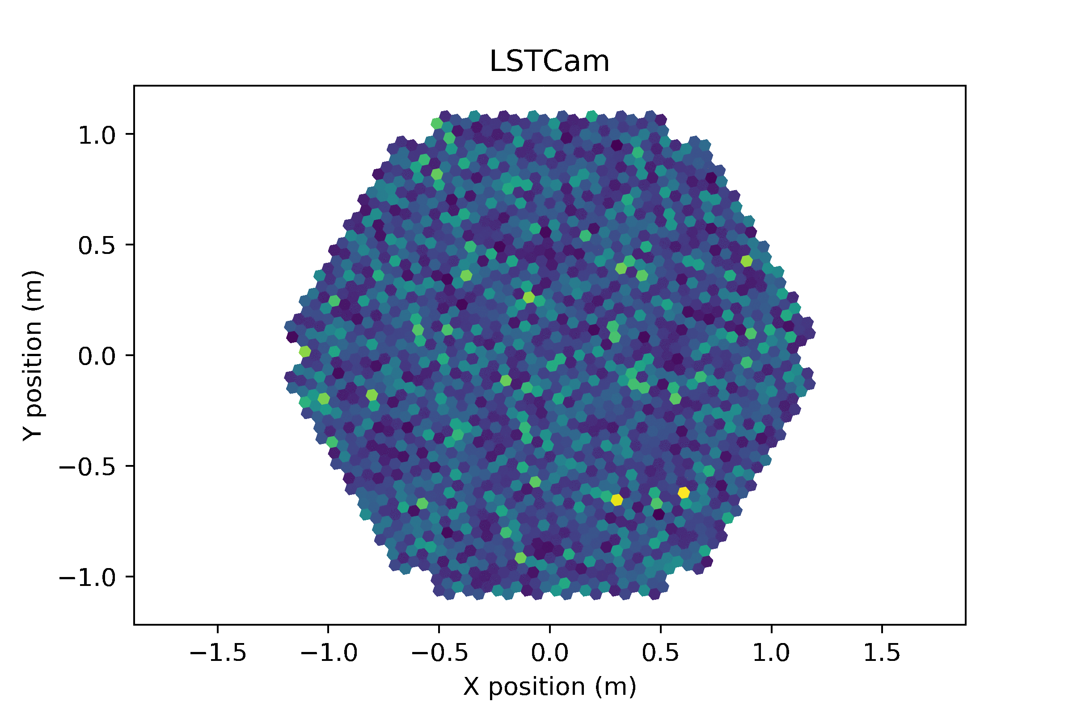
Deep learning frameworks for CTA
?
gamma event
E = 0,189 TeV
Direction = (1,23; 6,22)rad

Slide 14
Deep learning frameworks for CTA
Two frameworks developed in ESCAPE: GammaLearn and CTLearn:
https://gitlab.lapp.in2p3.fr/GammaLearn/ - MIT License
https://github.com/ctlearn-project/ctlearn - BSD-3 Lciense
Provide frameworks to ensure reproducible and reusable deep learning experiments
A common approach : integration in the CTA workflow, common input data format, common output data format, common metrics calculation for results comparison
https://github.com/cta-observatory/dl1-data-handler

Slide 15
And many other contributions on the way… Stay tuned.

Slide 16
Enhancing science through sharing software – benefits & use cases
Thank you!
Thomas Vuillaume, LAPP, CNRS
ESCAPE OSSR Webinar - 17/02/2021

Slide 17
Join our community!
Follow us on Twitter: @ESCAPE_EU
Follow us on LinkedIn: linkedin.com/company/projectescape/
Subscribe to our Newsletter: https://projectescape.eu/#mc_embed_signup

