Slide 1
Data processing and data management for a neutrino telescope
Mieke Bouwhuis (KM3NeT / NIKHEF)
31 March 2022

Slide 2
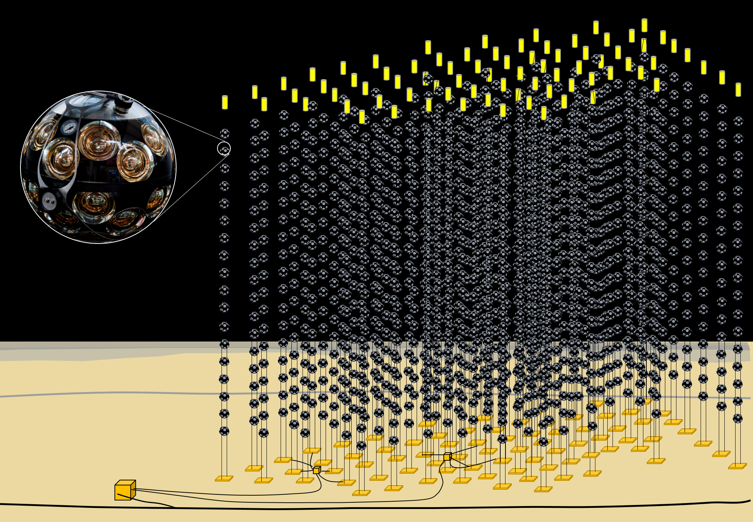
The KM3NeT Neutrino Telescope
Distributed infrastructure in the Mediterranean Sea
FR: 10⁷ m³
IT: 1 km³
Modular telescope array
345 vertical strings
200.000 light-sensitive photo-multiplier tubes
Today:
FR: 10% operational
IT: 5% operational

Slide 3
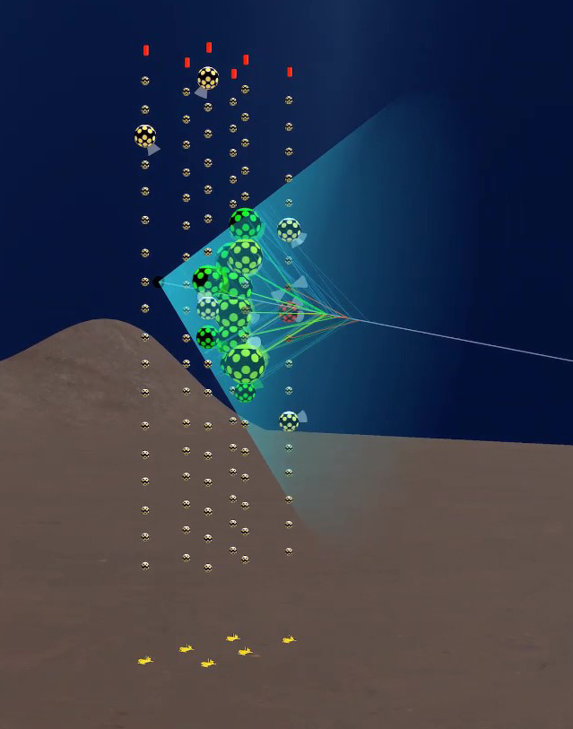
KM3NeT data rates
Detection of Cherenkov light produced by relativistic particles
Photo-multiplier tubes (PMT) measure the arrival time of the light at the quantum level
PMT singles rate 10 kHz
1 string 300 Mbps
Full detector 100 Gbps (345 strings)
All data to shore
18 modules/string
31 PMTs/module

Slide 4
KM3NeT Computing Model
Local computing resources
data
analysis
Tier-2
data
processing
Computer Centre IT
Computer Centre PL
Computer Centre NL
Computer Centre FR
Computer Centre …
CC-FR
CC-IT
data
storage
CC-FR
CC-IT
Tier-1
FR
IT
data
acquisition
Tier-0
onshore computing
onshore computing

Slide 5
Using DIOS in KM3NeT
Local computing resources
data
analysis
Tier-2
data
processing
data
storage
Tier-1
FR
IT
data
acquisition
Tier-0
onshore computing
onshore computing

Slide 6
DIOS at the KM3NeT Tier-0 level
All data to shore
Onshore computing: finding causalities between
Arrival time of the photons
Positions of the detection modules
Filters out “events”
Event rate: 200 Hz
Reduction factor: 10⁴
DIOS handles data storage of filtered events
Safe storage
Replication to multiple sites
“events”
onshore computing

Slide 7
DIOS at the KM3NeT Tier-1 level
Calibration of raw events
PMT quantum efficiency calibration
PMT gain calibration
Position calibration of detection modules
Orientation calibration of detection modules
….
“Reconstruction” of calibrated events, determination of
neutrino type
neutrino direction
neutrino energy
DIOS handles storage of calibrated and reconstructed data
Accessible to all KM3NeT partners
Distribution of the data processing
Organization in data sets
Input to all analyses
raw events
reconstructed events

Slide 8
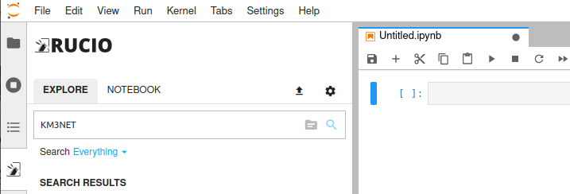
DIOS at the KM3NeT Tier-2 level
Scientific analyses
Neutrino astronomy
Multi-messenger astronomy
Usage of single interface Data Lake as a Service
Finding calibrated and reconstructed data
Conversion to reduced data format
Ingestion into the Data Lake
Data Lake as a Service experience
User-friendly interface to the Data Lake
Organization in data sets
Integrated development environment

Slide 9
Conclusions
KM3NeT under construction
Data taking ongoing 24/7
Analyses progressing
Different data processing at different data levels
KM3NeT needs a data management solution for the next 15-20 years
Demonstrated KM3NeT with DIOS on all data management layers
KM3NeT is adopting a DIOS-like infrastructure

