Slide 1
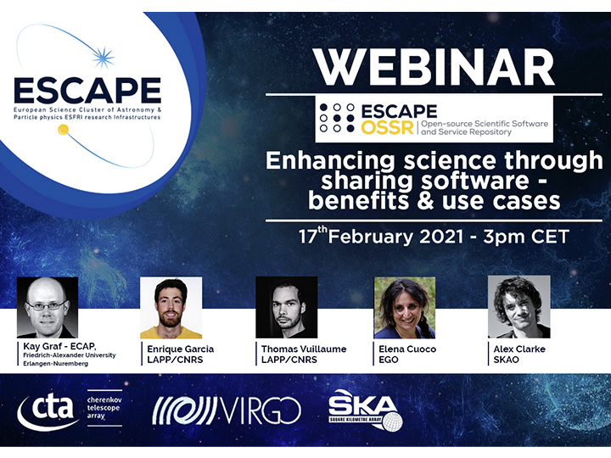

Slide 2
Enhancing science through sharing software – benefits & use cases
A FAIR Multi-messenger data-driven cooperative approach - ESCAPE OSSR and EOSC
Enrique García, LAPP, CNRS
ESCAPE OSSR Webinar - 17/02/2021

Slide 3
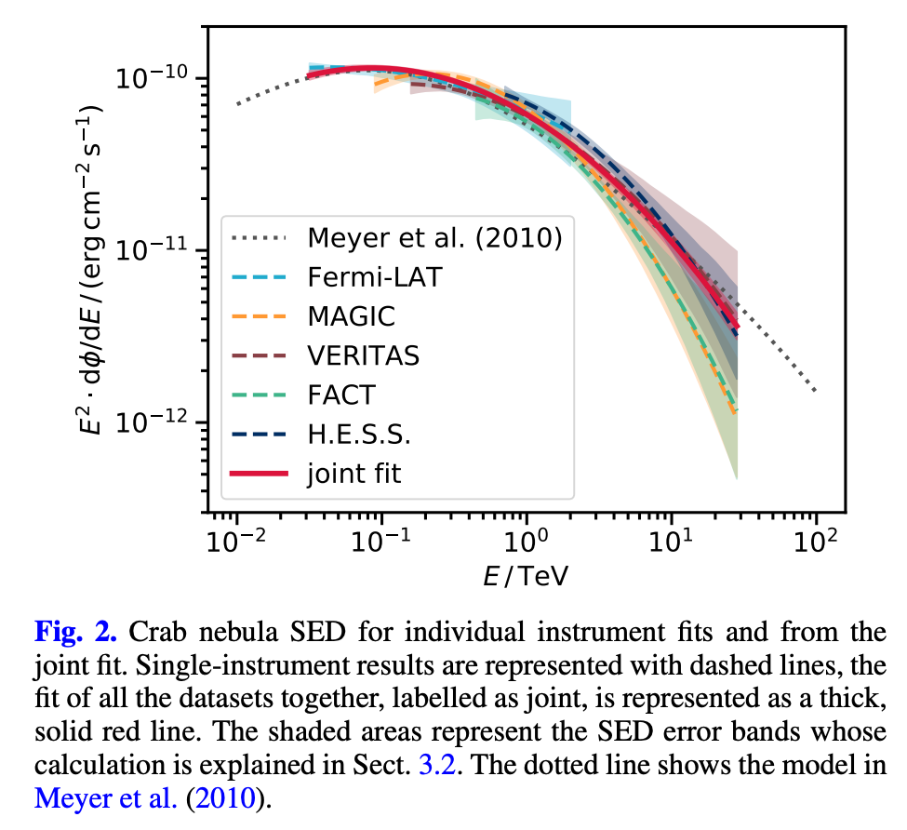
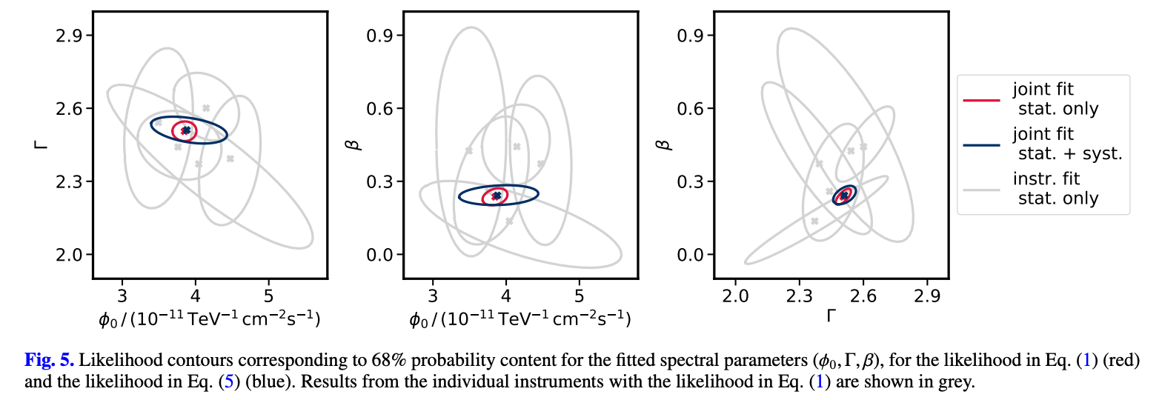
An example of open science project : The Crab bundle
Multi-instrument gamma-ray analysis of the Crab Nebulae with Fermi-LAT, MAGIC, VERITAS, FACT and H.E.S.S.
*Towards open and reproducible multi-instrument analysis in gamma-ray astronomy, C. Nigro et al, in A&A 625 (2019)
T. Vuillaume’s ESCAPE progress meeting slides (Feb ’21)

Slide 4
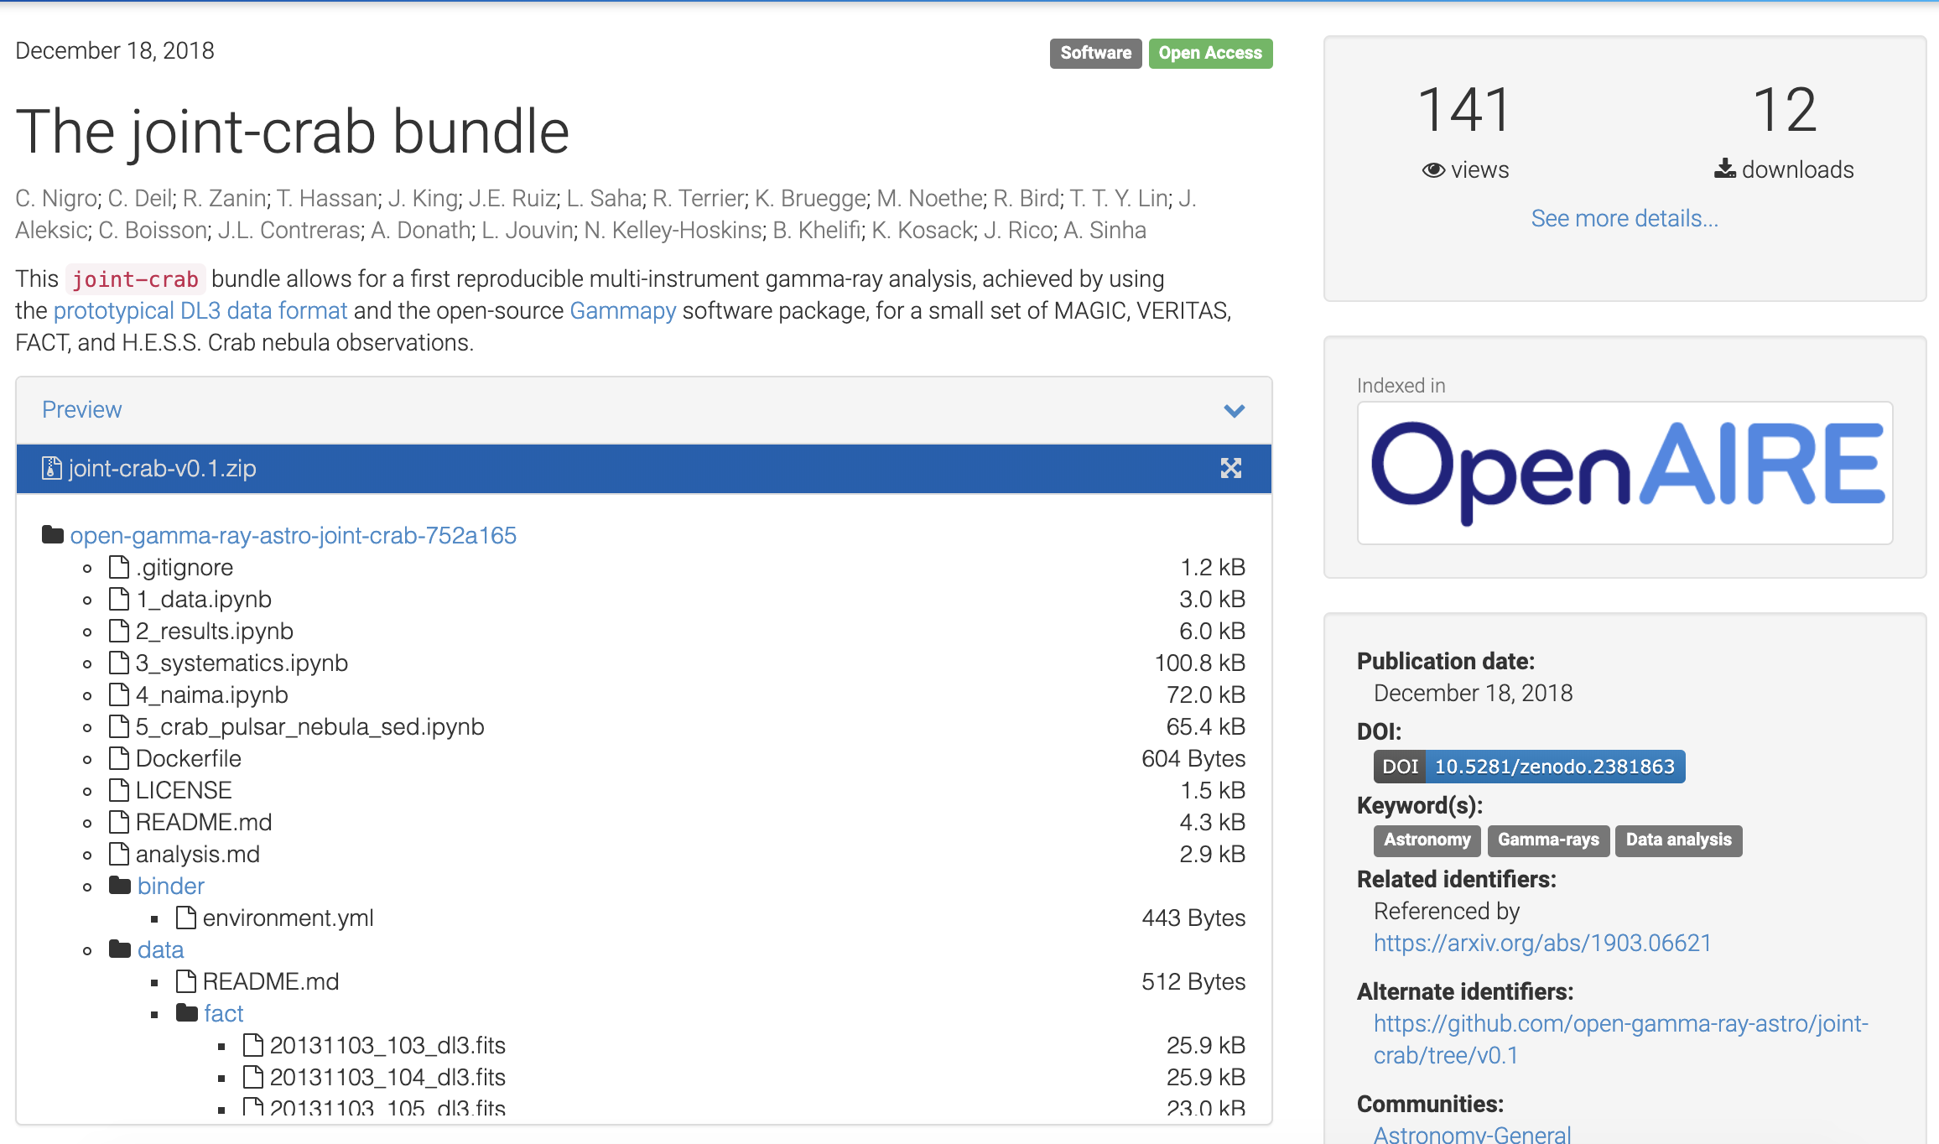
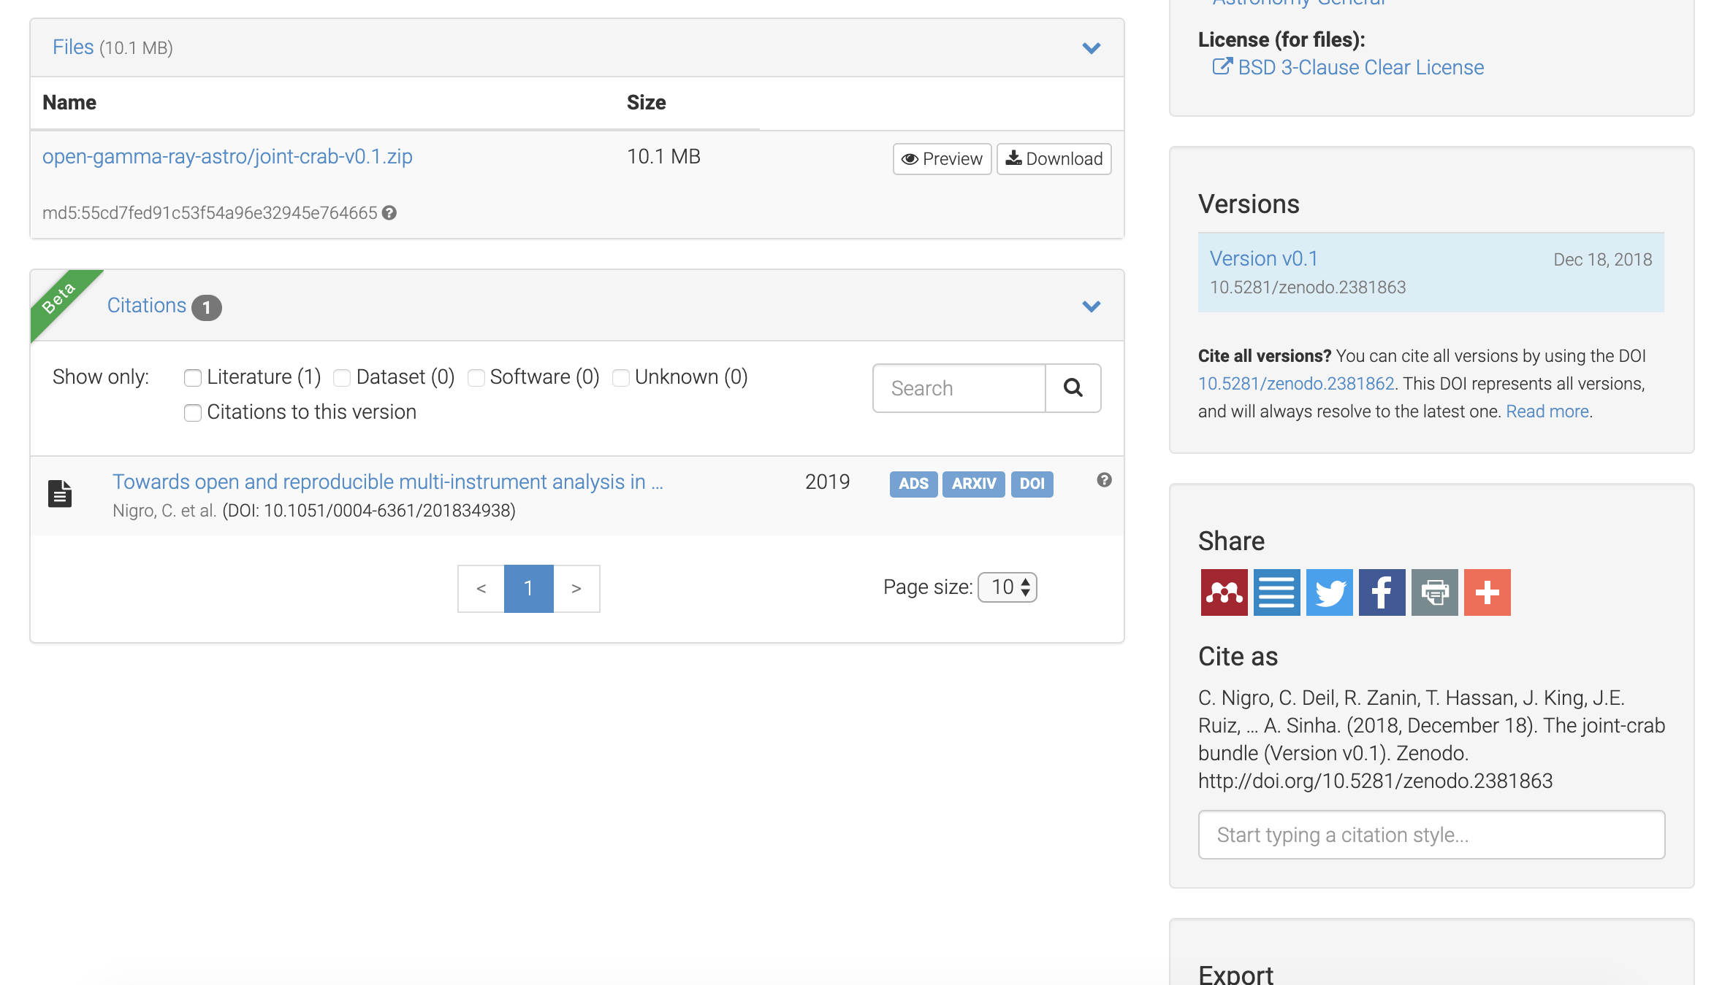
An example of open science project : The Crab bundle
The Crab multi-instrument gamma-ray analysis with MAGIC, VERITAS, FACT and H.E.S.S.
https://github.com/open-gamma-ray-astro/joint-crab/tree/v0.1
https://zenodo.org/record/2381863#.XkxcD5NKhhA
license
Cited by
Cite as
Link to project and article
Metadata (exportable schemas)
Source code and data

Slide 5
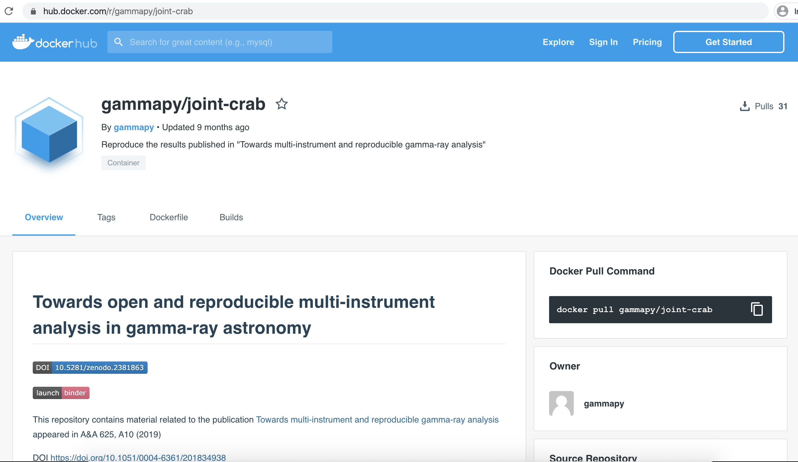
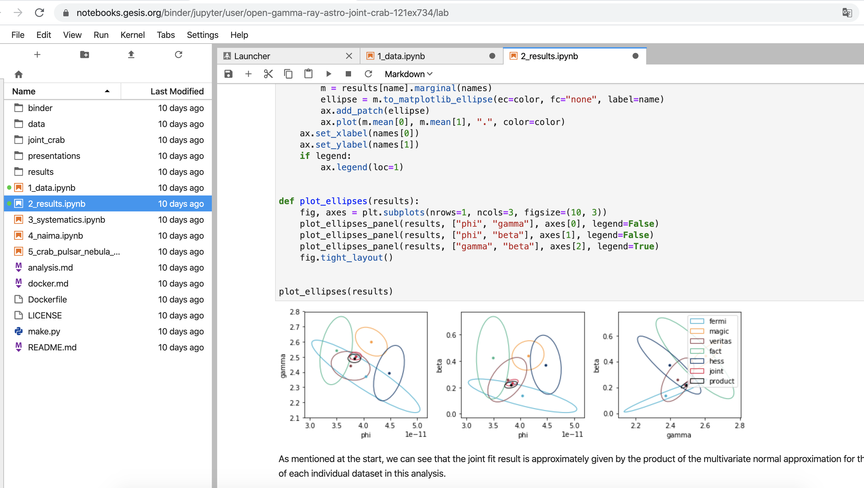
An example of open science project : The Crab bundle
The Crab multi-instrument gamma-ray analysis with MAGIC, VERITAS, FACT and H.E.S.S.
https://github.com/open-gamma-ray-astro/joint-crab/tree/v0.1
https://zenodo.org/record/2381863#.XkxcD5NKhhA
Binder to test
and run analysis
interactively online
Docker to ensure reproducibility
T. Vuillaume’s ESCAPE progress meeting slides (Feb ’21)

Slide 6
How do we get here ?
Thanks to the promotion and implementation of FAIR* principles
Findable → Data is described with rich metadata, and assigned an unique and persistent identifier
Accessible → Metadata identifiers follows standard (open, free, universal) communication protocols – accessible even when data is no longer available!
Interoperable → Metadata uses a formal, accessible, shared, and broadly applicable language for knowledge representation (metadata schema or standard).
Reusable → Data and collections have a clear usage licenses and provide accurate information on provenance.

Slide 7
How do we get here ?
Providing the infrastructure and services to host FAIR contributions → OSSR prototype (Kay’s Talk)
GitLab
Git repository hosted at cc-in2p3.
Fully connected with Zenodo by providing a metadata schema.
Various metadata standards are being investigated
https://gitlab.in2p3.fr/escape2020/wp3
Zenodo
General general-purpose open access repository.
Hosted and operated by CERN (since 2013).
FAIR compliant !
https://zenodo.org/communities/escape2020

Slide 8
OSSR environment - FAIR principles
Findable → Data is described with rich metadata, and assigned an unique and persistent identifier
Persistent DOI
Metadata (various exportable schemas)
Scientific project
Metadata file (standard/schema)

Slide 9
OSSR environment - FAIR principles
Accessible →Metadata identifiers follows standard (open, free, universal) communication protocols – accessible even when data is no longer available!
Persistent DOI
Metadata (various exportable schemas)
Long term archived (CERN)
Entries findable even if restricted/closed data.
OAI-PMH harvest protocol
Scientific project
Metadata file (standard/schema)

Slide 10
OSSR environment - FAIR principles
Interoperable → Metadata uses a formal, accessible, shared, and broadly applicable language for knowledge representation (OSSR metadata schema; CodeMeta schema).
Persistent DOI
Metadata (various exportable schemas)
Long term archived (CERN)
Entries findable even if restricted/closed data.
OAI-PMH harvest protocol
Scientific project
Metadata file (CodeMeta standard/schema)

Slide 11
OSSR environment - FAIR principles
Reusable → Data and collections have a clear usage licenses and provide accurate information on provenance.
OSSR Environment provides an integration service.
Persistent DOI
Metadata (various exportable schemas)
Long term archived (CERN)
Entries findable even if restricted/closed data.
OAI-PMH harvest protocol
Builds images
(prototype workflow, still WIP)
Publishes to OSSR
Open Source License Scientific project
Metadata file(CodeMeta standard/schema) + Provenance

Slide 12
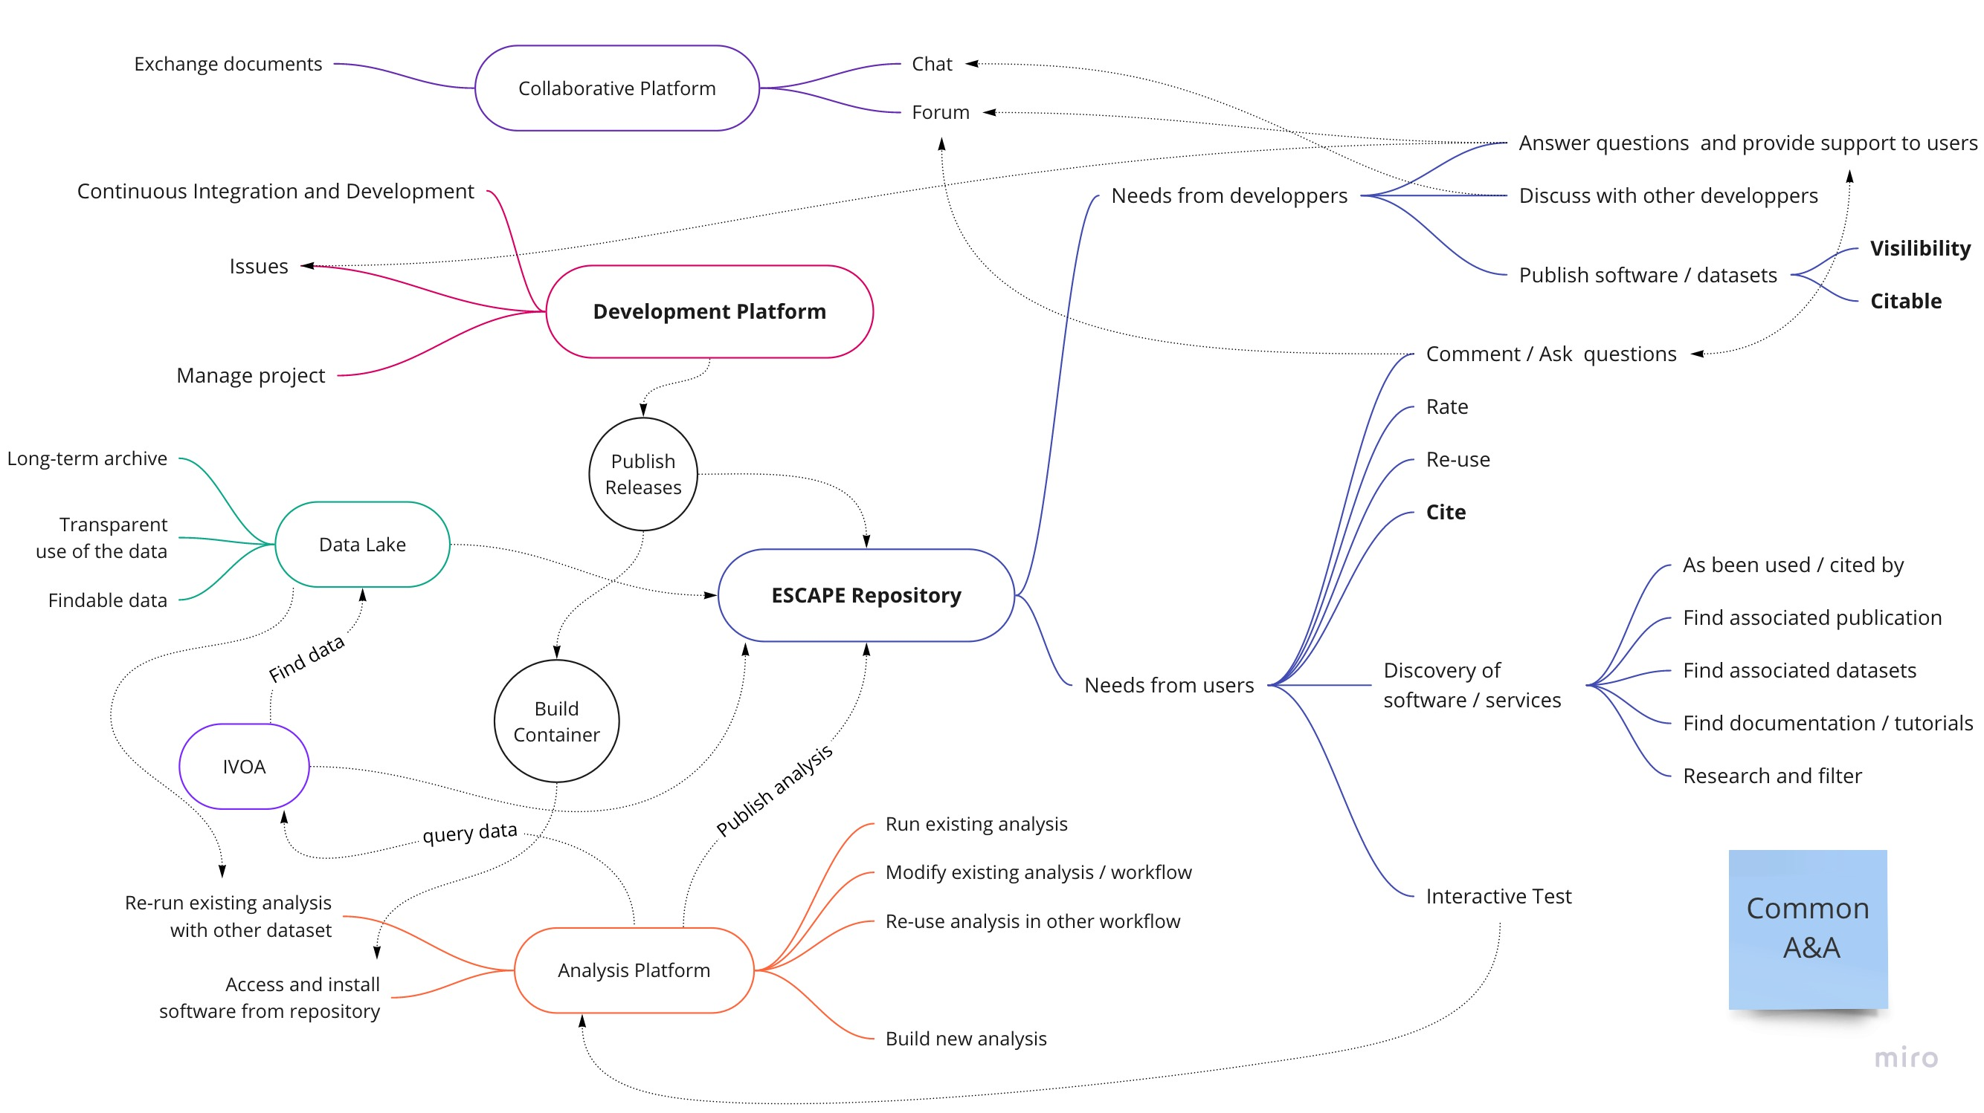
ESCAPE Virtual Environment. A general (evolving) overview
Common A&A and (compatible) metadata schemas
12

Slide 13
Next steps – OSSR and EOSC
Where are we ?
Connect the ESCAPE services to create an integrated environment
✅ OSSR environment
WIP ESCAPE services
Define license, provenance and metadata guidelines
✅ OSSR environment
WIP ESCAPE services
What we aim for ESCAPE ?
Starting a new Science project (through validation) sets up a complete linked virtual environment
Researchers / Institutes contribute to the science project by publishing software / data / workflow - The contributions are validated by science project curators.
Users can search the repository (OSSR / EOSC) or explore it through the science projects
Enhancing the FAIR principles in every contribution to the OSSR

Slide 14
Enhancing science through sharing software – benefits & use cases
Thank you!
Enrique García, LAPP, CNRS
ESCAPE OSSR Webinar - 17/02/2021

Slide 15
Join our community!
Follow us on Twitter: @ESCAPE_EU
Follow us on LinkedIn: linkedin.com/company/projectescape/
Subscribe to our Newsletter: https://projectescape.eu/#mc_embed_signup

