Slide 1


Slide 2


Enhancing science through sharing software – benefits & use cases
Welcome and ESCAPE OSSR developments & achievements to date
Kay Graf, ESCAPE OSSR Team Leader & General Manager at ECAP, Friedrich-Alexander University Erlangen-Nuremberg
ESCAPE OSSR Webinar - 17/02/2021

Slide 3
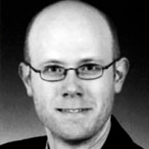
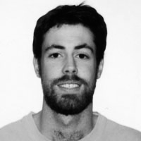
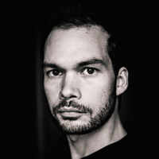
Agenda
Welcome and ESCAPE OSSR developments &
achievements to date (OSSR)
- Kay Graf, ECAP FAU Erlangen-Nürnberg, Germany
Senior Researcher and OSSR Co-ordinator
A FAIR Multi-messenger data-driven cooperative approach –
ESCAPE OSSR and EOSC
- Enrique Garcia, LAPP/CNRS Annecy, France
Data Scientist
Encouraging common software developments (CTA)
- Thomas Vuillaume, LAPP/CNRS Annecy, France
Research Engineer and OSSR Task Leader
Notes:
Kay Graf - ECAP, Friedrich-Alexander University Erlangen-Nuremberg
Kay is senior researcher at the Erlangen Centre for Astroparticle Physics (ECAP) at the University of Erlangen, Germany (FAU) and the general manager there. He works in the field of astroparticle physics. He co-ordinates the ESCAPE WP3 – OSSR and is Computing and Software Coordinator at the KM3NeT ESFRI. He was member of the EAWG Working Group
Enrique Garcia - LAPP/CNRS
Enrique Garcia is a Data Scientist at LAPP/CNRS (Annecy, France), working for the ESCAPE and the CTA projects. Within the former, he is participating in the technical implementation of the Open-source Scientific Software and Service Repository (OSSR) since his arrival to LAPP, on July 2019.
Thomas Vuillaume - LAPP/CNRS
Thomas is a research engineer at LAPP, CNRS and focuses on developing analysis pipelines for the Cherenkov Telescope Array. He is responsible for the real-time analysis for the first telescope built on-site (the LST-1) and principal investigator of the GammaLearn project which develops novel approaches using deep learning for the event reconstruction. In ESCAPE, he is responsible for setting-up the Open-source scientific Software and Service Repository.

Slide 4
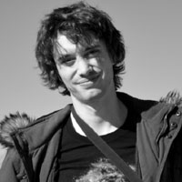
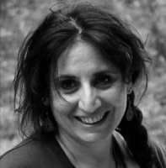
Agenda
Providing workflows for scientific reuse (SKA)
- Alex Clarke, SKAO
Regional centre scientist
Exploring scientific data with innovative techniques
(EGO Virgo)
- Elena Cuoco, EGO
Head of Data Science Office at EGO, ESCAPE GA Chair
Q&A
What’s next & Closing Remarks
Notes:
Alex Clarke - SKAO
Alex is a regional centre scientist at the SKAO, looking at data processing and analysis workflows for the SKA. His background is in observing radio galaxies and clusters, and using machine learning to classify sources in surveys.
Elena Cuoco - EGO
Member of LIGO Virgo Collaboration.Head of Data Science Office at European Gravitational Observatory, since March 2018 Associate Faculty at Scuola Normale Superiore. Main proposer of the COST action “A network for Gravitational Waves, Geophysics and Machine Learning” (www.g2net.eu), which was financed by COST association. Elena is also Cost Action 17137 chair. ESCAPE (https://projectescape.eu/) General Assemby chair.

Slide 5


Slide 6
E-OSSR Aims and Objectives
Aim:
shared open science products based on FAIR principles
Objectives:
  Facilitate and support continuous development, deployment, exposure and preservation of partners’ software/tools/services
  Foster interoperability, software re-use and cross-fertilisation between ESFRIs (e.g. simulation)
  Offer an open innovation environment for open standards (e.g. workflows, data-formats), common regulations and shared (novel) software for multi-messenger & multi-probe data
All objectives follow:
  Paradigm of enabling open science
  a community-based, inclusive approach
  the FAIR principles for open science resources –
  software and derivatives
  Federation of available resources

Slide 7


Co-Development and Community Engagement

Slide 8
OSSR Prototype

Slide 9
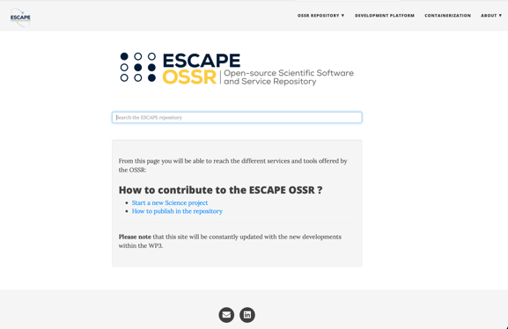
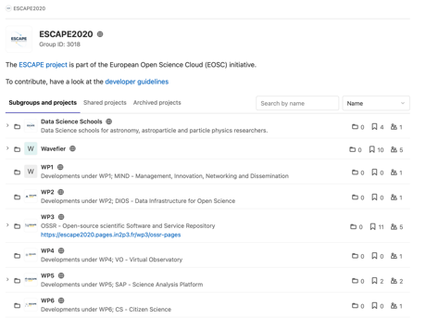
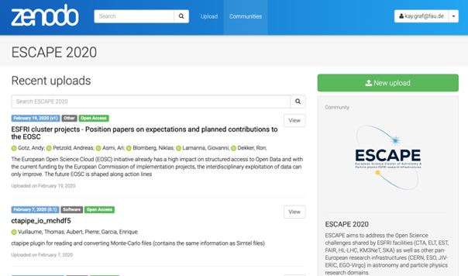
OSSR Prototype
Landing Page
Entry point, Link Aggregation
Search
Development Platform
Software Development
Integration & Automization
Repository
Service Aggregation
Preservation

Slide 10

Enhancing science through sharing software – benefits & use cases
Thank you!
Kay Graf, ESCAPE OSSR Team Leader & General Manager at ECAP, Friedrich-Alexander University Erlangen-Nuremberg
ESCAPE OSSR Webinar - 17/02/2021

Slide 11
Join our community!
  Follow us on Twitter:
  @ESCAPE_EU
  Follow us on LinkedIn: linkedin.com/company/projectescape/
  Subscribe to our Newsletter: https://projectescape.eu/#mc_embed_signup

